Slide 1
Curriculum and Emotions— Solving Problems and Resolving Conflicts
Michael Bowen—Ventura College
Julie Bruno—Sierra College
Michelle Grimes-Hillman—Long Beach City College

Slide 2
Temperature Check

Slide 3
Curriculum and Emotions
Running an effective meeting and getting work done challenges even the most talented curriculum chair. How do you resolve conflict within the committee? How do you ensure that your processes are effective and fair while dealing with individuals that might be a challenge? This breakout explores effective practices for communication before, during, and after curriculum meetings. (Effective Practices Strand)

Slide 4
Breakout Learning Outcomes
Evaluate sources of conflict in the context of curriculum development and the curriculum committee.
Analyze the underlying interests, positions, emotions, and college culture elements that may contribute to the conflict.
Evaluate the type(s) of conflict taking place (for example, process conflict, role conflict, or interpersonal conflict), and employ good practices to avert, manage, and/or resolve the conflict by selecting appropriate responses.
Suggestions?

Slide 5
Contents
Typical Sources of Conflict
Conflict Management Decisions
Conflict Considerations
Responding Appropriately
Good Practices
Scenario

Slide 6
Typical Sources of Conflict: Who?
Conflict among individuals and groups:
Faculty
Administration
Curriculum Committee Chair
Curriculum Committee Members
Curriculum Specialists
Articulation Officers
Academic Senate
Divisions/Departments
Others?
Notes:
Evaluating sources of conflict (BLO #1).

Slide 7
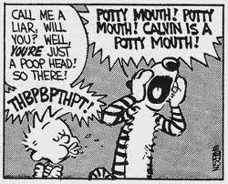
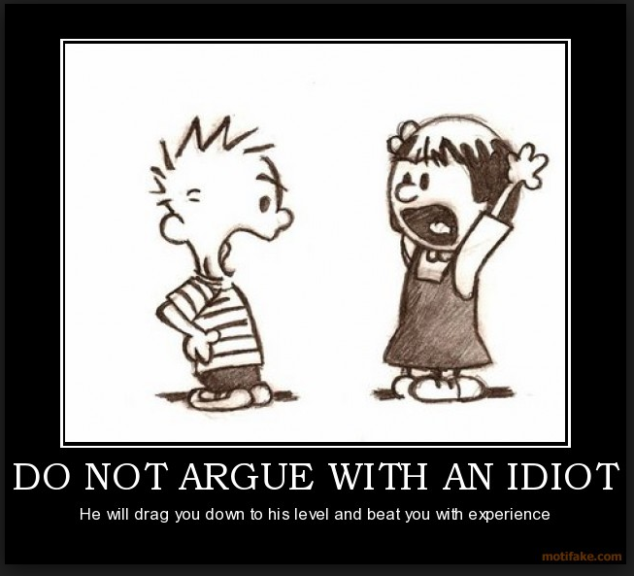
Typical Sources of Conflict: What?
Notes:
Evaluating sources of conflict (BLO #1).

Slide 8
Typical Sources of Conflict: Why?
Emotions are often a source of conflict:
Emotions are inherent in decision-making
Emotions can act as triggers to conflict
Some are able to identify emotions and keep them under control, but others just react
Messages to others may include both content and relational aspects
Developing Emotional Intelligence
Notes:
Evaluating sources of conflict (BLO #1); analyzing the underlying emotions (BLO #2).

Slide 9
Conflict Management Styles: Choices
Avoidance
Accommodation
Competition
Compromise
Collaboration
Constructive or Destructive?
Notes:
Selecting appropriate responses (BLO #3). Hidden.

Slide 10
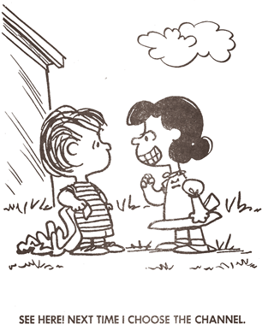
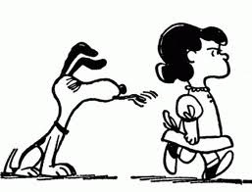
Conflict Management Decisions
Notes:
Selecting appropriate responses (BLO #3).

Slide 11
Conflict Considerations
What is at issue?
Who should be involved?
Who should be consulted?
What are the interests?
Are there emotions connected to the situation?
What policies, procedures, or processes may affect the issues, interests, problems, or solutions?
What is the conflict culture of the college?
Notes:
Analyzing interests, positions, emotions, and culture (BLO #2).

Slide 12
Responding Appropriately: Process Conflicts
How much control do you have over the process?
What are the root causes of the problem?
What are the improvement opportunities?
Talk first to the owner of the process
Describe the problem and obtain agreement
Suggest a workable solution and action plan
Follow through on the plan
Give recognition to the owner of the process
Notes:
Evaluating the conflict type and resolving the conflict (BLO #3).

Slide 13
Responding Appropriately: Role Conflicts
How do you perceive your role in relation to the others who are involved?
Take responsibility for clarifying your role
Be prepared to change your perception of your role
Show willingness to be flexible in achieving goals
Stay positive; view any role change in terms of the opportunities it presents
Notes:
Evaluating the conflict type and resolving the conflict (BLO #3).

Slide 14
Responding Appropriately: Interpersonal Conflicts
What personal biases/prejudices are you bringing to the conflict?
What three behaviors could you change to reduce the conflict? Could you commit to following through on these?
Ask the other person how you could defuse the conflict; encourage honest feedback
Put yourself in that person’s position; how do you think they view your commitment to reducing conflict? Why?
List five of the other person’s strengths, and then five ways that improving your relationship would benefit you
Notes:
Evaluating the conflict type and resolving the conflict (BLO #3).

Slide 15
Good Practices to Avert, Manage, or Resolve Conflict (1/4)
Take nothing personally
Listen, Listen, Listen!
Presume good intent
Anticipate interests and personalities
Recognize and address both content and emotion
Adopt and model effective conflict management
Consider time and place
Notes:
Evaluating the conflict type and resolving the conflict (BLO #3). Curriculum Committee is usually not the best place to resolve conflicts!

Slide 16
Good Practices to Avert, Manage, or Resolve Conflict (2/4)
Do your homework; get as much information as possible before discussing
Provide context for discussion
Share college/district policy or state regulations that apply to the situation
Define terms and conditions
Keep the interests of the students and college overall in the forefront, and guide participants to do the same
Notes:
Evaluating the conflict type and resolving the conflict (BLO #3).

Slide 17
Good Practices to Avert, Manage, or Resolve Conflict (3/4)
Make sure everyone has the opportunity to participate
Find agreement where you can
Take breaks
Robert’s Rules of Order can help keep the discussion professional, but it can also constrain discussion (find balance)
Fall on your sword, if necessary
Resist the temptation to pursue or claim personal victories over others
Notes:
Evaluating the conflict type and resolving the conflict (BLO #3).

Slide 18
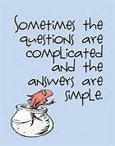
Good Practices to Avert, Manage, or Resolve Conflict (4/4)
When in doubt, consult the Doctor! (Dr. Seuss, that is)
Notes:
Evaluating the conflict type and resolving the conflict (BLO #3).

Slide 19
Scenario (1/2)
Our 115th college has a serious enrollment issue. One way to increase enrollment is to seek out new populations of students. The administration decides that they will increase offerings in adult education and CTE noncredit coursework. The college does not have not have full-time faculty to develop the noncredit courses so the dean hires part-time faculty in the discipline area to write the curriculum. The faculty member works on the courses but the curriculum paperwork is incomplete and the dean asks the department chair to complete it.
(continued on next slide…)

Slide 20
Scenario (2/2)
(…continued from previous slide)
The curriculum chair talks to the department chair and learns that the department was not involved in the decision to create noncredit courses. The department chair believes the faculty are being forced to write the curriculum without consultation. The adult education manager is resentful that she has been accused by faculty of writing curriculum and directed by the dean to get it through the curriculum committee. The faculty are frustrated that the administration is not honoring their Title 5 purview over curriculum.

Slide 21
Scenario #1
Your Student Learning Outcomes Committee is a sub- committee of your Curriculum Committee. The faculty chair of the SLO Committee is resisting requests from the curriculum chair to make more complete reports to the Curriculum Committee and to bring decisions to the Curriculum Committee for ratification. The SLO chair claims that her committee has developed expertise in the area of SLOs beyond that held by the average Curriculum Committee member, and that this expertise should be respected by allowing the SLO committee to work without having its decisions questioned. Everyone is frustrated with the situation. How can it be resolved?
Notes:
Hidden.

Slide 22
Scenario #2
A notification for a new course is sent to the Curriculum Committee members. The proposed new course is an Anthropology course, with an ethnographic component. The student, in the beginning of the semester, is taught the basics of how to use a camera. The Photography department, upon reviewing the course outline, has concerns that this course is teaching photography, and the instructor does not meet minimum qualifications, as they teach anthropology. This concern voiced to the curriculum chair and brought as a challenge to the Curriculum Committee meeting where the course is reviewed by faculty. Additionally, the concern is brought to the Senate. Everyone is frustrated with the situation. How can it be resolved?
Notes:
Hidden.

Slide 23
Questions?
Michael Bowen (mbowen@vcccd.edu)
Julie Bruno (jbruno@sierracollege.edu)
Michelle Grimes-Hillman (mhillman@lbcc.edu)

