Slide 1
Protecting and Supporting DACA Students
ASCCC Plenary
San Mateo
April 20, 2017

Slide 2
What is DACA?
The Deferred Action for Childhood Arrivals policy provides administrative relief from deportation for specific individuals who apply for and receive DACA status.
Established by the Obama Administration in June of 2012, it reflects the exercise of prosecutorial discretion to permit approved individuals to stay for two years at a time without fear of deportation.
Essentially, those with DACA status were put at the bottom of the priority list for deportation and are eligible for two-year employment authorization documents.

Slide 3
DACA Applicant Requirements
Must have been physically present in the US on June 15, 2012
Must have been under the age of 31 on June 15, 2012
Must have come to the US before 16th birthday
Must have continuously resided in the US since June 15, 2007
Must currently be in school, or have graduated high school or obtained a GED certificate, or have been honorably discharged from the armed forces
Have not been convicted of a felony and do not otherwise pose a threat to national security or public safety.

Slide 4
DACA and the New Administration
The Trump Administration has maintained the DACA program thus far.
New applications for DACA status are still being accepted and processed
Current USCIS internal policies provide that DACA data will not be disclosed to ICE or CBP for the purpose of immigration enforcement proceedings.
ICE’s Sensitive Locations Policy provides that enforcement actions should be avoided at sensitive locations, including “post-secondary schools up to an including colleges and universities.
NOTE: these are administrative policies that may be modified or rescinded

Slide 5
What is a “Sanctuary Campus?”
The term “sanctuary campus” has no legal meaning, and no consistent or agreed upon definition.
General concept: to encourage undocumented immigrants to feel secure going to law enforcement authorities for help or cooperating if they have information that can aid law enforcement.
Sanctuary campus policies and practices vary – some colleges have stated that they will not voluntarily (without a court order) assist the federal government in immigration enforcement.

Slide 6
Executive Orders
Executive Order Restricting Travel and Entry Into the United States
90 day ban on travelers
120 day ban for refugees
First travel ban signed January 27, 2017
Stayed by federal courts and abandoned by administration
Revised travel ban signed March 16, 2017
Differences between first and second travel ban
Currently stayed by federal courts

Slide 7
Executive Orders
Executive Order on Border Security and Immigration Enforcement & DHS Memo
“Priorities for Removal”
Obama: Individuals convicted of serious crimes
Trump: Individuals convicted of any crime, no matter how minor; individuals who have just been charged with a crime; individuals who have committed an act for which they could be charged; individuals who have “abused any program related to the receipt of public benefits”

Slide 8
Executive Orders
Executive Order on Border Security and Immigration Enforcement & DHS Memo
Increased Immigration Enforcement Workforce
DHS plans to hire 10,000 more officers and agents at Immigration and Customs Enforcement and 5,000 more Border Protection Officers
“Expedited Removal”
Memos call for an expansion of the expedited removal process where migrants do not go before an immigration judge, they are deported without a hearing
Obama: expedited removal process used for recently arrived immigrants within 100 miles of the border
New policy: expedited removal may be used throughout the country for any immigrant who cannot show that he or she has been in the United States for two years

Slide 9
Board of Governors/CCCCO Actions
Assured students and colleges that our campuses will remain safe, welcoming places for students of all backgrounds to learn
Informed students that no changes have been made with regard to admissions or financial aid
Informed students that financial aid for certain undocumented students is protected by state law

Slide 10
Board of Governors/CCCCO Actions
In November, called on President-elect Donald J. Trump to preserve Deferred Action for Childhood Arrivals; met with congressional leaders to advocate for this position
Joined with the University of California, the California State University and the California Community Colleges to defend the right of all students to obtain a higher education in California
Waived fees for enrolled international students prevented from returning to U.S. due to travel ban

Slide 11
March 2017 Board of Governors Resolution
Declares that all 113 colleges are safe and welcoming to students regardless of immigration status and that financial aid remains available
Urges President Trump to preserve DACA
CCCCO will not release any personally identifiable student information related to immigration status unless required by judicial order.

Slide 12
March 2017 Board of Governors Resolution
CCCCO will not cooperate with any efforts to create federal registry of individuals based on any protected characteristics.
Will vigorously advocate at every level of government to protect ALL students and our system’s values v
Encourages our local districts to consider our system’s values when creating policies and practices related to undocumented students

Slide 13
Dream Act, Financial Aid
Participated with state leaders in general market and Spanish language media outreach to counter 40 percent downward trend in applications for Dream Act financial aid
Outreach effort resulted in 5 percent increase in applications by March 2 deadline
Ongoing mobilization of I Can Afford Campaign College campaign to raise awareness of Dream Act in community outreach and paid media

Slide 14
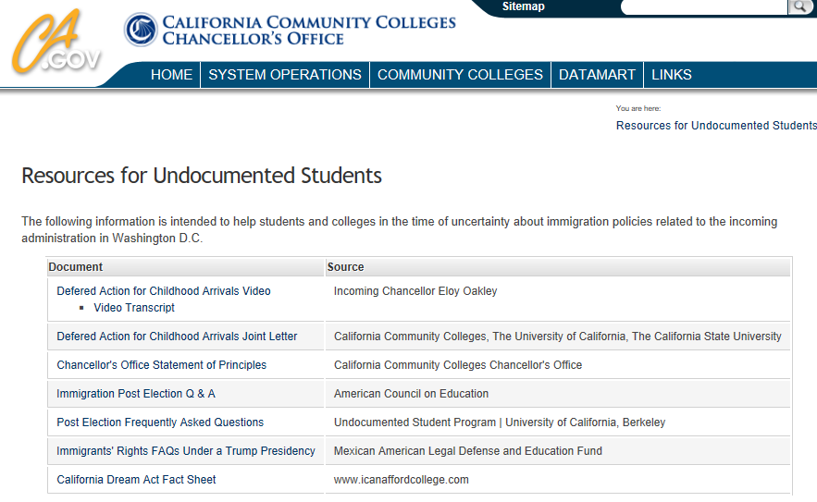
Resources for Undocumented Students
http://www.cccco.edu/ResourcesforUndocumentedStudents.aspx

Slide 15
Discussion and Questions?

