Slide 1
Cultural Competency Across the Curriculum
Randy Beach, ASCCC Executive Committee
Dolores Davison, ASCCC Secretary and 2016-17 Curriculum Chair
Cynthia Reiss, West Valley College

Slide 2
Description
Central to an institutional framework of equity and inclusion necessary for closing the success and persistence gaps for disproportionally impacted student populations is having a sense of our student’s capacity as learners and knowing that our students learn and demonstrate their learning better in culturally sensitive learning environments. In a culturally-sensitive environment, students’ prior learning and experiences are central to the design of their instruction. While this type of environment is laudable, faculty sometimes struggle with strategies to create it. How are faculty at your college achieving this? Is the institution as a whole engaged in supporting cultural-sensitive instruction? Are there models to promote cultural competency across the curriculum? Practitioners will provide models and examples to consider when working to make progress in this area locally. (Student Success/Equity Strand)
Notes:
Not sure of the thought behind this slide.

Slide 3
Why are you here today?
What do you hope to learn today?
What are you struggling with locally?

Slide 4
Why are we still discussing this?
Is it still a question that cultural competency is important?
Are we conflating cultural competency with political correctness?
What is the environment on your local campus regarding cultural competence?

Slide 5
What is Culture?
Shared traditions, beliefs, customs, history, folklore, and institutions of a group of people of the same ethnicity, language, nationality, or religion
A system of rules that are the base of what we are and affect how we express ourselves as part of a group and as individuals.

Slide 6
What is Organizational Culture?
Organizations have a "culture" of policies, procedures, programs, and processes, and incorporate certain values, beliefs, assumptions, and customs.
A culturally competent organization brings together knowledge about different groups of people -- and transforms it into standards, policies, and practices that make everything work.

Slide 7
What is Cultural Competency?
Cultural competence refers to a set of congruent attitudes, practices, policies, and structures that come together in a system or agency to enable professionals to work more effectively with members of culturally distinct groups in a manner that values and respects the culture and worldview of those groups.
Hanley, J. (1999). Beyond the tip of the iceberg: five stages toward cultural competence. Today’s Youth: The Community Circle Of Caring Journal, 3(2), 9-12.
Notes:
Not sure of the thought behind this slide.

Slide 8
"CULTURAL KNOWLEDGE, AWARENESS, SENSITIVITY, AND COMPETENCE?”: WHAT’S THE DIFFERENCE?
There are four levels to these concepts:
"Cultural knowledge" means that you know about some cultural characteristics, history, values, beliefs, and behaviors of another ethnic or cultural group.
"Cultural awareness" is the next stage of understanding other groups -- being open to the idea of changing cultural attitudes.
http://ctb.ku.edu/en/table-of-contents/culture/cultural-competence/culturally-competent-organizations/main

Slide 9
"CULTURAL KNOWLEDGE, AWARENESS, SENSITIVITY, AND COMPETENCE?”: WHAT’S THE DIFFERENCE?
"Cultural sensitivity" is knowing that differences exist between cultures, but not assigning values to the differences (better or worse, right or wrong). Clashes on this point can easily occur, especially if a custom or belief in question goes against the idea of multiculturalism. Internal conflict (intrapersonal, interpersonal, and organizational) is likely to occur at times over this issue. Conflict won't always be easy to manage, but it can be made easier if everyone is mindful of the organizational goals.
http://ctb.ku.edu/en/table-of-contents/culture/cultural-competence/culturally-competent-organizations/main

Slide 10
"CULTURAL KNOWLEDGE, AWARENESS, SENSITIVITY, AND COMPETENCE?”: WHAT’S THE DIFFERENCE?
"Cultural competence" brings together the previous stages -- and adds operational effectiveness. A culturally competent organization has the capacity to bring into its system many different behaviors, attitudes, and policies and work effectively in cross-cultural settings to produce better outcomes.
http://ctb.ku.edu/en/table-of-contents/culture/cultural-competence/culturally-competent-organizations/main

Slide 11
Does it matter?
According to the National Education Association ⁵
Culture plays a critical role in learning
Cultural competence leads to more effective teaching
Cultural competence helps address student achievement gaps
Cultural competence reinforces American and democratic ideals
Cultural competence helps educators meet accountability requirements
⁵ NEA Policy Brief. “Promoting Educators’ Cultural Competence To Better Serve Culturally Diverse Students.” NEA Human and Civil Rights Department (2008).

Slide 12
Cultural Competence Is Important because…
Cultural competence acknowledges and validates who people are
By focusing on the organization's culture, it removes the need to place blame and assume guilt. Since becoming culturally competent focuses on the "how-to" of aligning policies and practices with goals, everyone is involved in the process. This "inside-out" model relieves the outsiders (or excluded groups) from the responsibility of doing all the adapting.

Slide 13
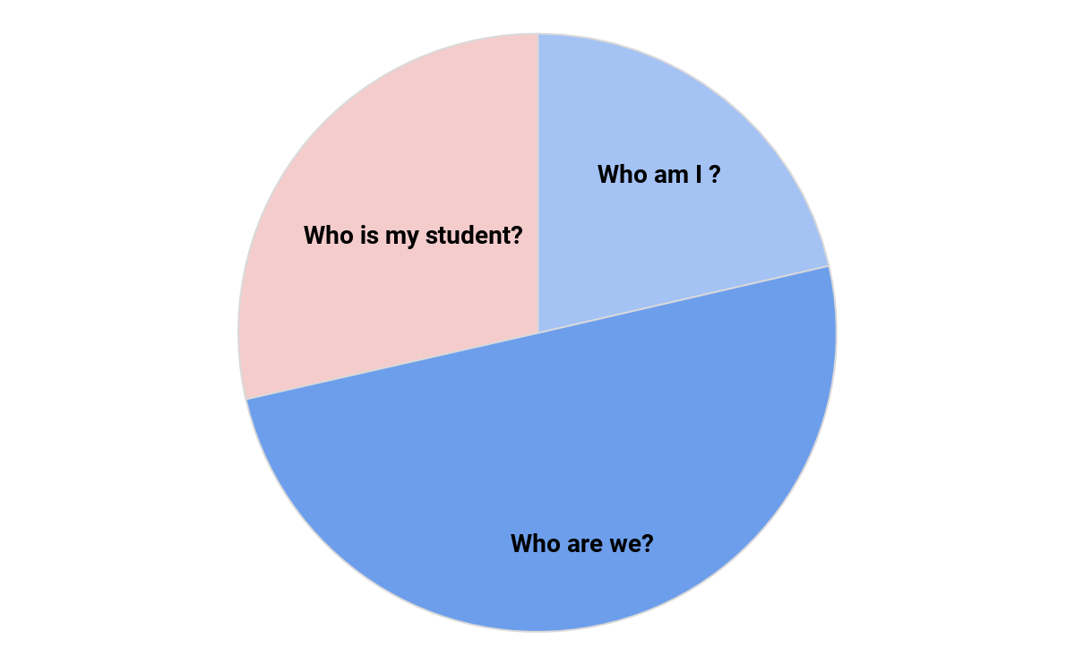
Cultural Competence and Equity
If we do not know who our students are , where they come from, what their experiences are…how can we genuinely create an effective culturally competent environment?

Slide 14
What do the data say?
276 ethnic groups in the US ¹
By 2044, more than half of all Americans will identify as a member of a “minority” group (2015) ²
The number of people who identify as multi-racial is projected to triple from eight to 26 million by 2060 ²
1 Gollnick, D. M., & Chinn, P. C. (2002). Multicultural education in a pluralistic society (6th ed.). Upper Saddle River, NJ: Merrill Prentice Hall.
2 Colby, S. L. & Ortman, J. M. (2015). Projections of the size and composition of the U.S.population: 2014 to 2060. Retrived fromhttp://www.census.gov/content/dam/Census/library/publications/2015/demo/p25-1143.pdf?

Slide 15
What do the data say?
Diversity of CC student populations even more varied
Students from diverse backgrounds/minorities comprise 45% of the student population in community colleges nationwide ³
Community college mission (open access/affordability) supports a diverse student population
³ American Association of Community Colleges (2012). Students at community colleges. Retrieved from http://www.aacc.nche.edu/Pages/default.aspx.

Slide 16
California’s Community Colleges Students⁴
42.5 percent of students identified as Hispanic;
27.4 percent as White;
6.4 percent as African American;
11.6 percent as Asian;
3.2 percent as Filipino or Pacific Islander; and
3.7 percent as multi-ethnic
⁴ California Community College Chancellor’s Office. “California Community Colleges Key Facts” (2017). http://californiacommunitycolleges.cccco.edu/PolicyInAction/KeyFacts.aspx

Slide 17
What about faculty?
According to CCCCO DataMart… 18,593 Tenure and Tenure Track Faculty (FA 16)⁵
African-American | 1,080 | 5.81%
American Indian/Alaskan Native | 117 | 0.63%
Asian | 1,731 | 9.31%
Hispanic | 2,851 | 15.33%
Multi-Ethnicity | 222 | 1.19%
Pacific Islander | 68 | 0.37%
Unknown | 1,279 | 6.88%
White Non-Hispanic | 11,245 | 60.48%
⁵ Data accessed from the CCCCO Data Mart on 6/30/2017

Slide 18
Characteristics of a Culturally Competent Learning Environment
Values diversity and similarities among people
Understands and effectively responds to cultural differences
Engages in cultural self-assessment at the individual and organizational levels
Uses data from assessment and makes adaptations to the delivery of services and enabling supports; and
Institutionalizes cultural knowledge

Slide 19
Creating the Culturally Sensitive Environment: Prior Learning and Experiences
Do we know our students?
Do faculty meet students where they are rather than adapting wholly to instructor’s experience ?
Are program and curricular development designed with what students bring to the table and how those skills/experiences affect their learning in the program/course?

Slide 20
Creating the Culturally Sensitive Environment: Prior Learning and Experiences
Staff agree with the notion that instruction should attempt to meet the student where they begin rather than student adapting wholly to an instructor’s experience
Program development that considers cultural competency asks what do students bring to the table and how does it affect their learning in the program/course
Learning outcomes and skills taught align with cultural competency goals of the institution as stated in institutional learning outcomes, the mission, educational planning

Slide 21
Creating the Culturally Competent Environment: Strategies in the Classroom⁶
Recognize and discuss with students cultural competency as an institutional value
Review syllabi for inclusive language
Incorporate readings, examples, and assignments into curricula that challenge dominant narratives
Create ground rules for community discussion
Use a variety of teaching techniques to address multiple learning styles
⁶ ”Faculty Teaching Strategies for Creating Inclusive Classrooms.” Kristie Ford, Skidmore College; Kelly Maxwell, University of Michigan; Teresa Nance, Villanova University; Kathleen Wong (Lau) San Jose State University. PowerPoint. AACU Conference: Diversity, Learning and Student Success. March 15, 2017-March 17, 2017

Slide 22
Creating the Culturally Competent Environment: Strategies in the Classroom⁶
Take temperature of class climate; request feedback
Model appropriate forms of engagement; mutual sharing; risk taking and acknowledge when students do the same
Be conscious of visible/invisible social identities, including your own
Practice empathy-take on others’ perspectives
⁶ ”Faculty Teaching Strategies for Creating Inclusive Classrooms.” Kristie Ford, Skidmore College; Kelly Maxwell, University of Michigan; Teresa Nance, Villanova University; Kathleen Wong (Lau) San Jose State University. PowerPoint. AACU Conference: Diversity, Learning and Student Success. March 15, 2017-March 17, 2017

Slide 23
Creating the Culturally Sensitive Environment: Challenges in the Classroom⁶
How much of one’s own identity to share?
How to engage in a topic when there’s only one student that represents that positionality (solo status)?
How to represent identities that aren’t in the room?
How to deal with micro/macro aggressions?
How to deal with conflict when it surfaces?
⁶ ”Faculty Teaching Strategies for Creating Inclusive Classrooms.” Kristie Ford, Skidmore College; Kelly Maxwell, University of Michigan; Teresa Nance, Villanova University; Kathleen Wong (Lau) San Jose State University. PowerPoint. AACU Conference: Diversity, Learning and Student Success. March 15, 2017-March 17, 2017

Slide 24
Creating the Culturally Sensitive Environment: Challenges in the Classroom⁶
How to create a safe space--balancing freedom of expression in today’s political climate? What is a brave space?
How to signal to students that I (as a faculty member) am someone that is safe to talk to about a variety of challenging campus and personal issues?
⁶ ”Faculty Teaching Strategies for Creating Inclusive Classrooms.” Kristie Ford, Skidmore College; Kelly Maxwell, University of Michigan; Teresa Nance, Villanova University; Kathleen Wong (Lau) San Jose State University. PowerPoint. AACU Conference: Diversity, Learning and Student Success. March 15, 2017-March 17, 2017

Slide 25
Creating the Culturally Competent Environment: The Faculty
Advocating for cultural competency and diversity as a value in faculty hiring
Discussing values around student diversity and equity in curriculum development and program management
Valuing culturally competent instructional/assessment methods
Establishing demonstration of cultural competency as a learning outcome or graduation requirement

Slide 26
Creating the Culturally Competent Environment: The Faculty
Where are the barriers? Resistance?
Question of academic freedom
Careers didn't begin with a specific goal to teach; choice came later to teach within community colleges
Community college instructors are often hired with no or minimum academic preparation teaching and learning

Slide 27
Creating the Culturally Competent Environment: The Faculty
Little training training to search for and infuse diverse readings and pedagogical methods
Course objectives vs. metacognition focus (too little time)
It is easier to ignore diversity than acknowledge it; changing instructional practices to reflect diverse viewpoints may result in conflict between students

Slide 28
Creating the Culturally Competent Environment: The Institution
Cultural competency and diversity as a value in all hiring and professional development
Promoting cultural competency as an institutional value in the mission and strategic planning
Holding everyone accountable for clearly defined standards of conduct

Slide 29
Cultural Competence and Global Engagement
Equips our students to thrive in a global economy
Cultivates the capacity for all students to see themselves in other shoes and see the world from multiple perspectives
Builds global confidence
Creates experiences in the world through service learning, study abroad and capstone projects to compel students to observe, reflect on and take action
Engages students by using high-impact practices which engage students prior learning and experiences in observing, reflecting on and creating solutions

Slide 30
Cultural Competence and Global Engagement
Case Studies:
West Valley College Global Initiatives
College of the Canyons Service Learning
Miami Dade Community College

Slide 31
Cultural Competency and Millennials
Born 1981-2000
Characteristics include determination/Hopefulness
Recent reports about today’s millennial-generation college students—those born in or since 1985—highlight their greater acceptance of cultural diversity, increased civic participation, and advocacy for social justice issues⁷
Is this a challenge or an opportunity?
⁷ Castro, Antonio J. “Themes in the Research on Preservice Teachers’ Views of Cultural Diversity: Implications for Researching Millennial Preservice Teachers.” Educational Researcher, Vol. 39, No. 3, pp. 198–210. DOI: 10.3102/0013189X10363819

Slide 32
Creating the Culturally Sensitive Environment: Distance Education
General principles of equity-minded instruction online include⁸
Values Diverse Life Experiences and Ways of Knowing-Instructor respects and values diverse abilities, talents, life experience and ways of knowing and recognizes their importance for collaborative learning
Advocates High Expectations for All Students-Instructor communicates inclusive and attainable high expectations and provides explicit criteria for success for all students
Accessibility-Instructor ensures inclusive practices regarding web design and on-line accessibility
Continuous Improvement and Self-Evaluation-Instructor uses assessment information to continually improve course design and instruction in order to enhance inclusivity and respect for diversity in the course and recommends areas in need of institution- wide improvement

Slide 33
Creating the Culturally Competent Environment: Distance Education
Discussions of equity and cultural awareness in online classrooms is only recently being discussed
Equity planning at colleges should address online learning
General principles of equity-minded instruction online include⁸
Inclusivity-Instructor communicates that all students are important and equal partners in the education process and acts in inclusive ways that demonstrate respect for all students and their contributions
Respect for diversity-Instructor communicates that racial/ethnic, cultural, gender, age, social class and other kinds of human difference are important and valued
Equity-Minded Worksheet for Instructors of Online Courses.” University of Wisconsin, Green Bay. 2015.

Slide 34
Best intentions, but are we listening?
Can cultural competency really improve student success if we don’t act on what we learn?
What do we do when faculty and administration assume student success is not their responsibility?
Are faculty sometimes blinded to the lack of student engagement?

Slide 35
What can you do? Faculty
Approve a cultural competency requirement for the associates degree
Integrate culturally diverse readings into assignments
Use real world scenarios that involve cultural differences in critica; thinking exercises and projects
Promote class environments as “brave spaces”

Slide 36
What can you do? Institution
Integrate cultural competency and global awareness learning outcomes
Hold the institution accountable for hiring and promoting staff with a mindset for equity, cultural awareness, and diversity
Be transparent about gaps, be aspirational in goal-setting

Slide 37
“
QUESTIONS?

