Slide 1
Low-Unit Certificates: making them “count”
Patti Blank, Chancellor’s Office
Lorraine Slattery-Farrell, ASCCC Executive Committee
Kim Schenk, Diablo Valley College
Notes:
Introductions, Temperature of the Room (Michael), Pass our Stickie Notes for Questions (Donna)

Slide 2
Presentation Overview
Low-Unit Certificates Defined
Why they are important?
How are they being reported?
How do they get approved?
SACC (5C) Workgroup Considerations
Status update – T5 changes

Slide 3
What are “low-unit” certificates?
The basics - Types of certificates:
CREDIT
Achievement: 18 units and over; 12-17.99 units, CO approved
May be transcripted
“Low unit Certificates” = Other local name/s: proficiency, accomplishment, recognition, etc. up to 17.99 units, not CO approved
May not be transcripted
NONCREDIT:
Competency: a certificate in a recognized career field articulated with degree-applicable coursework, completion of an associate degree, or transfer to a baccalaureate institution
Completion: a certificate leading to improved employability or job opportunities

Slide 4
The “case” for low-unit certificates
Program completion is considered evidence of student success. CCCAOE and the RP group have discussed the merits of tracking “low unit” certificates. There is a growing emphasis on “stackable” credentials, based on the notion that students, once engaged in a pathway or discipline, can be encouraged to persist by recognition “along the way” as long as each award is recognized as having value in the worksite.
Notes:
Donna

Slide 5
The “case” for low-unit certificates
Current research on the award and value of low-unit certificates is sparse. A study at Georgetown University suggests a complex picture, and explores important differences by field of study/sector as well as differential payoffs by gender and race for certificates in general.
http://www9.georgetown.edu/grad/gppi/hpi/cew/pdfs/Certificates.ExecutiveSummary.071712.pdf
The study emphasizes the importance of understanding best design and practice -- to ensure that lower unit certificates DO “stack” toward higher unit ones to the extent possible and appropriate, so that students are set up for continuing opportunities for both educational AND career advancement . . . and associated wage gains.

Slide 6
The “case” for low-unit certificates
Up to 30% of community college students are "skills builders“, students who take a small number of courses, do very well in them, and then move on . . . these may be among our most successful students, but they may not be counted as successes in our completion metrics. It may be that some number of these skills building students are earning lower unit certificates, but system data is not reporting or tracking these awards as detailed in the recent report LearningWorks released with the RP Group, "What's Completion Got to Do With it. . . . " http://www.learningworksca.org/whats-completion-got-to-do-with-it-using-course-taking-behavior-to-understand-community-college-success/

Slide 7
Why the interest in low-unit certificates?
Strong Workforce Program funding model includes metrics for completions in both the local, regional and incentive funds
Credit and noncredit certificates “count”
Both Chancellor’s Office-approved and non-Chancellor’s Office-approved credit certificates “count”
Notes:
Donna

Slide 8
How are low-unit certificates reported?
Colleges have always had the ability to report low-unit certificate outcomes to the Chancellor’s Office
Data Element Dictionary http://extranet.cccco.edu/Divisions/TechResearchInfoSys/MIS/DED.aspx
Relevant data elements
SP02 – Student Program Award
SP04 – Student Program Control Number

Slide 9
SP02 – Student Program Award - Credit

Slide 10
SP02 – Student Program Award - Noncredit

Slide 11
SP04 – Student Program Control Number

Slide 12
Curriculum Practice Recommendations
Encourage all programs to submit all certificates through the same local approval process, regardless of unit value, credit or noncredit status
Ex. Department>Division>Curriculum Committee>Governing Board
May be other groups [CTE committee, College Council (resources), Academic Senate]
All certificates should appear in the catalog, advisement materials, educational planning tools etc.
Often “low-unit” certificates are “scaffolded”, i.e. parts of higher unit programs. Ensuring their visibility is helpful to students, parents, counselors, etc.
Build all programs in college/district MIS

Slide 13
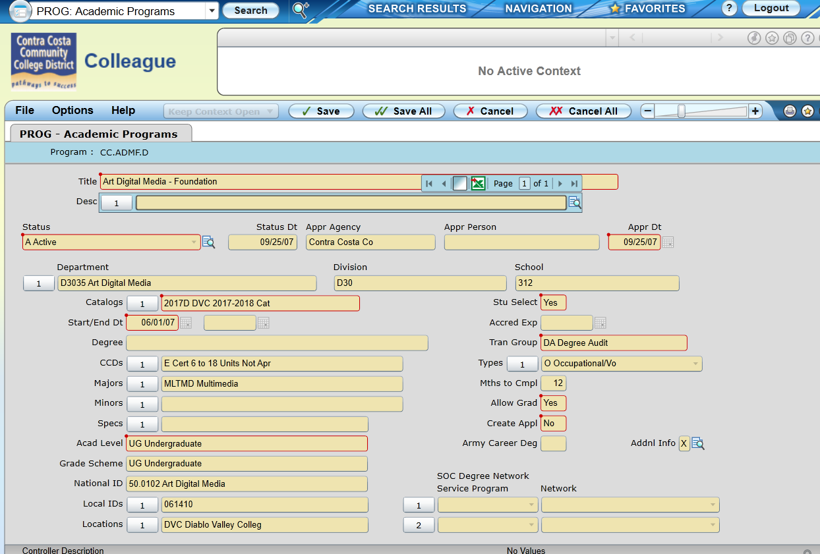
Reporting process
Once a low-unit (<18 units, not CO approved) has been approved by the local Governing Board and published via a catalog or addendum, it must be “built” in the local MIS system, using the codes above, in order to be reported to COMIS

Slide 14
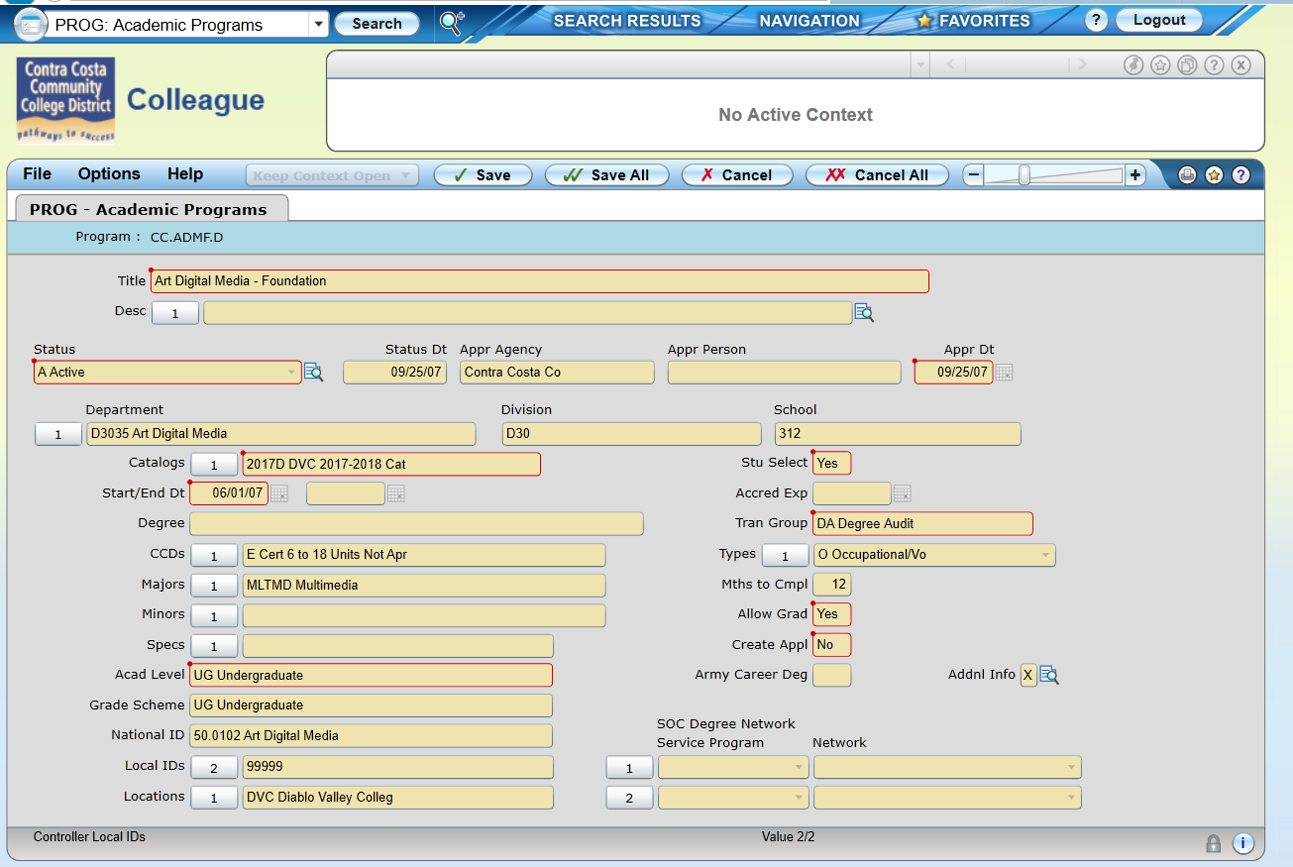

Slide 15
MIS Reporting Timelines

Slide 16
Certificate of Achievement Submission Process
Program Award (SP02)
B – 12 to less than 18 units
These certificates require the same approval process as Certificates of 18 units or greater
C – 18 or Greater units
Program Goal –
C -- CTE
O – Other
New/Substantial/NonSubstantial change

Slide 17
Narrative Items for New/Substantial Revision Certificates
Item 1: Program Goals and Objectives
Item 2: Catalog Description
Item 3: Program Requirements
Item 4: Master Planning
Item 5: Enrollment and Completer Projections
Item 6: Place of Program in Curriculum/Similar Programs
Item 7: Similar Programs at Other Colleges in Service Area

Slide 18
CO Review New/Substantial Revision to CTE Proposals
Supporting Documentation=Narrative + 3 additional:
Labor Market Information (LMI) & Analysis
Regional Consortia Recommendation
Advisory Committee Recommendation
Program Review Date on the proposal must be:
Every 2 years, per Education Code 78016

Slide 19
Common Revision Requests
Proposal:
Program Award (SP02)
Program Goal
Units don’t match Narrative
Program Review Date incorrect for CTE
Net Annual Labor Demand (CTE only) not supported
Missing or Incorrect Attachments
CTE documentation if applicable
ASSIST documentation as appropriate
CORS not attached or incorrect or duplicated
Course Reports incorrect or not complete/duplication
Narrative
Common Revision Requests

Slide 20
SACC Workgroup Considerations (Jan 2016)
1. Data/quantification considerations
Lowest recordable award for the ScoreCard = 8 units; is this malleable? What are implications?
New codes needed in MIS SP02 Student-Program-Award
Recommendation to create new codes for 6-<12 non CO approved and 12 - <18 non CO approved?
2. Qualitative considerations:
Establish approval criteria for low-unit certificates:
Industry certification/credential
Labor market demand: employability and/or wage gain
Scaffolding for basic skills/ESL
Continuing education
Should there be a lower limit?
Regional consortium review/approval requirements?
Entry into the Curriculum Inventory?
Possible outcomes may include raising awareness, developing guidance for good practice, changes to Title 5/new certificate category
Value/philosophy for low-unit certificates?

Slide 21
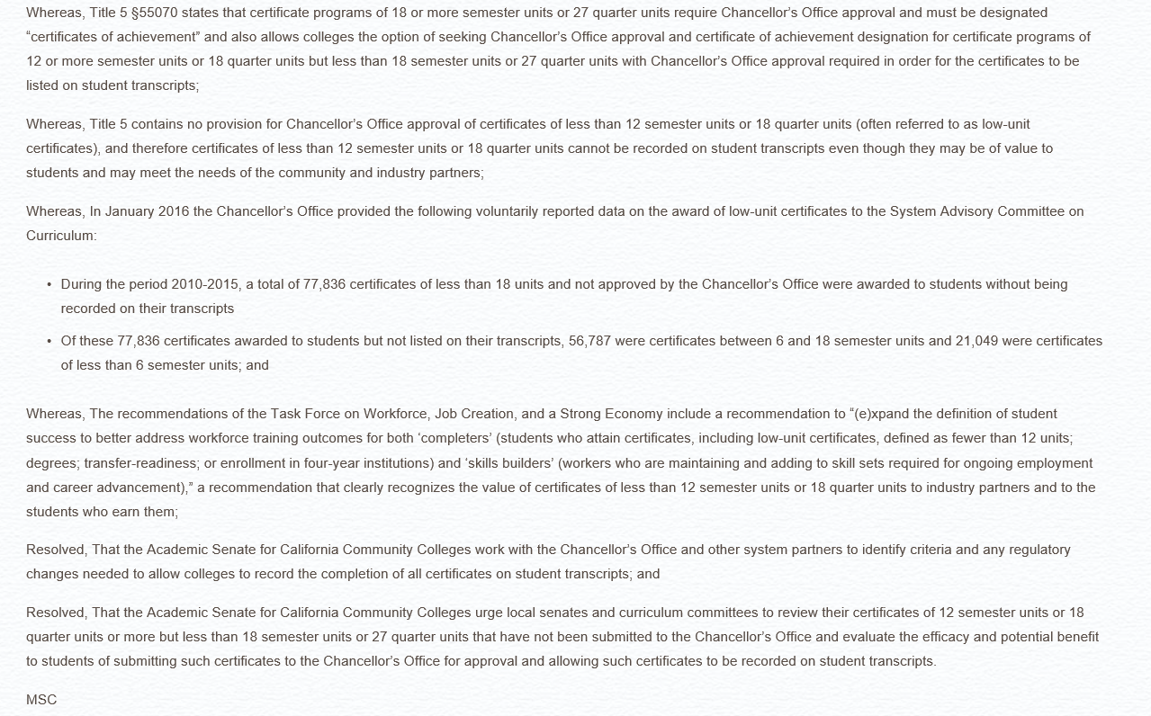
ASCCC
“Low-unit” resolution 09.03 SP16 – assigned to SACC

Slide 22
ASCCC
Proposed changes to Title 5 CCR §55070
Draft changes currently under discussion
Questions?

Slide 23
Thank you!
Patti Blank: pblank@CCCCO.edu
Kim Schenk: kschenk@dvc.edu
Lorraine Slattery-Farrell: lfarrell@msjc.edu

