Slide 1
Facilitating Civil Dialogue in the Face of Change
EDAC Presenters: Mandy Liang, Ed.D., City College of San Francisco (North); Martin Jones-Ramey, Mt. San Antonio College (South)

Slide 2
Colleges are often challenged to balance the goals of creating inclusive environments with uncertain and changing political and resource landscapes. How can colleges promote cultural competency among faculty, staff, and student when sands begin to shift? What are some strategies to address this goal?

Slide 3
“No one should make the claim of being educated until he or she has learned to live in harmony with people who are different.”
Wilson, A. H. (1982, Summer). Cross-cultural experiential learning for teachers. Theory Into Practice, 21(3), 184-192.

Slide 4
What is Cultural Competency?
Cultural competence refers to a set of congruent attitudes, practices, policies, and structures that come together in a system or agency to enable professionals to work more effectively with members of culturally distinct groups in a manner that values and respects the culture and worldview of those groups (Hanley, 1999).
Hanley (1999) defined cultural competency as “the ability to work effectively across cultures in a way that acknowledges and respects the culture of the person or organization being served.” The extent to which educators, students, and the total educational environment reflect cultural competence significantly affects the nature and type of schooling and the conditions for learning, as well as learning outcomes.

Slide 5
Traditional Application of CC

Slide 6
According to the Southern Poverty Law Center, between the election and Nov. 14 (seven days), there were 437 incidents of intimidation, targeting blacks and other people of color, Muslims, immigrants, the L.G.B.T. community, and women.
Alexis Okeweo, The New Yorker, Nov. 17, 2016.

Slide 7
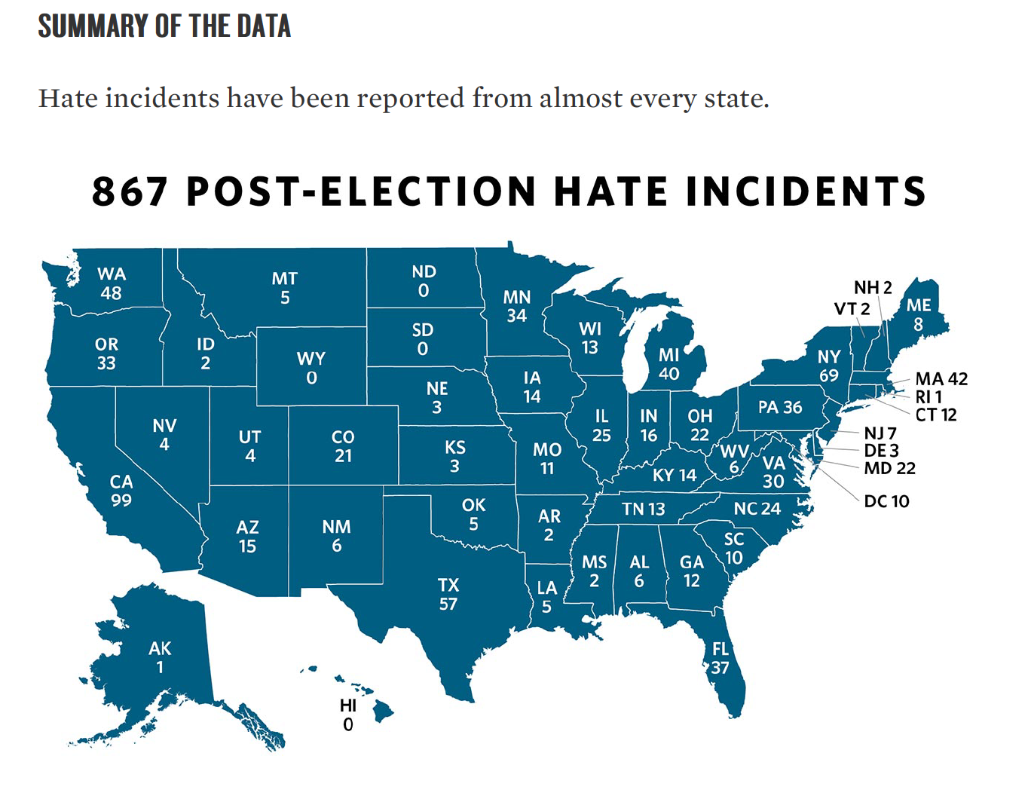
Ten Days After: Harassment and Intimidation in the Aftermath of the Election, Southern Poverty Law Center, Nov. 29, 2016.

Slide 8
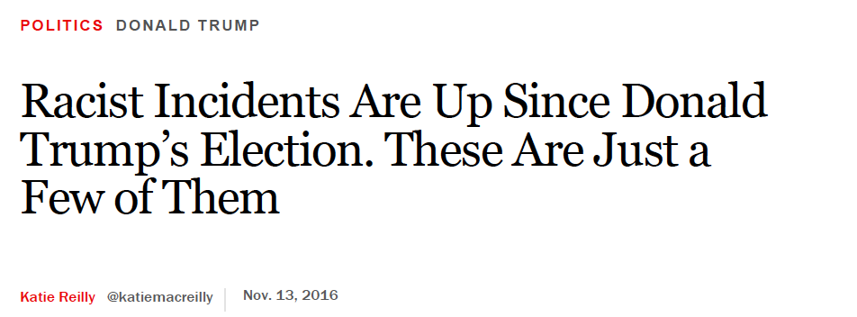

Slide 9
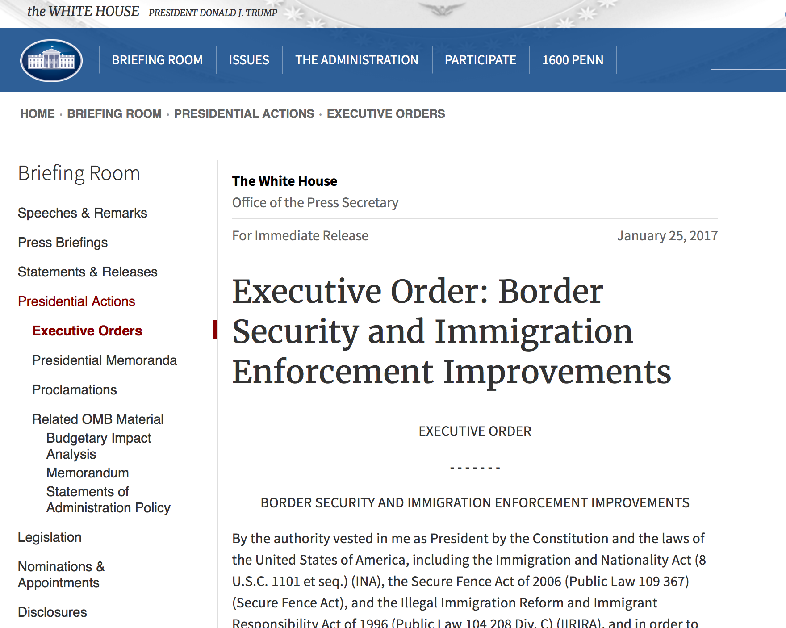
Entry ban on visitors from 7 countries
DACA?
Border Wall
Additional ICE staff – deportations?
Denial of funding to ”sanctuary jurisdictions”

Slide 10
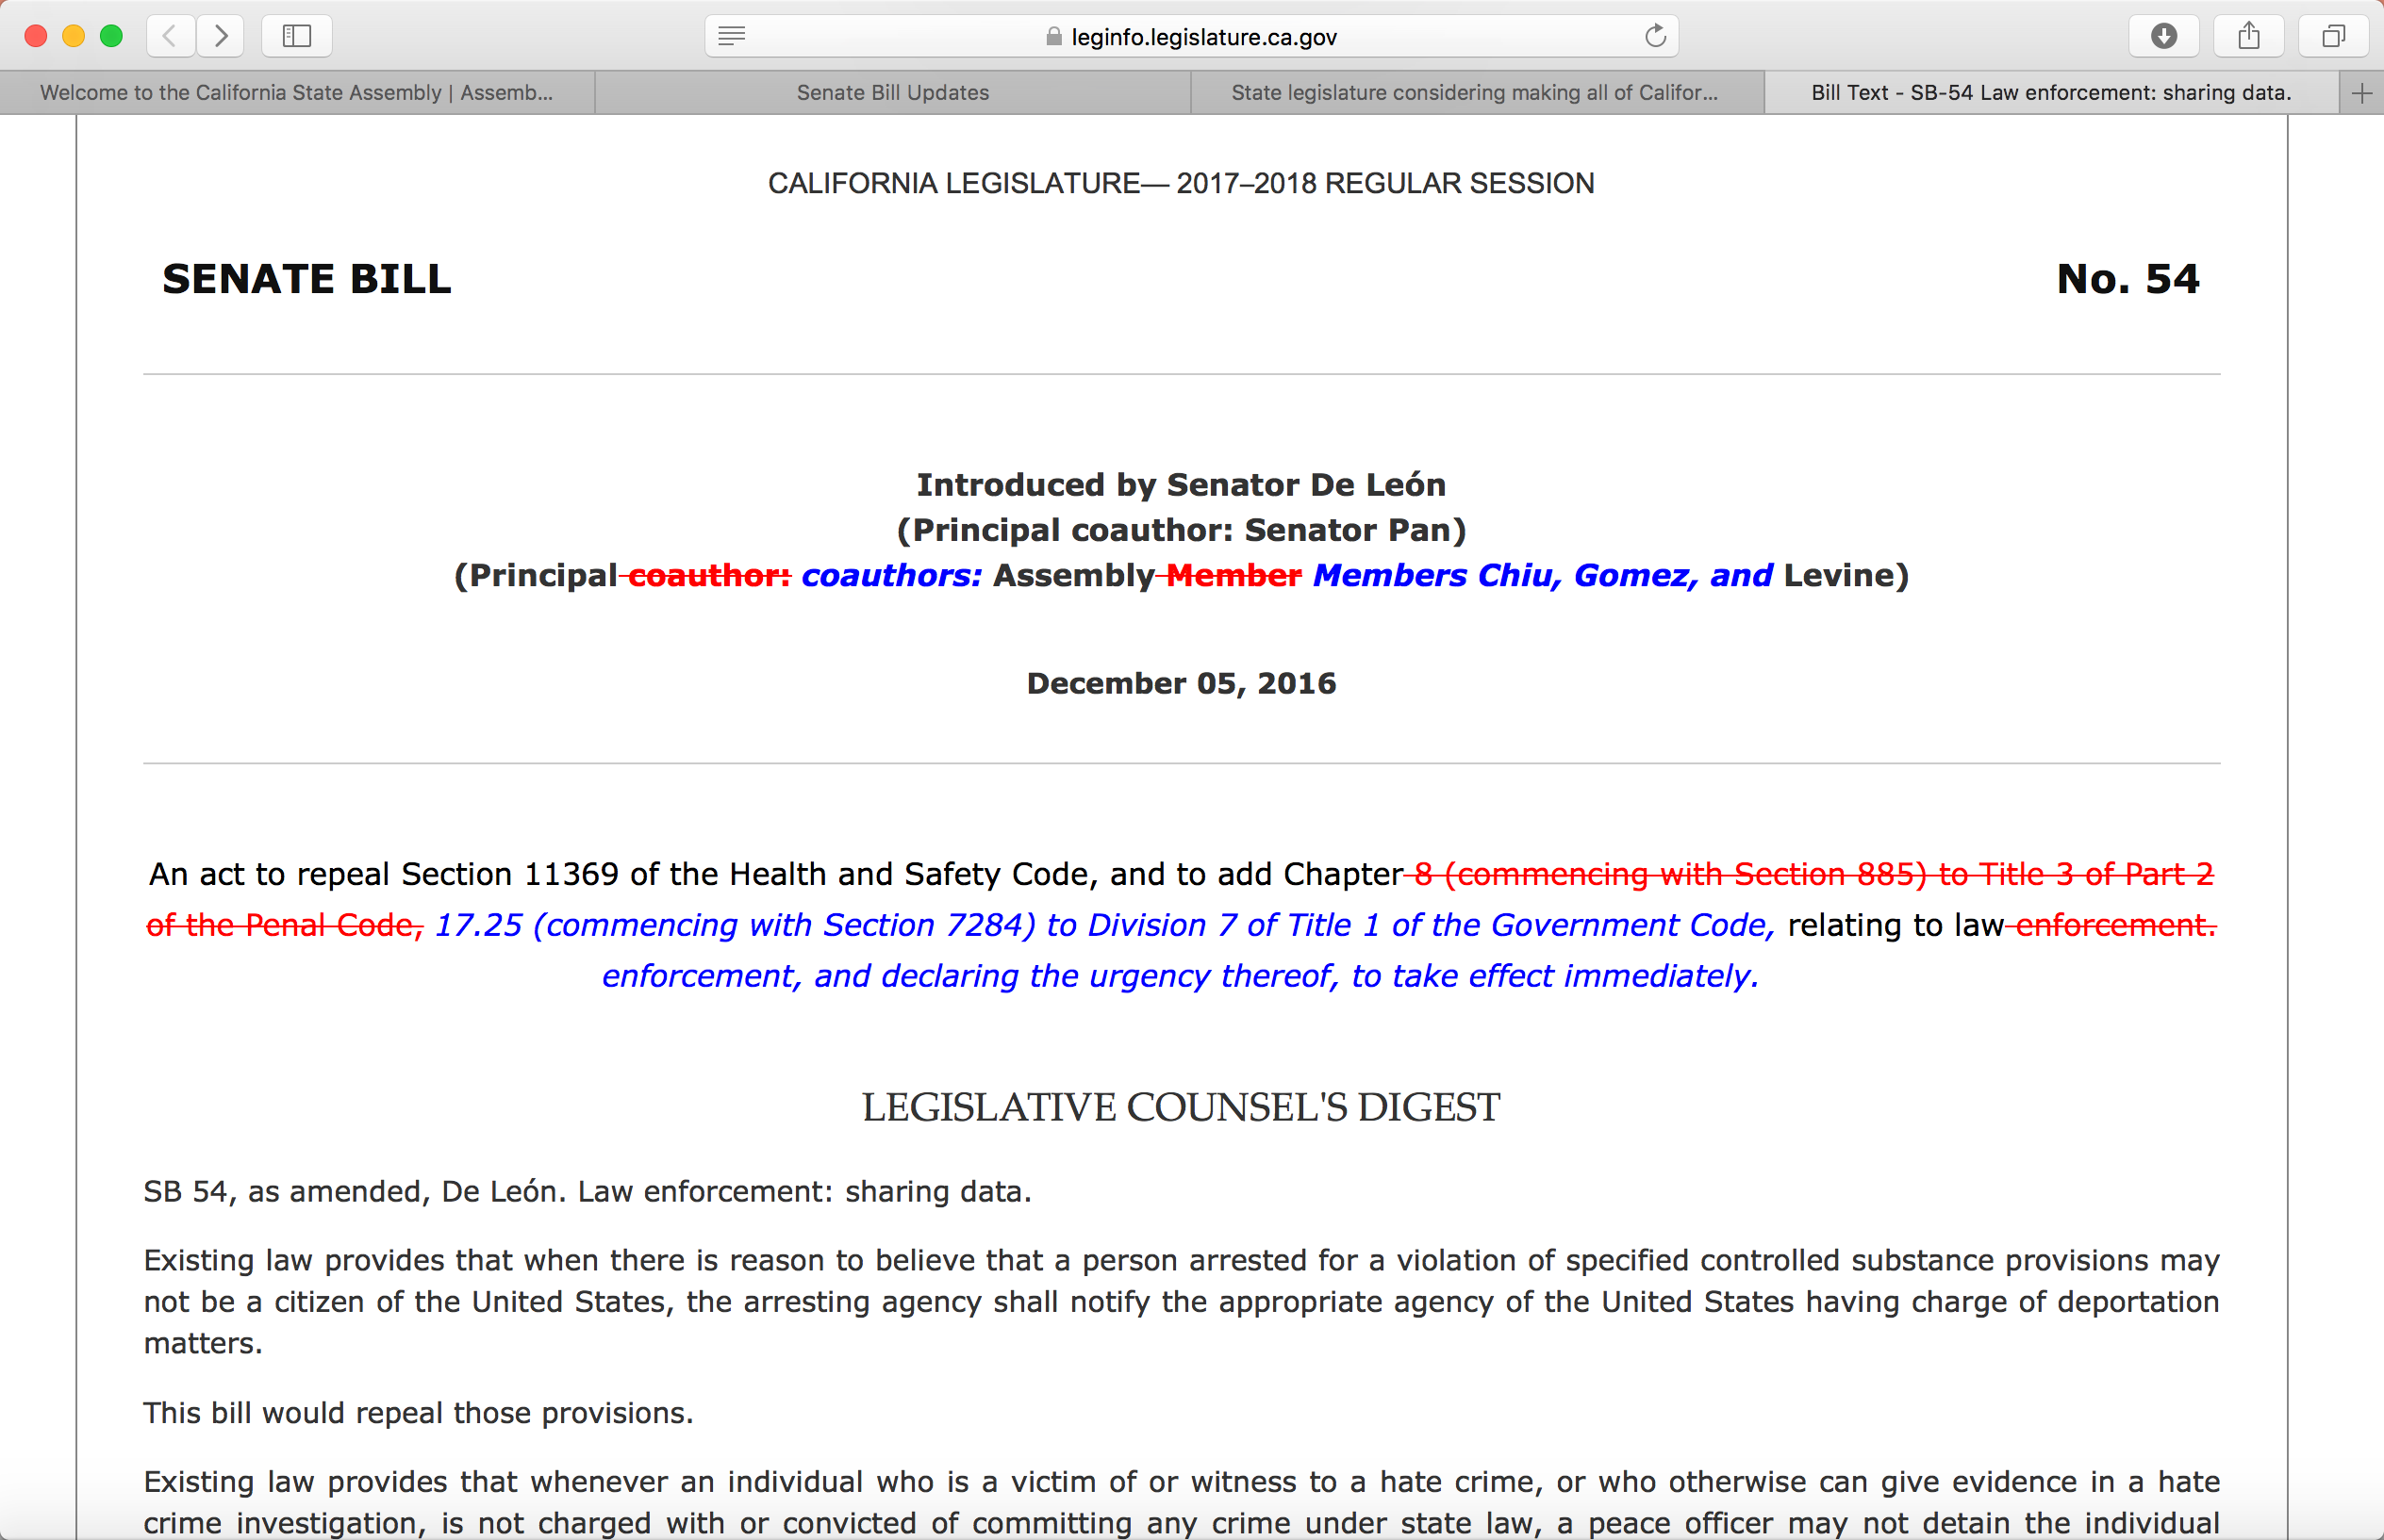

Slide 11
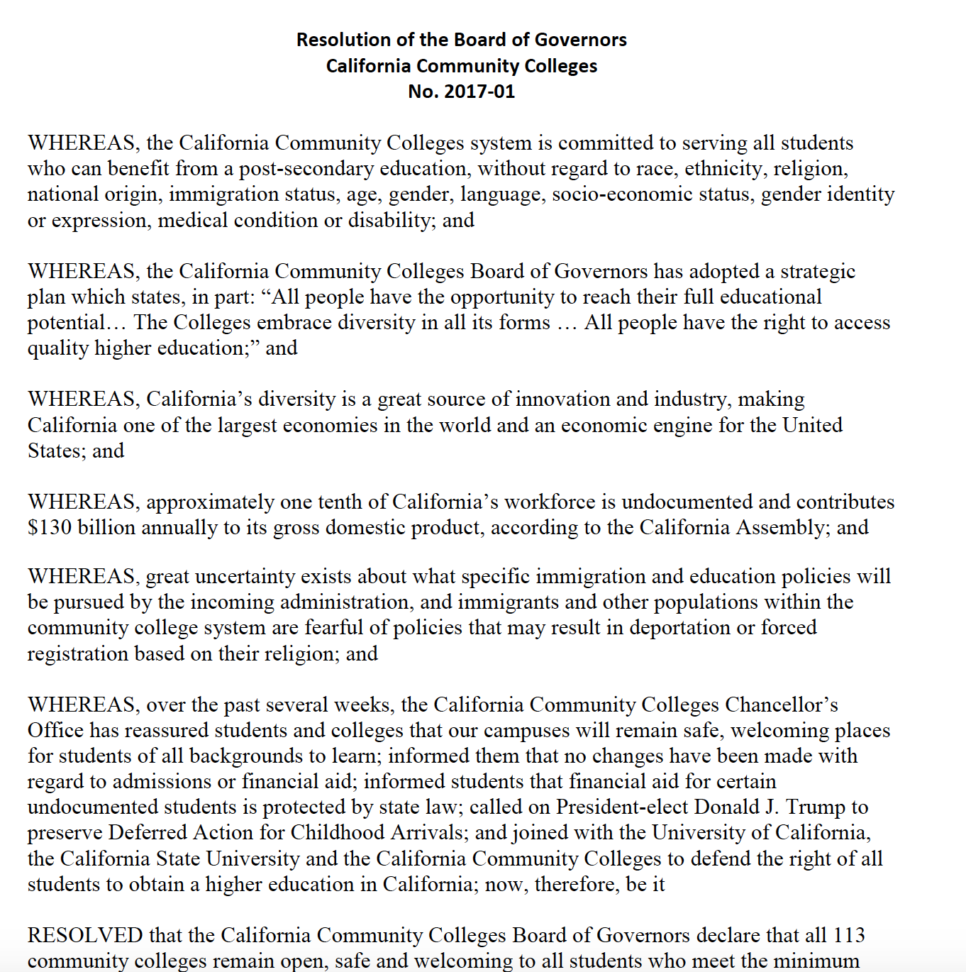

Slide 12
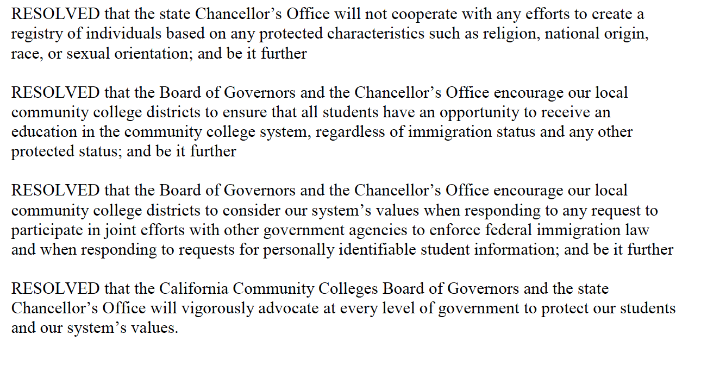

Slide 13
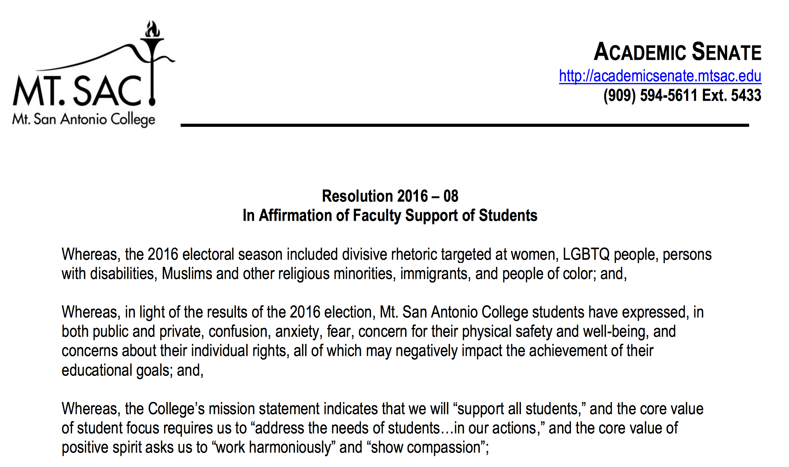
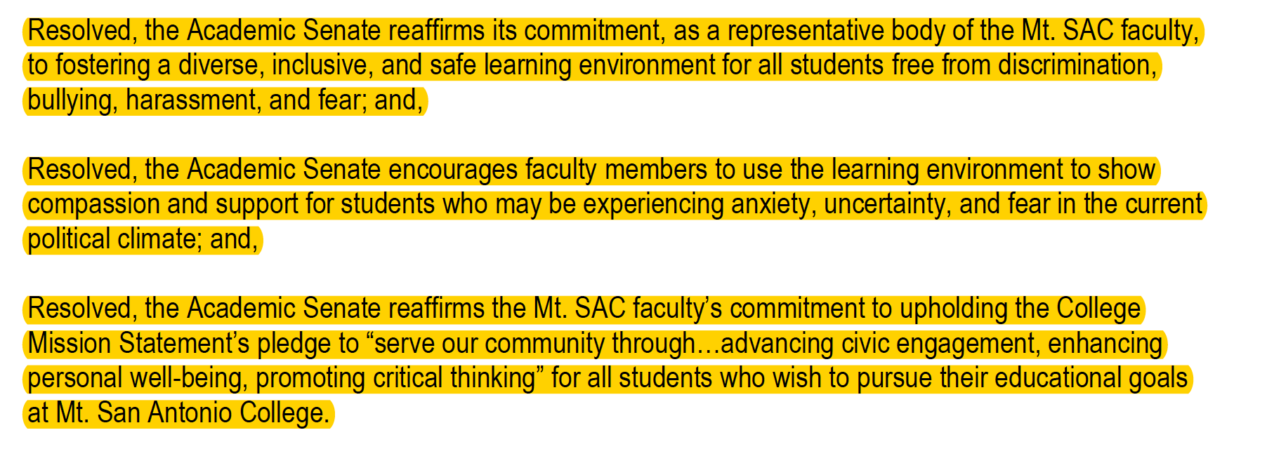

Slide 14
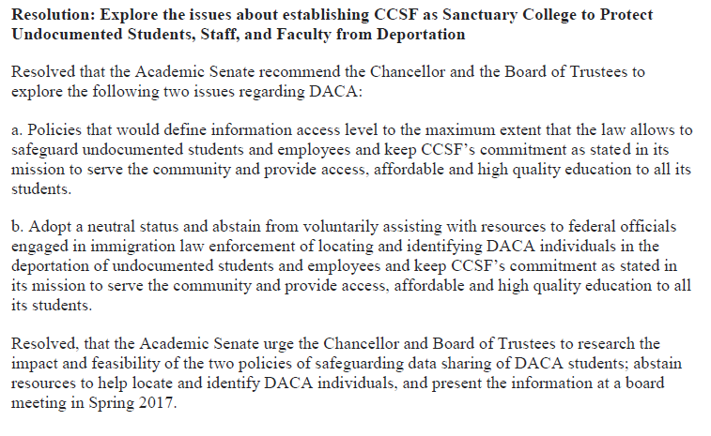
Sanctuary College Status
Source: City College of San Francisco
Notes:
CCSF Academic Senate Resolution http://www.ccsf.edu/dam/ccsf/images/academic_senate/AS_Docs/Academic_Senate_2016_17/Other/Resolution%202016.12.14.03.pdf

Slide 15
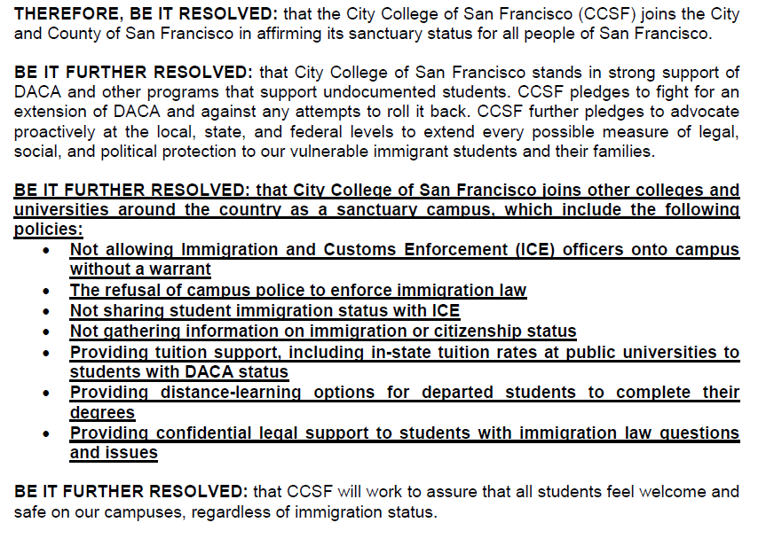
Sanctuary College Status
Source: City College of San Francisco
Notes:
CCSF Board of Trustee Resolution: Sanctuary Status http://www.ccsf.edu/BOT/2016/December/346r.pdf

Slide 16
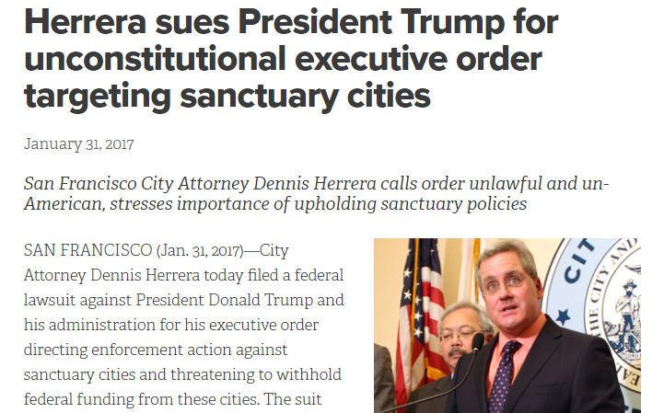
Sanctuary City
Source: Office of City Attorney of San Francisco
Notes:
http://www.sfcityattorney.org/2017/01/31/herrera-sues-president-trump-unconstitutional-executive-order-targeting-sanctuary-cities/

Slide 17
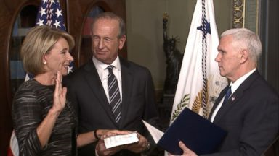
Source: NBC News

Slide 18
How are California Community Colleges and our faculty responding to the uncertain and changing political and resource landscapes while creating and sustaining an inclusive environment?

Slide 19
Legal Questions to Explore with Your Counsel
Can a district decline to disclose student information, particularly social security numbers and related residency information to ICE or other federal agencies that requested?
Can a district protect student privacy by narrowing the passive forms of sharing information, for example by not identifying key student information for certain types of applications, records, or requests for information? (Federal Integrated Postsecondary Education Data System (IPEDS), campus police reports, student discipline records, financial aid documents, admissions applications, etc.)

Slide 20
Legal Questions to Explore with Your Counsel
Can a district opt out of CCC Apply if SSNs are required for noncredit student enrollment?
What legal guidelines can a District offer its students in protecting their privacy?
Can a district stop requiring the FAFSA as a universal application for community college financial aid and instead make the BOG Fee Waiver Application widely available?
Can a district declare it will not voluntarily report student worker information?
Can a district continue to employ students who hold DACA work permits after those permits expire?
What options are available for DACA students now after the inauguration?

Slide 21
Strategies to Consider
Respect different perspectives, political views, and opinions
Create a safe space for students and employees
Educate all students about your district’s unlawful discrimination and harassment policy
Provide faculty support
Strengthen communication and collaboration between Academic Affairs and Student Services, make referrals as needed
Provide professional development such as diversity training
Train peer mentors, student ambassadors and student leaders about diversity awareness and the importance of inclusiveness

