Slide 1
Policies, Processes, and Practices, Oh My!
Randy Beach, South Representative, ASCCC
Carrie Roberson, North Representative, ASCCC
Faculty Leadership Institute, Sacramento, CA
June 15-June 17, 2017

Slide 2
Description
Robert Frost wrote, “Good fences make good neighbors.” In this breakout, presenters will discuss how well-written, faculty-driven policy and procedure “fences” can help you and your senate assert its authority and collaborate effectively with other constituencies. Presenters will discuss processes and strategies for writing policies and procedures, what policies are legally mandated and recommended, and areas where your senate should be especially involved in creating strong policy to support student success and the faculty role in decision-making.
Notes:
Not sure of the thought behind this slide.

Slide 3
What Brings You Here?
What do you want to know?
How are polices and procedures managed at your college?
Where are the areas of concern?

Slide 4
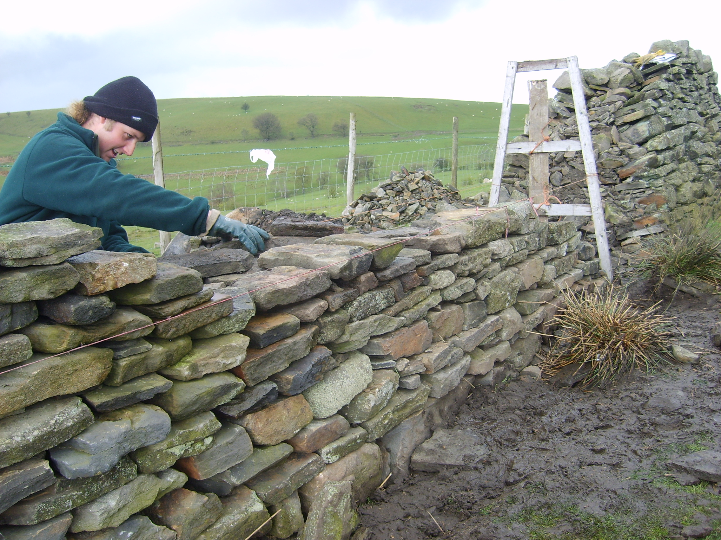
“Good fences make good neighbors”

Slide 5
Policies
Establish the values and operating principles of the college District and demonstrates those for the community (the voice and position of the Board)
Legally bind the district and protect from liability
Are considered vital parts of accreditation compliance
Implement federal and state laws and regulations
Delegate authority to and through the chief executive to administer the district
Taken in part from the Community College League of California Board Policy and Administrative Procedure Subscription Service Implementation Handbook (2014)

Slide 6
Administrative Procedures*
Address how the general goals of the district are achieved and set the process by which staff carry out that position, statement, standard, or law
Ensure transparency of operations
Include details of policy implementation, responsibility, accountability and standards of practice.
Developed and implemented by the CEO, administration, faculty, and staff members
Not intended for Board action, BUT local decision rules
*A variety of terms are used throughout the colleges
Taken in part from the Community College League of California Board Policy and Administrative Procedure Subscription Service Implementation Handbook (2014)

Slide 7
What Goes Where?
How do you determine which are policy elements and which are procedural?
Policies set standards
Procedures explain processes
Policies affirm abstracts
Procedures demand concretes

Slide 8
Legally Mandated vs. Recommended or Advised
Polices/Procedures that are legally required have been determined so through
  Legislative action
  Recommendations from CCLC, CCCCO or other
  Recommendation from local legal council
Polices/Procedures that are advised
  Capture effective practice unique to a district
  Address local issues or requirements
  Reflect the district’s personality

Slide 9
CCLC
The Community College League of California provides a policy/procedure subscription service
CCLC Numbering system used by many. Districts may use their own
Some see CCLC as too “management-centric”
A useful place to begin
Supports legal compliance
Begin with the templates; make them your own

Slide 10
General Areas (based on CCLC Numbering)
Chapter 1: District
Chapter 2: Board of Trustees
Chapter 3: General Institution
Chapter 4: Academic Affairs
Chapter 5: Student Affairs
Chapter 6: Business and Financial Affairs
Chapter 7: Human Resources

Slide 11
Chapter 1 District & 2 Board of Trustees
Chapter 1
  The mission
Chapter 2
  Shared Governance
  10 + 1
  Governance structures
  Conducting meetings
  Board Elections and Board member issues (compensation)
  Negotiations

Slide 12
Chapter 3 General Institution
Safety
Planning
Nondiscrimination, EEO, and harassment
Smoking and alcohol policies
Service animals
Free speech zones

Slide 13
Chapter 4 Academic Affairs
Curriculum, including prerequisites
Standards of scholarship
Award requirements
Student performance standards, renewal, dismissal
Grading standards
Often the main focus of senates and curriculum committees

Slide 14
Chapter 5 Student Services
Student conduct
Student organizations
Financial Aid
Awarding credit
Student records
Admissions and concurrent enrollment

Slide 15
Chapter 6 BFA & Chapter 7 Human Resources
Chapter 6 Business and Financial Affairs
  Budget management principles; fiscal management principles
  Purchasing and contracts
  Civic center
  Audits
Chapter 7 Human Resources
  Hiring Processes
  Equal employment
  Discipline and dismissal

Slide 16
Accreditation Expectations
Many standards relate to required policies or establish how pol/procedures should be addressed
  I.A.1 The Mission is described and available
  I.B.7 The institution regularly evaluates its policies and practices across all areas of the institution… to assure their effectiveness in supporting academic quality and accomplishment of mission
  I.C.5 The institution regularly reviews institutional policies, procedures, and publications to assure integrity in all representations of its mission, programs, and services.
  Policies on academic integrity and academic freedom, codes of conduct, admissions, student records, hiring, evaluations, and technology in the classroom

Slide 17
Questions for Effective Policy/Procedure Management
Are you required to bring policy/procedure together simultaneously? Advantages or disadvantages?
Do you have a scheduled cycle for revision?
Do you assign review responsibility to existing/standing committees?
Have you established a senate committee to manage policy/procedure schedule?
What about taking one chapter at a time?

Slide 18
“
Questions?

