Slide 1
Elections Process in a State of Emergency
Wendy Brill-Wynkoop
ASCCC Elections Chair
elections@asccc.org

Slide 2
Changes to Elections Process
Before the move to Electronic Ballots the ASCCC had several resolutions in Fall 2019 that changed the Senate Rules on elections
Elimination of Trickle Down/Changes to nominations A candidate can only run for a total of two Executive Committee Seats. Nominations are limited from the floor.
Instant Runoff Voting Delegates rank candidates in order to assure one candidate will receive the majority vote in an election
Change the Order of Elections At-Large election will be run before other non-officer Exec Comm seats
https://asccc.org/resources/resolutions

Slide 3
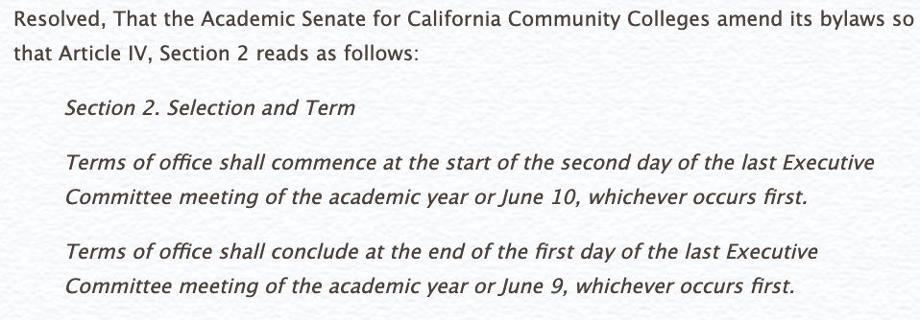
Align Terms of Office in Bylaws to Practice
Fall 2019 - Resolution Number 1.01

Slide 4
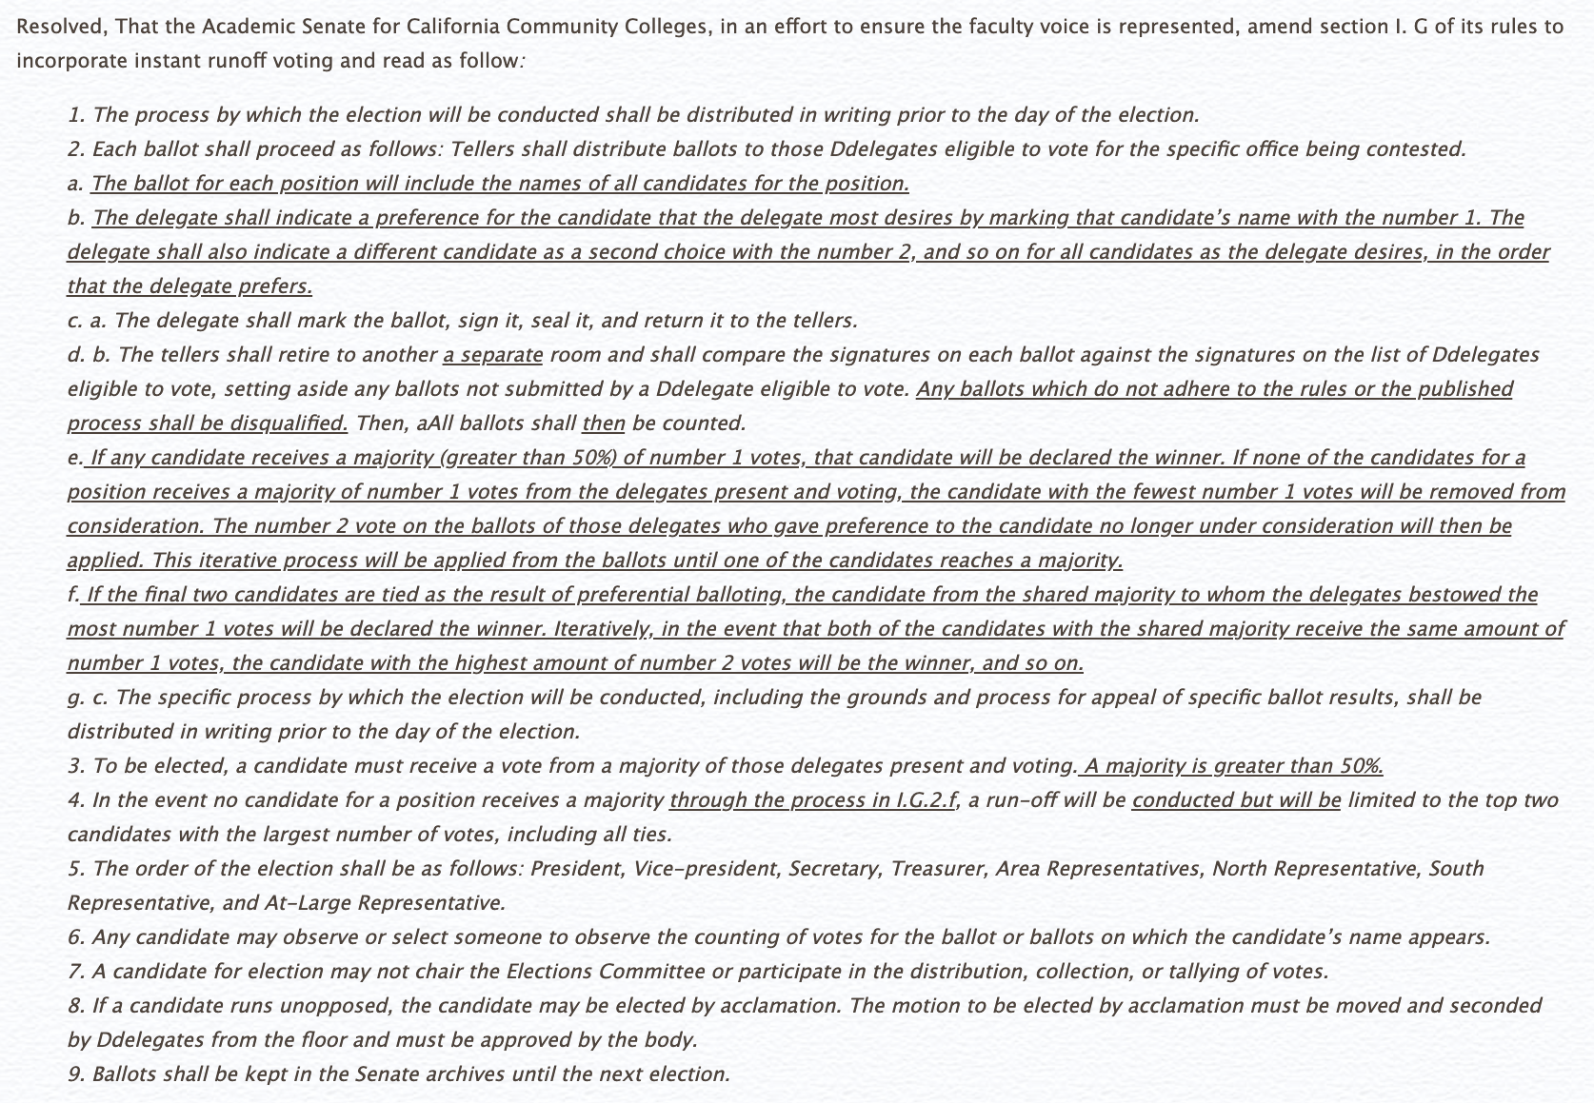
Adopt Instant Runoff Voting
Fall 2019 - Resolution Number: 01.02

Slide 5
Adopt Instant Runoff Voting
Fall 2019 - Resolution Number: 01.02 (continued)
e. If any candidate receives a majority (greater than 50%) of number 1 votes, that candidate will be declared the winner. If none of the candidates for a position receives a majority of number 1 votes from the delegates present and voting, the candidate with the fewest number 1 votes will be removed from consideration. The number 2 vote on the ballots of those delegates who gave preference to the candidate no longer under consideration will then be applied. This iterative process will be applied from the ballots until one of the candidates reaches a majority.
f. If the final two candidates are tied as the result of preferential balloting, the candidate from the shared majority to whom the delegates bestowed the most number 1 votes will be declared the winner. Iteratively, in the event that both of the candidates with the shared majority receive the same amount of number 1 votes, the candidate with the highest amount of number 2 votes will be the winner, and so on.

Slide 6
Limit Nominations from the Floor
Fall 2019 - Resolution Number: 01.04

Slide 7
Reverse the Order of the Area, North/South, and At-Large Representative Elections
Fall 2019 - Resolution Number: 01.05

Slide 8
Clarify Nomination Process and Eliminate “Trickling”
Fall 2019 - Resolution Number: 01.07

Slide 9
2020 Spring Plenary canceled
NOTICE OF CHANGE TO PROCESS
For the spring 2020 term, the ASCCC will be conducting elections by online written ballot, using the software company E-ballot. To note, ASCCC Bylaws Article IV, Section 2 require that elections be held during a plenary session. However, in our current state of emergency, the ASCCC does not have the ability to hold a traditional in-person plenary session and postponing the elections would severely disrupt the continued governance of the ASCCC. In lieu of holding an in-person election, the ASCCC is invoking California Corporations Code (Section 7140(m)) that permit the leadership body of an organization to take certain actions to protect the interests and functions of the corporation in the event of a genuine emergency.

Slide 10
ASCCC 2020 Elections Timetable
March 30, 2020: Call for Executive Committee Nominations
April 17, 2020: Closing date for Executive Committee Nominations
April 23, 2020: All candidates listed on ASCCC Elections Page
April 27, 2020: Elections open by E-Ballot – up to 3 rounds of voting may occur and will be determined once all candidate nomination forms are received.
May 15, 2020: Elections close
May 18, 2020: Complete candidate winners listed on ASCCC Page
May 25, 2020: If needed: special elections open

Slide 11
NOTIFICATION OF DELEGATES TO ASCCC
In order to conduct the online election, we will need each member Senate to verify that we have the college’s correct delegate for voting.
The Senate President listed in the Senate Directory for each campus, will need to complete the Delegate Change Form.
The college will not be able to vote in the online election unless this form is submitted.
Another delegate form will be mailed out to current mForms must be emailed to the ASCCC Office - elections@asccc.org by April 17, 2020.

Slide 12
Instant Runoff Voting
Indicate a preference for the candidate that they most desire by marking that candidate’s name with the number 1, followed by marking their second choice candidate with the number 2, and so on for all candidates in the order that the delegate prefers.
Three ballots over three weeks
Officer and At-Large positions
North and South Representatives,
Area Representatives last
Delegates will receive separate emails for each balloting cycle.

Slide 13
Ballot Tutorial

Slide 14
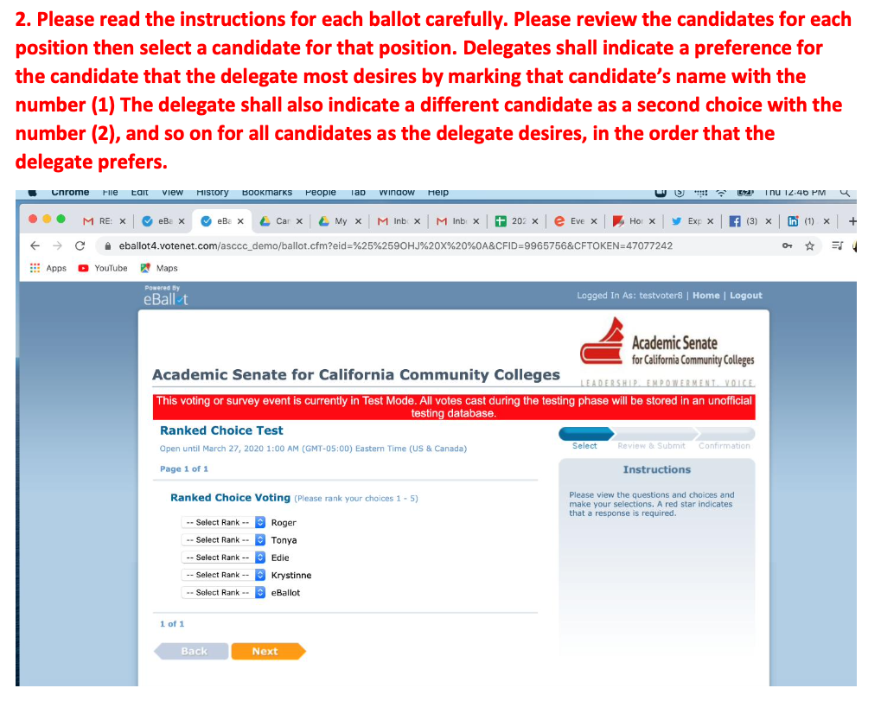

Slide 15
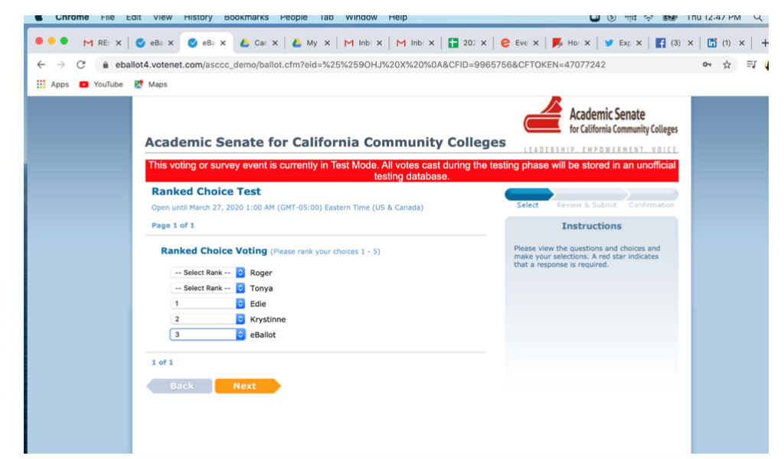

Slide 16
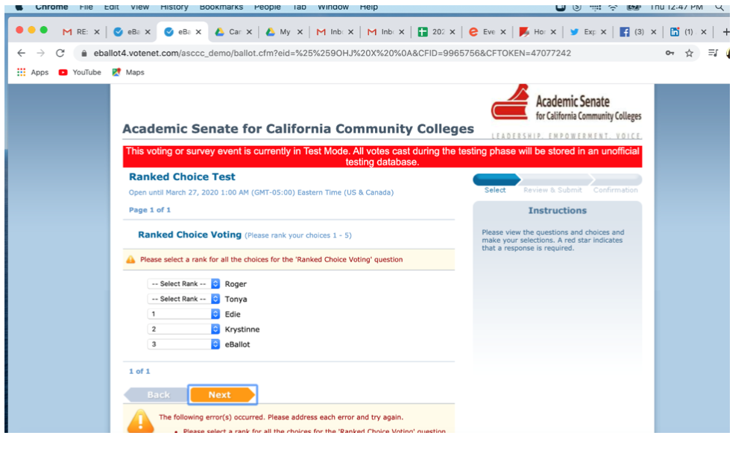

Slide 17
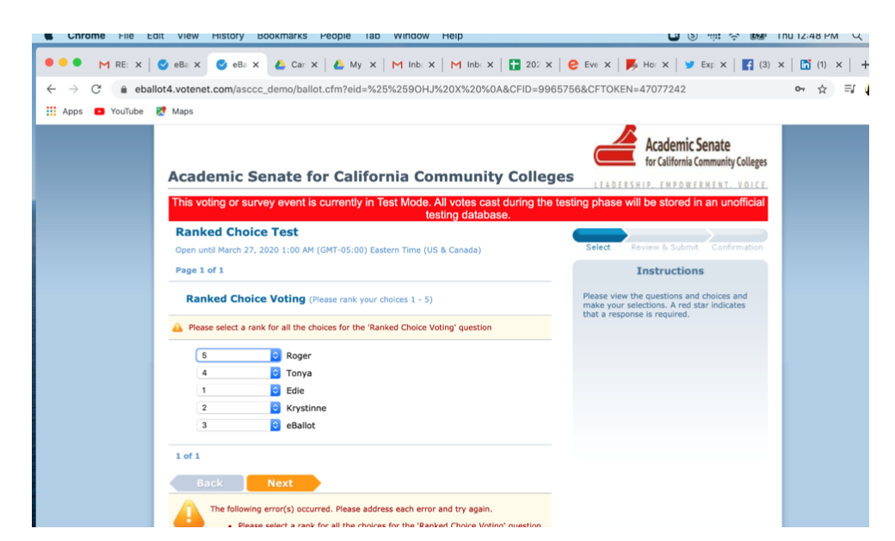

Slide 18
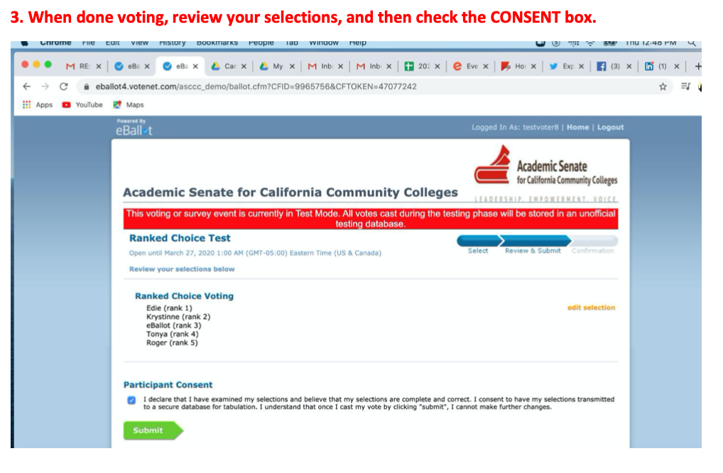

Slide 19
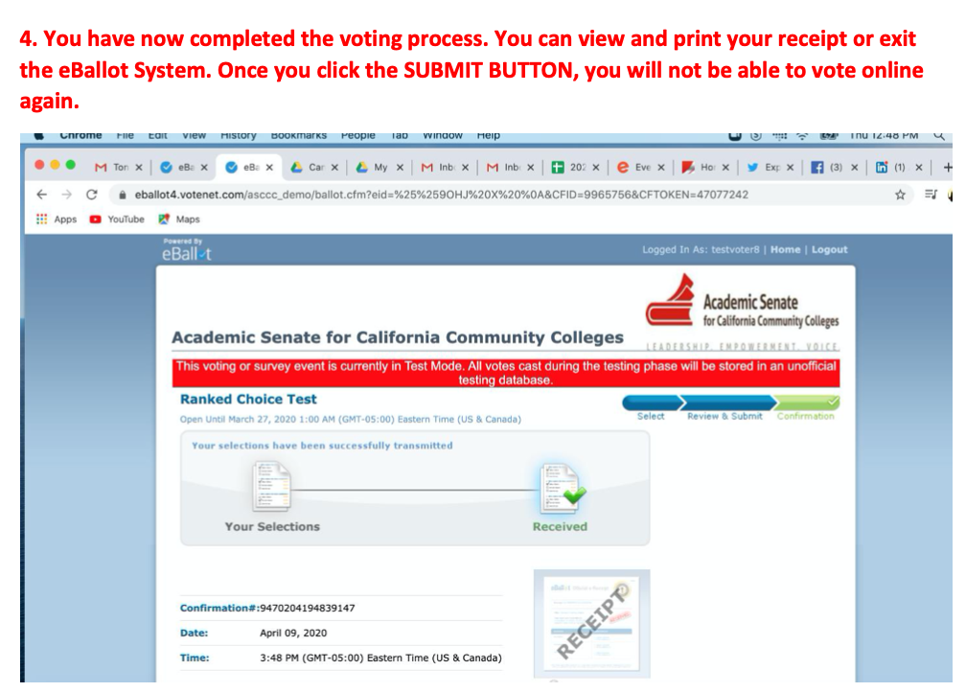

Slide 20
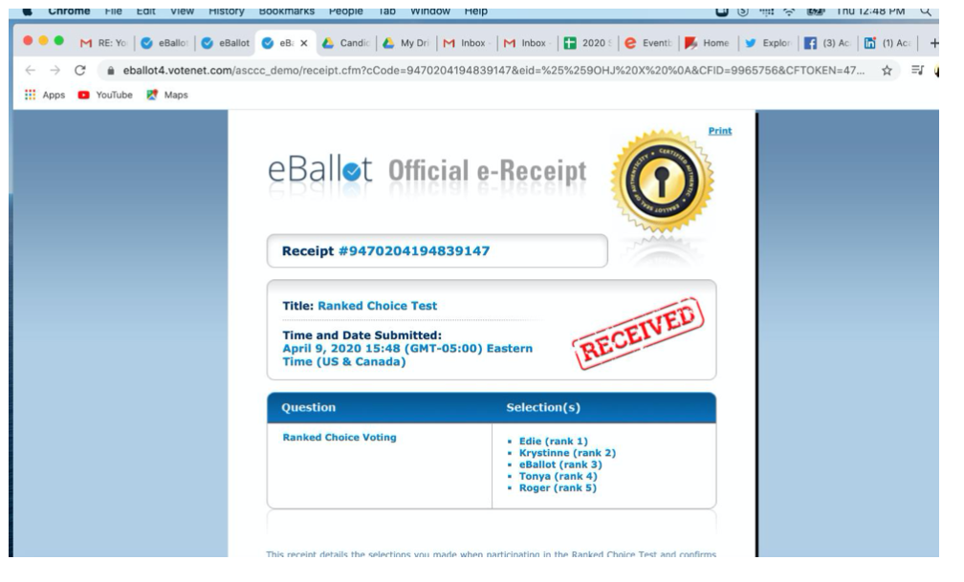

Slide 21
ASCCC Elections Resource Documents
Executive Committee Revised Responsibilities
The ASCCC Executive Committee is responsible for ensuring the organization is acting in the best interest of the ASCCC members. To this end, the Executive Committee provides strategic guidance for the successful achievement of the ASCCC's Mission. The Executive Committee oversees the strategic plan of the ASCCC and its organizational performance, reviews high-level organizational goals and policies, makes high-level decisions, reviews Executive Director performance, and serves as a community advocate for the ASCCC.
Candidate Information Session Handout
ASCCC Elections Website
Senate Rules
Bylaws

Slide 22
All candidates for election to the Executive Committee shall meet at least one of these criteria:
1) is a Delegate or a local senate president;
2) has within the last three years immediately preceding the election been a local senate president or an ASCCC Executive Committee member or officer; or
3) has been nominated by a resolution of a Member Senate. The minutes of the meeting at which that resolution was adopted must be submitted to the Elections Committee chair with the nomination of the individual.

Slide 23
The Executive Committee’s composition and annual elections
are part of the ASCCC’s by-laws.
Officers Positions: Term 06/10/2020 – 06/09/2021 (one-year term)
Start of term: either the first day of June Orientation or June 10, whichever comes first; and End of term: either the Executive Committee meeting in June or June 9, whichever date comes first.
● President
● Vice President
● Secretary
● Treasurer
Executive Committee Representatives: Term 06/10/2020 – 06/09/2022 (two-year terms)
Start of term: either the first day of June Orientation or June 10, whichever comes first; and End of term: either the Executive Committee meeting in June or June 9, whichever date comes first.
● Area A one-year term (06/10/2020 – 06/09/2021)
● Area B
● Area C
● North Representative
● South Representative
● At-Large Representative

Slide 24
Nomination Information
Nominations for this election will only be accepted by completing the Executive Committee Candidate Form.
This form must be submitted by April 17, 2020.
Candidate Materials
Candidate Statement
Speech - in video format
Copy of local senate resolution (if applicable)
Submitted by April 22, 2020
If you have questions about meeting deadlines, please contact ASCCC Executive Director Krystinne Mica – Krystinne@asccc.org.

Slide 25
Questions?

