Slide 1
Applying TOP Code
Alignment Principles
Throughout All Curriculum
Marie Boyd, Chaffey College
Eric Wada, Folsom Lake College
ASCCC Curriculum Institute July 11-14, 2018 Riverside Convention Center

Slide 2
Goals for This Presentation
Review the TOP Code Alignment Project and its benefits
Review TOP, CIP, SOC and SAM codes and their uses
Review possible uses of TOP Code alignment with transfer courses
Review TOP Code Alignment in light of Guided Pathways
ASCCC Curriculum Institute July 11-14, 2018 Riverside Convention Center

Slide 3
TOP Code Alignment Project - Definition
A faculty-led process for examining the reporting codes (TOP, CIP, SOC, and SAM) that have been assigned to CTE courses and program awards.
Joint project of the ASCCC, Chancellor’s Office, Centers of Excellence and WestEd
ASCCC Curriculum Institute July 11-14, 2018 Riverside Convention Center

Slide 4
Codes Refresher - TOP
TOP – Taxonomy of Programs
Only used in California Community Colleges; first published in 1979
Originally based on the federal government’s Higher Education General Information Survey (HEGIS) which was replaced in 1979-80 by the Classification of Instructional Programs (CIP)
Originally started out with 2-4 digits and had evolved to 4-6 digits
* added in 1983 to indicate CTE programs
Used in COCI
Two, Four, and Six Digits
Tied to State apportionment
EXAMPLE
TOP Directory – Most recent revision: 2012; some new, unpublished codes.
CCCCO TOP/CIP Crosswalk
*01 Agriculture
*0109 Horticulture
*0109.10 Landscape
*0109.20 Floriculture
*0109.30 Nursery
ASCCC Curriculum Institute July 11-14, 2018 Riverside Convention Center

Slide 5
TOP Codes and Curriculum
How are TOP codes assigned to courses and programs? To what extent are faculty involved?
What is the role of faculty in selecting CIP and SOC Codes at your college?
How can you ensure faculty primacy in selecting TOP Codes?
ASCCC Curriculum Institute July 11-14, 2018 Riverside Convention Center

Slide 6
Codes Refresher – CIP
CIP – Classification of Programs
The federal standard for postsecondary instructional program classification
Tied to federal financial aid
Used for Gainful Employment which is reported on your program’s website
Used for tracking Baccalaureate Degrees
Used for Veterans’ financial aid
Used for Accreditation
Not yet in COCI
EXAMPLE 2 – digit 14 Engineering
4 – digit 14.08 Civil Engineering
6 – digit 14.0804 Transportation & Highway Engineering
CIP Code Directory
O*NET Crosswalk CIP/SOC
ASCCC Curriculum Institute July 11-14, 2018 Riverside Convention Center

Slide 7
Codes Refresher - SOC
SOC – Standard Occupational Classification
Managed by the U.S. Dept. Labor, Bureau of Labor Statistics
Used by federal agencies to classify workers into occupational categories for the purpose of collecting, calculating, or disseminating data.
Used when calculating supply and demand and developing labor market projections for job openings.
Tracks program completers to make sure they end up in a recognized occupation (SOC Code)
EXAMPLE
2018 Standard Occupational Classification
11-1000 Top Executives 11-1010 Chief Executives
11-1011 Chief Executives
11-1020 General and Operations Managers
11-1021 General and Operations Managers
ASCCC Curriculum Institute July 11-14, 2018 Riverside Convention Center

Slide 8
Codes Refresher – SAM (CB09)
Student Accountability Model (SAM) codes help identify pathways within CTE programs, such as which courses are introductory and which are the capstone courses.
SAM codes are used to determine Perkins and Strong Workforce Program funding and in the calculations for the Student Success Scorecard, CTE Outcomes Survey, and LaunchBoard.
SAM codes affect calculations about students who took ono-intro courses and skills-builders
*(A) Apprenticeship (offered to apprentices only)
*(B) Advanced Occupational
A “B” course is offered in one specific occupational area only and clearly labels its taker as a major in this area. The course may be a “capstone course” that is taken as the last requirement for a career technical education program.
*(C) Clearly Occupational (but not advanced)
Courses will generally be taken by students in the middle stages of their programs and should be of difficulty level sufficient to detract “drop-ins.”
*(D) Possibly Occupational
“D” courses are those taken by students in the beginning stages of their occupational programs. The “D” priority can also be used for
service (or survey) courses for other occupational Programs.
(E) Non-Occupational
These courses are non-occupational.
Which ones only qualify for Perkins?
ASCCC Curriculum Institute July 11-14, 2018 Riverside Convention Center

Slide 9
SAM Codes and Perkins Funding
More Information at CCCCO Workforce and Economic Development. http://extranet.cccco.edu/Divisions/WorkforceandEconDev/CareerEducationPractices/PerkinsIV/OnlineTrainingTutorials/Accountability.aspx
But as an example, a “concentrator” is defined as
“Students enrolling during a cohort year (most recent three years) and successfully completing 12 units in Career Technical Education in a two-digit TOP of which one course was a Sam A-C is then counted within the system and considered a concentrator.”
The number of concentrators is a key comparison in Perkins accountability reporting. The number of CTE concentrators who complete, persist, and leave are reported as ratios.
ASCCC Curriculum Institute July 11-14, 2018 Riverside Convention Center

Slide 10
TOP Code Alignment Project - Purpose
To ensure that these codes appropriately match the content of the curriculum.
Elements of the process below can be used for non-CTE programs.
ASCCC Curriculum Institute July 11-14, 2018 Riverside Convention Center

Slide 11
TOP Code Alignment Project - Benefits
More money for your college
More aid available for your students
Information to support cross-college alignment clear documentation on target occupations and more specific information on the skills included in the program, which can support articulation.
ASCCC Curriculum Institute July 11-14, 2018 Riverside Convention Center

Slide 12
TOP Code Alignment Project - Benefits
Better statewide/national data
Less work for your college*
Access to experts*
Ensure data integrity
*unique to CTE TOP code project
ASCCC Curriculum Institute July 11-14, 2018 Riverside Convention Center

Slide 13
The Process
Document Codes
Code Alignment Workshop
Final Review
ASCCC Curriculum Institute July 11-14, 2018 Riverside Convention Center

Slide 14
A. Document Codes
(Kick-off call between TOP Code Alignment team and College team. It is recommended that the Curriculum chair and/or Curriculum Specialist be included on this call.) This could be an initial call for faculty buy-in.
College Team selects (CTE) curriculum to be examined during the TOP Code Alignment process – both courses and awards
After this selection has occurred, (WestEd and Centers of Excellence) compile a Code binder that lists the following:
All possible codes and their descriptions
Codes currently used by the College
Codes used by other Colleges
Code crosswalks
Cross-over courses
Jobs across similar awards
The next slide shows a method for documenting existing codes.
ASCCC Curriculum Institute July 11-14, 2018 Riverside Convention Center

Slide 15
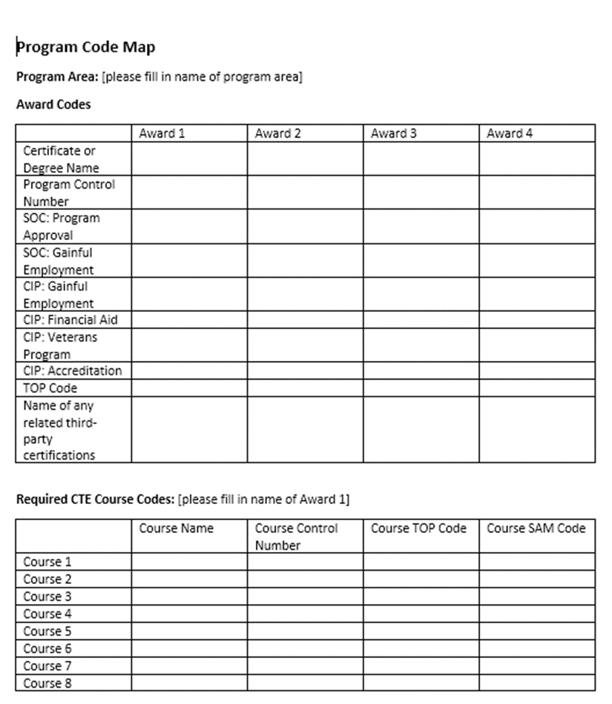
A. Gathering
Information on Codes
This task is normally done by the college researcher (with support from the CTE Data Unlocked Expert.)
The college can (use CTE Data Unlocked funds to) pay a faculty member or consultant to fill it out.
ASCCC Curriculum Institute July 11-14, 2018 Riverside Convention Center

Slide 16
B. Code Alignment Workshop
Face to face meeting where faculty review the Code binders that list possible codes and their descriptors, and determine which codes best describe the program/award(s).
Meeting is facilitated by the TOP Code Alignment team assigned to the College. This team includes an ASCCC-appointed curriculum expert, and a Center of Excellence Labor Market Information expert.
Discipline faculty will come for a 1-2 hour segment to work with the team on their program.
Curriculum committee chair/member should plan on attending the entire day.
ASCCC Curriculum Institute July 11-14, 2018 Riverside Convention Center

Slide 17
B. Face to Face Meeting: Alignment Discussions
Start by discussing what jobs the students are training for (SOC)
Then discuss what subject areas/content the program covers (CIP)
Move on to a review of the currently assigned TOP code
Then look at the codes assigned to the courses in that award (TOP6)
Check the SAM codes for sequencing of courses in the award
Lastly, how to the programs fit together. How do the codes crosswalk with each other? Does anything that has been discovered necessitate a change?
ASCCC Curriculum Institute July 11-14, 2018 Riverside Convention Center

Slide 18
B. A Visual of this Discussion
ASCCC Curriculum Institute July 11-14, 2018 Riverside Convention Center

Slide 19
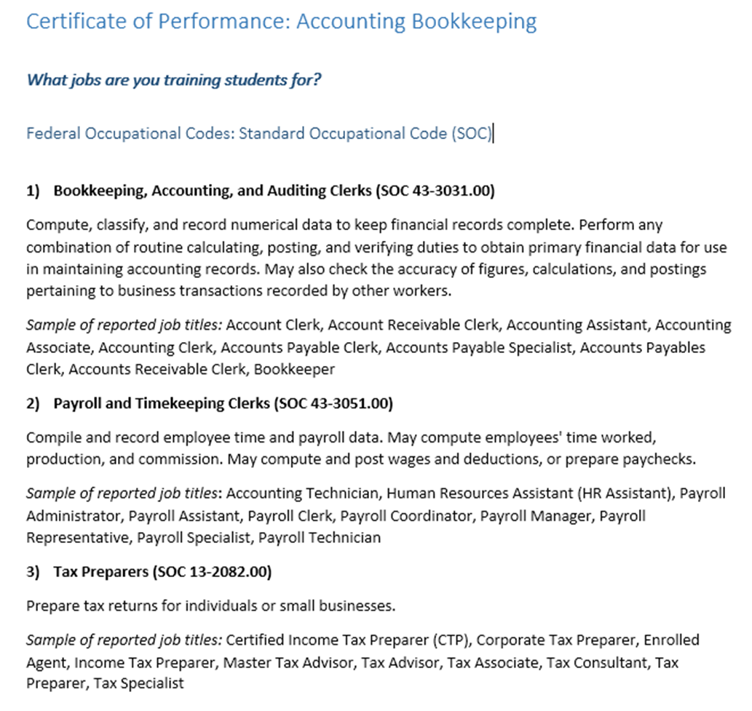
1. Discussing what jobs the students are training for (SOC)
Typically selected as part of the program planning/approval process.
Select no more than 3-5 occupations per award.
Select 6-digit SOC codes; stay away from 8-digit codes (there is no labor market data for them).
Each occupation is assigned a “typical” entry-level education and “typical” on-the-job training. Ask: Will my students be qualified for employment in this occupation right after they complete my program?
The faculty determined that its curriculum was only focused on the first of the three possible occupations. The other jobs are the focus of other accounting certificates.
ASCCC Curriculum Institute July 11-14, 2018 Riverside Convention Center

Slide 20
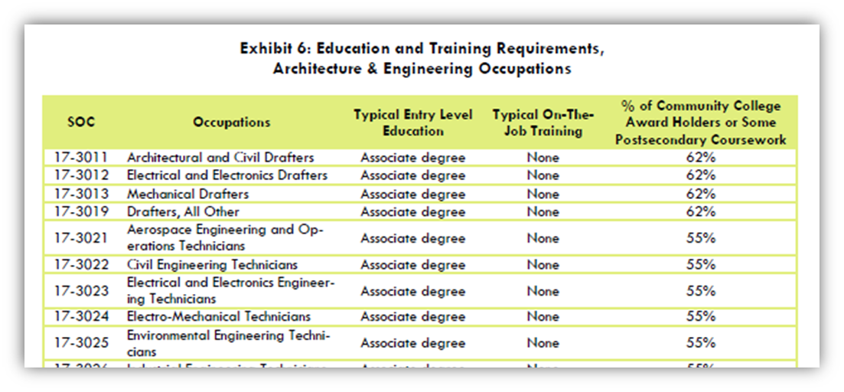
SOC codes are used in demand and supply calculations
ASCCC Curriculum Institute July 11-14, 2018 Riverside Convention Center

Slide 21
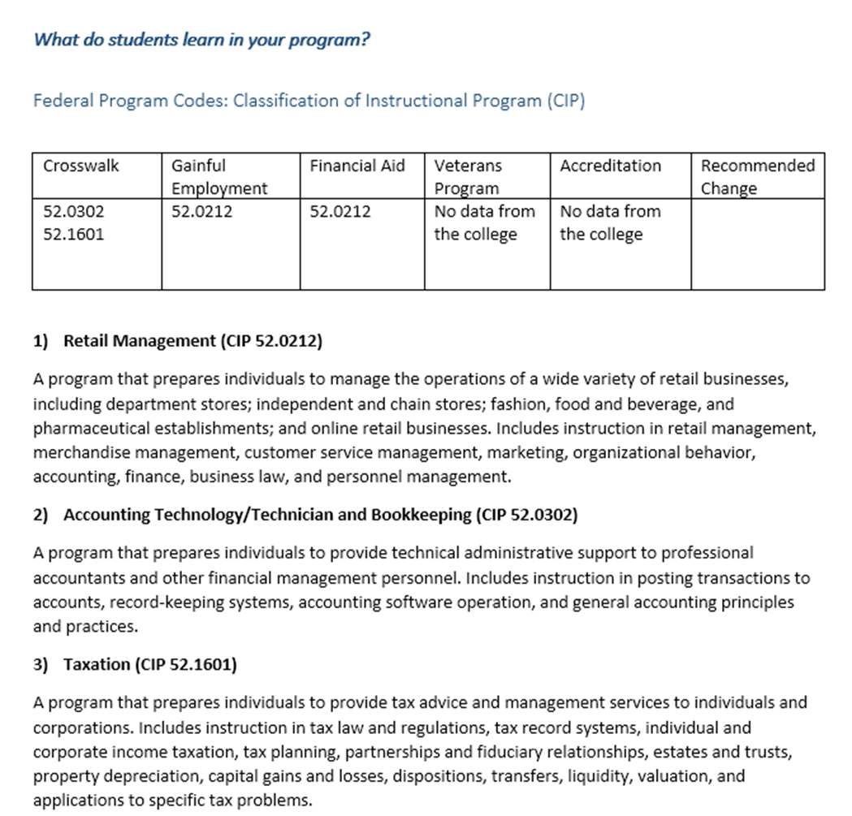
2. Discussing what subject areas/content the program covers (CIP)
Selected by various college staff for accreditation, gainful employment reporting, financial aid, and veterans programs, sometimes using a crosswalk posted by the Chancellor’s Office.
Select only 1 CIP per award
Look for the best fit based on CIP description and what is taught in your program.
Choose how many digits in the CIP code, based on how broad or specific the program is.
Remember that CIP sometimes provides an opportunity for a more specific code.
The faculty determined the accounting program is inadvertently being reported as a retail management program to federal agencies.
ASCCC Curriculum Institute July 11-14, 2018 Riverside Convention Center

Slide 22
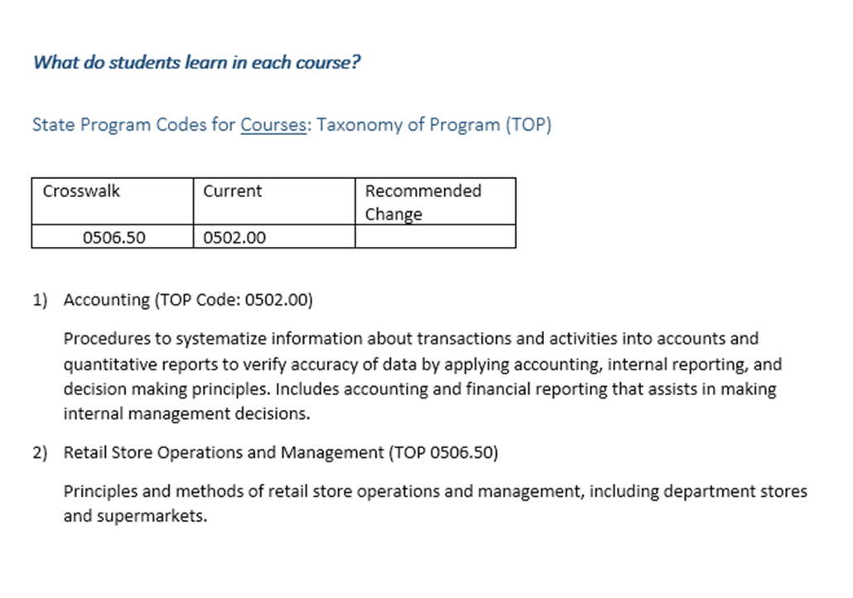
3. Review the currently assigned TOP code
Usually part of the curriculum approval process
Select the California Program Code (TOP)
Select only 1 TOP Code per award
Some TOP codes and/or delimitation could be out of date; find the best fit within the existing structure.
Through the Code Alignment Project, we will document common programs for which there is no TOP code.
The faculty affirmed that the correct state code is being used for its accounting certificate.
ASCCC Curriculum Institute July 11-14, 2018 Riverside Convention Center

Slide 23
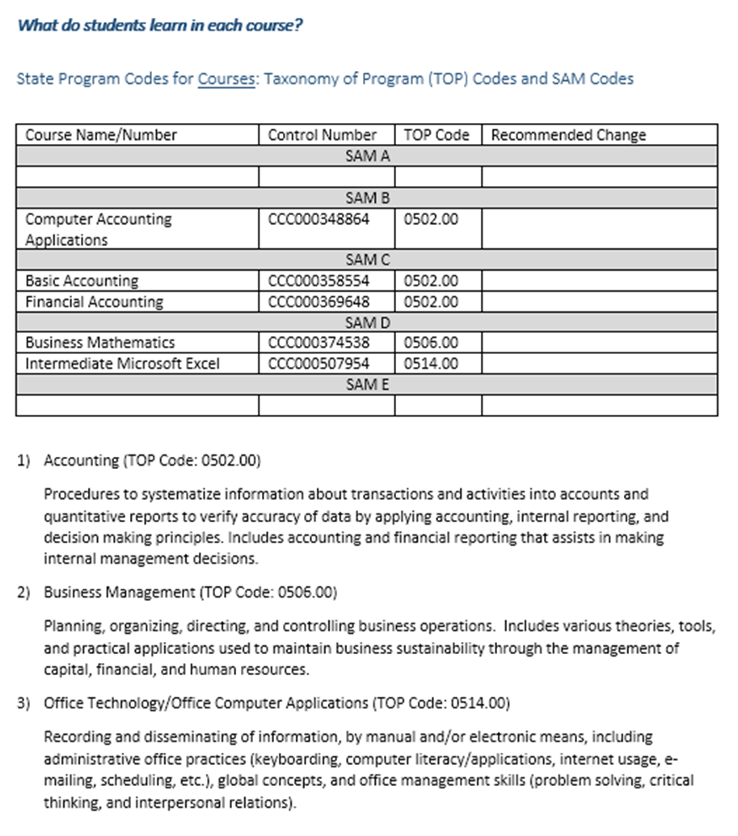
4. Examine the codes assigned to the courses in that award (TOP6)
Select the California Course codes (TOP)
The faculty found that while the course codes regarding content were correct, the sequence of courses was incorrect.
ASCCC Curriculum Institute July 11-14, 2018 Riverside Convention Center

Slide 24
5. Check the SAM codes for sequencing of courses in the award
Usually SAM codes are assigned during the curriculum approval process
Validating SAM Codes
Arrange courses in their logical sequence.
Pay attention to which courses are marked as introductory versus further in the sequence, particularly if many students take intro courses without intending to major in the program.
ASCCC Curriculum Institute July 11-14, 2018 Riverside Convention Center

Slide 25
Dueling TOP Codes
*0514 Office Technology
*0702.10 Software Application
*0614 Digital Media
*07XX Computer Technology
*0614.60 Computer Graphics and Digital Imagery
********************************************************
*0709.10 E-Commerce
*0501 Business and Commerce
**********************************************************
0801 Education
*1305.50 The School Age Child
4901.20 Liberal Studies (Elementary Teacher ADT)
4930.60/.62 Elementary and Secondary Education
ASCCC Curriculum Institute July 11-14, 2018 Riverside Convention Center

Slide 26
6. How do the programs fit together. How do the codes crosswalk with each other? Does anything that has been discovered necessitate a change?
Things to Know BEFORE Changing Codes: I.e. How do codes get changed?
TOP - Awards: codes must be submitted to the Chancellor’s Office for a review before they can be changed in the Curriculum Inventory.
TOP - Courses: codes can be changed in the new Curriculum Inventory, without review by the Chancellor’s Office.
SAM: codes can be changed in your college’s local data system and in COCI, without review by the Chancellor’s Office.
ASCCC Curriculum Institute July 11-14, 2018 Riverside Convention Center

Slide 27
C. Final Review
College will review proposed changes, determine which changes to make and move forward with those changes through your local and state processes.
Your College will share what you decided with the CTE data Unlocked team to help validate code crosswalks.
College can continue the process with additional CTE programs/awards.
ASCCC Curriculum Institute July 11-14, 2018 Riverside Convention Center

Slide 28
CTE and Non CTE (Transfer) Curriculum
Is there a reason to extend this process to transfer-level courses?
Stackable local certificates
Streamlined approval forthcoming from CCCCO
Outcomes-based funding
Link to program review
Program currency and relevance
Designing innovative curriculum to meet other student needs.
Integrating transfer-level courses into CTE curriculum
ASCCC Curriculum Institute July 11-14, 2018 Riverside Convention Center

Slide 29
TOP Code Alignment and Guided Pathways
How does this process link into Guided Pathways?
ASCCC Curriculum Institute July 11-14, 2018 Riverside Convention Center

Slide 30
Code Alignment and Guided Pathways
Leveling courses
Clear course sequencing and scheduling for students
How does your college plan for scheduling sequential courses and capstone courses?
How are these plans advertised to students?
Employment guidance for students who are uncertain
How does your college advertise career guidance, and is this a part of your curriculum process?
Increase awareness of majors that students would not have considered
Many students will not get a job in the field in which they majored
ASCCC Curriculum Institute July 11-14, 2018 Riverside Convention Center

Slide 31
For More Information on TOP Code Alignment
http://doingwhatmatters.cccco.edu/LaunchBoard/CodeAlignment.aspx
ASCCC Curriculum Institute July 11-14, 2018 Riverside Convention Center

Slide 32
Questions?
Marie Boyd, Curriculum Chair, Chaffey College marie.boyd@chaffey.edu
Eric Wada, ASCCC Curriculum Committee, Folsom Lake College
Eric.Wada@flc.losrios.edu
ASCCC Curriculum Institute July 11-14, 2018 Riverside Convention Center

