Slide 1
C-ID and CTE: A Framework and Perspectives
Krystinne Mica, ASCCC Executive Director
Carrie Roberson, ASCCC North Representative
Miguel Rother, ASCCC Director of Grants & Initiatives
2019 Curriculum Institute- Decoding Your Curriculum
Friday, July 12
9:00 am – 10:15 am

Slide 2
Here we are…
You have questions? We have answers! Come to this breakout session to hear the latest in C-ID news, hear about current efforts around career technical education (CTE) C-ID, and engage in dialogue with the presenters. If you have a burning question related to C-ID, this breakout is for you!

Slide 3
TODAY
Realities!
CTE for student success
CTE C-ID
SB 462 - Urban and Rural Forest and Woodlands Restoration and Fire Resiliency Workforce Program
Activity
Q&A

Slide 4
REALITIES!
Students and the student experience
Workforce needs/ data
System driven by legislation and law
Considerations: UNIQUE local college/district, department/program, course

Slide 5
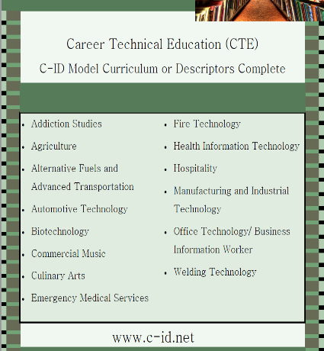
Some Stats…
Total of 102 finalized CTE C-ID descriptors that colleges can submit courses for review
Total of 340 CCC courses approved for CTE descriptors
10 CTE MC finalized and available on c-id.net for colleges to use

Slide 6
CCC Baccalaureate Programs
Working on four model curricula to align with CCC Baccalaureate programs in:
Respiratory Care
Biomanufacturing
Automotive Technology
Dental Hygiene

Slide 7
UC Transfer Pathways
Created jointly by the CCC and the UC based on several priorities shared by the two systems:
Expanding inclusive access
Thorough academic preparation
Similar guarantee as ADT-s: guaranteed admission into the UC system (not campus specific)
Student must meet minimum GPA of 3.5
Student completes lower division prep at CCC
Chemistry – utilizes 40 units aligned to existing C-ID descriptors
Physics – utilizes 45 units aligned to existing C-ID descriptors
Transfer into UC as full-time student should allow student to complete the degree within 2 years

Slide 8
SB 462 – Urban and Rural Forest and Woodlands Restoration and Fire Resiliency Workforce Program
This bill would require the CCC Chancellor’s Office, working in collaboration with the ASCCC, to develop a forest and woodlands restoration workforce model curriculum and vocational programs to be offered by community college districts commencing on or before July 31, 2021.
The MC and the related vocational programs shall accomplish all of the following:
Provide professional training in fire projects
Focus on ecological concerns
Train students in retrofitting houses
Train students in urban forestry
Train students in policies related to management of vegetation and infrastructures

Slide 9
Build cross agency partnerships and clarify roles
Identify sector or industry and engage employers
Design education and training programs
Identify funding needs and resources
Align policies and programs
Measure community economic impact
Measure system change and performance
ELEMENTS of
Career/Technical Pathways

Slide 10
YOUR TURN!
What can the ASCCC do to support your local college C-ID efforts?

Slide 11
QUESTIONS…& THANK YOU!
Krystinne Mica
Krystinne@asccc.org
Njeri Griffin
ngriffin@CCCCO.edu
Carrie Roberson
RobersonCa@butte.edu
Miguel Rother
Miguel@asccc.org

