Slide 1
Pismo Beach CA by Bert Sijen

Slide 2
Ready for Anything!
The Flexible Classroom
Cheryl Chapman & Amanda Taintor 2020

Slide 3
Flipped & Flexible
Asynchronous
Live
Synchronous
Recorded
Notes:
Do a "temperature check" of experiences/knowledge/opinion in the room

Slide 4
Adventurous?
images from clipart.com

Slide 5
Risk Taker?
images from clipart.com

Slide 6
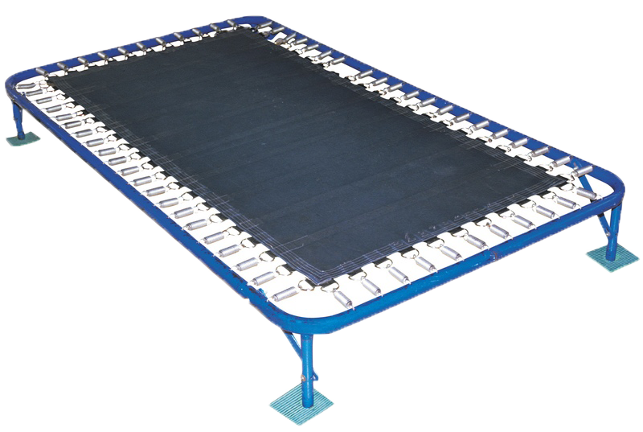
Bouncer?
images from clipart.com

Slide 7
Just Chill?
images from clipart.com

Slide 8
Follow the Crowd?
images from clipart.com

Slide 9
Look Familiar?
images from clipart.com

Slide 10
Flip the Switch!
images from clipart.com
Notes:
Cheryl 0-10

Slide 11
What To Do?
Reverse “Lecture & Homework”
Inspire Active Learning
Hybrid Design
Repurpose Meeting Times
skills application/concept development
Notes:
Amanda

Slide 12
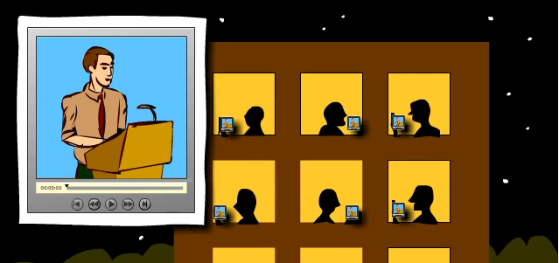
Notes:
Amanda

Slide 13
Flipped Classroom "model"
Notes:
Amanda

Slide 14
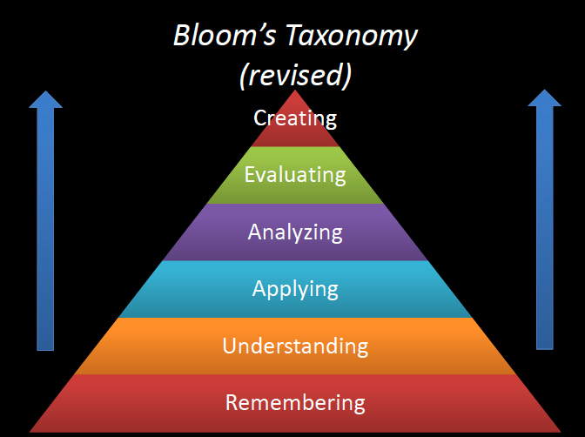
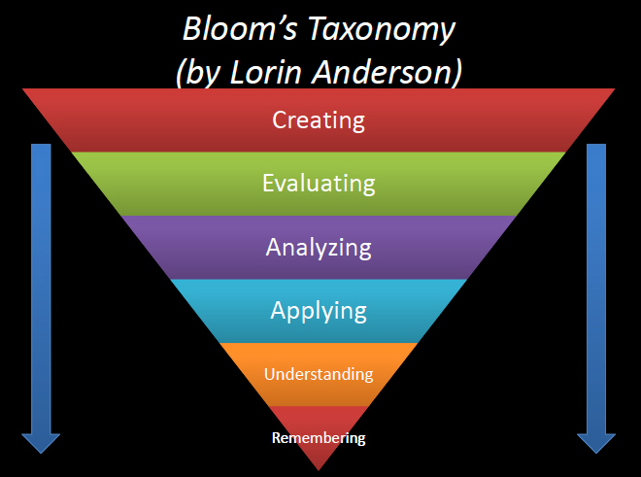
Notes:
Amanda

Slide 15
Effective Flipping
Communicate your 'Why'
Incentivize preparation
Connect the two
Allow time
Choose familiar technologies
Facilitate and guide
Notes:
Amanda

Slide 16
Learner
Prior to Class Time
View short video lectures
Review course materials
Online exercises or short quiz
Develop questions in class activities
Be prepared to…
Participate and Engage
Dive more deeply into material
Complete Projects, etc
Notes:
Cheryl
On the review course materials it would be nice to plug OER as it gives students access on day one

Slide 17
What to Develop
Transfer of F2F activities to online delivery
Design
Start with course outcomes/objectives - Backward design
Content materials
Authentic, learner centered, problem solving projects
Assessment rubrics
Produce
Video/podcast lecture clips/animations (4-7 min)
Prepare students for new experience
Notes:
Amanda

Slide 18
Techniques
Encourage collaboration; coach, advisor & facilitator
POGIL : Process Oriented Guided Inquiry Learning
pogil.org
Probing questions and clarify content
Inspire reflection, interaction and participation
Notes:
Cheryl

Slide 19
How Do I…
Find time to create videos/learning curve
Blend direct instruction/constructivism
Build Interactivity
Develop Peer instruction and Review
Encourage participation/discussion
Notes:
Amanda

Slide 20
Tools We Use
CANVAS - Course Management System
Collaborative spaces
Google Docs / 0365
Media Cloud Repository
DropBox/One Drive/Google Drive/iCloud
Images, Video & Audio
Unsplash / Pixlr / Creative Commons Image Search
Notes:
Cheryl

Slide 21
Capture/Record
Software
PowerPoint
ScreenCast-O-Matic
TechSmith Camtasia/Snagit
Canvas Studio
ConferZoom
Adobe Spark
Notes:
Amanda
Emphasize during slide that choosing something you are comfortable with and can navigate without being frustrated, instructors try to get fancy and it makes it hard to sustain then.
If video lectures drive the instruction, it is just a repackaging of a more traditional model of didactic learning. It is not a new paradigm nor pedagogy of learning.

Slide 22
Interactive Video
Captions/Quizzes/Conversations
Canvas Studio
TechSmith Knowmia
VoiceThread
Notes:
Cheryl
Just as recommended in fully only courses Interactive videos helps students to stay engaged with the content

Slide 23
Animations
Simulations/Games
Teampedia
Animated Presentations
Powtoon
My Simple Show
Bitmojis
Notes:
Cheryl

Slide 24
Roadblocks
Moving from teacher to facilitator
"Doing whatever they want time...."
Learner Onboarding
Student access to technology
Design of the physical space
Notes:
Amanda
The options for experiential engagement are limitless. Again, the goal is to offer an engaging and authentic learning activity that introduces learners to the course topic, that creates a desire for them to want to learn more
Students might not be prepared for this model of learning. They have gone through an educational system where they passively intake knowledge.

Slide 25
In Action
"Flipping the Classroom": An interview with Chris Tisdell

Slide 26
Fearless!
Trust in What You Know
Ask When You Don’t Know

