Slide 1
Academic Senates and Unions: Creating, Maintaining,
and Leveraging Effective Partnerships Friday, June 17, 2022, BREAKOUT SESSION 2: 10:30 AM - 11:45 AM

Slide 2
Presenters
Cheryl Aschenbach,
ASCCC Vice President
Wendy Brill-Wynkoop,
FACCC President

Slide 3
Session Description
As established by Education Code, employer-employee relations, which include collective bargaining of faculty salaries and working conditions, are unions’ responsibility, while making recommendations on academic and professional matters is the responsibility of academic senates. In reality, though, the responsibilities of the two faculty representative groups are nuanced. Presenters will review the purview of academic senates and scopes of unions as established in Education Code and Title 5 and explore the areas where the work of academic senates and unions may overlap, including on the current hot topics of academic freedom and faculty evaluations. The discussion will include creating and maintaining effective senate-union relations and leveraging senate-union partnerships.

Slide 4
Authority of Union
Salary and Working Conditions
California Government Code section 3543 (a)
(a) Public school employees shall have the right to form, join, and participate in the activities of employee organizations of their own choosing for the purpose of representation on all matters of employer-employee relations. Public school employees shall have the right to represent themselves individually in their employment relations with the public school employer, except that once the employees in an appropriate unit have selected an exclusive representative and it has been recognized pursuant to Section 3544.1 or certified pursuant to Section 3544.7 , an employee in that unit shall not meet and negotiate with the public school employer.
Notes:
Wendy
1976 EERA - Educational Employee Relations Act (1976) established collective bargaining in California K-12 schools and CCCs
1979 Dills act 1979 - collective bargaining rights for all other state government workers in California
1979 HEERA Higher Education Employer-Employee Relations act - CSU/UC
And then more acts to follow with municipal employees
CA Govt Code 3543 (a) - right to form and participate in a union and
Public school employees shall have the right to form a collective bargaining unit (or union)
The right to represent themselves individually in their employment relations with the public school employer,
Once they have selected an exclusive representative they cannot negotiate outside the CBA - collective bargaining agreement or the contract
Negotiate vs. Collegial consult
Define - collegial consultation
Collegial Consultation is defined as either or both: relying primarily upon the advice and judgment of the academic senate or by reaching a mutual agreement as defined in local board policy
Local senate president has the right to appear before the BOT on the 10+1 matters
If board disagrees with senate’s recommendation the senate can request the board reasoning in writing
The union operates differently – we negotiate
Define negotiate
Negotiation is the primary tool used to draft a Collective Bargaining Agreement or contract between faculty and the district to determine the conditions of employment
The process of negotiations includes rules of engagement
Bargain in Good faith – duty of both parties to meet and negotiate at reasonable times with willingness to reach an agreement – but not required to make a concession or agree
Negotiating in ”bad faith’ is against the law
PERB -California Public Employment Relations Board (PERB)
Single entity that administers and enforces labor laws, and adjudicates disputes for all public employee unions in California
Appeal to PERB if the process is not followed
Union addressing the Board
Don’t have the right to address the board like the academic senate
BUT - a member of public faculty should be informing the board regularly
Typically the board doesn’t respond directly to the union but would direct the district lead negotiator
Be sure to ‘Wear the proper hat” - individual, senate president, union

Slide 5
Collective Bargaining
School calendar;
Compensation;
Wages;
Hours of employment;
Terms and conditions of employment - health and welfare benefits;
Leave;
Transfer and reassignment policies;
Safety conditions;
Notes:
SCOPE:
CA Govt Code 3543.2
The scope of representation shall be limited to matters relating to
wages, hours of employment,
and other terms and conditions of employment.
What the law says is “Terms and conditions of employment” includes
Academic Calendar
Wages
Health and Welfare benefits
Leave
Transfers and reassignment policies
Safety conditions
Change SLIDE
Class size
Evaluation procedures
Organizational security or seniority
Grievance procedures
Certain aspects of layoffs
Causes and procedures for discipline
Additional compensation or salary schedule based on criteria other than years of training and experience
For example PERBs pocket guide on the EERA lists all the PERB court decisions
Several pages of subjects that fall within the ”scope”
the union has the right to consult with the district over educational objectives, the content of courses and curricula, and selection of textbooks - matters of academic freedom
Collective Bargaining Agreement (CBA) Contract
72 CCC districts and 83 different faculty contracts (FT/PT)
The local collective bargaining unit or union CAN bargain anything with in the scope.
It doesn’t mean that a local union has everything negotiated with in the scope of the law
Conditions of employment and salary look very different on each campus as we know.
Read your contract! If its been a while, reread your contract
If there is something missing or that needs to be changed, negotiate it!
Ed Code - Title 5 (regulation) - state level
On-campus: Contract(s) and local policy/procedures
Some times these are in conflict

Slide 6
Collective Bargaining
Class size;
Procedures for evaluation of employees;
Organization security;
Procedures for processing grievances;
Layoff procedures;
Alternative compensation or benefits for employees adversely affected by pension limitations;
Additional compensation or salary schedule based on criteria other than years of training and experience.
Notes:
Wendy
Scope cont’d – read under previous slide.

Slide 7
Authority of Senate
Ed Code 70901(b)(1)(E)
Minimum standards governing procedures established by governing boards of community college districts to ensure faculty, staff, and students the right to participate effectively in district and college governance, and the opportunity to express their opinions at the campus level and to ensure that these opinions are given every reasonable consideration, and the right of academic senates to assume primary responsibility for making recommendations in the areas of curriculum and academic standards.
Ed Code 70902(b)(7)
Establish procedures that are consistent with minimum standards established by the board of governors to ensure faculty, staff, and students the opportunity to express their opinions at the campus level, to ensure that these opinions are given every reasonable consideration, to ensure the right to participate effectively in district and college governance, and to ensure the right of academic senates to assume primary responsibility for making recommendations in the areas of curriculum and academic standards.
Notes:
Cheryl

Slide 8
Academic and Professional Matters
Title 5 §53200 (c)
“Academic and professional matters” means the following policy development and implementation matters
Curriculum, including establishing prerequisites
Degree & Certificate Requirements
Grading Policies
Educational Program Development
Standards & Policies regarding Student Preparation and Success
Notes:
Cheryl

Slide 9
Academic and Professional Matters
College governance structures, as related to faculty roles
Faculty roles and involvement in accreditation process
Policies for faculty professional development activities
Processes for program review
Processes for institutional planning and budget development
+1 Other academic and professional matters as mutually agreed upon.
Notes:
Cheryl
Again Local Policy will be different on each campus

Slide 10
Possible Areas of Overlapping Purview
Academic Calendar
Faculty Evaluations
Tenure Review Process
Faculty Hiring Procedures (job duties and compensation)
Enrollment Management
Program Viability/Discontinuance
Office Assignment
Textbooks
Professional Development
Academic Freedom (textbooks and AF)
Notes:
Wendy
What else should be there?
Example about AB 705: English Class size
English faculty made a pedagogical argument to curriculum committee to limit the English 101 class size due to changes to pre-req. Curriculum committee agreed. Then the union stepped in to negotiate.

Slide 11
Diversity Equity Inclusion & Accessibility
Title 5 changes and resources
DEIA Competencies
refer to skills, knowledge, abilities, and behaviors all employees must demonstrate and utilize in interactions with students and colleagues, and the performance of their job duties.
DEIA Criteria
refer to the elements used in employee evaluation and tenure review processes to measure performance.
DEIA Competencies and Criteria Recommendations
Title 5 Regulations
Employee Evaluations and Tenure Review approved May 23, 2022
Notes:
Wendy

Slide 12
Faculty Evaluation and Tenure
Education Code §87663(f)
“[i]n those districts where faculty evaluation procedures are collectively bargained, the faculty’s exclusive representative shall consult with the academic senate prior to engaging in collective bargaining regarding those procedures.”
Sound Principles for Faculty Evaluation (ASCCC 2013)
Evaluations are shared purview: unions negotiate specific contract language based on academic senate input
Notes:
Cheryl
Education Code §87663(f) includes the provision that “[i]n those districts where faculty evaluation procedures are collectively bargained, the faculty’s exclusive representative shall consult with the academic senate prior to engaging in collective bargaining regarding those procedures.”
Sound Principles for Faculty Evaluation (2013), this language means that while bargaining units may negotiate the language specific to faculty evaluations, they must do so with input from academic senates (Academic Senate for California Community Colleges, 2013).
This work requires communication, collaboration, respect, and trust, all of which can be developed with intention if the academic senate and union do not already work well together. Meeting together regularly can help senates and unions to discuss areas of shared interest or concern and learn more about each other’s priorities; this practice can better position senates and unions to act proactively together. As senates and unions dialog, they can explore what can be done to integrate cultural competence and DEI into faculty evaluations while respecting the concerns each may have. https://asccc.org/content/integrating-expectations-cultural-competence-faculty-evaluations

Slide 13
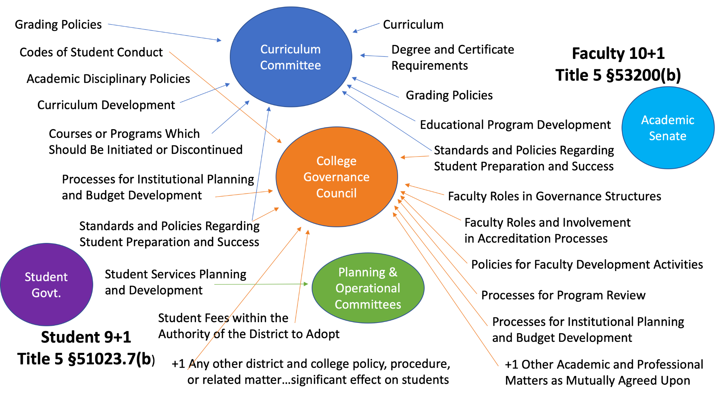
Student Senate
https://ssccc.org/
The Senate is recognized by California Community Colleges Board of Governors and Chancellor’s Office as the official voice of students in system participatory governance in accordance with Title 5, §50002. The Senate shall maintain system participatory governance as one of its mission’s three pillars of engagement and act through System Affairs Directors from each Region to facilitate the involvement of students in the same.
Notes:
Cheryl
Make sure to talk about Grading as an example

Slide 14
Scenario #1
Which stakeholders are involved in the process?
Online Attendees Discuss:
The Nursing Department would like to implement the use of plus/minus grading campus wide.
In-Person Attendees Discuss:
College administration is interested in cutting programs to balance the budget during a period of enrollment decline. The administration recommends discontinuance of the welding program.
Notes:
Left side:
Senate
Grading Policy
Standards or policies regarding student preparation and success
Share story about our campus and nurses concern – C- is not passing, Problem with their accreditation
Students – definitely, should be consulted.
Union – Not really,
A real stretch – possibly workload? But not that I really agree
Right side:
Senate
Curriculum
Processes for program review
Processes for institutional planning and budget development
Union
May FX faculty positions and cause layoffs
Students
Students ability to complete a program

Slide 15
Scenario #2
Which stakeholders are involved in the process?
Online Attendees Discuss:
The faculty was informed by the district that a decision was made to shorten the academic term and change finals week.
In-Person Attendees Discuss:
As the term begins, a part time faculty with seniority had her class cancelled due to low enrollment. She asserts she has the right to take another faculty’s class with less seniority.
Notes:
Left Side:
Union –
Academic calendar – definitely within the scope
Holidays, workdays, hours (Shortened)
Senate –
Curriculum
Standards & Policies regarding Student Preparation and Success
Grading and finals
Possibly change to FLEX calendar – pro dev is both union and senate
Reach out to students – survey?
What would help them be more successful?

Slide 16
Scenario #3
Which stakeholders are involved in the process?
Online Attendees Discuss:
A world-wide pandemic forces all community college coursework to be delivered online. At your campus, faculty are being told they must participate in training as a condition for teaching in this situation.
In-Person Attendees Discuss:
The department faculty have voted to implement OER materials in place of the traditional textbooks but one faculty member would like to continue to use a traditional textbook.
Notes:
Left side
Ed Code – faculty are prepared to teach online format, different than correspondence classes
Federal and accreditation requirements
That don’t exist with F2F classes
Senate –
Curriculum/DLA
Policies regarding student preparation and success
Professional development
Right Side
Academic Freedom allows faculty freedom within their discipline to teach the way they want within the COR
To choose their materials
But also it is a question of student success and completion due to cost
And a curricular issue
PERB scope = textbooks
Work together – it is about the students!
Maybe – allow more time to transition to an OER for a faculty who isn’t ready?

Slide 17
Best Practices:
Collegiality and conversation
Mutual understanding of purview between Senate and Unions
Written agreement between Senate and Union
Draft when both bodies are not stressed by RIF or other major concerns
Familiarity with local board policies and collective bargaining agreement
Include all faculty (full and part time)
Notes:
Clearly more overlap than we likely realized! So its key that senate and union work together
Local policy and contract can sometimes conflict
Both should be reviewed regularly
Both can be revised or changed
And in the end, contract will win out.
Example – faculty transfer policy
All represented by the collective bargaining agreement (whether member or not) and all represented by senate
Being in opposition creates problems for both union and senate
Collegiality and conversation – go out for coffee
Mutual understanding of purview between Senate and Unions
Written agreement between Senate and Union
Draft when both bodies are not stressed by RIF or other major concerns
Familiarity with local board policies and collective bargaining agreement
Include all faculty (full and part time)
Do your homework and research
Look to other colleges for examples
Read local policy/procedures and collective bargaining agreement
Research - “Ed code says...” said by Admin all the time
Ask ASCCC/Union Affiliate
Know your elected representatives – your board members
Educate them! Our BOT didn’t know that the senate and union had authority under law
Don’t be afraid to speak up, ask questions, and document
Willingness to seek input, but good solutions take time
ASCCC Ed Pols Committee working on Academic Freedom paper – importance of Union and Senate supporting each other

Slide 18
Resources
Academic Senate Website
www.asccc.org
Senate Paper: Developing Model Effective Senate-Union Relationships
https://www.asccc.org/papers/developing-model-effective-senateunion-relations
Rostrum Article: Senate-Union Relationship
https://www.asccc.org/content/senate-and-union-relationship-understanding-their-roles-and-working-together

Slide 19
Questions?
Cheryl Aschenbach
ASCCC Vice President
caschenbach@lassencollege.edu
or info@asccc.org
Wendy Brill-Wynkoop
FACCC, President
president@faccc.org

Slide 20
Thank you
for coming!

