Slide 1
Breakout X Credit ESL: Implementation Placement Guidelines and Practices for AB705
Friday, July 10 2:45pm-4:00pm

Slide 2
Session Description
The adoption of AB 705 in 2017 changed the way the students are placed and how course sequences are structured for English language learners. Will placement testing still be available? How are colleges that have moved away from placement test placing students into ESL courses? What do you need to complete to make sure your college is ready for full implementation of AB 705? Please join us for a lively discussion where we will review the guidance from the Chancellor’s Office, discussion the work of the AB 705 ESL Implementation Committee, and answer all of your questions about how to continue to serve the needs of English language learner students in the world of AB 705.

Slide 3
Presenters
Craig Rutan: Physics Faculty, Santiago Canyon College
CCCCO AB705 Implementation committee
CCCCO AB705 ESL Advisory committee
ASCCC Data and Technology Specialist and Regs King
Lisa Saperston: ESL Faculty, LACCD
ASCCC Curriculum Committee
CCCCO AB705 ESL Advisory committee & CB21 ESL Workgroup
Kathryn Wada: ESL Faculty, Cypress College
CCCCO AB705 Implementation committee
CCCCO AB705 ESL Advisory committee & CB21 ESL Workgroup

Slide 4
Fielding Questions
We would love for you to share your questions, thoughts, local practices, and any concerns during our presentation.
Please type any information that you want to share in the Google Doc available here.
A representative from ASCCC is monitoring the document and will share your thoughts and questions with the presenters.
Notes:
Craig:
Put this link into the chat:
https://docs.google.com/document/d/1ajT4IKf2Xh7wPqFQwQex4wwvSuYmxJkeCDHh6Aa3clQ/edit?usp=sharing

Slide 5
Will placement testing still be available?
With the emergency guidance memo, placement tests can continue to be used through June 30, 2021.
A college may use a writing assessment that has been approved for systemwide use or use at their college. They may not use a writing assessment that has only been approved for another college to use.
The Chancellor’s Office will be reconvening the Assessment Committee to determine whether testing in any form can continue for ESL after July 1, 2021.
Notes:
Lisa

Slide 6
How are colleges placing students into ESL courses if they have moved away from a placement test?
Extension for ESL Placement Assessments to July 1, 2021
Guided Placement: A process or a tool used to encourage a student to reflect on his or her academic history and educational goals that may include the student evaluating their familiarity and comfort with topics in English or mathematics. After completing the process, students will receive their course placement.
Self-Placement: The process in which a student chooses their placement after consideration of the self-assessment survey results and other relevant factors.
In the Google Doc, please share what your colleges have been doing to place students without them being able to come on campus.
Notes:
Craig

Slide 7
Progress Report @ LACCD: ESL GSP
Active ESL District Discipline Committee
Nine colleges - One ESL GSP (not published yet)
Currently housed in Qualtrics and facilitated through Zoom
9 survey questions (self) / 3 survey questions (guided)
Students request results from Admission / Records or Assessment Offices

Slide 8
ESL Assessment @ Cypress
Moving to a new sequence in Fall 2020, so not offering sequence courses this summer (breathing room to plan)
Fall assessment using CELSA:
All incoming students wanted in-person assessment rather than remote.
Cypress admin and staff are making that happen in accordance with COVID restrictions.
Students email Assessment Center Coordinator for an appointment on specific dates.

Slide 9
How are colleges placing students into ESL courses if they have moved away from a placement test?
Extension for ESL Placement Assessments to July 1, 2021
Per AB 705 Guided and Self Placement Guidance and Adoption Plan Instructions AA 19-19, April 15, 2019, “[t]he restrictions on guided and self-placement that are outlined in Title 5 §55522 do not currently apply to ESL.”
Therefore, §55522(c)(1)(C) does not apply to ESL:
District placement methods based upon guided placement, including self-placement, shall not:
(i) incorporate sample problems or assignments, assessment instruments, or tests, including those designed for skill assessment, unless approved by the Chancellor; or
(ii) request students to solve problems, answer curricular questions, present demonstrations/examples of course work designed to show knowledge or mastery of prerequisite skills, or demonstrate skills through tests or surveys.
Notes:
Craig

Slide 10
What do you need to complete to make sure your college is ready for full implementation of AB 705?
Implementation delay to next July 1, 2021
What should colleges should be considering in the meantime?
“… credit ESL throughput rate” is TBD
Curricular Changes: integration vs. discrete, direct to TLC, etc
Data Collection
Notes:
Kathy – ESL Implementation Plan meld with Implementation deadline

Slide 11
Emergency Guidance Memo ES 20-24, June 23, 2020
Emergency Guidance for AB 705 Implementation Memo
Clarifications related to credit ESL:
Omission of 3-year timeline for ESL in paragraph 1
HS grads placed according to 55522 vs. "placed into English": What is the difference?
Notes:
Kathy

Slide 12
§55522.5 ESL Regulations
Have you read the ESL Regs?
What do you think they say?
Notes:
Lisa

Slide 13
§55522.5 ESL Regulation Topics
Scope and Intent
Placement Methods
Assessment
Communication surrounding assessment procedures
The “shall not” lists
SEA funding
Non-compliance consequences
ESL placement data collection
Notes:
Lisa

Slide 14
ESL Regulations - §55522.5(b)
ESL regulations:
Adopted on the Monday, March 16 of COVID-19
Highlights of changes: §55522.5(b)(2)
Students who have acquired a United States high school diploma or the equivalent shall be placed according to section 55522.
Highlights of changes: §55522.5(b)(4)(B)
(B) The district's failure to demonstrate that the local placement method meets or exceeds the credit ESL throughput rate(s) of a placement method, once published, by the Chancellor's Office.
Notes:
Kathy
Emphasize the “once published” aspect

Slide 15
ESL Regulations - §55522.5(5) and (6)
Highlights of changes: §55522.5(5) and §55522.5(6)
(5) Districts must inform students placed into credit ESL coursework prior to fall 2020 of their right to access the newly adopted placement processes that comply with this section and students who have completed a United States high school diploma or the equivalent shall be placed according to section 55522. Districts shall disclose their plans to implement retroactive placement recommendations as part of the adoption plan described in subparagraph (b)(4).
(6) Any placement for the fall semester or quarter of 2020 must comply with this section and Education Code section 78213.
Notes:
Kathy:
Talk about “prior to Fall 2020”: Not clear how this still applies since we don’t have confirmation from the CO.

Slide 16
The Work of the AB 705 ESL Advisory Committee
Per the June 2020 Guidance Memo:
Define evidence-based multiple measures
Continued research into placement options for ELLs without U.S. high school data
Identify promising models of assessment
Develop process for colleges to share evidence on effectiveness of ESL placement with the Chancellor’s Office.
Notes:
Lisa

Slide 17
PLAN NOW for 2021-2022 ESL and CSU & IGETC Course and Program Approvals at your Campus
Consider creating an ESL TLC course following your local curriculum approval processes
Apply for IGETC 3B / CSU C2 Humanities GE fulfillment or UCTCA (transferability as elective units)
Consider ESL Milestone Certificates

Slide 18
ELL Success Beyond AB 705: Transferability & GE Requirements
Rooted in AB 705 amendments that recognize …
ESL instruction as distinct from “remediation” in English
Students in ESL courses are engaged in foreign language learning
Rooted in evidence:
“ …improves the likelihood of earning a degree by almost 13 percentage points” (PPIC 2019)
Rooted in success:
Small but mighty ESL with A2 have had high success.
Small number of advanced ESL courses have 3B/C2 approval.
Notes:
Kathy: We probably won’t get to these following slides about GE and the certificates, but I’d like to leave them here for people to review later if they want to.

Slide 19
IGETC 1A/A2 Approvals for ESL Courses (ESL TLC)
Historical approval of ESL courses for IGETC 1A Written Communication: NONE | Historical approval of ESL courses for CSU A2: American River College ESLW 340 - approved Su2003 Citrus ESL 101 Reading and Composition De Anza ESL 5 Adv Composition and Reading Sacramento City ESLW 340 - approved Su2003
Fall 2019 approval of ESL courses for IGETC 1A: Cabrillo ESL 1A Santa Rosa ESL 10 | Fall 2019 CSU A2 approvals: Cabrillo ESL 1A Santa Rosa ESL 10
Fall 2020 approval of ESL courses for IGETC 1A: American River ESLW 340 Cypress ESL 110 C Grossmont ESL 122 Palomar ESL 110 Sacramento City ESLW 340 | Fall 2020 CSU A2 approvals: American River ESLW 340 Cypress ESL 110 C Grossmont ESL 122 Palomar ESL 110 Sacramento City ESLW 340 Modesto Junior College ELIC 100 Orange Coast ESLA 100
Notes:
(info based off of Kathy’s assist.org inquiries of the all the CCCs)

Slide 20
The Third Way: IGETC 3B/C2 Humanities
Optimizing Success for ELLs in and beyond Transfer-level Composition
Submit courses for IGETC 3B/CSU C2 Humanities GE fulfillment
AB 705 ESL Guidance Memo AA 18-41 (July 2018):
Pursue the possibility of submitting transfer level ESL courses for inclusion in CSU General Education Breadth Area C2 and for course-to-course articulation
IGETC 3B approval for advanced ESL courses can save a student up to 15 units!
*In-house illustrations by Hailey Wada

Slide 21
IGETC 3B/CSU C2 Approvals for ESL Courses
Historical approval of ESL sequence courses for IGETC 3B Humanities: NONE | Historical approval of ESL sequence courses for CSU C2: F1990: Palomar ESL 103 F1990: Palomar ESL 102 F1990: Palomar ESL 101 F1991: De Anza ESL 6 Su2003: Sacramento City ESLR (denied 3B F20)
Fall 2019 approval of ESL courses for IGETC 3B Humanities: Palomar ESL 106 (1LB) Palomar ESL 103 (2LB) De Anza ESL 6 (TLC+1) | Fall 19 CSU C2 approvals: Palomar ESL 106 (1LB) City College of San Francisco ESL 188 (1LB– denied 3B F19) Reedley ESL 15 (1LB – denied 3B F20)
Fall 2020 approval of ESL courses for IGETC 3B Humanities: NONE | Fall 20 CSU C2 approvals: American River College ESL 350 (TLC+1– denied 3B F20) Cypress ESL 109 (1LB – denied 3B F19 & F20) Cypress ESL 108 (2LB – denied 3B F19 & F20) Reedley ESL 14 (2LB – denied 3B F20) Riverside ESL 50 Norco ESL 50 Moreno Valley ESL 50
Notes:
(info based off of Kathy’s assist.org inquiries of the all the CCCs)

Slide 22
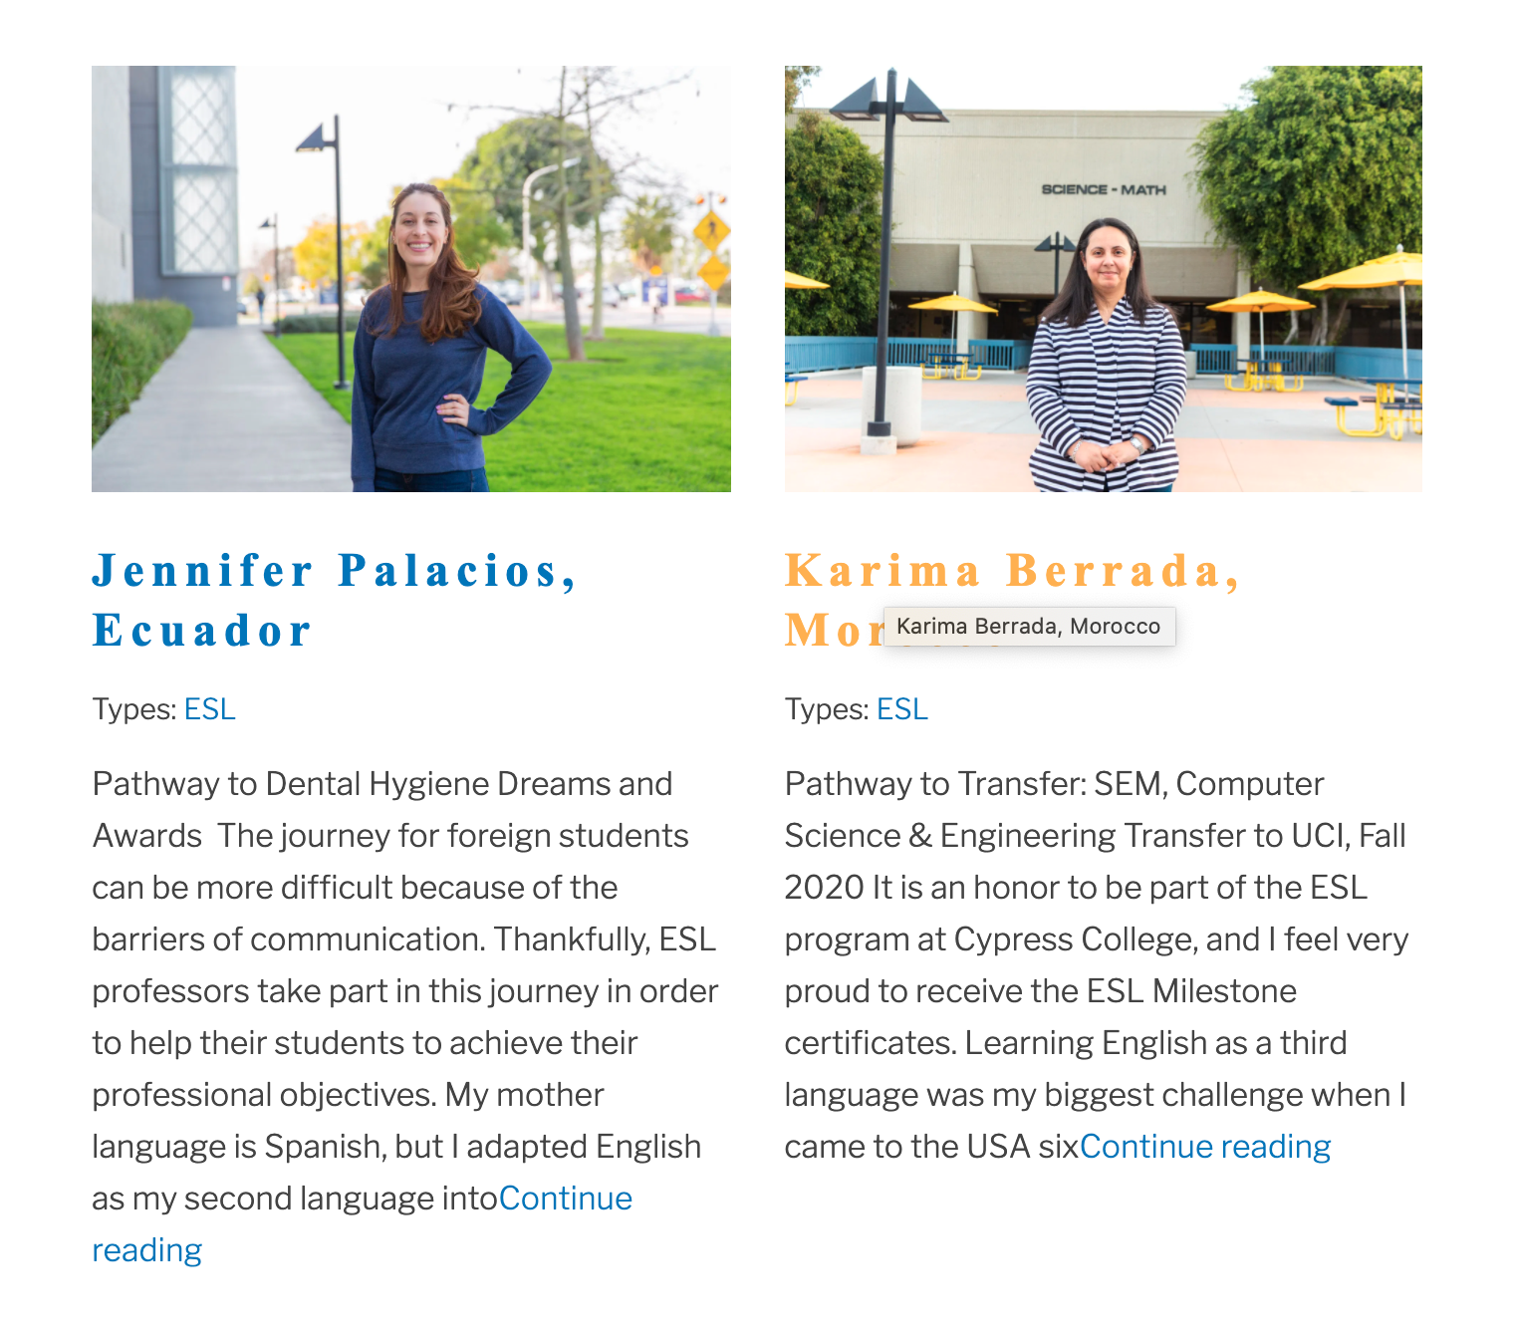
Cypress College Guided Pathways ESL Milestone Certificates
Links:
Overview of the Certificates
ESL Student Testimonials

Slide 23
ELL Success Beyond AB 705: Cypress College Guided Pathways ESL Milestone Certificates
Rooted in AB 705 amendments that recognize …
ESL instruction as distinct from “remediation” in English
Students in ESL courses are engaged in foreign language learning
Amazing student success at Cypress:
Fall 2019: 79 students for a total of 301 certificates!
Spring 2020: 124 students for a total of 407 certificates!
For 2018-2019, Cypress College awarded approximately 1,200 certificates in total. In the first year of the GP ESL Milestone certificates, we have awarded 700+ so far!
Notes:
Kathy

Slide 24
Certificate Data – Spring 2020
First Generation College Student | Educational Goal: degree or transfer
56% | 90%
Spring 2020 | N | Spring 2020 Certificate students | ESL Dept. Overall
Asian or Pacific Islander | 86 | 79% | 69%
African American | 3 | 3% | 2%
Hispanic | 13 | 12% | 12%
White | 7 | 6% | 14%
Not Reported | 15 | 14% | 3%
Total | 124 | 109 | 100%
Certificate Types: ESL Milestone SPRING 2020 | N | Percent
Pathway to Transfer: Written Communication | 106 | 26%
Pathway to Transfer: Social Science | 77 | 19%
Pathway to Dental Hygiene, Nursing, Psych Technology | 53 | 12%
Pathway to Transfer: Oral Communication | 49 | 12%
Pathway to Business & Computer Information Systems | 46 | 11%
Pathway to Science, Engineering, and Mathematics | 38 | 9%
Pathway to Diagnostic Medical Sonography, Health Information Technology, Radiological Technology | 25 | 6%
Pathway to Kinesiology | 7 | 2%
Pathway to Aviation and Travel Careers | 6 | 1%
Total | 407

Slide 25
ELL Success Beyond AB 705: Cypress College Guided Pathways ESL Milestone Certificates
Technical Information:
These certificates were approved by the Cypress College curriculum committee in October 2018 and then approved in April 2019 by California Community College Chancellor’s Office as certificates of achievement for the 2019-2020 academic year. They align with the standards and definitions of the Program and Course Handbook, 7th edition and are TOP-coded as ESL-integrated 4930.87. For more information about the technical aspects of these ESL certificates, please contact Kathy Wada, Cypress College ESL Dept.
Notes:
Kathy

Slide 26
ELL Success Beyond AB 705: Cypress College Guided Pathways ESL Milestone Certificates
These certificates have been featured in the following publications:
Public Policy Institute of California, How Community College Reforms Could Help English Learners, October 2019
Inside Higher Ed, Accelerating Coursework for ESL, December 2019
Public Policy Institute of California, English as a Second Language in California’s Community Colleges, April 2019
Notes:
Kathy

