Slide 1
The Student Voice
“I was transferred to Cal City prison as a disciplinary action [18 months earlier]. When I arrived here, there was a buzz around the facility that I have never experienced in this environment [I'm a multi-termer]. Everywhere I turned, people were talking about what classes they have, what homework was due, how many units they needed to complete their degree. I found myself on the outside of conversations involving topics like politics, social behavior, psychology, different periods of art, etc. I had to see what this was all about.
After this semester I will have an accumulated 36 units and on track to complete my first degree by this summer or fall. I have a counselor that keeps me accountable with progress reports, makes sure that I have books and supplies, and helps me...set short and long term educational goals. I now plan to transfer to a CSU on release for my Bachelor’s.
For the first time in a long time, I don’t feel like a “lost cause.”
-California City Correctional Facility Student (over 45 years of age)

Slide 2
Razor Wire, Lockdowns and No Tech: A Neo-Traditional Model for Student Success
Lisa Stephens (ENFP), The Champion
Nicole Griffin (ISTP), The Mechanic
Peter Fulks (ENTP), The Debater – *Resolved, I’m actually a Visionary*
ACCJC Spring 2019

Slide 3
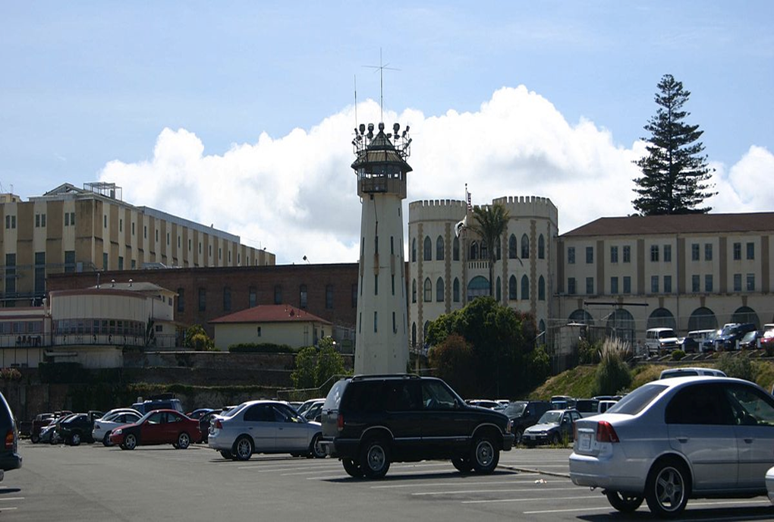
Senate Bill 1391: Apportionment for CA Community Colleges in Prison
$1 invested in prison education = $5 saved in future prison costs in CA
(RAND Report)
SB1391 – Signed into Law September 2014
Compensates Community Colleges for face-to-face education. Creates equity to traditional low income tuition assistance
State-level policies are allowing incarcerated individuals to become full-time college students
Driving purpose is to reduce recidivism rates in CA
San Quentin Prison

Slide 4
Nationwide -Incarcerated Population *numbers are approximate for incarcerated populations and budgets based on recent national reports
2,200,000
INCARCERATED NATIONALLY
700,000
RELEASED YEARLY FROM PRISON
68%
RETURN TO PRISON IN 3 YEARS
83%
RETURN TO PRISON IN 9 YEARS
*Bureau of Justice Statistics most recent report 5/2018

Slide 5
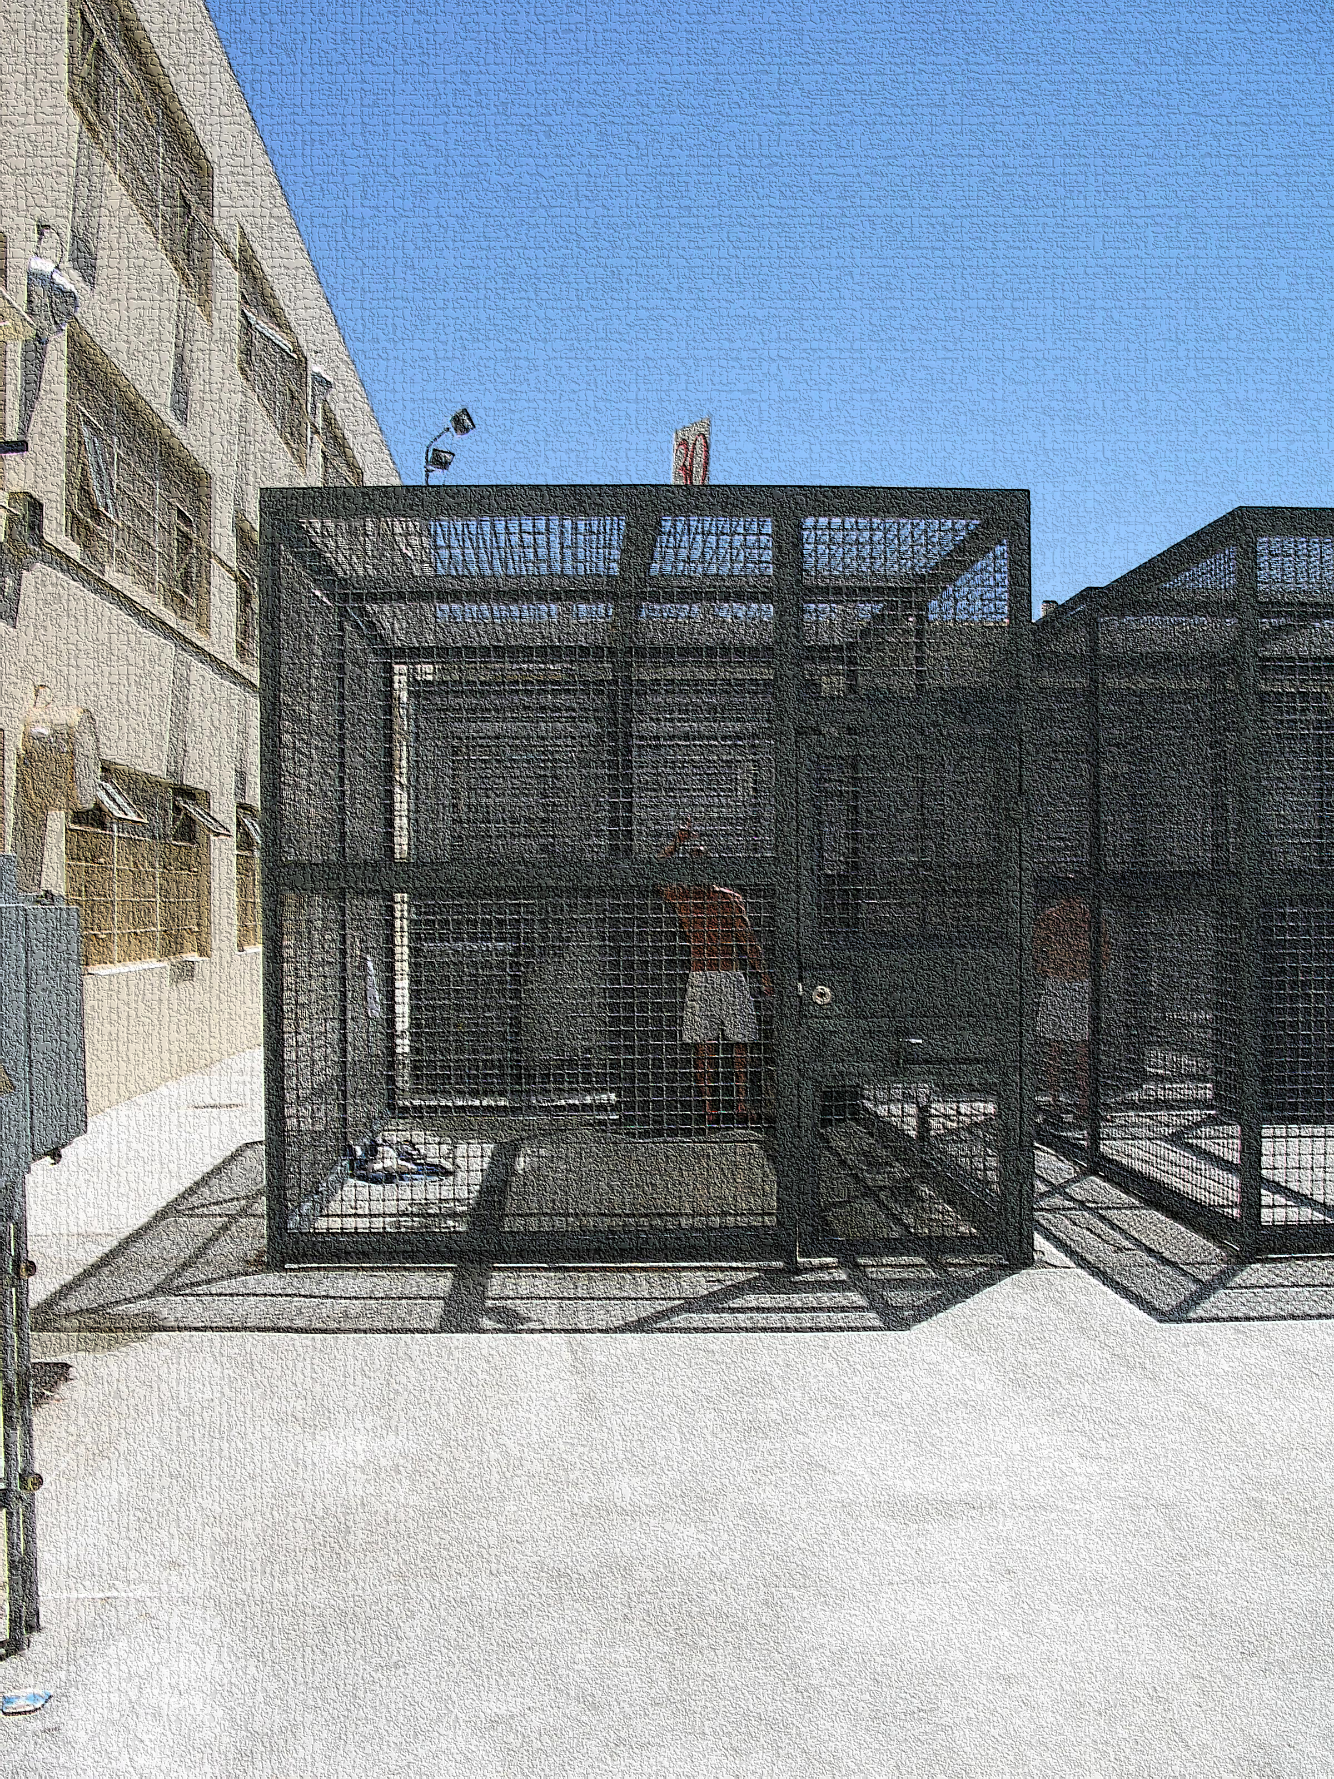
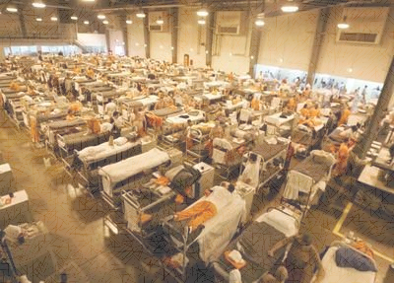
Security Housing Unit
Over Crowding
1791 Enlightenment
2011 Human Rights Violation

Slide 6
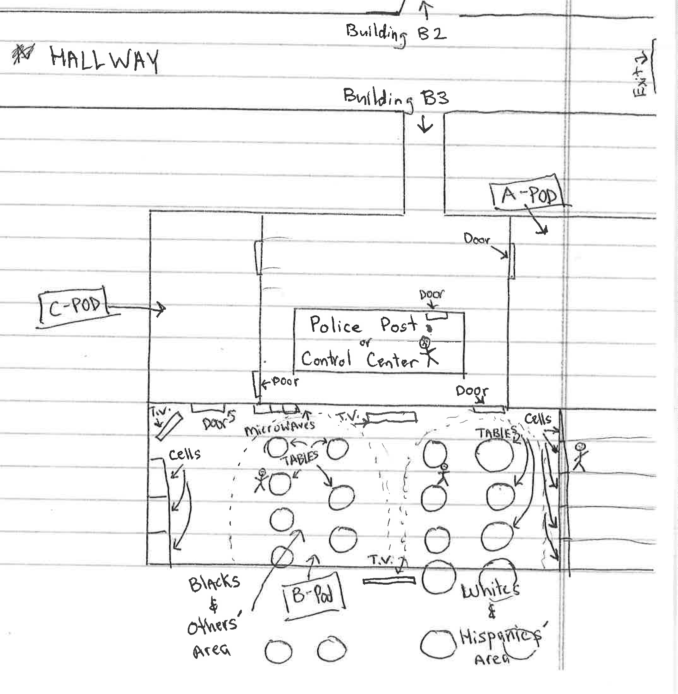
Barriers To Education:
Don’t they sit around all day?
- Jobs
- Lockdowns
- SAP Programs
- Disallowed Materials
- Court Mandated Programming
- Court Visits
- Controlled Movement
- Literal Oppression
Race Segregation

Slide 7
California Prison Spending California Higher Ed Spending *CA’s Legislative Analyst Office, budget and populations rounded
$12 BILLION
Spent on 140,000 people in CA prison 2017-18
= $75,000/year
$16 BILLION
Spent on 2.8 million students in ca public higher education 2017-18
= $5,600/year

Slide 8
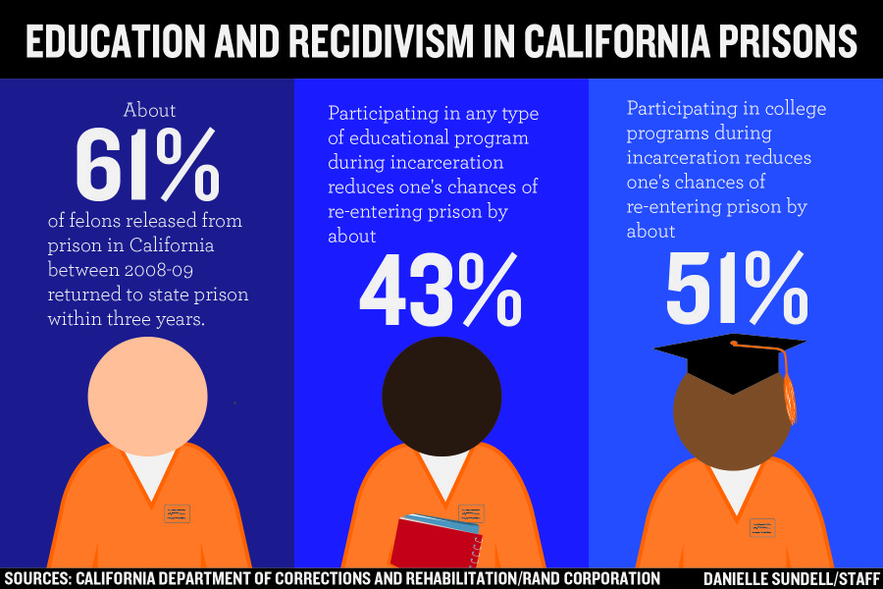
Measuring the Impact of Education in our Incarcerated Population

Slide 9
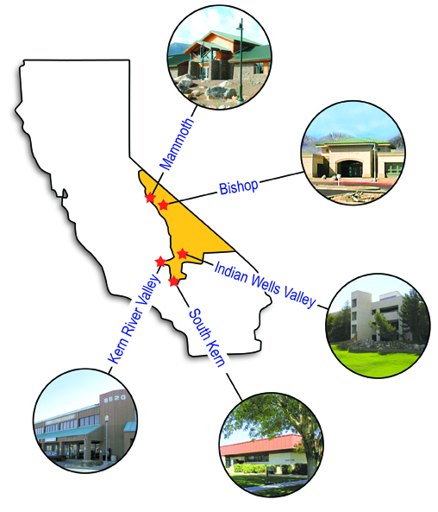
Cerro Coso’s Service Area
Cerro Coso Community College
Kern Community College District
~8,000 students per Academic Year
Over 50% of enrollments are online
Serves 18,200 square miles
7 campuses (not including prisons)
Uniquely positioned to serve rural areas and prisons
Cerro Coso Coyotes

Slide 10
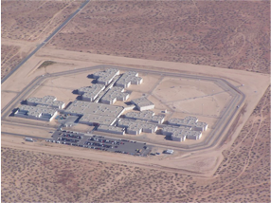
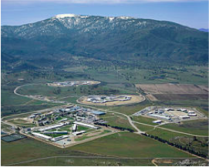
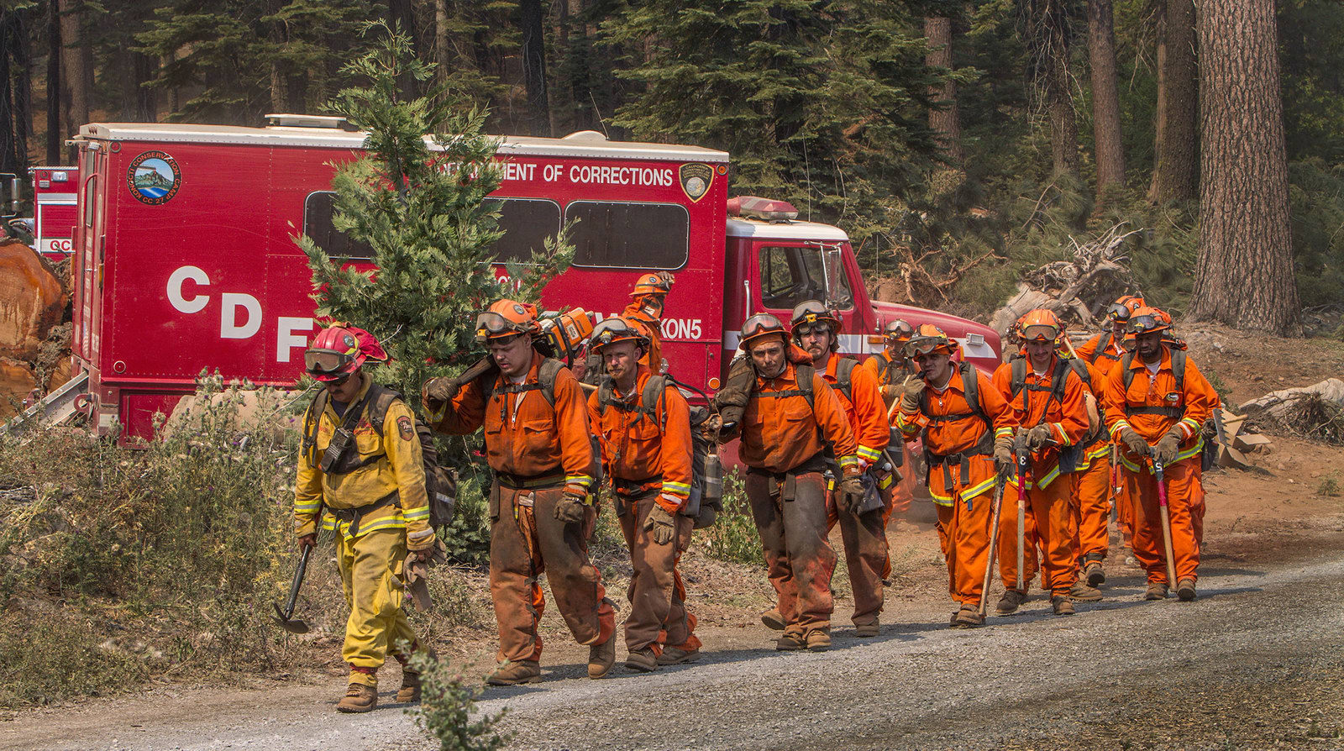
Cerro Coso’s Face to Face Prison Ed
California City Correctional Facility
Warden: George Jaime
Level 2
~2,500 population
496 Students
California Correctional Institute - Tehachapi
Warden: William “Joe” Sullivan
Level 1-4 on 5 yards
~4,300 population
741 Students
Owens Valley Fire Camp – Bishop
MOU signed
100 Potential Students

Slide 11
Headcount Overview: 1300+ Cumulative Total Students Served Since 2015
Incarcerated Student Unduplicated Headcount
by Primary Terms 2015 - 2019
Annual Unduplicated Headcount Comparison
870
881
~300
Notes:
Vision For Success Goal #1: Increase completions by 20%
Goal #5: Reduce previous equity gaps by 40% at a faster rate
Goal #6: Reduce regional equity gaps

Slide 12
Overview - Enrollment
Trends: Incarcerated Student Enrollment
by Term 2015 - 2018
17%
Of Enrollment
at Cerro Coso was Incarcerated in Academic Year 2018-19
S’17-S’18: 207% change
S’18-S’19: 49% change
Notes:
Vision For Success Goal #1: Increase completions by 20%
Goal #5: Reduce previous equity gaps by 40% at a faster rate
Goal #6: Reduce regional equity gaps

Slide 13
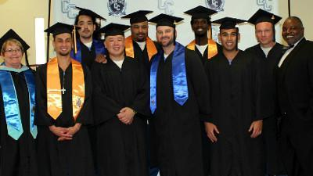
Student Voice
First Graduating Class of 2018
CAC Student Quote: “The Cerro Coso Professors here at C.A.C. are exceptionally encouraging and inspirational...they convey a sincere passion and desire to see us succeed as students and as individuals who will re-enter every day society.”

Slide 14
Demographics – Race/Ethnicity
(College-wide)
(Incarcerated)

Slide 15
Demographics – Age Groups
Incarcerated Student Population
vs. College-wide |
FALL 2018
Average Age for Incarcerated Student is 15 Years Older

Slide 16
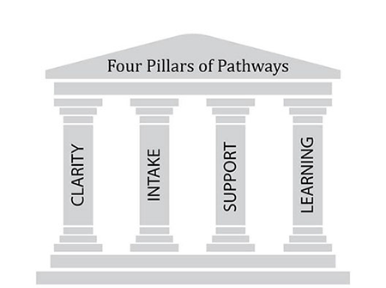
Guided Pathway Implementation
California City Correctional Facility
New! Associates Degree for Transfer
Administration of Justice
Anthropology
Business Administration
English
Psychology
California Correctional Institute - Tehachapi
New! Associates Degree for Transfer
Administration of Justice
Anthropology
Psychology
AA/AS with IGETC Pathway on all Facilities
Liberal Arts and Sciences – Humanities
Liberal Arts – Behavioral Sciences
Notes:
Goal #1: Increase Completions
Goal #2: Increase Transfers

Slide 17
Guided Pathway Implementation - Clarity
Student Voice: “I am eager to pursue my degree and have a sense of accomplishment...if a clear path to graduation is present and a degree is achievable, I will commit myself to it completely” -CCI B Yard
Clarity of the Pathway (Folder Handouts):
Information sheet on available pathways
Checklist of courses to follow the path
College Catalog abbreviated prison packet
IGETC and Transfer Pattern Education Map
Bookending their pathway with PDEV 101 and PDEV 131
Writing a .5 Unit Ed Plan Couse (In CIC Now)
Notes:
Goal #1: Increase Completions
Goal #2: Increase Transfers
Goal #3: Decrease average units

Slide 18
Guided Pathway Implementation - Intake
Intake of Students into the Path
Registration and Scheduling includes:
Pre-Registration orientation/informational to prospective students
Face to Face registration
Student informed scheduling and interests
Work assignment time consideration
Work directly with “Inmate Assignment” office
Alternating course times and offerings (for example 2 x 1.5 hr and 3 hour classes)
Scheduling Pathway completion within 2 years, revolving 4 year schedule
Yard/class space availability
Student Voice: “Give a man a taste of education, and he’s gonna want a little more, and more...until before you know it, his world has changed” - CCI D Yard
Notes:
Goal #1 - Goal #3

Slide 19
Guided Pathway Implementation - Support
Support Throughout the Path
Program Support
Office of Correctional Education support with site principals, VEP Coordinator, Prison partners are critical
Developed a shared governance ISEP Committee with student representation and all involved departments
ISEP committee works with Advisory Board of college and prison administration and staff (wardens, 3rd party re-entry community groups, college Faculty, Officer’s Union, etc.)
Student Support
Tutoring/Study Hall
English/Math Labs
Peer Mentoring
Ongoing in-person educational counseling
Open Ed Resources to offset Textbook cost
PTK honors society on each yard with faculty advisors
Student Voice: “Through the opportunity to join societies, like Phi Theta Kappa, a sense of confidence grows in being able to live well, with purpose.” - CCI C Yard

Slide 20
Student Voice - Peer Mentors and Tutors
Office of Correctional Education Partnerships
OCE hires Cerro Coso students as Adult Basic Ed Tutors
Voluntary/Peer tutor groups are supported and encouraged
Cooperative arrangement with Prison Library for space
Library workers are also Cerro Coso students who can tutor during the workday
English Lab & Tutoring Services
“September 14...was quite an exciting site. We held tutoring groups and the library was packed to capacity.
I made a comment to my class about how awesome it was to see that many people working together to learn. They could have been out on the yard or messing around...watching T.V. or playing cards, but they made the choice to be there.”
Thank you for this opportunity,
-Student/Math Tutor
Notes:
AB 705
Goal #5: Reduce Equity gaps

Slide 21
Student Services - Programs
Extended Opportunity Programs
& Services (EOPS)
AY 18-19
California City
165 current students
Tehachapi
19 current students
Phi Theta Kappa Honor Society
AY 18-19
California City &
Tehachapi (3 yards)
245 current members
2 ISEP Faculty Advisors
Current Projects
15.4%
EOPS Students of Total ISEP Headcount AY 18-19
22.7%
PTK Members of Total ISEP
Headcount AY 18-19
Notes:
Goal #1: Increase Completions
Goal #2: Increase Transfers

Slide 22
Guided Pathway Implementation - Learning
Student Voice: “These [college] opportunities help to re-learn self-discipline, cooperation with others, and restoration of seeking to adhere to the spirit of society, rather than a minimum behavior set by laws” – PTK Student
Learning Along the Path
Program-specific learning outcomes
Collaborative learning, student engagement
Faculty-based needs assessment to support student learning environment
Andragogical changes are producing better learning environments in prison over traditional

Slide 23
Andragogy

Slide 24
Open Educational Resources as Program Tool
Fall 2018
Spring 2019
Notes:
Goal #4: Reduce equity gaps

Slide 25
Incarcerated Student Education Program
.
Cerro Coso’s Mission Statement
The mission of Cerro Coso Community College is to improve the life of every student it serves. Through traditional and distance delivery, Cerro Coso Community College brings transfer preparation, workforce education, remedial instruction, and learning opportunities that develop ethical and effective citizenry to the rural communities and unincorporated areas of the Eastern Sierra. In doing so, we promise clarity of educational pathways, comprehensive and equitable support services, and a commitment to equity.
Notes:
Goal #1: Increase Transfers
Goal #2: Transfers to UC/CSU
Goal #3: Keeping units below 79
Goal #5&6: Closing equity gaps

Slide 26
Shared Governance: ISEP Standing Committee
Academic Senate Resolution to address institutional inequities with prison education program and unique programmatic needs
Accepted by College Council and established as standing committee that addresses Administrative, Faculty and Student concerns and innovations for incarcerated students
Charge is to innovate and recommend policy to the Board and develop procedures and best practices for California’s Community Colleges serving prison populations
Vice President, Instruction (administrator)
Director of East Kern (administrator)
Manager of Prison Education (administrator)
Administrator from Student Services
Faculty from Letters and Sciences with experience teaching in the prison
Faculty from Career Technical Educational with experience teaching in the prison
Faculty with no experience teaching in the prison
Faculty counselor
Faculty Librarian
Classified staff members, one representing admissions and records and one representing ACCESS
Student (x2), one formerly incarcerated and one currently incarcerated, if feasible

Slide 27
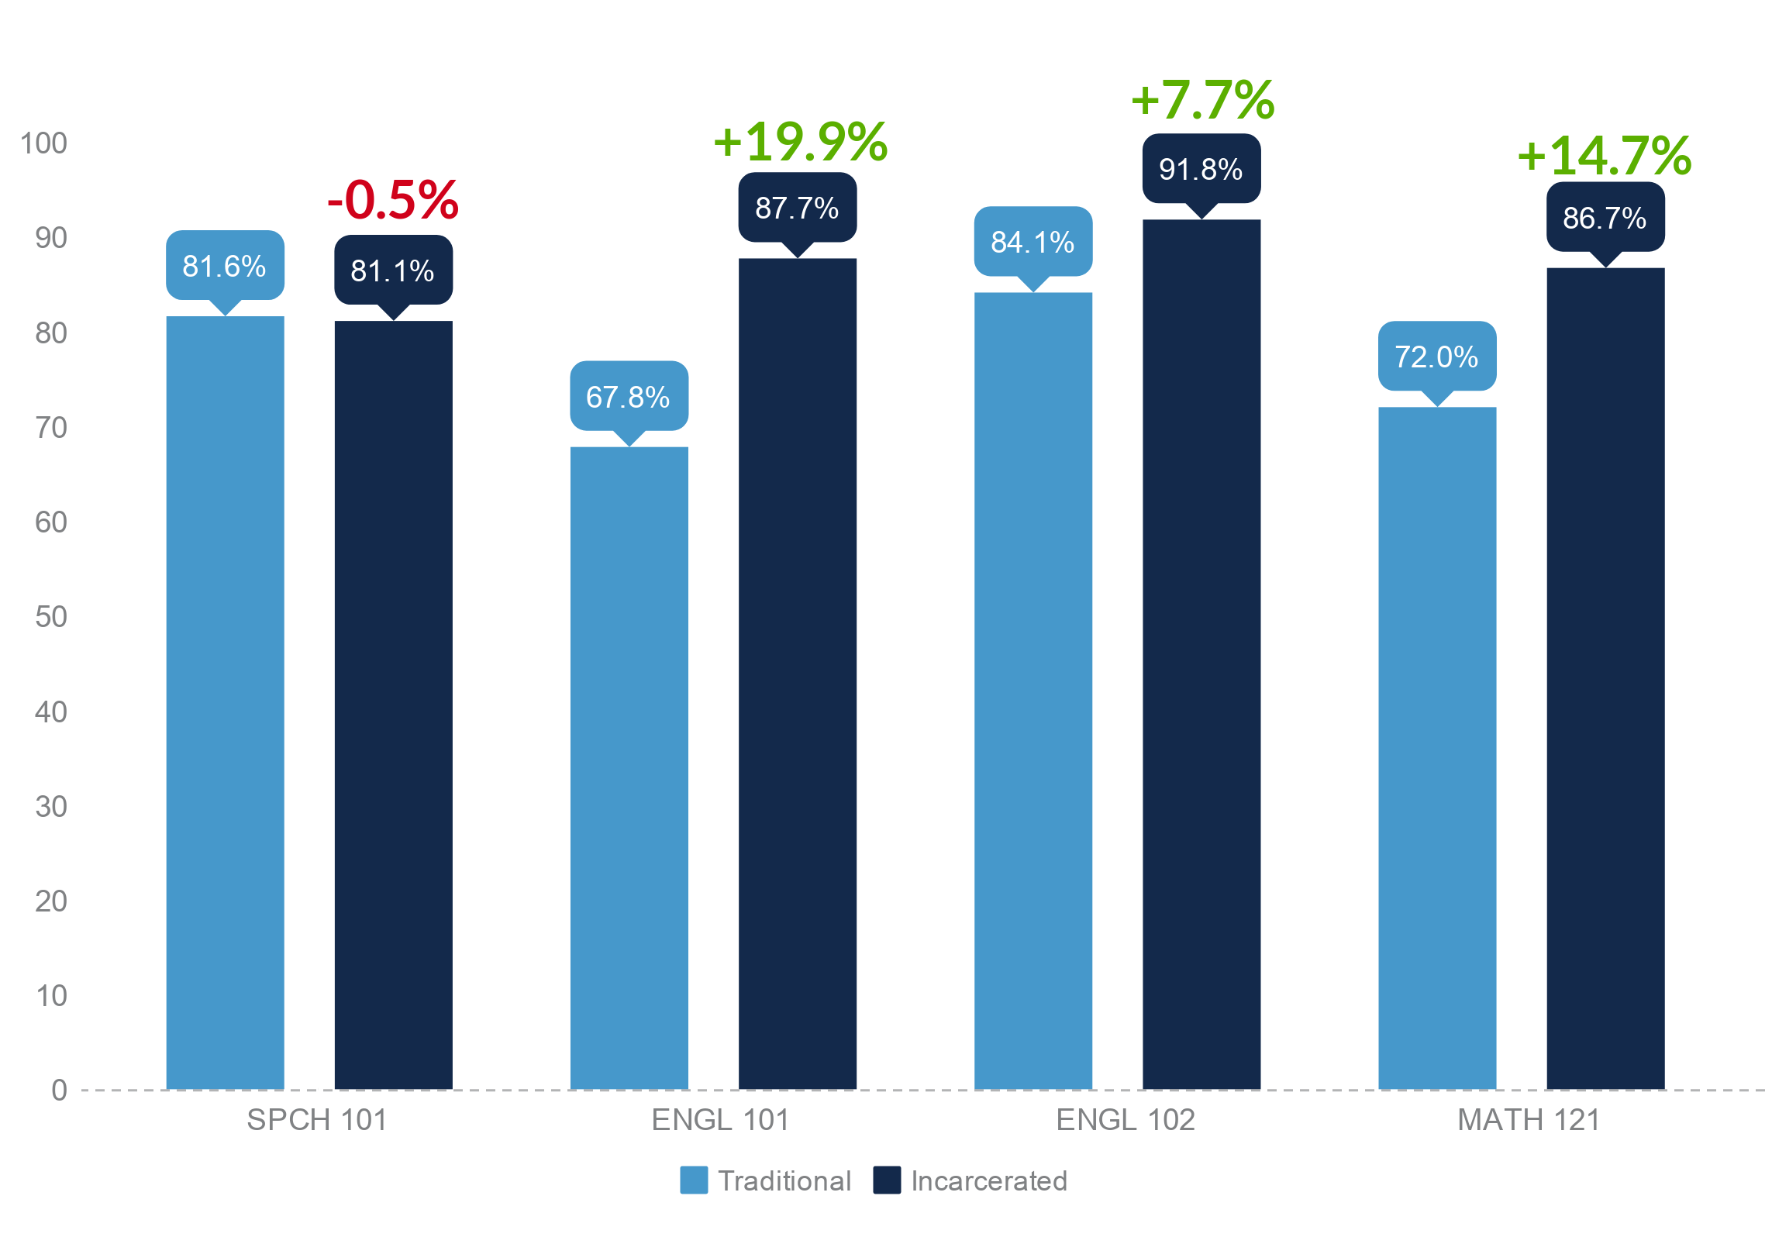
CSU Golden Four: Success Rate Comparison

Slide 28
Success Rate Comparison– By Course

Slide 29
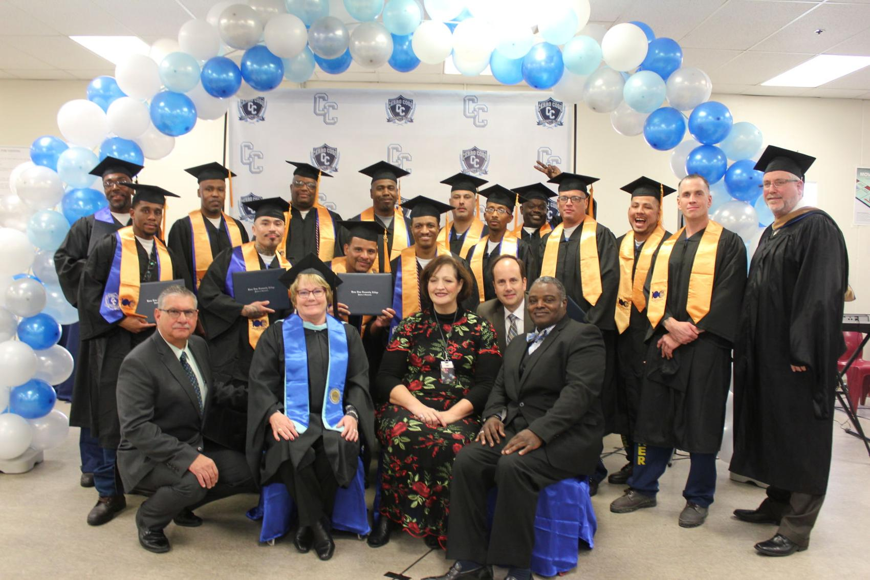
Student Voice
Second Graduating Class of 2018
CAC Student Quote: “The Cerro Coso Professors here at C.A.C. are exceptionally encouraging and inspirational...they convey a sincere passion and desire to see us succeed as students and as individuals who will re-enter every day society.”

Slide 30
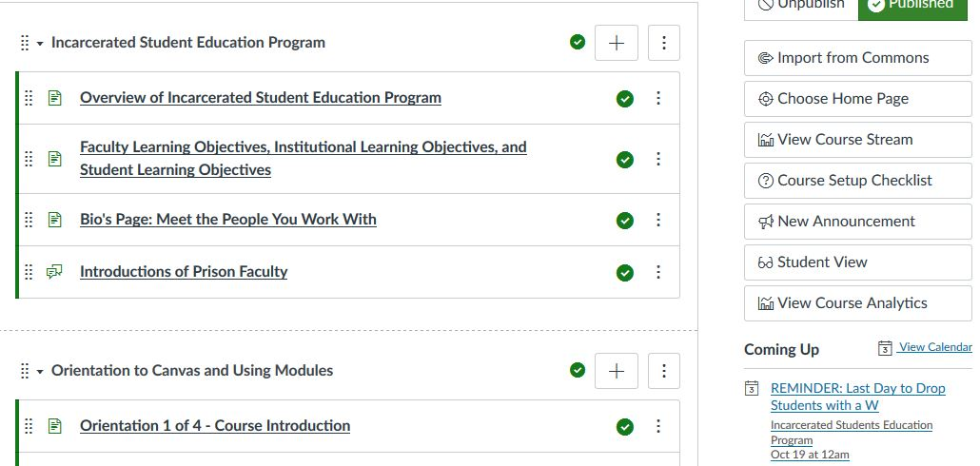
Continuing the Research and Taking Action
Continue to examine the metrics (i.e. ERS and other indicators, such as unit load [in handout now], GPAs, course-taking patterns, etc.)
Design and implement a mixed-methods study based-on Grounded Theory Approach
Faculty Needs Assessment Survey (Fall-2018)
Post PD evaluation
Observational Studies
Key Informant Interviews/ Focus Groups
Student Participatory Research
Grant Writing and 3rd Party Partners
Faculty online Professional Development and resource portal created as outcome of needs assessment.

Slide 31
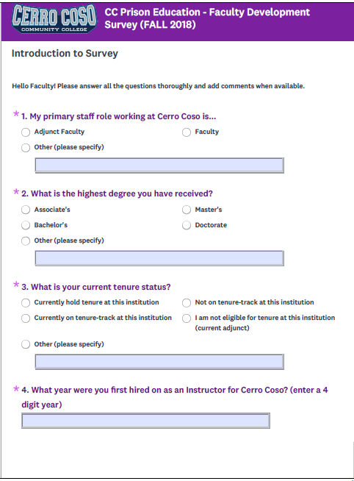
Faculty Needs Assessment Survey (Focus Areas)
Examined institutional perspective
Literature review to establish a quality set of questions beyond standard satisfaction based approach
Assessment of preparedness to instruct in the prison in many different ways (teaching experience, assessments, professional development, college resources, emotional and physical, etc.)
Teaching and learning Andragogy
Types of support and professional development

Slide 32
Preliminary Findings of Faculty Needs Assessment
29 Adjunct and 10 Full Time Faculty teaching in the Prisons (Fall 2018)
90% response on Survey
Years of experience is a better predictor of preparedness
Differences of perspective between genders of instructors
Positive teaching experiences
Learning has been achieved through informal modalities
Chancellor’s Office Innovation Award will now fund two full time faculty coordinators to create professional development, standard operating procedures and research and implement trauma informed practices for Andragogy and Programmatically.

Slide 33
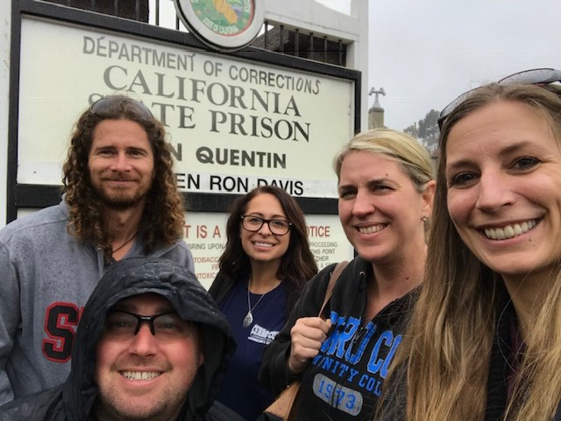
Next steps in research
Focus Groups
Working with NYU McSilver Institute of Social Work to determine levels of trauma experienced inside the facilities on Faculty and impacts to the student’s learning environment
Incarcerated Student Participatory Research (SPR-19)
Establishing Community-Based IRB
(Faculty and Administration actually having fun together at professional development!)

Slide 34
Call to Action
“If not us, then who? If not now, then when?”
-John Lewis (former freedom fighter)
www.Cerrocoso.edu/isep

