Slide 1
The Role of the ADA in Noncredit and Career Education
Donna Frankel, Foothill College
Manuel Velez, ASCCC South Representative
Dolores Davison, ASCCC President

Slide 2
Breakout Description
This breakout session is designed to review the reasoning for non- credit courses and career education following the guidelines in the Americans with Disabilities Act, and to demonstrate how to add these courses to your curriculum, whether in a separate division/ department or included in each division. We will discuss the benefits such a program has for disabled or differently abled students, the impact on the college community and the greater community We hope to inspire faculty with best practices in the preparation of these special needs students for the working world and connect them with those who are interested in hiring students who come out of our programs with skills and abilities that are desired in the workforce.

Slide 3
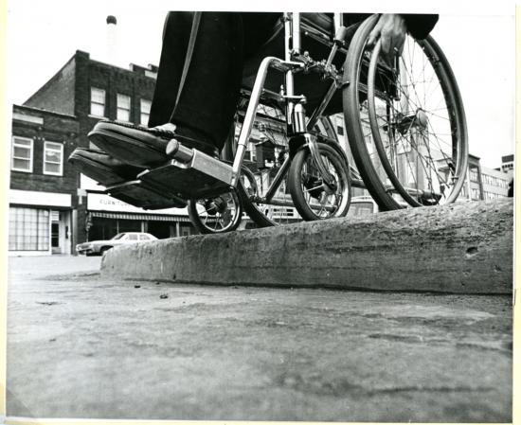
How is Kalamazoo, Michigan Integral to Accessibility?
Jack Fisher and Universal Design
Why Do These Matter?
Who Do They Serve?
What Lessons Can We Take from What Happened at Kalamazoo?

Slide 4
Why Should We Care About Accessibility?
It’s the law!
  Section 504 of the Federal Rehabilitation Act (1973)
  Section 508 of the Federal Rehabilitation Act (1973, amended 1998)
  Americans with Disabilities Act (1990)
  California Government Code §11135 (mirrors federal anti-discrimination statutes)
  Title 5 section 55200 (requires all online instruction to be compliant with ADA and Rehabilitation Act)
Accreditation
  DE instruction must be of comparable quality to face-to-face instruction

Slide 5
504 and 508 – What Do They Cover?
Section 504: "No otherwise qualified individual with a disability in the United States . . . shall, solely by reason of her or his disability, be excluded from the participation in, be denied the benefits of, or be subjected to discrimination under any program or activity receiving Federal financial assistance . . . .”
Section 508 requires federal agencies to develop, procure, maintain and use information and communications technology (ICT) that is accessible to people with disabilities - regardless of whether or not they work for the federal government.

Slide 6
Americans With Disabilities Act (ADA) and California Education Code
The Americans with Disabilities Act of 1990 or ADA (42 U.S.C. § 12101) is a civil rights law that prohibits discrimination based on disability.
No person in the State of California shall, on the basis of sex, race, color, religion, ancestry, national origin, ethnic group identification, age, mental disability, physical disability, medical condition, genetic information, marital status, or sexual orientation, be unlawfully denied full and equal access to the benefits of, or be unlawfully subjected to discrimination under, any program or activity that is conducted, operated, or administered by the state or by any state agency, is funded directly by the state, or receives any financial assistance from the state.

Slide 7
Identification of Students Who Are Eligible for Accommodations
More common in K-12 than in higher education
Testing and assessment done by specific offices at the college
Faculty cannot accept K-12 accessibility statements or documents
Faculty cannot ask students about what their disability is but can ask for clarification about what will work for students to meet their accommodations
DSPS recommendations are subject to law (ie, recordings)

Slide 8
Common Myths About Accessibility
I don’t have any blind students so I don’t have to use alt-text
I don’t have any deaf students so I don’t have to close caption
You Tube closed captioning is fine and doesn’t need to be checked
Screen readers skip over boring/difficult to understand things including urls
Software automatically makes things accessible
Faculty are not responsible for accessibility
Other myths that you have heard/are familiar with?

Slide 9
Accessibility Tends to Focus on Four Groups
students with vision impairment
students with hearing impairment
students with learning differences
students with mobility impairment
Is anyone missing? What else should we look at/for when considering accessibility?

Slide 10
Use of Universal Design in Providing Access
Multiple means of representation
Give students the same information through different formats (visual, auditory, or textual) to ensure that key information will be equally perceptible to all.
Multiple means of action and expression
Give students plenty of options for expressing what they know, and provide models, feedback, and supports for their different levels of proficiency.
Multiple means of engagement
What excites one student may bore another. Give students choices (working independently vs. working collaboratively, the sequence or timing of tasks, the level of challenge, etc.) to spark their interests and autonomy.

Slide 11
Resources
ASCCC PPTs and other materials
ASCCC OERI course on Accessibility Basics
Creation of Accessible Media Materials
Tutorials on Web Accessibility
Creating Accessible Documents

Slide 12
Thank You!
Questions? Contact us!
Info@asccc.org

