Slide 1
Counseling in an Online Environment Facilitators: LaTonya Parker, ASCCC Area D Representative Jackie Boboye, Counselor, International Students, Guidance Instructor
COUNSELING ZOOM WEBINARS:
APRIL 16, 2020 AT 1:00 PM
APRIL 23, 2020 3:00 PM

Slide 2
The Academic Senate for California Community Colleges is pleased to empower counseling faculty with an online platform to engage in dialogue/discussion around counseling in an online environment in the Zoom webinar format. Online counseling’s emergence and growth in California community colleges is directly related to the commonplace nature of the internet in the daily lives of students, social networking, electronic messaging video communication and posting documents. Today’s online services have increased in response to COVID-19.
Facilitators:
LaTonya Parker, ASCCC Area D Representative
Jackie Boboye, Chaffey College International Student Counselor

Slide 3
Today’s Discussion: The seminar will address international students experiences with the changes with the immigration rules due to the pandemic. The discussion will include online counseling support services, opportunities and challenges.
Engaging International Student in Online Counseling and Education

Slide 4
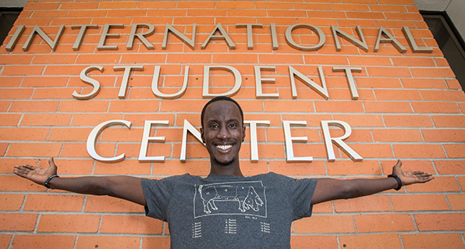
The International Student Center welcomes high school, transfer and new international students from all over the globe. The center offers a broad range of various support services to meet the unique needs of international students and personal assistance in adjusting to college life in the United States

Slide 5
The International Student Center Collaborations with Counseling
New student orientations information on topics such as “AOE” healthcare/medical insurance, transportation/travel, immigration, surrounding communities, host families, on-campus and off-campus employment, driver’s licenses, and social security
Educational Planning
Peer Mentoring workshops offered by International Student Counselor
Mixers to introduce international students to faculty, staff,
First semester “follow‐up” meetings to measure student success, connectedness with campus community and culture.
5

Slide 6
International Education Overview
F-1 Visa
International Students require F-1 visa to study in the United States.
International students enrolling in an academic program in the United States including the English language program
F-2 –Dependents
If the Department of State provides a student with an F or M student visa, it is for the purpose of studying in the United States.
M-1 Visa
An international student in the United States to proceed a full program of study at a recognized nonacademic institution or a technical program.
M-2--Dependents
6

Slide 7
Onboarding and Counseling Orientation
Entering the United States no more than 30 days before program of study starts.
Contact the designated school officer (DSO)
Attend International Student Orientation
Self Placement
Create education plan with a counselor
Receive registration date
Pay enrollment fees & Health Insurance
Submit proof of Tuberculosis (TB) test result or Take TB Test at Chaffey with the Student Health Services
Counseling CSEP
Technology
Cranium Café
Appointments
Remote Desk

Slide 8
Education & Fees
Estimated Cost for 1 Academic Year
Cost per unit $331
Tuition $7944
Health Insurance $804
Health Services Fee $34
Transportation Fee $18
Estimated
Books and Supplies $1000
Housing and Personal
Expenses $15,000
Total $24, 800
Form 1-20
Certificate of Eligibility for Nonimmigrant Student Status to study at a university or college.
Must take 12 units every semester.
Must pass all classes or speak with a counselor or DSO immediately
Unable to complete a program by the end listed on Form 1-20, requires possible program extension.

Slide 9
Challenges
Employment
Personal
Ineligible for financial aid/ work study
Difficult finding campus jobs
Funds (Loss of Business , Employment, Scholarship, etc).
Language Barriers
Homesick
Making new friends
Living condition
Online classes
Technology/Laptops Supplied
Disabilities (Referral, Student Empowerment, Advocacy)

Slide 10
Q & A Discussion
10

Slide 11
References
www.chaffey.edu/international/currstudents.shtml
www.https://studyinthestates.dhs.gov
www.USCIS.gov

Slide 12
THANK YOU
LaTonya Parker: latonya.parker@mvc.edu
Jackie Boboye: Jackie.Boboye@chaffey.edu
Email
Academic Senate for California Community Colleges: submit I inquiries to info@asccc.org

