Slide 1
Distance Education: Addendums, Guidelines, Faculty Preparation, Student Access, Etc.
Geoffrey Dyer, Taft College Robert L. Stewart Jr., ASCCC Area C Representative
July 10, 2020

Slide 2
DESCRIPTION
With a new focus on preparedness for remote delivery of instruction, colleges may need to expand or rethink the way they use and support distance education. Distance education encompasses any method of instruction where the student and faculty are separated by time and/or distance as specifically addressed in California Code of Regulations section 55200 through 55210. This breakout will provide an overview of the many forms distance education may take, guidance on communicating distance education participation expectations to students, requirements for faculty preparation, and methods for providing equitable experiences online.

Slide 3
Topics
Unprecedented Context
DE Addenda
Faculty Preparation
Types of DE Courses
DE Guidelines Update
Communicating Expectations to students
Providing Equitable Experiences Online
Correspondence Courses

Slide 4
Unprecedented Context
Many faculty provided remote instruction for the first time in spring and/or summer.
During spring 2020, CCCCO ES 20-06 stated "Colleges may need to waive local approval of instructors to teach online during emergencies."
However, on June 26, ES 20-26 states "These regulatory standards have not been temporarily suspended or waived due to the COVID-19 pandemic, and districts should continue to follow these requirements in addition to their local policies and collective bargaining agreements. For example, with respect to the selection and workload of faculty for distance education, title 5, section 55208 requires that faculty be prepared to teach distance education and outlines the faculty selection and student assignment processes."
ES 20-21 requires "a plan for ongoing professional development for faculty and staff for converting to online instruction."

Slide 5
Unprecedented Context
Many courses were offered for the first time in spring and/or summer.
Title 5 DE regulations must be followed, though many courses noted in blanket DE addenda may not yet have local approval.
Local approval of separate DE addendum required for DE courses (5 CCR § 55206)
ES 20-21 requires "a plan for obtaining local approval for all courses included in the submitted addendum by December 30, 2020."

Slide 6
DE Blanket Approvals (to CCCCO)
ES 20-21: Required submission of temporary, emergency DE addendum for fall term by July 1
Requires plans for local approval and PD
MIS definitions do not have to be changed
Districts still required to report programs with >50% DE to ACCJC
ES 20-22: Submit blanket addendum request for correspondence courses for incarcerated students by August 1.
MIS definitions do not have to be changed

Slide 7
Why do DE courses need separate approval, and what should it encompass?
§ 55206. Separate Course Approval.
If any portion of the instruction in a new or existing course is to be provided through distance education, an addendum to the official course outline of record shall be required. In addition to addressing how course outcomes will be achieved in a distance education mode, the addendum shall at a minimum specify how the portion of instruction delivered via distance education meets:
(a) Regular and effective contact between instructors and students and among students as referenced in title 5, section 55204(a), and
(b) Requirements of the Americans with Disabilities Act (42 U.S.C. § 12100 et seq.) and section 508 of the Rehabilitation Act of 1973, as amended, (29 U.S.C. § 749d)
The addendum shall be separately approved according to the district's adopted curriculum approval procedures.

Slide 8
Regular and effective contact
§ 55204. Instructor Contact.
In addition to the requirements of section 55002 and any locally established requirements applicable to all courses, district governing boards shall ensure that:
(a) Any portion of a course conducted through distance education includes regular effective contact between instructor and students, and among students, either synchronously or asynchronously, through group or individual meetings, orientation and review sessions, supplemental seminar or study sessions, field trips, library workshops, telephone contact, voice mail, e-mail, or other activities. Regular effective contact is an academic and professional matter pursuant to sections 53200 et seq.

Slide 9
Why is preparation required to teach online?
§ 55208. Faculty Selection and Workload.
(a) Instructors of course sections delivered via distance education technology shall be selected by the same procedures used to determine all instructional assignments. Instructors shall possess the minimum qualifications for the discipline into which the course's subject matter most appropriately falls, in accordance with article 2 (commencing with section 53410) of subchapter 4 of chapter 4, and with the list of discipline definitions and requirements adopted by the Board of Governors to implement that article, as such list may be amended from time to time.
(b) Instructors of distance education shall be prepared to teach in a distance education delivery method consistent with local district policies and negotiated agreements.

Slide 10
Faculty Preparation for DE
May already be agreed upon or contractual
Summer, flex, or virtual trainings needed to prepare faculty
Resources available from @one,
What PD is your district offering? How has your local academic senate been involved?

Slide 11
Types of Remote Instruction

Slide 12
Distance Education Definition (5 CCR § 55200)
§ 55200. Definition and Application.
Distance education means instruction in which the instructor and student are separated by time and/or distance and interact through the assistance of technology. All distance education is subject to the general requirements of this chapter as well as the specific requirements of this article. In addition, instruction provided as distance education is subject to the requirements of the Americans with Disabilities Act (42 U.S.C. § 12100 et seq.) and section 508 of the Rehabilitation Act of 1973, as amended (29 U.S.C. § 794d).

Slide 13
Types of DE
Fully online
Partially online (hybrid)
Fully online with flexible in-person component
DE Guidelines to field on-hold
Asynchronous online
Synchronous online
All require separate review/approval of DE addenda and preparation for faculty

Slide 14
Emergency, Temporary Online (local)
Some districts have adopted a local, temporary, emergency-only designation for online courses which they do not offer online typically
Strictly a local decision/designation
Local approval of DE addenda still required for these courses

Slide 15
Correspondence education
"Correspondence" stricken from definition of DE in Title 5 52000 in 2019 update.
Federal definitions of DE and correspondence (34 CFR 200.6):
Correspondence course: (1) A course provided by an institution under which the institution provides instructional materials, by mail or electronic transmission, including examinations on the materials, to students who are separated from the instructor. Interaction between the instructor and student is limited, is not regular and substantive, and is primarily initiated by the student. Correspondence courses are typically self-paced.
Distance education means education that uses one or more of the technologies listed in paragraphs (1) through (4) of this definition to deliver instruction to students who are separated from the instructor and to support regular and substantive interaction between the students and the instructor, either synchronously or asynchronously. . .
Title 5 §§ 58009 and 58003.1 updated May 18, 2020 to clarify that correspondence courses are eligible for apportionment

Slide 16
Equity Consideration
Synchronous
Asynchronous
Mirrors the face-to-face experience
Allows for real-time questions
Students have to log-in at designated time, even if sheltered-in-place with large family and limited devices/resources
Content is created in advance
Real-time questions can still be answered during office hours;
Provides students more opportunities to engage at their own pace

Slide 17
DE GUIDELINES UPDATE

Slide 18
DE Guidelines
Distance Education and Educational Technology Advisory Committee spent over one year developing recommended guidelines
Proposed definitions for types of DE courses endorsed via ASCCC Resolution 9.06 S19
DEETAC recommended guidelines to CO in January
Chancellor's Office has reviewed and asked for changes
Students still need to know if online classes have in-person requirements or synchronous requirements before enrolling

Slide 19
COMMUNICATING EXPECTATIONS TO STUDENTS

Slide 20
Students need to know . . .
If course is actually hybrid
If course has in-person, place-certain assessments or activities that cannot be completed from home
If the course is synchronous and requires them to log on at certain times
. . . before they enroll

Slide 21
Students need to know . . .
Technology requirements (browser, how to access Canvas, if Zoom is needed)
How to remotely secure texts in advance of course
If special materials are also needed
How to reach the professor
How to access virtual tutoring and support services
Course requirements

Slide 22
Providing EQUITABLE ONLINE EXPERIENCES

Slide 23
Students have limited devices and space
Students have limited resources, devices, and space to learn from home
Students share space with others
Synchronous delivery may be impossible for some
Jill Toyoshiba

Slide 24
OER Increase Access to Content
OER enable students to have access to materials before first day and save costs
ASCCC OER Resources: https://asccc-oeri.org/

Slide 25
@ONE
Equity and Culturally Responsive Teaching Courses

Slide 26
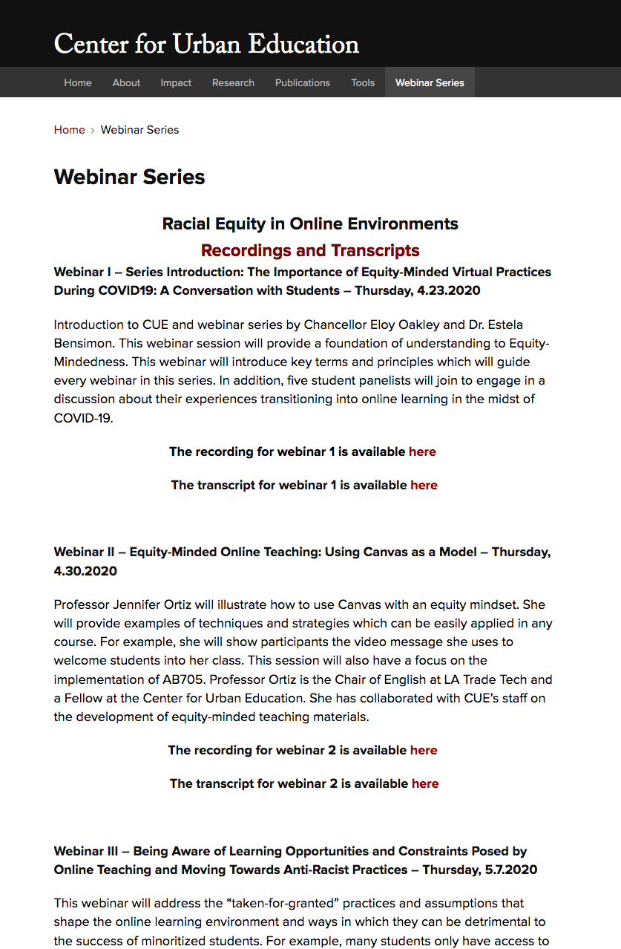
Archived Center for Urban Excellence Webinars on Racial Equity in Online Environments:
https://cue.usc.edu/events/

Slide 27
Putting it all together . . .
Local approval of DE addenda by December 30, 2020
Meets course outcomes
Regular and Effective Contact
Accessible
PD Might Focus on:
Equity-minded practices for online learning
Canvas basics
OER

Slide 28
Next steps in your district?

Slide 29
Questions?
Thank You!
Geoffrey Dyer gdyer@taftcollege.edu
Robert L. Stewart Jr. stewarrl@lasc.edu

