Slide 1
LGBTQIA+ @ MiraCosta
Steven Deineh, Librarian
sdeineh@miracosta.edu
Chair, LGBTQIA+ Caucus (ASCCC)

Slide 2
LGBTQIA+
Lesbian
Gay
Bisexual
Transgender
Queer / Questioning
Intersex
Asexual
+ = Non-binary, Gender Non-conforming, Genderqueer, and more!
“Catchall” options – queer or sexual minorities

Slide 3
Causes For Concern
Rejection by family, peers, church, community
Bullying in school leads to:
Dropping out, lower rates of persistence & graduation
Increased rates of:
Anxiety and depression
Self harm and suicide
Substance use disorders
Homelessness
Compounded & multiplied stress for members of multiple groups (e.g., African American and gay, Latina and lesbian, veteran and transgender, etc.)
Notes:
“Study after study shows LGBT Americans suffer from mental health disorders at rates far exceeding heterosexual people — depression strikes gay men at six times the rate of straight men; nearly half of transgender people encounter symptoms of anxiety and depression; lesbians and bisexual women also deal with higher rates of mental health struggles than their straight sisters, with bisexual women faring even worse than lesbians. LGB youth are four times more likely, and questioning youth three times more likely, to attempt suicide as their straight peers; 41 percent of transgender people have attempted to end their lives.” Broverman, 2016 - http://www.advocate.com/health/2016/3/18/how-our-intolerant-society-contributes-lgbt-mental-disorders. ****More People of Color identify as LGBT than Whites (Gallup, 2012), and twice as many Trans* people identify as veterans than the general population - Mother Jones article (“In a recent survey (PDF) by the Harvard Kennedy School's LGBTQ Policy Journal, 20 percent of transgender people contacted said they had served in the military—that's twice the rate of the general population. ”******

Slide 4
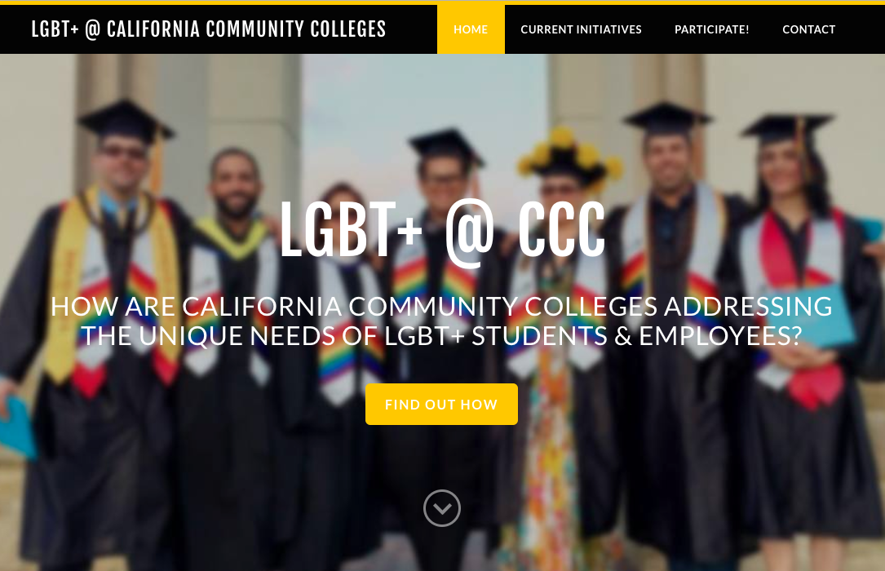
ccclgbt.org

Slide 5
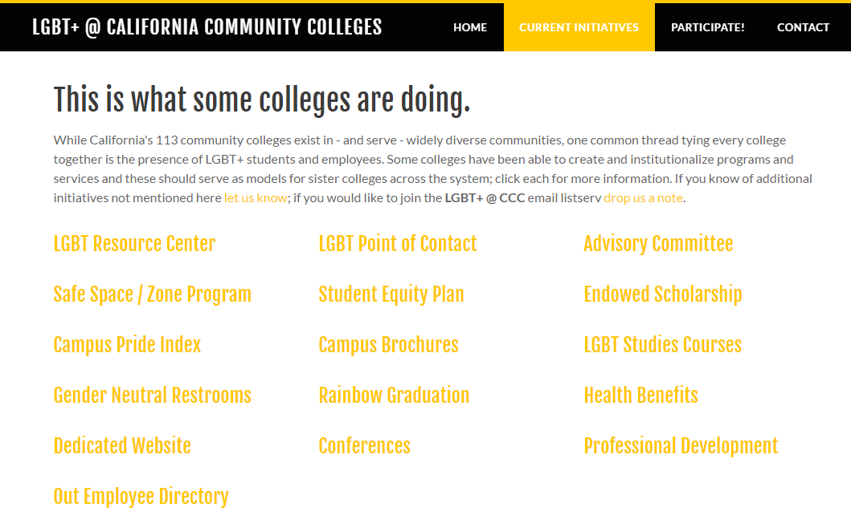
ccclgbt.org

Slide 6
Give Us The Data!
Chancellor’s Office has collected sexual orientation and gender identity via CCCApply since 2013.
This data is not being shared with CCCs despite California Education Code Section 66027 requesting it and ASCCC resolution 07.01 (FA15) calling for its dissemination
Education Code also requests designation of Point of Contact for needs of LGBT students & employees and requests assessment of quality of life for LGBT students and employees.
In the meantime we hope to generate data locally and use national data.

Slide 7
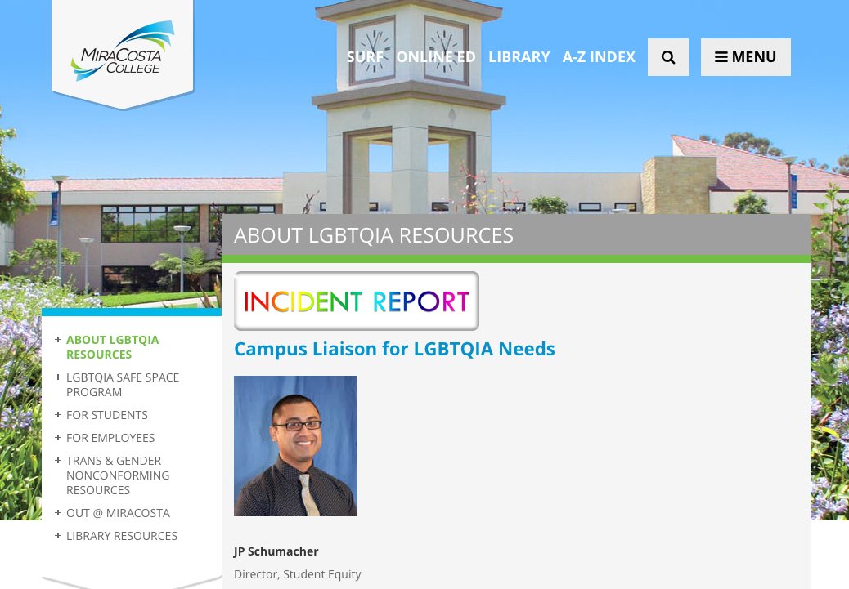
miracosta.edu/lgbt

Slide 8
LGBTQIA+ @ MiraCosta College
Dedicated website – miracosta.edu/lgbt
Robust Safe Space training program
online directory, office decal, colorful lapel pins
LGBT Point of Contact since 2013
Inclusion in 2014, 2015-2018 Student Equity Plan
3 LGBTQIA+ Student Scholarship Endowments
Tri-fold campus brochure
Rainbow graduation stoles
LGBT Studies (SOC 140) begins Fall 2017

Slide 9
LGBTQIA+ @ MiraCosta College
New library database subscriptions
LGBT Life with Full Text (EBSCOhost)
GenderWatch (ProQuest)
Included in professional development workshops teaching Cultural Competency
Completed Campus Pride Index Re-signed single user restrooms; location and hours listed on our LGBT website
OUT @ MiraCosta employee page
March 17 districtwide notice affirming transgender rights after Trump rescinded Obama’s 2016 “Dear Colleague” letter recommendations

Slide 10
To Do @ MiraCosta
LGBTQIA+ Resource Center / Pride Center
Human Resources is adding sexual orientation & gender identity to job applications
Dedicated and ongoing (institutional) district resources for LGBTQIA+ initiatives, programs
Create LGBTQIA+ academic cohort / learning community
LGBTQIA+ Student Services Specialist position
Notes:
LGBTQIA+ Resource Centers (aka Pride Centers) are standard at UCs and many CSUs. 4 community colleges have them (Los Medanos, Sierra, Palomar, City College of San Francisco)

Slide 11
Thank you!
Steven Deineh, Librarian
sdeineh@miracosta.edu
Chair, LGBTQIA+ Caucus (ASCCC)

