Slide 1
Integrating Guided Pathways to Institutional Structures
ASCCC Guided Pathways Taskforce
October 20, 2020

Slide 2
Housekeeping
Format: presentations, then Q&A
Please keep microphones muted!
Questions will be asked using the chat function.
Host / Moderator (Erik Shearer) will read questions for the presenters and facilitate follow-up.
Post-presentation follow-up questions or comments for the ASCCC? info@asccc.org

Slide 3
Session Description
The GP funding cycle is nearing an end. All the funds must be spent by June 2022. How can we integrate these efforts and sustain the redesign? How do we integrate all of our initiatives (SSSP, Equity, GPS, etc.) so that we are working toward a common goal of student success? How are campuses working together toward common goals and how are classrooms changing, innovating, etc as part of that model? How do we leverage institutional structures to reach and support our students going forward?

Slide 4
Session
Introduction
Long-term sustainability of Guided Pathways reforms will require thoughtful integration into institutional structures.
Now is the time to start on integration plans; funding comes to an end soon.
Key areas to consider:
  Sustaining role of student voice / input
  Hand-off to committees and other standing groups
  Changes to governance bodies and committees
  Institutional Planning: Annual, Educational and other Master Plans, Program Review, etc.
  Locating ongoing oversight with structures that provide appropriately high-level, holistic perspective on the institution
  Ongoing funding sources / budgets for anything currently funded through GP
  Continuing efforts to "de-silo" work
  Integration with Equity
Sustaining a Focus on Students

Slide 5
In Today's Presentation
A look at two examples of work on long-term integration efforts.
  Mt San Antonio College
  College of the Sequoias

Slide 6
College Example – Mt.SAC
How can we integrate these efforts and sustain the redesign?
Understanding what the efforts look like and how to recognize where they are taking place
Planning strategically
  Annual goal setting and accomplishment reporting
  Unit, division and college planning cycles
  Budgeting and strategic plans
Evaluating effectively
  Outcomes
  Programs
  Scorecards
  Accreditation

Slide 7
Integration:
How do we integrate all our initiatives
(SSSP, Equity,
GPS, etc.) so that we are working toward a common goal of student success?
INCLUSION SUMMIT 2019
  Placement, Accessibility, and Meeting our Students’ Needs Through the Equity Lens (AB 705 and Developmental Education)
  Academic Support Services Through the Equity Lens
  GPS Through the Equity Lens

Slide 8
Initiatives:
How do we integrate all our initiatives
(SSSP, Equity,
GPS, etc.) so that we are working toward a common goal of student success?
EQUITY SUMMIT 2020
  How do we move the needle on equity?
  Equity requires anti-racism work
  Qualitative & quantitative data w/ student surveys
  Data into action – Title V grant, Early Alert, fostering and sustaining inclusiveness in the classroom. Equity and Sustainability

Slide 9
Common Goals:
How are campuses working together toward common goals and how are classrooms changing, innovating, etc as part of that model?
The Community of Practice (COP) in English, American Language (AmLa), and mathematics provide professional development to prepare faculty to address engagement, critical thinking, growth mindset, etc. coinciding with the implementation of multiple measures and guided self-placement.

Slide 10
Classroom Innovations:
How are campuses working together toward common goals and how are classrooms changing, innovating, etc as part of that model?
Teaching from the Back of the Room equity-based training provides professional development for presenters to create more engaging and interactive teaching practices.
Created Reimagining the Student Experience (RISE) for faculty seeking funding from Guided Pathways to fund student-centered projects for their discipline.

Slide 11
RISE:
How are campuses working together toward common goals and how are classrooms changing, innovating, etc as part of that model?
Created Reimagining the Student Experience (RISE)
https://www.mtsac.edu/gps/rise.html

Slide 12
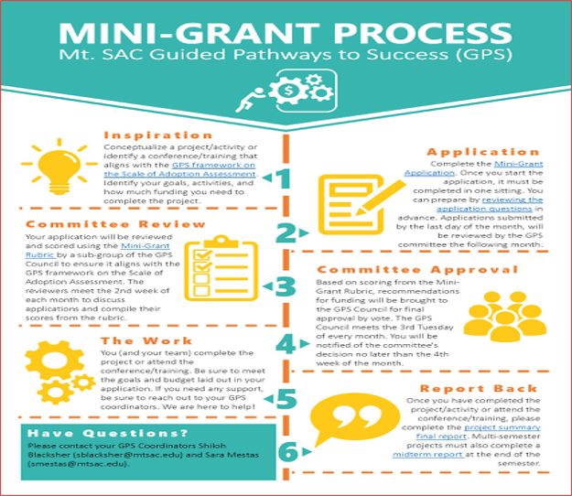
Mt. SAC Mini-Grants:
How are campuses working together toward common goals and how are classrooms changing, innovating, etc as part of that model?

Slide 13
Institutional Structures:
How do we leverage institutional structures to reach and support our students going forward?
Onboard student: The Student Success Collaborative is a partnership of more than 550 colleges and universities working together to improve student outcomes and the student experience. Partners of the Collaborative use EAB’s Student Success Management System, Navigate, a comprehensive technology that brings together administrators, faculty, advisors, and staff to support students from enrollment to graduation and beyond.

Slide 14
Pilot Data:
How do we leverage institutional structures to reach and support our students going forward?
Fall Pilot Campaign numbers October 2020
First 2 weeks of September - Sent to all faculty participating in the pilot resulting in 750 evaluations.
68 alerts raised on 50 unique students.
18 cases overall were created. The other 50 did not generate a case.
Of the 18 cases, 4 are still open with 14 cases closed.
Of the 14 closed cases 1 was basic needs 1 was financial aid 4 were general counseling issues and 8 were academic tutoring concerns.

Slide 15
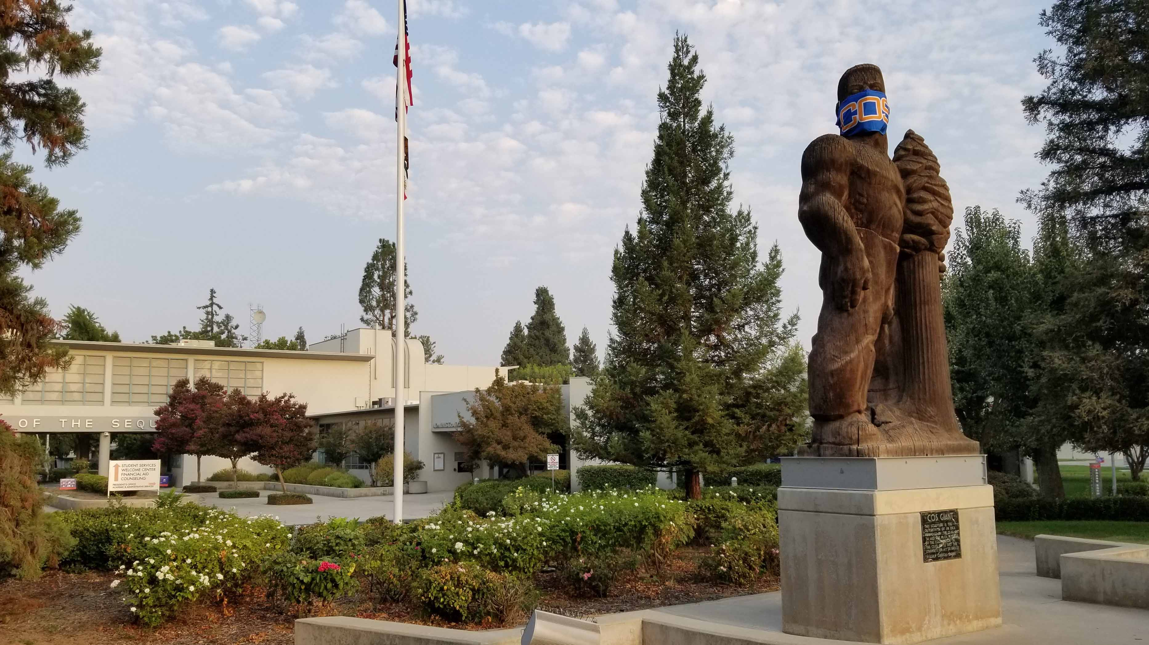
College Example: College of the Sequoias

Slide 16
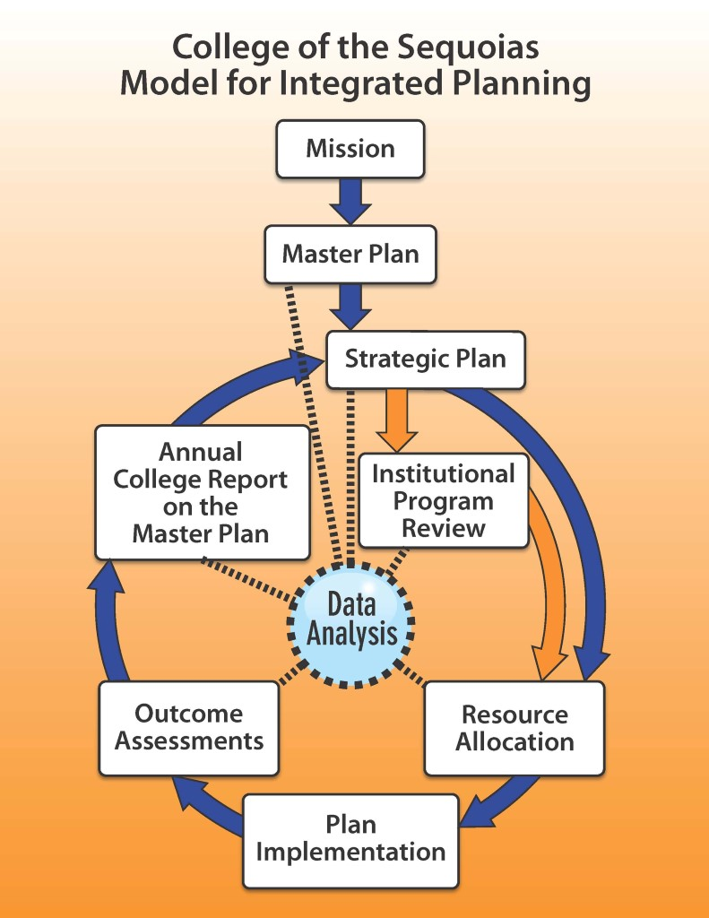
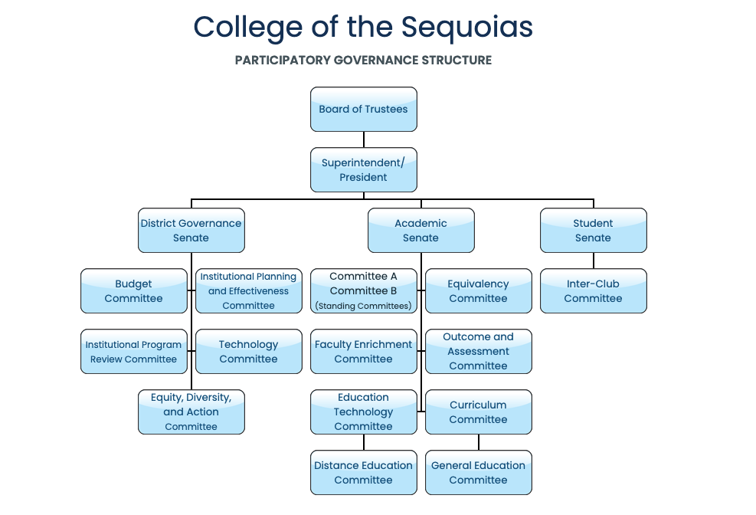
Planning and Governance

Slide 17
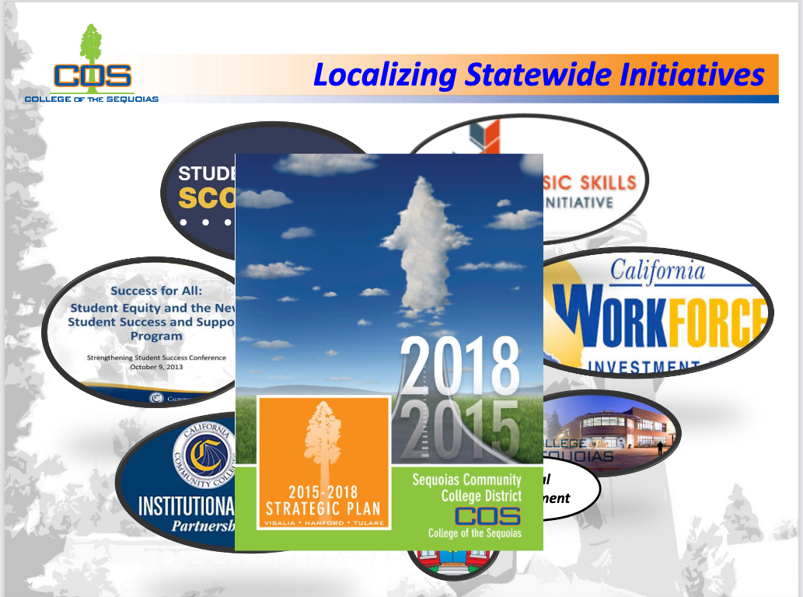
Integrating Initiatives: Planning
Some initiatives referenced in COS Strategic Plans:
  Strong Workforce
  Vision for Success
  Student Centered Funding Formula
  Basic Skills/ AB705

Slide 18
Integrating Initiatives: Planning (cont.)
Pathways as an umbrella – other initiatives fit within it!
GP Taskforce charged with reporting and budget only
Strategic plan initiatives and actions mapped to pathways key elements
Pathways work assigned via strategic plan responsible parties

Slide 19
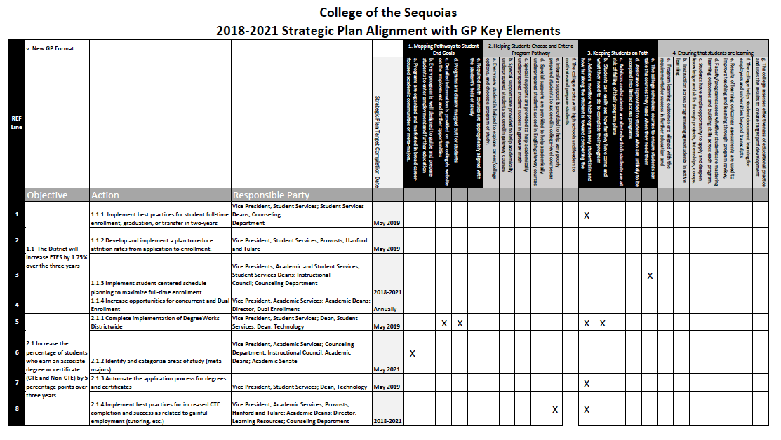
Sustaining Our Work: Governance

Slide 20
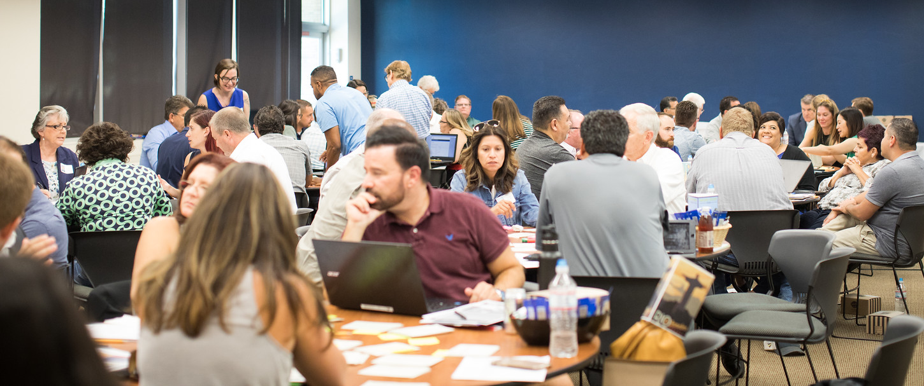
Sustaining Our Work: Governance (cont.)
Meta-Majors creation integrated into Strategic Plan as an action to support student success
Action assigned to multiple parties, including Academic Senate
Academic Senate convened a taskforce charged with creating initial Meta Majors draft
Taskforce work reported-out through annual report on Master Plan
Following draft creation and approval, ongoing support and updates to be covered in Curriculum Committee
Draft action complete - new strategic plan actions for next cycle

Slide 21
Building and Sustaining Campus Culture
Some possible sites for review:
  Planning: What are the ongoing sites for planning? Consider Master planning, Strategic planning, program review, committee charges and initiatives, others?
  Reporting: How is ongoing work assessed and reported? How is it communicated to the campus?
  Governance: What are the current sites of pathways work? Where are your champions, and how can their work be highlighted and institutionalized?

Slide 22
Q & A
Thank you for joining us today!
Erik Shearer, Napa Valley College
  Erik.Shearer@napavalley.edu
Lance Heard, Mt. San Antonio College
  lheard@mtsac.edu
Sarah Harris, College of the Sequoias
  sarahha@cos.edu

