Slide 2
Housekeeping for Today’s Presentation
Format: presentations, then Q&A
Questions will be asked using the chat function.
Host / Moderator (Erik Shearer) will read questions for the presenters and facilitate follow-up.
Post-presentation follow-up questions or comments for the ASCCC? info@asccc.org

Slide 3
Guided Pathways and DEI Work

Slide 4
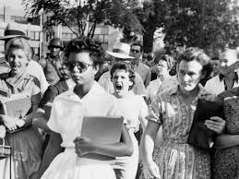
DEI Glossary of Terms: Diversity
The myriad of ways in which people differ, including the psychological, physical, cognitive, and social differences that occur among all individuals, such as race, ethnicity, nationality, socioeconomic status, religion, economic class, education, age, gender, sexual orientation, marital status, mental and physical ability, and learning styles. Diversity is all inclusive and supportive of the proposition that everyone and every group should be valued. It is about understanding these differences and moving beyond simple tolerance to embracing and celebrating the rich dimensions of our differences.
***adopted by the system as working definitions of DEI Terms
Notes:
https://www.cccco.edu/-/media/CCCCO-Website/Files/Communications/vision-for-success/8-dei-glossary-of-terms.pdf?la=en&hash=21FCA99EAE353E6F481025115DC98272EAA36BA9

Slide 5
DEI Glossary of Terms: Equity
The condition under which individuals are provided the resources they need to have access to the same opportunities, as the general population. Equity accounts for systematic inequalities, meaning the distribution of resources provides more for those who need it most. Conversely equality indicates uniformity where everything is evenly distributed among people.
***adopted by the system as working definitions of DEI Terms
Notes:
https://www.cccco.edu/-/media/CCCCO-Website/Files/Communications/vision-for-success/8-dei-glossary-of-terms.pdf?la=en&hash=21FCA99EAE353E6F481025115DC98272EAA36BA9

Slide 6
DEI Glossary of Terms: Anti-racism
A powerful collection of antiracist policies that lead to racial equity and are substantiated by antiracist ideas. Practicing antiracism requires constantly identifying, challenging, and upending existing racist policies to replace them with antiracist policies that foster equity between racial groups.
***adopted by the system as working definitions of DEI Terms
Notes:
https://www.cccco.edu/-/media/CCCCO-Website/Files/Communications/vision-for-success/8-dei-glossary-of-terms.pdf?la=en&hash=21FCA99EAE353E6F481025115DC98272EAA36BA9

Slide 7
DEI Glossary of Terms: Anti-Racist
Person who actively opposes racism and the unfair treatment of people who belong to other races. They recognize that all racial groups are equal (i.e. nothing inherently superior or inferior about specific racial groups) and that racist policies have caused racial inequities. They also understand that racism is pervasive and has been embedded into all societal structures. An anti-racist challenges the values, structures, policies, and behaviors that perpetuate systemic racism, and they are also willing to admit the times in which they have been racist. Persons are either anti-racist or racist. Persons that say they are ‘not a racist’ are in denial of the inequities and racial problems that exist.
***adopted by the system as working definitions of DEI Terms
Notes:
https://www.cccco.edu/-/media/CCCCO-Website/Files/Communications/vision-for-success/8-dei-glossary-of-terms.pdf?la=en&hash=21FCA99EAE353E6F481025115DC98272EAA36BA9

Slide 8
Student Success
Equity and Diversity
Operational Efficiencies
Facilities
June 11, 2020 Board Resolution: Commitment to Racial Justice and Equity
Our system reflects the biases of its time of construction. How old is your college?
Notes:
Emphasize that one mechanism implemented by the legislature and adopted by the system to address these goals is Guided Pathways.
Emphasize goal #5 re: closing equity gaps

Slide 9
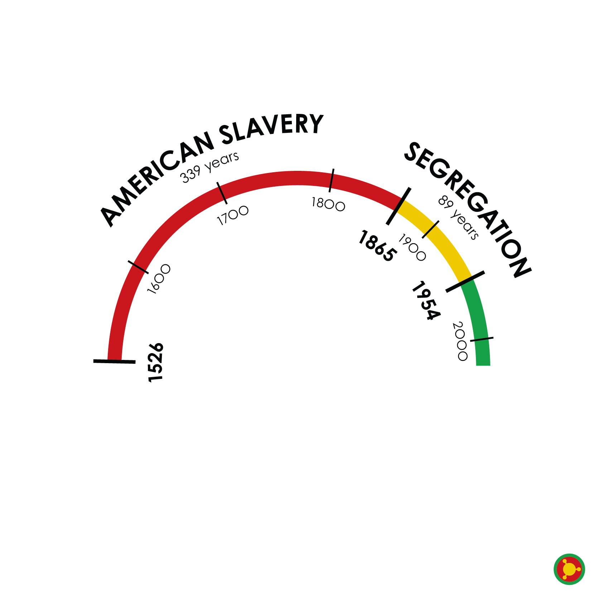
This work, both DEI work and Guided Pathways implementation, calls for transforming our system(s) to better reflect the mission and values of today through the lens of serving today’s students

Slide 10
Call for Action from the Academic Senate for California Community Colleges – state level faculty values and imperatives
Make agendas that include anti-racism/no-hate education.
1
Acknowledge the college houses the biases and prejudices of its founding time.
3
Redesign the evaluation of hiring and evaluation processes.
4
Request services from the ASCCC about any of these topics here.
5
Find the voices among your faculty missing in governance.
6
Create constructive ways students can express themselves.
7
Prioritize culturally responsive curricular redesign.
2
Notes:
http://createsend.com/t/y-406A779B3CC74AB2

Slide 11
One example of local resolutions: SBVC Resolution SU20.01
Resolved, That the SBVC Academic Senate will actively infuse the anti-racism/no- hate education by:
Integrating an accurate portrayal of the roles and contributions of all groups throughout history across curricula, particularly groups that have been underrepresented historically,
Identifying how bias, stereotyping, and discrimination have limited the roles and contributions of individuals and groups and how these limitations have challenged and continue to challenge our society,
Encouraging all members of the educational community to regularly examine assumptions and prejudices, including but not limited to racism, sexism, and homophobia, that might limit the opportunities and growth of students and employees,
Coordinating with organizations and concerned agencies which promote the contributions, heritage, culture, history, and health and care needs of diverse population groups, and
Promoting a safe and inclusive environment for all;

Slide 12
CCC Student Population Is More Diverse Than Any Employee Types
Notes:
INQUIRY AND UNPACKED WHAT IT COULD MEAN TO STUDENT SUCCESS

Slide 13
Student Success
Student Success is the heart of what drives guided pathways implementation at our colleges
Students are more successful when the faculty in shared governance institutions are more diverse

Slide 14
Student Success through DEI-Focused Change
Policies, procedures, and behaviors must be designed to cultivate an inclusive ecosystem focused on equity and mutual respect in order to recruit, retain and support a diverse workforce that is continually responsive to the needs of a diverse student population
The system DEI Integration Plan includes proposed recruitment, retention, and support strategies to be adopted at the system and local level within 1-5 years
These strategies and the related activities fall into three categories:
Institutional strategies driven by policy changes.
Interactional strategies driven by changes to existing procedures.
Individual strategies driven by activities that promote supportive and inclusive behaviors

Slide 15
What is your college doing? What are you doing?
Click the link in the chat to access a Google doc and provide input on the following three questions:
What institutional policy change has your college been discussing or would you like to see discussed to integrate diversity, equity, and inclusion?
Where have you seen or would like to see procedures change at your institution to integrate diversity, equity and inclusion?
What activities have you or can you personally participate in at your institution to promote supportive and inclusive behaviors towards diverse students and co-workers?
We’ll follow-up with discussion in response to your input.

Slide 16
Resources
Considerations for Measuring the 2nd Minimum Qualification Goggle document
https://docs.google.com/document/d/1pY0bneUXea6Dqrsy41c_iYyju1N2Hq5z2wf9mI1LI3M/edit
ASCCC Model Hiring Principles and Procedure (June 2020)
https://ccconlineed.instructure.com/courses/5733
Notes:
https://docs.google.com/document/d/1pY0bneUXea6Dqrsy41c_iYyju1N2Hq5z2wf9mI1LI3M/edit
https://ccconlineed.instructure.com/courses/5733

Slide 17
Other Resources
Academic Senate for California Community Colleges. A Re-examination of Faculty Hiring Processes and Procedures. ASCCC. Spring 2018
Dyer, Geoffrey and Michelle Velasquez Bean. "Measuring the Second Minimum Qualification: Considerations for Exceeding Mere Compliance." Rostrum. ASCCC. Oct. 2019
Lara, Luke. "Equitizing Merit and Fit: Establishing a Baseline Understanding." Rostrum. ASCCC. Feb. 2020
Stanskas, John, Michelle Velasquez Bean, and Luke Lara. "Refocusing on Student Success through Faculty Hiring: The Second Minimum Qualification as an Equity Framework." ASCCC Fall 2019 Plenary Session. Nov. 8 2019
Stanskas, John and Krystinne Mica. "Diversifying Leadership in the Faculty Ranks." Rostrum. ASCCC. Apr. 2019
Chancellor’s Office Vision Resource Center

Slide 18
Thank you!

