Slide 1

Regional Advisory Communities
Inland Empire/Desert Region
Funded by the IEDRC Region Strong Workforce Program
May 13, 2022

Slide 2

The Design:
Regional Advisory Communities
Link Industry to Education through Participation in the Development of and/or the Improvement of Curriculum
www.DesertColleges.org

Slide 3
The Design:
Regional Advisory Communities
Link Industry to Education through Participation in the Development of and/or the Improvement of Curriculum
Facilitate to allow Industry to LEAD
Create a Continuing Community
Support with Industry Organizations
Solicit and Provide Feedback
www.DesertColleges.org

Slide 4
The Design:
Regional Advisory Communities
Link Industry to Education through Participation in the Development of and/or the Improvement of Curriculum
Facilitate to allow Industry to LEAD
  Educators are Spectators
  Curriculum reviewed in Advance
www.DesertColleges.org

Slide 5
The Design:
Regional Advisory Communities
Link Industry to Education through Participation in the Development of and/or the Improvement of Curriculum
Create a Continuing Community
  Build On New relationships
  Maintain/Strengthen Industry Involvement
  Seek new opportunities/Invite new partners
www.DesertColleges.org

Slide 6
The Design:
Regional Advisory Communities
Link Industry to Education through Participation in the Development of and/or the Improvement of Curriculum
Support from Industry Organizations
  Inland Empire Economic Partnership
  Community Organizations
  County Workforce Development Office
www.DesertColleges.org

Slide 7
The Design:
Regional Advisory Communities
Link Industry to Education through Participation in the Development of and/or the Improvement of Curriculum
Solicit and Provide Feedback
  Industry reports visible results
  Educators report curriculum changes
  Feedback is shared
www.DesertColleges.org

Slide 8
Participate:
Regional Advisory Communities
For Project Information Visit: http://bit.ly/IEDRC_RAC
Join the LinkedIn Group Advisory Communities:
  Advanced Manufacturing
  Advanced Transportation & Logistics
  Business & Entrepreneurship
  Digital Media
  Information Communications Technologies (ICT)
www.DesertColleges.org

Slide 9

Participate:
Regional Advisory Communities
Want more Details?
Download the Free Pilot Project Publication - Visit:
https://bit.ly/3FIQXgc
www.DesertColleges.org

Slide 10

Participate:
Regional Advisory Communities
www.DesertColleges.org

Slide 11
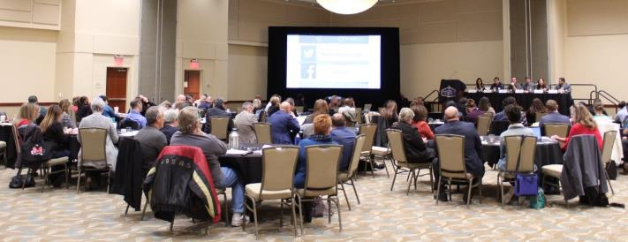
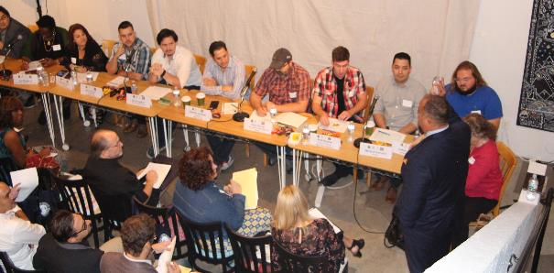
Real World Examples
  Advanced Manufacturing and Engineering Regional Advisory
  Digital Media Advisory
Ready – Set - Advise…

Slide 12
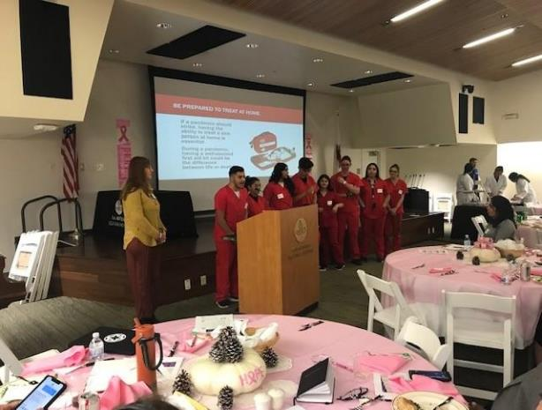
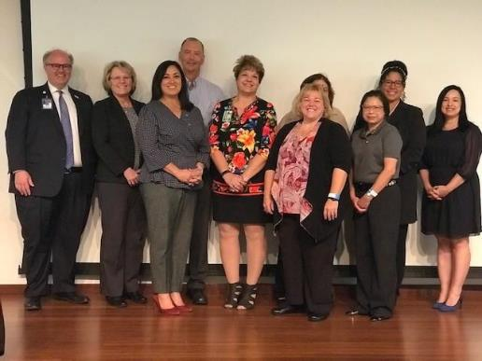
Healthcare Regional & Sub-Regional Events
Started in the Inland Empire

Slide 13
Employer Engagement Manager (EEM)
The EEM is a regionally funded position designed to connect business to the community college system. The Inland Empire Desert Regional Consortium (IEDRC) developed a structure to meet all of the regional business’s needs.
Due to the size of the IEDRC, the EEM’s are divided sub-regionally for effectiveness. The four EEMs broken down as:
Metro 1-Western San Bernardino County (Chaffey College, Crafton Hills College, and San Bernardino Valley College and District)
Metro 2-West/Southwest Riverside County (Moreno Valley College, Mt. San Jacinto College, Norco College, and Riverside City College and Riverside Community College District)
High Desert (Barstow College, Copper Mountain College, and Victor Valley College)
Coachella Valley/Low Desert (College of the Desert and Palo Verde College).
The EEM’s are not industry focused, they are business focused.

Slide 14

EEM Team
The EEM’s team includes a representative from each college within the sub-region in the following areas:
  Apprenticeship
  Contract Education – (Not-for-Credit Training)
  Job Developers
  CTE Deans
  K-12 pathway coordinators
The EEM will coordinate with the regional leadership team.

Slide 15
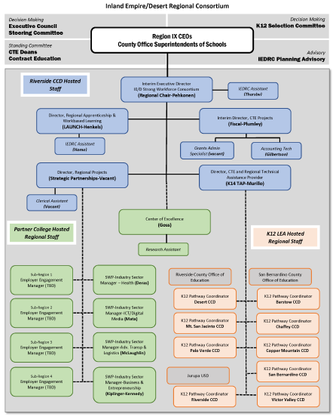
Regional Governance
Key Talent
IEDRC Chair (regional chair)
IEDRC Fiscal Director
Director of K12 Strong Workforce (K-14 TAP)
SWP K12 Pathway Coordinators (9)
Center of Excellence Director
LAUNCH Apprenticeship Director
Director of Strategic Partnerships
Sub-regional Employer Engagement Managers
SWP funded Regional Industry Sector Managers (formerly RDEE/DSN)
SWP funded Regional Project Managers

Slide 16




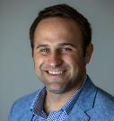


The Inland Empire Regional Team
https://desertcolleges.org/
Sector/Project Focus | Industry Sector Manager/ Regional Director
Business and Entrepreneurship | Lisa Kiplinger-Kennedy lkiplingerkennedy@barstow.edu
ICT-Digital Media | Susanne Mata smata@sbccd.edu
Health | Wendy Deras wederas@collegeofthedesert.edu
LAUNCH Apprenticeships | Charles Henkels charles.henkels@rccd.edu
K-14 Pathways | Stephanie Murillo stephanie.murillo@rccd.edu
Innovation and Automation | Alan Braggins abraggin@sbccd.edu
Advanced Transportation & Logistics Energy, Construction & Utilities | TBD - Hosted At Victor Valley College TBD - Hosted at College of the Desert

Slide 17








Contact your Regional Team

Slide 18

Questions?
Thank you for your Interest and Participation!

