Slide 1
ASCCC Resources to Support your Local Senate
Cynthia Rico, Executive Committee
Mary Rees, Moorpark College
John Zarske, Santa Ana College

Slide 2
Relations with Local Senates Committee(RLSC)
Cynthia Rico – Chair
  Executive Committee
  San Diego Mesa College
Gini May
  Executive Committee
  Sacramento City College
Alicia Nuñez
  Cuyamaca College
Rochelle Olive
  Alameda College
Mary Rees
  Moorpark College
John Zarske
  Santa Ana College
Notes:
Not sure of the thought behind this slide.

Slide 3
“
The Relations with Local Senates Committee serves to augment the work of the Executive Committee in its efforts to provide an opportunity to share information on issues of concern at the local and state levels.
Members of the Relations with Local Senates Committee will be primarily liaisons and conduits for information and requests for assistance.

Slide 4
Outcomes for Today
Identify Resources Available to Local Senates
Define the needs of local senates

Slide 5
Local Senates Handbook
www.asccc.org/sites/default/files/local_senates_handbook2015-web.pdf

Slide 6
Using the Handbook
Part I – A brief History
Part II – Roles and Responsibilities of the Senate
Part III – Duties as a Local Senate President
Part IV – Ensuring the Effectiveness of the Local Senate
Part V – Linking Local Senates
Notes:
Each of us take turns to describe Each part, highlights of each
Cynthia Part I
Mary Parts II, IV
John Parts III, V

Slide 7
The ASCCC Web Site
www.ASCCC.ORG
Notes:
Take a few minutes to review the web site. Past resolutions, past papers, Rostrum Articles, links to Title 5, Curriculum, SLO’s, future events, Disciplines List and Minimum Qualifications, request site visit, other???

Slide 8
Institutes and Meetings
Plenary Sessions
Curriculum Institute
CTE Institute
Leadership Institute
Academic Academy
Regional Meetings
Area Meetings
and others
See web site for more details

Slide 9
Local Senate Visits
Local senates may request visits from members of the Executive Committee and the Relations with Local Senates Committee.
  The purpose of such a visit is for the committee members to serve as a liaison between the Senate and the local senate.
  Our role is to listen to your discussions, share Senate resources to support you and gather questions and concerns to forward to the Academic Senate President for consideration and response.
The visit can be with the local senate president, the local executive committee, the entire senate-whatever you would like.

Slide 10
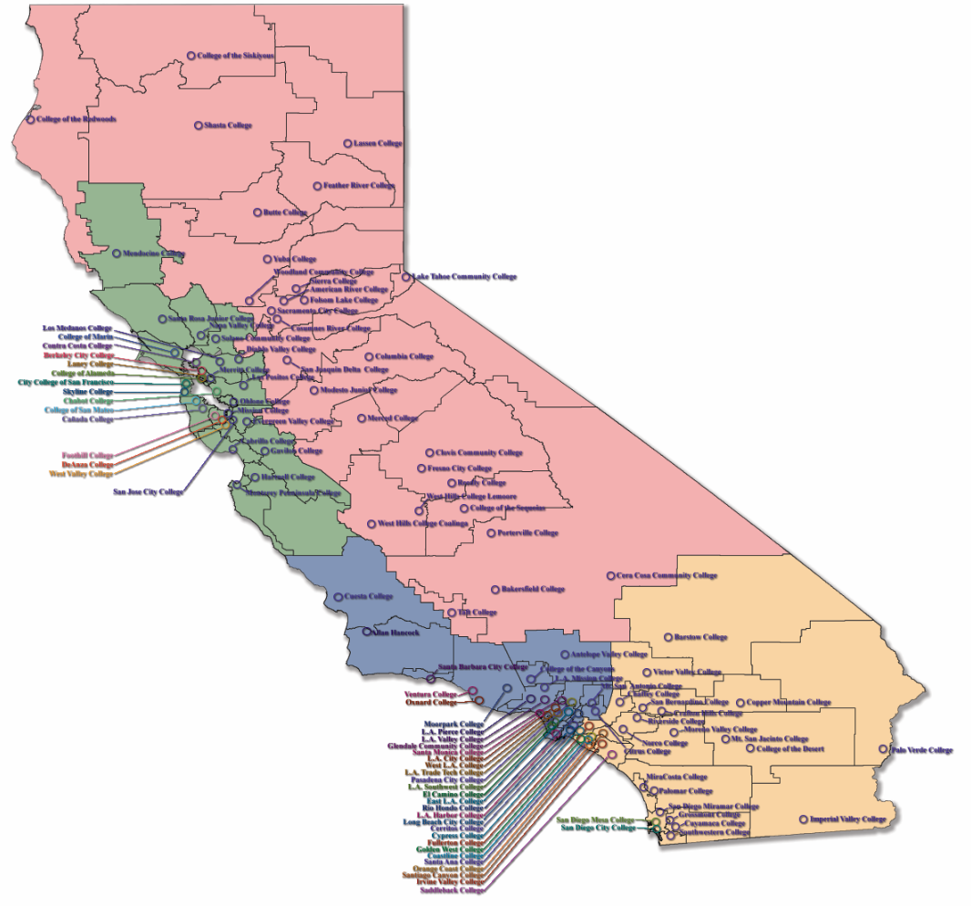





















Local Visits 2015-2016
Notes:
This slide to be updated

Slide 11
Technical Assistance
A Joint Program of the Academic Senate and
Community College League
Visit must be supported by both the administration
and Senate

Slide 12
Institution Effectiveness Partnership Initiative
The California Community Colleges Institutional Effectiveness Partnership Initiative (IEPI) makes technical assistance available to colleges through Partnership Resource Teams (PRTs). The PRT will visit the college at least three times, to understand the issues thoroughly, help the college develop an improvement plan (called the Innovation and Effectiveness Plan), and provide follow-up support as needed.
Requires a letter of interest and the signature of the college CEO.

Slide 13
Other Reasons for a Visit
Budget Process
Curriculum
Disciplines List
Minimum Qualifications and Equivalence
Participatory Governance and 10 + 1
Institutional Effectiveness
CTE
Non credit
Regional Concerns
OR…..

Slide 14
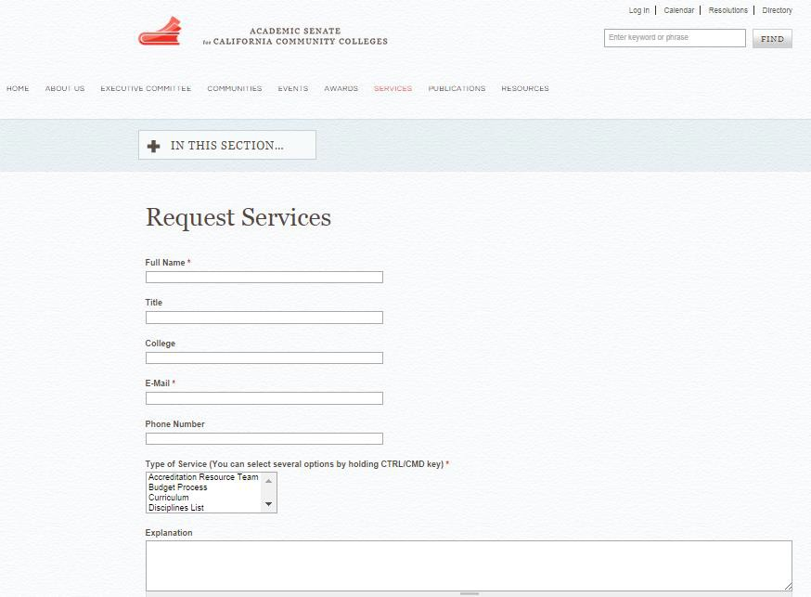
How to Request Services

Slide 15
RLSC Survey
We would like your input on your past experiences and needs for your local senate
What has worked in the past?
What do you need for the future?

Slide 17
Your Local Needs?
Notes:
Small Group Discussion and report out

