Slide 1
LET’S COLLABORATE! BUILDING NONCREDIT TO CREDIT PATHWAYS

Slide 2
Facilitator
Maryanne Galindo
Los Angeles Mission Community College
Chairperson/Professor
Academic Readiness, Career & Community Institute
(ARCC Institute)
(formerly Adult Basic Education Department)
galindm@lamission.edu
Association of Community & Continuing Education (ACCE)
Noncredit Council Lead/Board Member
Academic Senate for California Community Colleges
Noncredit, Pre-transfer, Continuing Education Committee

Slide 3
Overview
Speaking into the Listening of Divergent Subcultures
3 Collaboration Strategies to Build Noncredit to Credit Pathways
Models of Each Strategy
4. Q&A

Slide 4
Speaking Into People’s Listening
Implies:
Understanding what the audience is inherently receptive to, and speaking into that space;
Accurately hearing what the audience truly wants/expects;
“Cultural translation” of multiple perspectives into the listening of others;
Finding the interconnections to foster collaboration
Institutional Subcultures
Admin
Credit
Faculty
Noncredit Faculty
Students/ Community
Industry Employers

Slide 5
Speaking Into People’s Listening
Understanding Your Audience – Campus Culture and Readiness Level
What outrageous views have you heard about noncredit?
What do your partnering Industry Employers listen for?
What are students are listening for?
What perceptions influence how credit faculty listen?
How does the mission of Adult Ed influence how noncredit faculty listen?
What obstacles prevent credit and noncredit faculty from working together?
What impacts how administrators listen?
Institutional Subcultures
Admin
Credit
Faculty
Noncredit Faculty
Students/ Community
Industry Employers

Slide 6
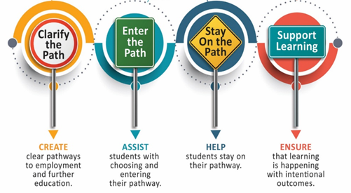
Speaking Into People’s Listening
Check Point:
What statements surprised/jumped out at you?
As Noncredit Champions, how does such divergence impact you and your leadership?

Slide 7
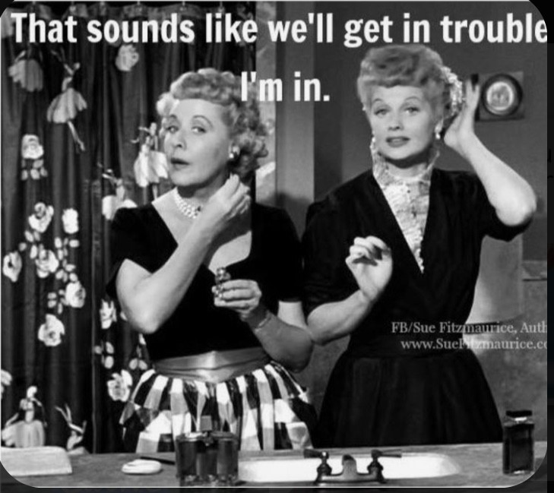
And you still want to “embed” noncredit? ☺
The invisible work you do:
Identify Listening Perspectives
Dispel Myths
Take People Where They Are
Act as a Cultural Translator by Speaking into the Listening of Multiple Stakeholders
Build Relationships & Networks (Roadshow)
Think Big Picture & Frame the Debate
Identify/clarify purpose needs
Build Multiple Bridges

Slide 9
Strategically Integrating & Leveraging Statewide & Funding Initiatives
Think Big Picture Context:
Where are the interconnections?
Guided Pathways
Equity, Diversity, Inclusion
Student Success
CAEP/
AB705
WIOA/ Strong Workforce
Integrated Education & Training
Rising Scholars
PANDEMIC
ENROLLMENT
FEAR
FUTURE BUDGET CUTS

Slide 10
How do you get faculty buy-in?
Universal Question
Creating an open space for the credit faculty to tell us what they need
Speaking into their listening
Asking Questions
How familiar are you with noncredit?
Does it fit into an existing pathway? If so, how?
What skills would you want your students to have before they entered your course?
How many hours (units) would this course be?
How do you envision scheduling this program?
Is there an advantage to cohort scheduling?

Slide 11
What those questions reveal …
What skills would you want your students to have before they entered your course?
Helps to determine if they need onboarding, complementary or capstone
How familiar are you with noncredit?
“Sell” the benefits of noncredit and tailor it depending on how familiar/unfamiliar they are with it (e.g. starting with the basics or just a single selling point)
How many hours would this course be?
Introduce the concept of creating courses based on hours instead of units
Helps with curriculum and how to structure the course (or program) and even future scheduling
Does it fit into an existing pathway? If so, how?
Let’s me know if there could potentially be a pathway from noncredit to credit OR is it supporting completion of a credit pathway OR are we starting a brand new pathway?
Onboarding
Complementary
Capstone/ Industry

Slide 12
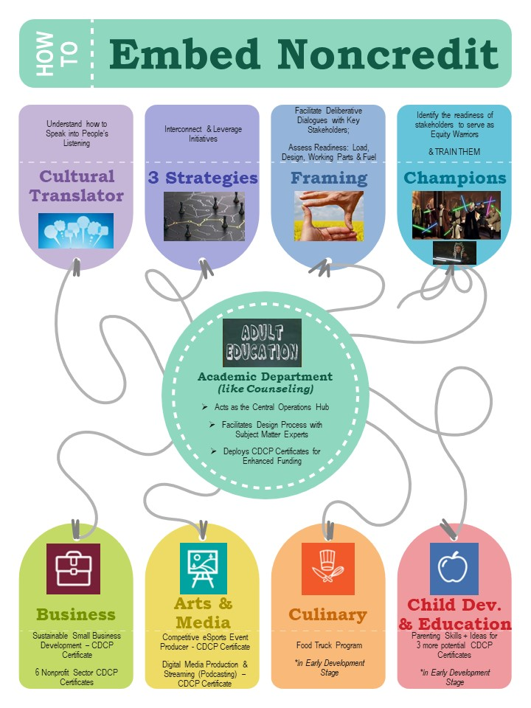
3 Collaboration Strategies for Building
Noncredit to Credit Pathways
Onboarding
Complementary
Capstone/ Industry
College Readiness
Academic Readiness (GED)
Career Exploration
Digital Literacy
Community Needs
Mirrored Courses
Support Courses (AB705)
Vocational/ Career Prep
Sustainability

Slide 13
ALIGNING PRIORITIES:
LAMC Integrated Strategic Master Ed Plan
LAMC Growth Opportunities
LAMC Guided Pathways
LAMC Local Partners
LAOC Regional NC Strong Workforce
Onboarding Bridges
PATHWAYS THAT BRIDGE COMMUNITY TO THE COLLEGE
Enhances foundational skills that support college readiness & success in all 6 LAMC pathways
Job Readiness Certificate
Academic Readiness Certificate
Academic Readiness (Bilingual) Certificate
Digital Literacy Certificate (Microsoft Office Exam)
Pathway to Citizenship Certificate
College Readiness Certificate*
*Currently being developed by updating, existing stand alone courses – anticipated Winter 2024
Foundational/ Universal

Slide 14
ALIGNING PRIORITIES:
Designing Structures for Equity & Inclusivity
Addressing AB705
Guided Pathways
Complementary
GUIDED PATHWAYS, MIRRORED COURSES & SUPPORT COURSES
VocEd 110CE: Pathway to Biotech
Sustaining the success of a completed grant through noncredit
Anticipated Launch – Fall 2021
ESL Mirrored Courses
Launched Spring 2021
First in LACCD
Academic Prep – Math Support
Launched 2020
In response to AB705
Academic Prep – English Support
In early development stage
Equity Gaps Diversity & Inclusion

Slide 15
The Capstone Opportunity: CDCP Institutes
CTE Prep Certificates for Enhanced Funding
CTE PREP PATWAYS TO CREDIT CTE
Sustainable Small Business Development
Introduction to CSIT – Robotics
Introduction to CSIT – Social Media
Introduction to CSIT – Programming
Intro to Construction Technologies
Digital Media Production & Streaming*
Competitive eSports Event Producer*
Community Dental Health Coordinator*
Non-Traditional Leadership for Community Enhancement*
The Art & Practice of Conflict Resolution*
Emergency Preparedness Specialist**
Community Safety Specialist**
Fund Development Specialist**
Nonprofit Management**
*Coming Soon – Spring 2023
**In Development – Anticipated Fall 2023
New!

Slide 16
How can one well-designed program impact several pathways?
Competitive eSports Event Producer: Certificate of Competency
Intro to the multi-billion dollar eSports industry
Event & Business Management
Graphic Design
K-12
Guided Pathways
Workforce Reentry
ASO (capstone)
Transitioning noncredit to credit
Programming

Slide 17
Strategy #1: Onboarding
Competitive eSports Event Producer Certificate (7 St.Hrs.)
Prepares students for entry-level internships in the eSports industry; “feeds” AMP pathway & Business Administration pathway; provides infrastructure to existing eSports club in ASO; attracts new students and universities to LAMC via this emerging, multi-billion dollar industry.
VOC ED 881CE
eSports Event Management
(3)
VOC ED 882CE
Tech Planning for LAN Events
& Livestreaming
(3)
VOC ED 883CE Competitive eSports Event Production
(1)
Completed in 1 semester (two 8-week sessions) & 1 intercession
Fall Session 1 | Fall Session 2 | Winter | Spring Session 1 | Spring Session 2 | Summer
eSports Event Management | Technology Planning for LAN Events & Livestreaming | Competitive eSports Event Production | eSports Event Management | Technology Planning for LAN Events & Livestreaming | Competitive eSports Event Production

Slide 18
Strategy #1: Onboarding
Strategy #2: Complementary
Strategy #3: Industry/Capstone
Digital Media Production & Streaming Certificate (6 St.Hrs.)
Prepares students entry-level internships; “feeds” credit AMP certificates and degrees; provides infrastructure for future “LAMC Internet Radio” (podcasts)
VOC ED 871CE Digital Media: Audio Storytelling
(2)
VOC ED 872CE
Digital Media: Podcast Production & Live Streaming
(2)
VOC ED 873CE
Digital Media: Video Storytelling
(2)
Completed in 1 semester,
in three 5-week sessions
Fall Session 1 | Fall Session 2 | Fall Session 3 | Spring Session 1 | Spring Session 2 | Spring Session 3
Audio Storytelling | Podcast Production & Live Streaming | Video Storytelling | Audio Storytelling | Podcast Production & Live Streaming | Video Storytelling

Slide 19
Strategy #1: Onboarding
Strategy #2: Complementary
Strategy #3: Industry/Capstone
Sustainable Small Business Development (12 St.Hrs.)
Introduces students to core entrepreneurship competencies; scheduled for targeted audiences in a cohort model; supports exploration & idea formation; serves departmental goals for onboarding or capstone projects; connects with potential incubation services offered by community partners.
VOC ED 190CE
Pathway to Socially Responsible Entrepreneurship
(2)
VOC ED 191CE
Starting Your Own Small Business
(2)
VOC ED 192CE
Managing Small Business Operations
(2)
VOC ED 195CE
Entrepreneurial Finance
(2)
VOC ED 193CE
Marketing & Sales for Small Business
(2)
VOC ED 194CE
Technology for Small Business
(2)
Co-teaching & IET delivery model
Contextualized for specific industry sectors & LAMC’s 6 Guided Pathways
Winter | Spring Session 1 | Spring Session 2 | Summer | Fall Session 1 | Fall Session 2
ESL/ESLNC BS Comp. | VocEd 190CE VocEd 191CE VocEd 192CE | VocEd 193CE VocEd 194CE VocEd 195CE | ESL/ESLNC BS Comp. | VocEd 190CE VocEd 191CE VocEd 192CE | VocEd 193CE VocEd 194CE VocEd 195CE

Slide 20
Complementary Noncredit Courses: Nursing
Strategy #2: Complementary
Basic skills improvement for credit healthcare career programs
Contextualized basic skills math course
Covered dosage calculations, measurements, decimals, percent, proportions, and fraction

Slide 21
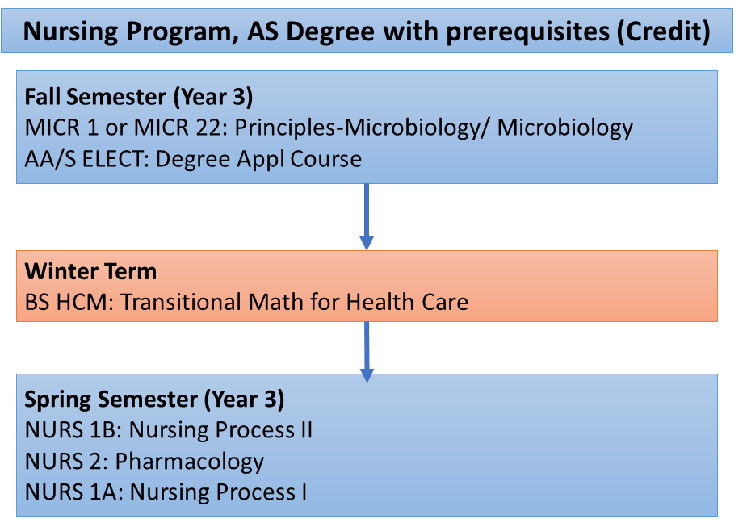
Complementary Noncredit Courses: Nursing
4-week pre-requisite (Nursing)
229 students have completed healthcare math since Summer 2017
Overall, 98% of the students who took healthcare math have passed pharmacology
* 34 additional students enrolled in HCM1 in Summer 2021 and are currently enrolled in Pharmacology in Fall 2021

Slide 22
Complementary Noncredit Course: Welding
English for Special Uses (ESU)
Contextualized ESL course
Collaboration between credit Welding faculty and noncredit VESL faculty
Pre-taught welding concepts and vocabulary before introduction to welding course

Slide 23
Strategy #3: Industry/Capstone

Slide 26
Noncredit SWP Metrics – LA Region
LA REGION | Project Year 1 | Project Year 2 | Project Year 3 | Project Year 4 | % Increase from 2016
 | 2016-17 | 2017-18 | 2018-19 | 2019-20
Number of Enrollments, Noncredit CTE Courses | 33,437 | 35,317 | 38,022 | 40,144 | 20%
Number of Students Who Earned Noncredit Vocational CDCP Certificates | 628 | 766 | 1,063 | 2,125 | 238%
Number of Students Who Earned Noncredit Milestone | 7,366 | 7,912 | 8,255 | Data Not Available | 12%
View data reports by college
Notes:
Shannon

Slide 27
Career Development and College Preparation (CDCP) Certificates Developed in Project
Sector/Discipline | Count of Certificate
Health | 42
Energy, Construction and Utilities | 40
Business/Entrepreneurship | 33
Retail, Hospitality, Tourism | 32
Workforce Preparation | 29
ICT/Digital Media | 14
Advanced Transportation and Logistics | 7
Public Safety/Education | 3
Total | 200
Notes:
Shannon - Over 200 Programs Developed in LA Region

Slide 28
Where will you start?
What noncredit certificate are you considering?
A Brief
Cautionary Tale

Slide 29
Pondering the Possibilities
Think Tank Time!
What noncredit certificate are you considering?
Who is the audience?
Which of your campus pathways does it connect with?
Which strategy (or strategies) will your model use to embed noncredit? (onboarding, complementary, capstone)
Identify the top 3 initiatives that you can leverage.
Do you have a “champion” in mind? Who are your allies?
Bridge Equity Gaps
Foster Inclusivity
Sustainability
Guided Pathways
Equity, Diversity, Inclusion
Student Success
CAEP/
AB705
WIOA/ Strong Workforce
Integrated Education & Training
Rising Scholars
Notes:
Add sectors

Slide 30
Continued Reflection Questions for Deeper Inquiry:
How do you get faculty buy-in?
What do you do to get better at your craft?
How could I have framed that conversation better?
Why don’t you engage (credit faculty, a department, a certain admin)?
What will you do differently?
Who are my champions? (will lead)
Who are my allies? (will lead from behind – vote, etc.)
How can you increase disciplined reflection?
How do you know if something is feasible? Readiness level (faculty, dept.)
Why do you do what you do?
What have you learned from a project that fell short of the intended benchmarks of success?
To reach your success, what do you need to get better at and how are you going to get better at it?
What does your program need to attract the next level of success?

Slide 31
Q&A….Feedback
Maryanne Galindo
Chairperson/Professor
Academic Readiness, Career & Community Institute
(ARCC Institute)
(formerly Adult Basic Education Department)
galindm@lamission.edu
lamission.edu/academics/arcc

