Slide 1
Noncredit ESL and CTE: Opportunities for Collaboration
CTE-Noncredit Regional Meeting
March 6, 2023 at Laney College

Slide 2
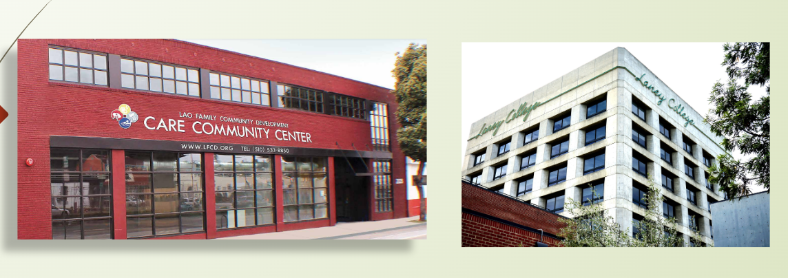
Welcome
Laney College &
Lao Family Community Development (LFCD)
Career Readiness Program (CRP)

Slide 3
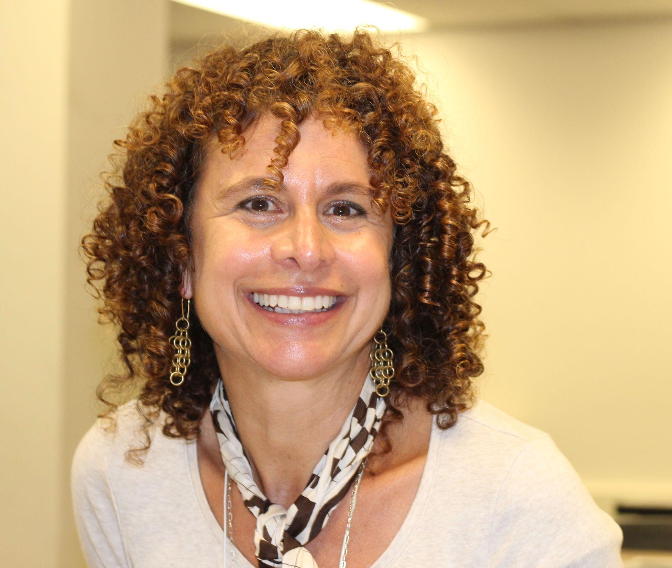
Your Presentation Moderator
Cheryl (Share-All) Eccles,
Laney College ESOL Instructor,
CRP Faculty Lead

Slide 4
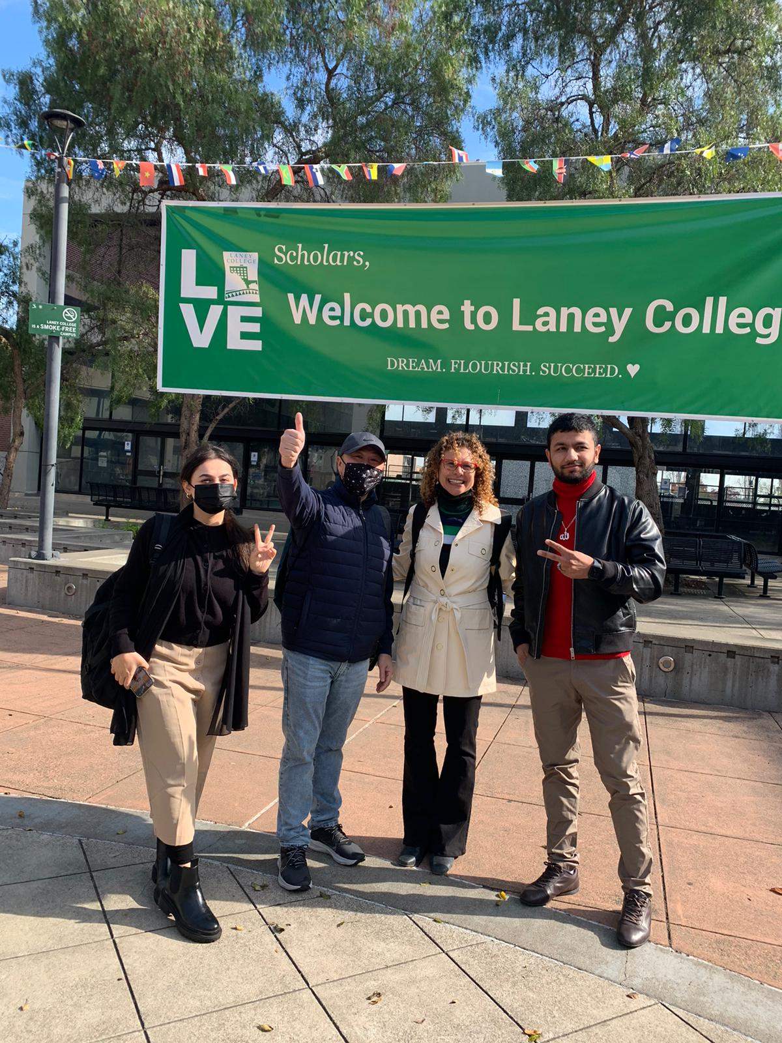
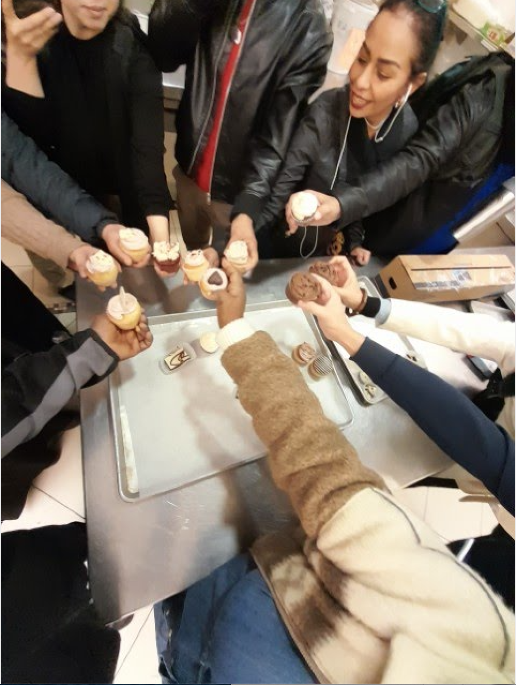
Purpose of our program
Our program offers ELL students a gentle helping hand in accessing post-secondary educational services, CTE programs, and workforce readiness.

Slide 5
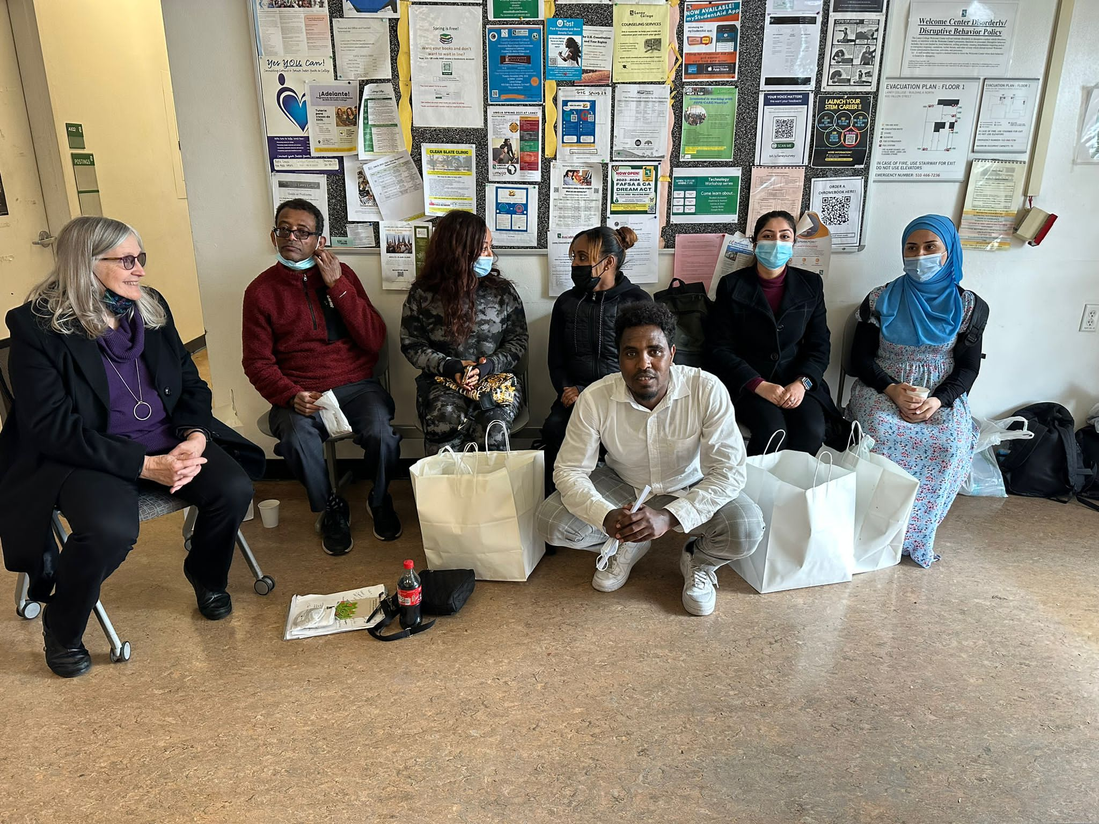
Session Description
Today we will discuss
ESOL and CTE collaboration in the Laney/Lao program
Student preparation for workplace and CTE pathways
Program models, resources and funding
Notes:
Learn about opportunities for noncredit and CTE collaboration following the evidenced-based strategies that incorporate noncredit ESL, career and technical education, and/or workplace readiness.
Learn how these collaborations prepare students for the workplace and transition to credit CTE pathways.
Participants will receive an overview of program models, and resources, and learn about potential funding opportunities to encourage noncredit and credit collaboration.

Slide 6
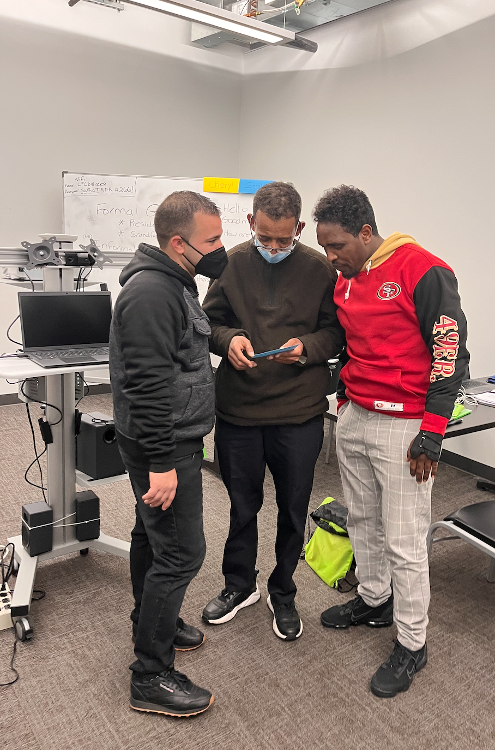
Agenda
Agenda:
Laney/Lao Career Readiness Program:
Origin
Overview
Courses & Tutoring
Collaboration Partners
Our Students

Slide 7
Outcomes
Outcomes
Learn about the collaborative efforts of our “Team” at Laney College and LFCD
Discover how these collaborations help support a holistic approach for promoting our students’ growth and well-being
Learn about the classes we offer, and the embedded tutoring, Academic counseling, and Career coaching
See how we help students find a path toward realizing their academic and career aspirations

Slide 8
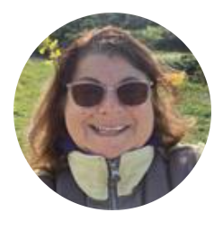
CRP Beginnings
CRP Beginnings
Raya Zion, Program Manager, Laney College Employment Services and Workforce Development
Notes:
Some ideas for Raya:
Creating the Bridge CTE grant with LFCD and ??? funding CBOs
When it was created; when it began
Purpose

Slide 9
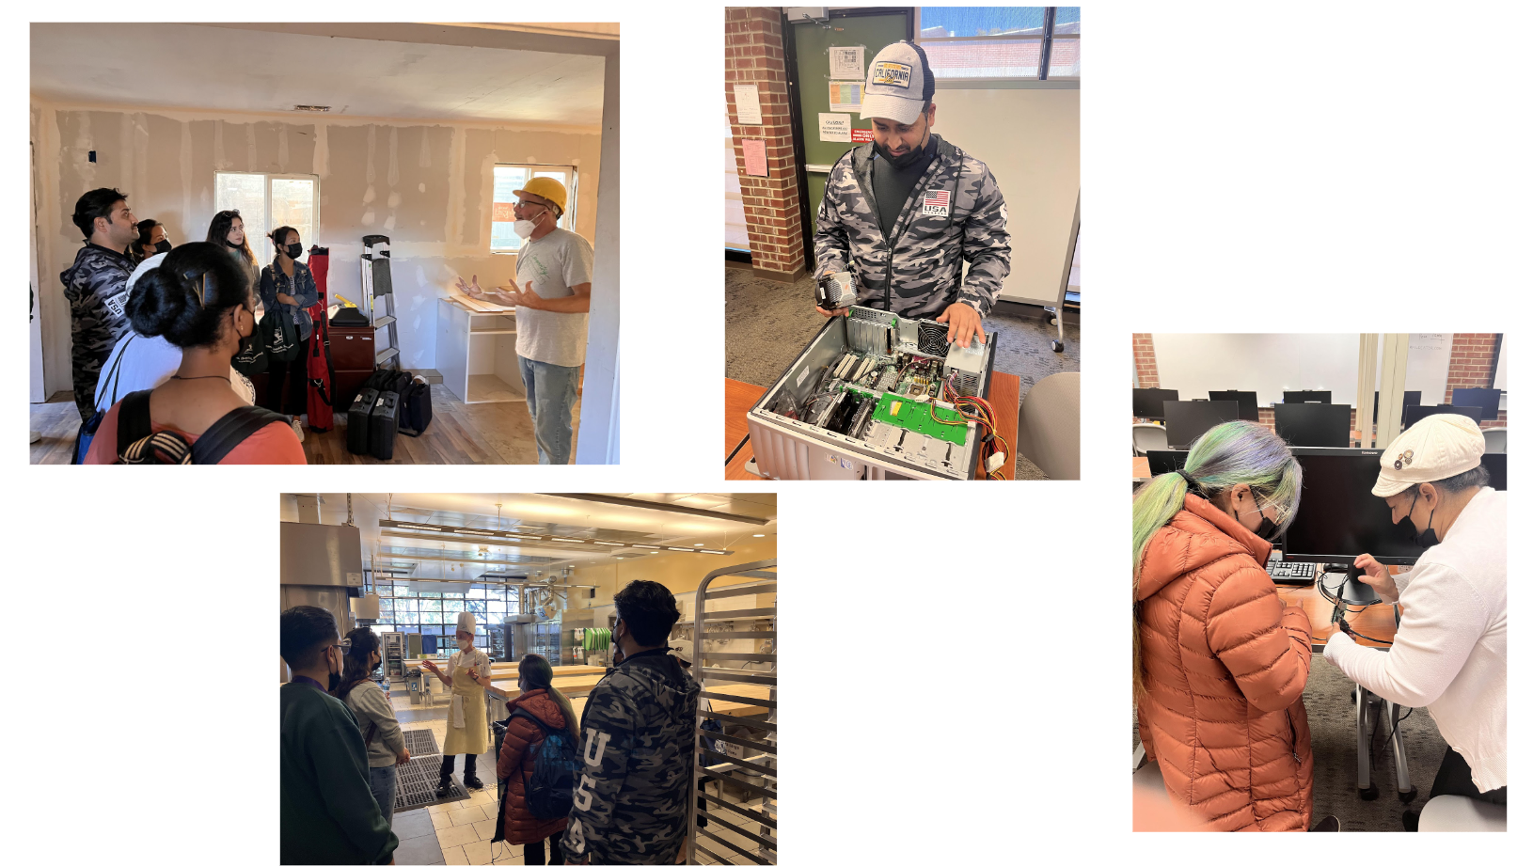
CRP Overview
CRP Overview
Cheryl Eccles, Laney College ESOL Instructor, CRP Faculty Lead

Slide 10
CRP Overview: What we Do
What We Do
We are a Collaborative Vocational Program in partnership with Laney College and Lao Family Community Development
We teach four, eight-week Certificate Programs from August - May
Monday - Thursday 9:30 am - 2:30 pm
Schedule for Spring 2023:
Session 1: January 23 - March 16, 2023
Session 2: April 3 - May 25, 2023
We prepare students for success in the career of their choice

Slide 11
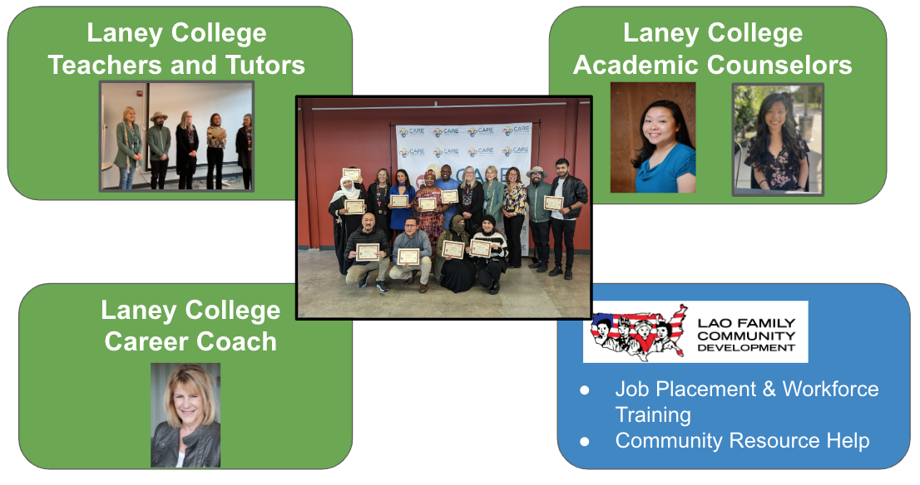
CRP Overview: Our Collaborators
Laney College &
Lao Family Community Development (LFCD)
Career Readiness Program (CRP)
Notes:
Some ideas for Raya:
Creating the Bridge CTE grant with LFCD and ??? funding CBOs
When it was created; when it began
Purpose

Slide 12
CRP Overview: Our Students
Our Students
53% of our students participate in our program in their first year in the U.S.
Students home countries include Afghanistan, Yemen, Nigeria, Ethiopia, Eritrea, Sri Lanka, China, Burma/Myanmar, Cambodia, Peru, Cuba, Guatemala, El Salvador, Honduras, Mexico
Wide range of formal educational backgrounds, English language abilities, and Math literacy
Career interests in various CTE and workforce industries: automotive, construction, cosmetology, culinary, computers, early childhood education, teaching, medical assistants, nursing, dental assistant, wood technolgy, HVAC, and electrical, to name a few.
Based on the 55 students in our program between Jan ‘22 - March ‘23

Slide 13
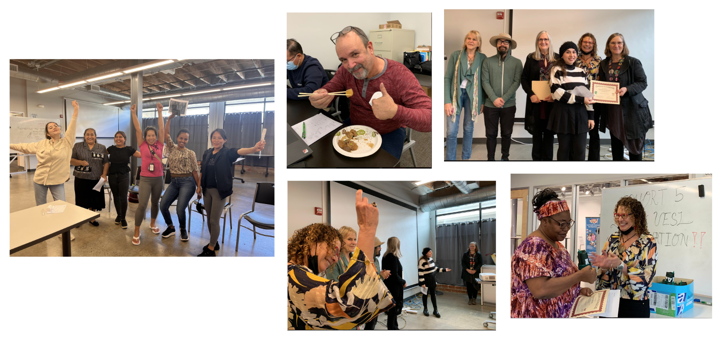
CRP Courses & Tutoring
Courses and Tutoring:
Sarah Shaffer, Laney College ESOL Instructor
Jen Gerry, Math Instructor & Tutoring Program Manager

Slide 14
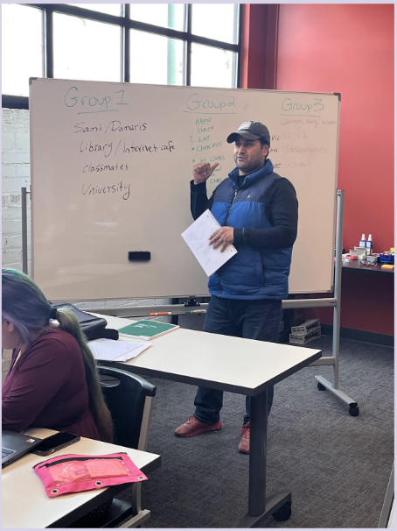
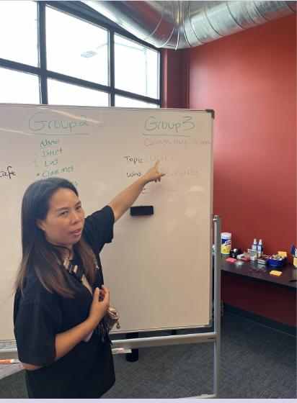
CRP Overview: What We Teach
Our Courses
English for Customer Service
English for Job Search
English for Technology
Workforce Math with English Emphasis
Notes:
Some ideas for Raya:
Creating the Bridge CTE grant with LFCD and ??? funding CBOs
When it was created; when it began
Purpose

Slide 15
CRP Courses
Job Search with Sarah
How to find and apply for jobs
How to write a resume
How to interview for a job
Customer Service with Cheryl
What is small talk?
Why is body language important?
How do we handle an angry customer?
Math with Tony
How to use Math in in the workforce
carpentry, bookkeeping, retail, restaurant, etc.
Technology with Cheryl
How to use Chromebooks
How to write a formal email
How to make a Google slideshow
How to use our College Canvas System
Notes:
Teachers will talk about their classes, 3-5 minutes each

Slide 16
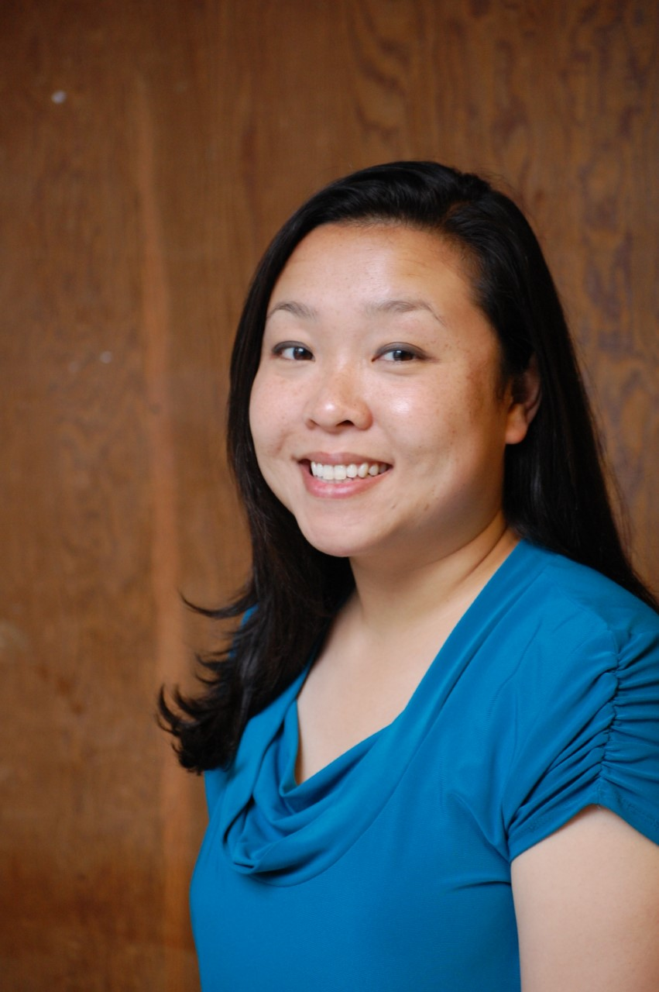
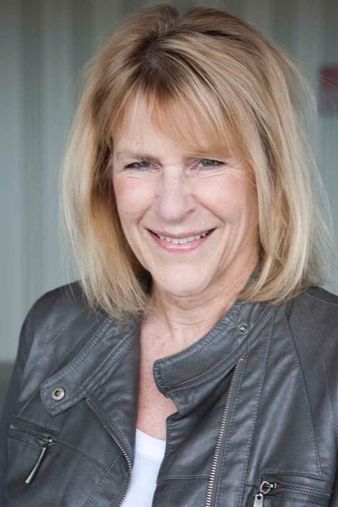
CRP Collaboration Partners:
Laney College
Laney College &
Lao Family Community Development (LFCD)
Career Readiness Program (CRP)
CRP Collaboration Partners/Laney College
Nancy Trinh Chieng, APASS Embedded Academic Counselor
Susie O'Bryant, Laney College Embedded Career Coach

Slide 17
APASS
What is APASS?
We serve ALL students and in particular, we support ESOL students.
APASS FREE services:
Academic/career counseling.
Special events & field trips to college campuses.
Help applying for transfer to a 4-year university.
Translation services: Chinese, Vietnamese, Mongolian, and Japanese.
Laney College

Slide 18
APASS
APASS embedded connection with Laney/Lao CRP
Embedded counseling in a few ESOL classrooms every semester to provide services student direct services.
Lao Family CRP - provided workshops on resources at Laney, student education plans (SEP), and degrees/certificates.
Follow-up with each student to provide an individualized SEP based on their goals. Provide translation support if needed.
Laney College

Slide 19
Job Search Workshops
Embedded Career Coach Connection
Three workshops are provided in the Job Search Course during the 8-week session
Get Creative with your Job Search
Cover Letter & Resume
Interview Skills
The Career Coach serves as a resource for current and former students via informational interviews, community trainings, job opportunities & follow-up services through the Employment Services Center on campus.
Susie O’Bryant, Career Coach, Laney College

Slide 20
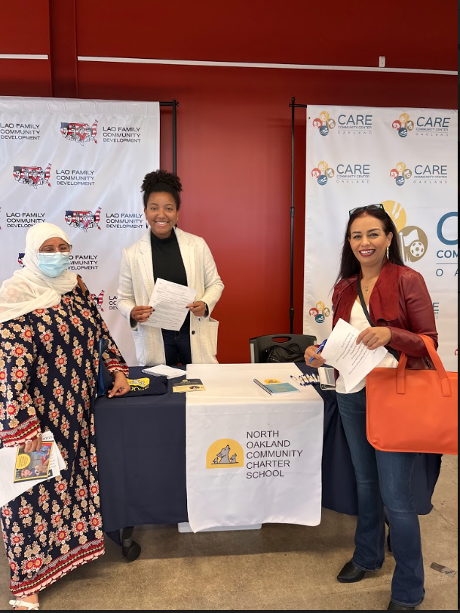
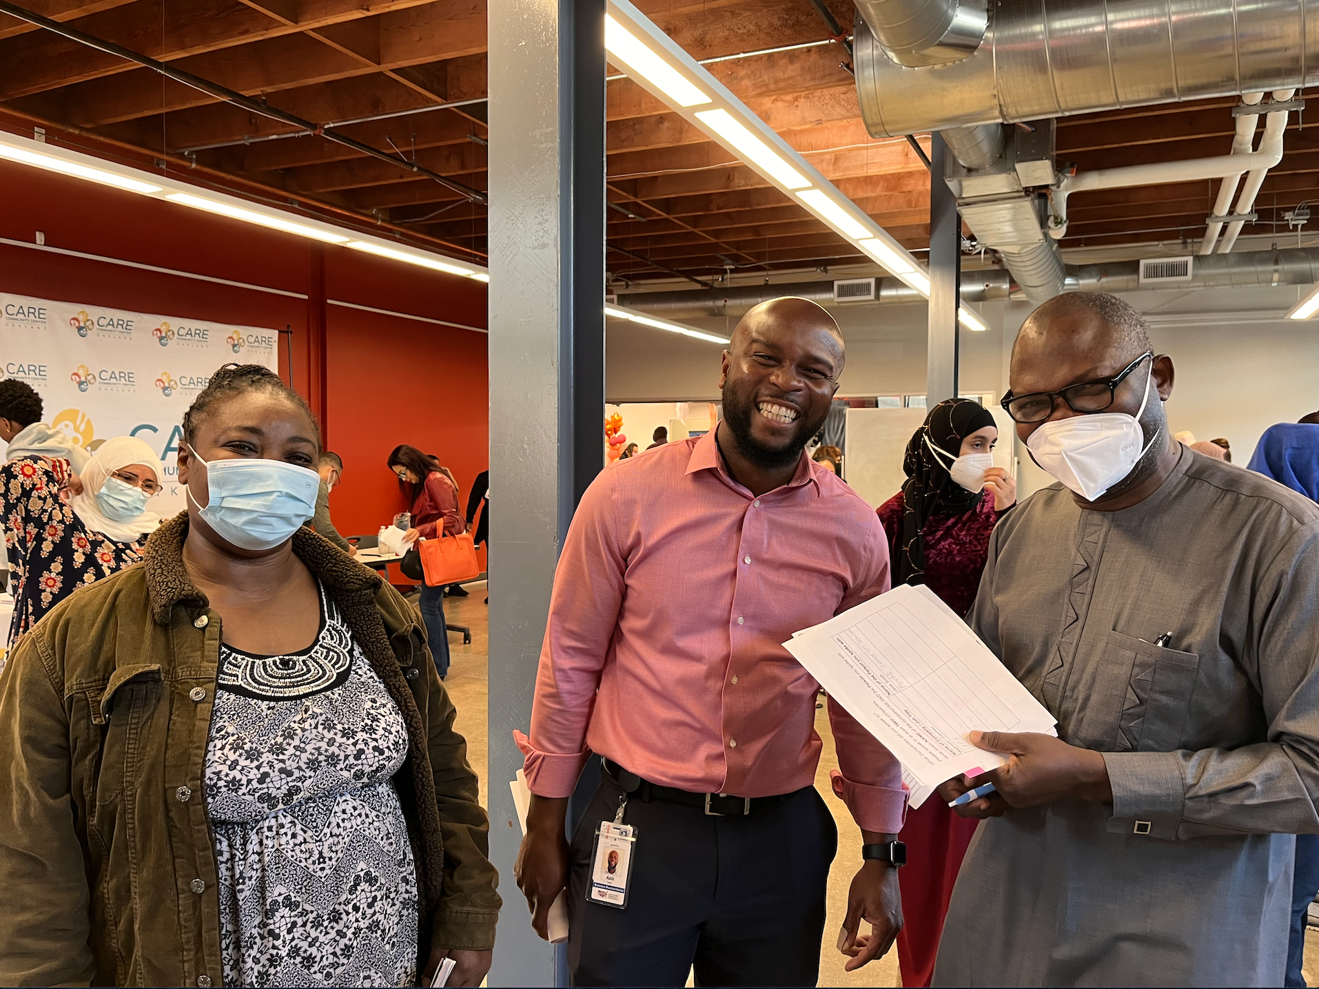
CRP Collaboration Partners:
LFCD
CRP Collaboration Partners/LFCD
Su Dung, WIOA Youth & Adult Employment Program Manager, Global Career Development Facilitator
Ada Chen, WIOA Program Coordinator
Zaw Thein, LFCD Refugee Programs Coordinator

Slide 21
LFCD Vision and Mission
Notes:
Slides 16 - 18 are from another Lao slideshow. We may not need all of this information.

Slide 22
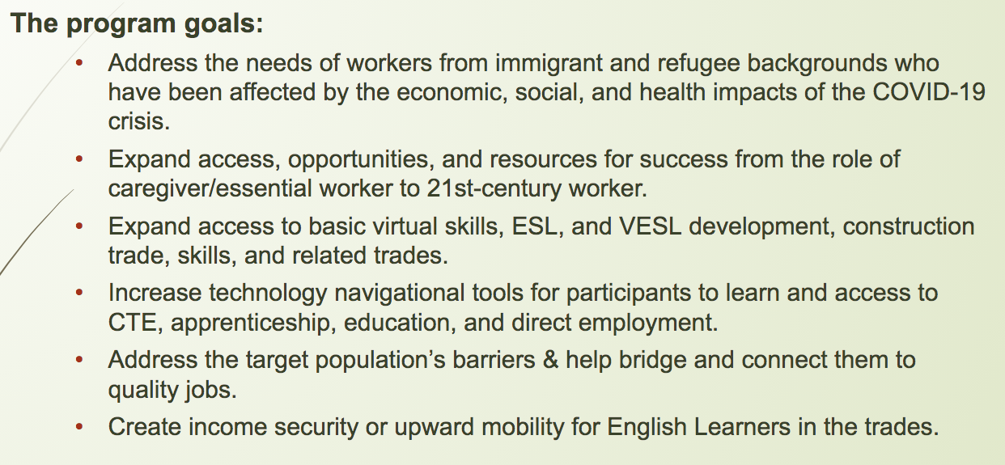
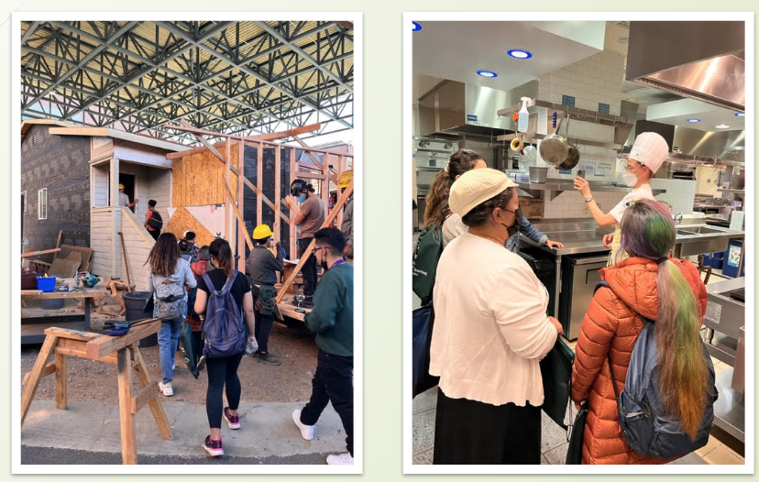
Laney College and LFCD Partnership
Goals
Laney College and LFCD Partnership

Slide 23
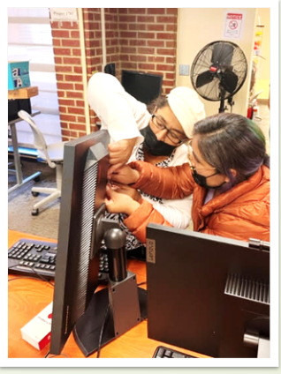
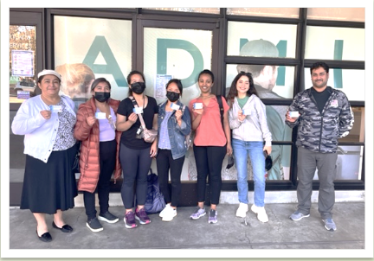
Collaboration Activities

Slide 24
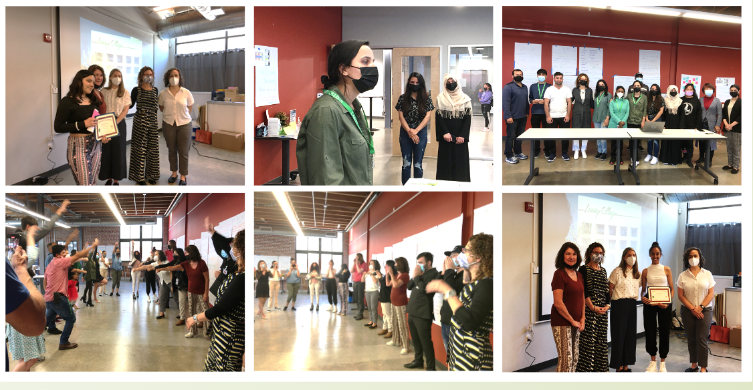
CRP Graduates
What are our Former Students doing Now?
68% of former students are currently enrolled in ESOL classes at Peralta Colleges
32% of Students are currently in CTE and other certificate/A.A. degree programs
56% of students are currently working 10 - 40 hours per week
**Data based on 70% of former students who have responded to questionnaire and emails. Students in program from between 1/22 -12/22. Total 55 students
What are they doing now?

Slide 25
Current Student Experience
A Word from our Current Student, Neelab Ahmadi
Neelab Ahmadi

Slide 26
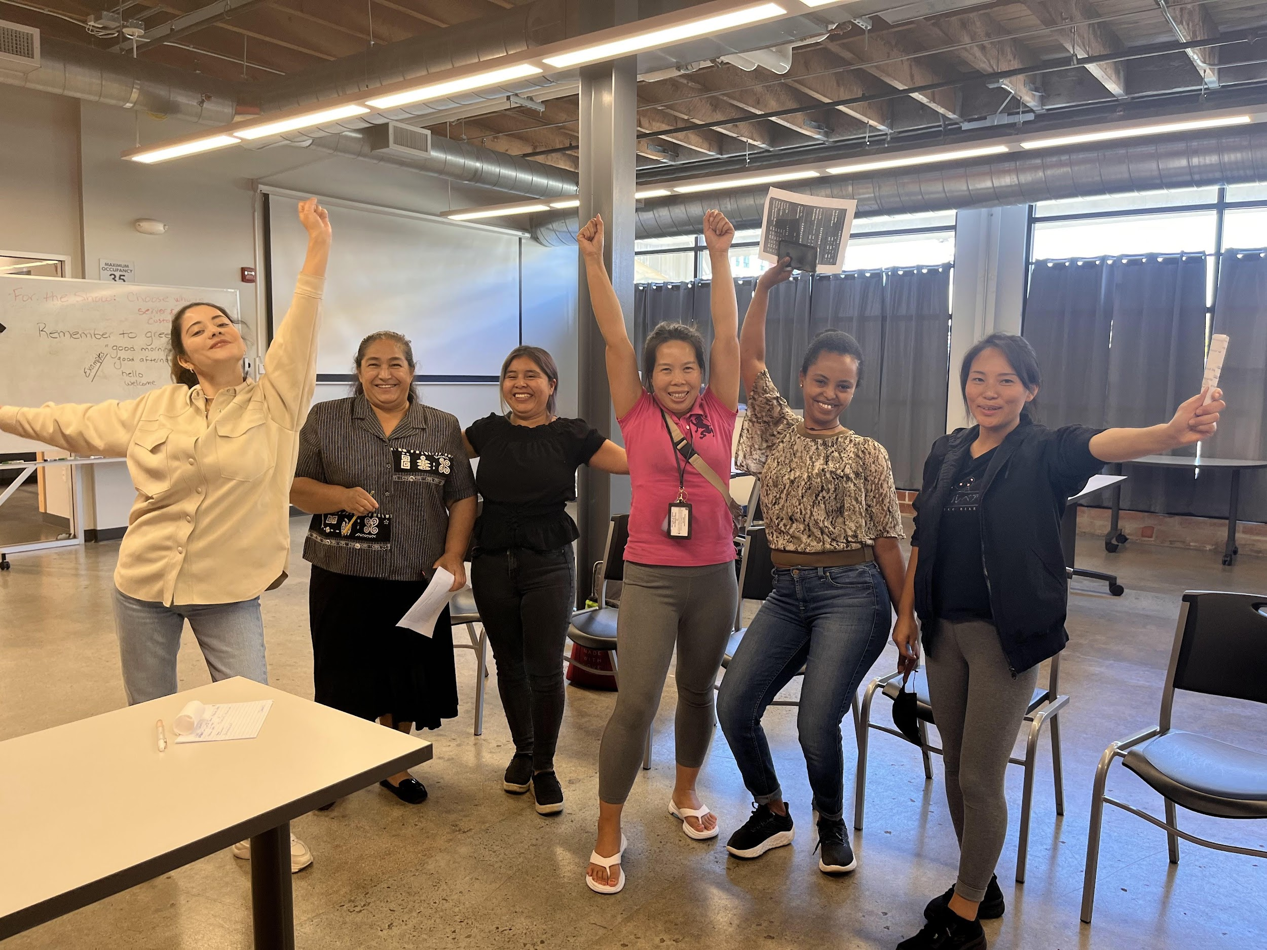
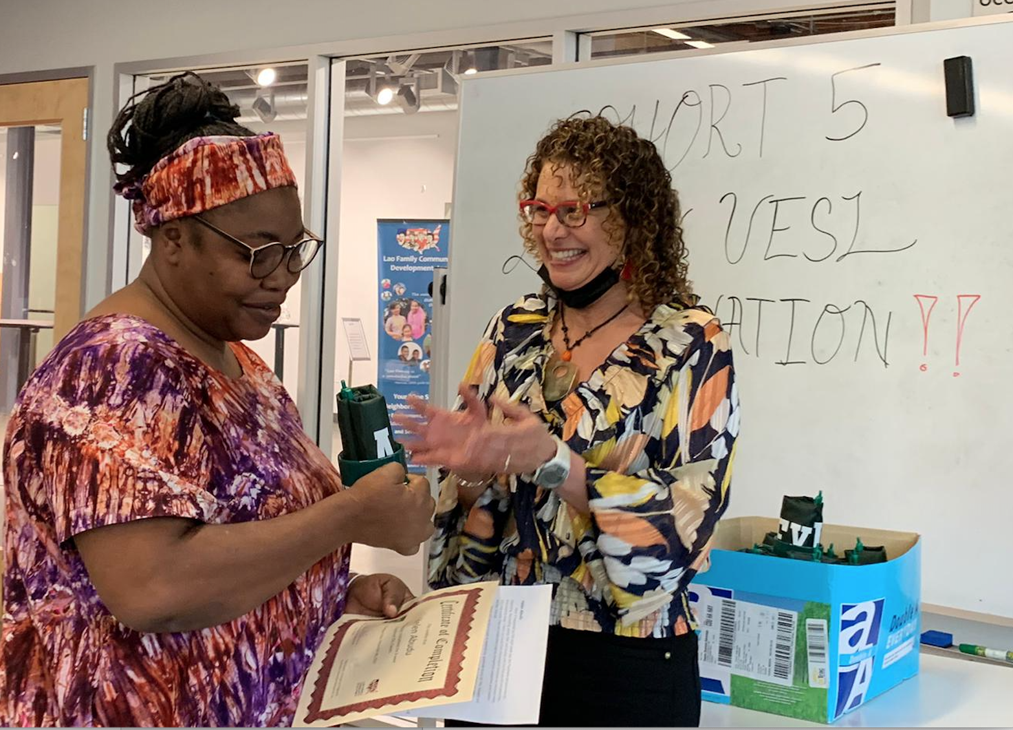
CRP Graduates: What Students say about the program
Quotes from our Students
Wow! It happened so fast eight week ago, the Readiness program was so interesting, fascinating, stress free and loaded with fun that we did not notice the time creeping away.
Words will not be enough to express my gratitude to you all. You brought out the best potential in us like me.
Before the program I was like a jellyfish but now I have a backbone,
hopeless now hopeful,
dreamless now a dreamer.

Slide 27
Areas of Improvement
Here are some areas we are working on:
We would like more students in each session (15- 20 students per session)
Marketing to a wider group of students at our partner CBOs, and the colleges
Creating a new flyer for potential students
Create a better system for tracking former students in their academic and career trajectories
Create a database of former students
Perhaps have a tutor help with contacting students directly.

Slide 28
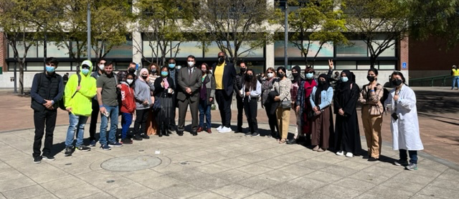
Thank You!
Any questions?
Email info@asccc.org

Slide 29
END SLIDESHOW

