Slide 1
OER Basics Made Easy - Academic Freedom in Action
Dave Dillon, OERI Regional Lead, Grossmont College
Heather Dodge, OERI Regional Lead, Berkeley City College

Slide 2
Hello!
Introduce yourself in the chat. Please let us know what academic freedom means to you.

Slide 3
Agenda
Defining Academic Freedom and OER
Faculty role in academic freedom, do you love your textbook?
Student agency in academic freedom? Do students have a voice?
Why OER?
Practices for adapting and adopting OER

Slide 4
What we talk about when we talk about...
Academic Freedom
Academic freedom is the freedom to teach, both in and outside the classroom, to conduct research and to publish the results of those investigations, and to address any matter of institutional policy or action whether or not as a member of an agency of institutional governance.
(excerpt from 2010 ASCCC Resolution: https://www.asccc.org/resolutions/academic-freedom-new-recommendations)
OER
Open educational resources are materials for teaching or learning that are either in the public domain or have been released under a license that allows them to be freely used, changed, or shared with others.
(adapted from Creative Commons Wiki https://wiki.creativecommons.org/wiki/What_is_OER%3F)
Notes:
NOTE FOR HEATHER: Not a perfect definition - I could not find anything on AF that relates directly to learning materials or textbooks, but I think this will suffice. Not sure why it looks bolded on right but not on left...

Slide 5
POLL in Pathable...
Let’s talk textbooks! Are you satisfied with yours? Does it meet your needs? How about the needs of your students (cost/accessibility, etc.)?
Notes:
This is where I’ll put the poll and have folks talk to each other in the chat

Slide 6
Faculty sometimes...
Skip chapters.
Reorder chapters.
Wish their texts were more current and/or
used different terminology.
Teach chapters/sections because they are
there and students had to purchase the
text.
Feel obligated to use ALL of the text.

Slide 7
Reflecting on the Social Messages of our Chosen Textbooks
“Teaching is never a neutral act. The texts we bring into our classrooms have messages about social continuity and social change, whether we acknowledge these messages or not.” – Shantel Ivits
Source: "Teaching is not Neutral" by Lauri Aesoph is licensed under CC BY 4.0
Image: "ivits_shantel_15_0056_bw" is licensed under CC BY 4.0
Notes:
This is kind of heady and theoretical, but I am hoping i can just briefly plant the seed that textbooks and using just one or two core texts gives students the idea that there is one presentation/representation of a topic/idea/theory, etc. How do we model use of different and opposing viewpoints to our students, what if we empowered them as knowledge creators.

Slide 8
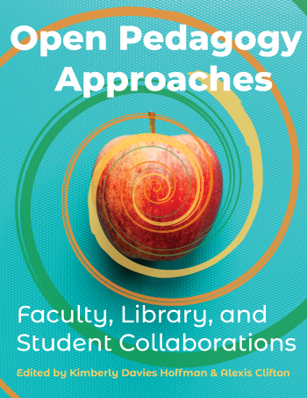
Student Voice
New OER publication from SUNY:
https://milnepublishing.geneseo.edu/openpedagogyapproaches/
Notes:
DD New OER text from SUNY edited by Alexis Clifton and Kimberly Davies Hofftman. Includes foreward from AA Keynote speaker Robin DeRosa. Robin is speaking at 9am PST tomorrow morning on Crises and the Commons. Includes chapter on “Open Pedagogy as Open Student Projects”
Intersection: AA session tomorrow at 1pm PST Suzanne Wakim and Tia Germar’s session on Open Pedagogy.

Slide 9
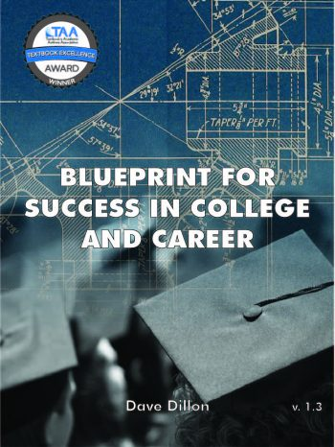
The case for going open...
A successful example from Dave Dillon, counseling faculty and professor at Grossmont College
Notes:
DD
(note from HD, I think your slide portion can take between 15-18 minutes.

Slide 10
Fall ‘17 Sabbatical OER Project
Project to create/curate OER for three College Success courses
Backward design: Course Outline
Surveyed existing peer reviewed College Success OER
Identify content, determined licenses, implement, edit, edit, edit
Peer Review
Piloted Blueprint for Success in College and Career in Spring ’18
Official release Summer ‘18
Notes:
DD - shout out to mentors: Una Daly, Nicole Finkbeiner, James Glapa-Grossklag, Amy Hofer. Pressbooks, LibreText, OER Commons. Rebus (Apurva, Zoe, Hugh)

Slide 11
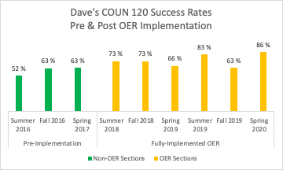

Slide 12
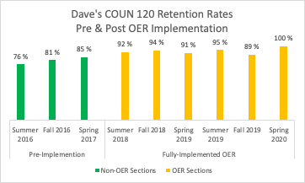

Slide 13
Additional Measured Success
Textbook and Academic Author Association Textbook Excellence Award
OE Global Textbook Award
Adoptions and Adaptions
Notes:
DD - 10,000 students/semester, tie back to Academic Freedom. Mention Adjuncts

Slide 14
Practices for applying academic freedom to OER (adopting/adapting)
OER discovery
Start looking. Use the list of suggested sites linked here to see if there’s something that would work for your course.
Talk to a colleague
Are there colleagues on your campus that are using OER. Or one in your discipline? Talk to them to see what their experience has been.
Educate yourself
Take an ASCCC OERI webinar, or a CCCOER webinar, or sign-up for an OER listserv to find out more about OER.
Be OER curious
Not ready to ditch your textbook quite yet? Try swapping out one chapter/module of your current class with an OER chapter and see how it goes.
Dig In
Found a good OER alternative to your traditional textbook? Start integrating those materials now to get a jump on spring semester.
Adapting
Learn about licenses, platforms, and audiences. How can you create or adapt OER for your local student and faculty population?
Notes:
This is a wordy slide...needs help? I just liked the symmetry.

Slide 15
Thanks!
More info here: https://asccc-oeri.org/
Dave Dillon: dave.dillon@gcccd.edu twitter: @blueprint_text
Heather Dodge: hdodge@peralta.edu

