Slide 1
California Community Colleges HBCU Connections
Transfer Options Beyond the California Border

Slide 2
AGENDA
Welcome and framing the conversation: by Dr. Siria Martinez
History of HBCU’s
HBCU Impact
Benefits of HBCU’s
Who HBCU’s Serve
Background of CCC and HBCU Project Transfer Guarantee Project
Program Benefits and Advantages, Partner Locations
CCC to HBCU Program Outcomes
Pipeline2Possibilities Program
Q&A

Slide 3
Vision Goals Commitments
Increase credential obtainment by 20%
Increase transfer by 35% to UC and CSU
Decrease average unit obtainment for a degree to 79
Increase employment for CE students to 76% in their field of study
Reduce and erase equity gaps
Reduce regional gaps
Focus on students’ goals
Design with the students’ experience in mind
High expectations and high support
Foster use of data and evidence
Own student performance
Thoughtful innovation and action
Cross-system partnership

Slide 4
What is a HBCUs
Historically Black colleges and universities (HBCUs) are institutions that were established prior to 1964 with the principal mission of educating Black Americans. These institutions were founded and developed in an environment of legal segregation and, by providing access to higher education, they contributed substantially to the progress Black Americans made in improving their status.

Slide 5
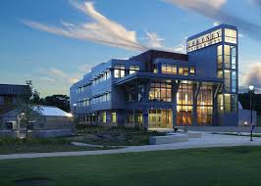
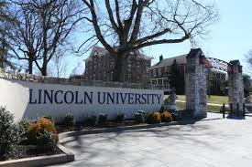
Our First HBCUs
85 HBCUs established
Cheyney University of Pennsylvania
Wilberforce University (OH)
1837 1854 1856 1861 – 1865 1902
Lincoln University (PA)
Civil War
Notes:
The Morrill Acts
The First Morrill Act - the Morrill Land Grant College Act of 1862 set aside federal lands to create colleges to “benefit the agricultural and mechanical arts.”
The Second Morrill Act of 1890 The Second Morrill Act of 1890
prohibited the distribution of money to states that made distinctions of race in admissions unless at least one land-grant college for African Americans,
required the former Confederate states to establish sister universities for Blacks
creating the 1890 Historically Black Land-Grant Universities, which were some of the first Historically Black Colleges and Universities (HBCUs) in the nation. was established…establishing19 public black colleges

Slide 6
The A,B,Cs of HBCU’s
Currently there are 101 Historically Black Colleges and Universities recognized by the US Dept. of Education located mainly in the South and on the East Coast. *2% of degree granting post-secondary institutions in the US. They include public, private, denominational, liberal arts, land-grant, independent university systems, single-gender serving, researched based, large and small with enrollment that range from less than 300 to over 11,000 students.
59% Award Bachelor’s Degrees only
41% Award Graduate/Masters/Professional Degrees
28% Award Doctoral Degrees

Slide 7
HBCU Impact
How Many African Americans Are HBCU Graduates?
22% of Bachelors Degree Holders
40% of Members of Congress
12.5% of CEO’s
40% of Engineers
50% of Professors at Non-HBCU Institutions
50% of Lawyers
80% of Judges
(Diverse Issues in Higher Education, September 9th 2015/TMF Website)
Notes:
This has in fact created the Black Middle Class –Representing only 2% of higher ed institutions in US but producing this excellence

Slide 8
BENEFITS OF HBCUs
Low teacher to student ratio
Most classes are taught by professors not teaching assistants
Long term income earnings are higher for students who attended HBCUs. (Huffingtonpost.com 5/27/16)
Memorable social experiences such as battle of the bands, step shows, and homecoming.
Competitive Tuition Costs
Longer Application Periods
Graduate School Opportunities and Employment Opportunities
Diversity – students from all over the US and the world

Slide 9
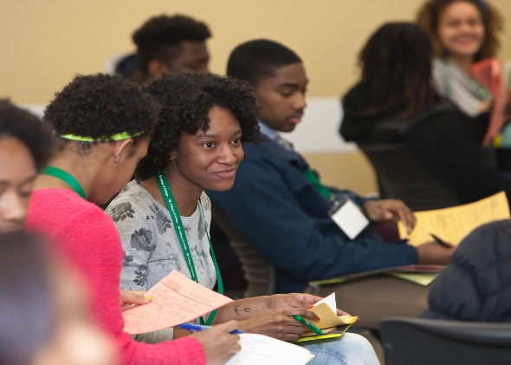
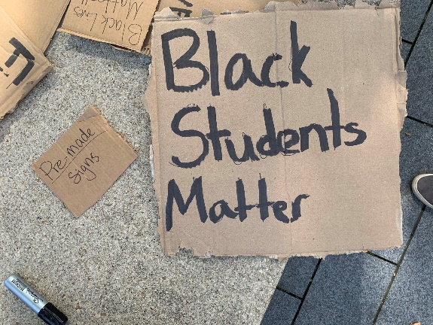
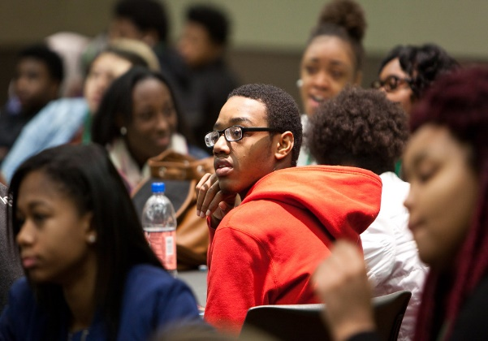
Who HBCU’s Serve
76% Black/African American Population
52% of Students are First Generation
71% Low-income/Pell Grant Eligible
94% of students awarded some type of financial aid

Slide 11
Background of the CCC to HBCU Transfer Guarantee Project
Why CCCCO Consider the Project (2015)
Local Impaction for CCC Students within CSUs & UCs
Desire to create additional Transfer Pathway options for CCC students
What things were in place for CCCCO to create Project
Associate Degrees for Transfer – can be used as state-wide, program-level articulation Agreements w/IGETC & CSU General Education
Notes:
Created pathways that would allow for a smooth transition from our CCC to partner HBCUs
Elaine Moore, Linda Malcloski

Slide 12
How Students Qualify for the Transfer Guarantee Agreement
(A) Obtain an Associate Degree for Transfer (ADT)*(60 units) with a 2.0 or higher GPA are guaranteed admission with junior standing to the 39 participating HBCUs.
*The Intersegmental General Education Transfer Curriculum (IGETC) or the California State University General Education Breadth pattern (CSU GE) must be followed when completing the ADT.
OR
(B) Transfer with 30 or more UC or CSU transferable units and a 2.0 or higher GPA. Units will be accepted for general education, pre major or elective units.
(Be advised that the minimum GPA requirement is higher for select partner HBCUs)

Slide 13
Program Benefits &Advantages
IN ADDITION TO THE ACCEPTANCE OF
TRANSFERABLE UNITS STUDENTS RECEIVE:
Fee waiver for the online Common Black College Application
Pre-transfer advisement from program and HBCU admission staff
Priority consideration for campus housing when deadlines met
Priority consideration for scholarship for students with a 3.2 GPA or higher based on available funding of HBCU

Slide 14
HBCU Partners Location
Notes:
Alabama, Arkansas, Carolinas (North & South), Florida, Georgia, Kentucky, Louisiana, Maryland, Mississippi, Missouri, Ohio, Pennsylvania, Tennessee, Texas, Virginia, West Virginia,

Slide 15
CCC to HBCU PROGRAM OUTCOMES
Over 400 CCC Students applied and transferred to one of the 39 HBCU partner schools
Average Persistence Rate 1 Year After Transfer: Approx. 359 (75%)
Average Persistence Rate for attending same institution: Approx. 238 (65%)
Average time to BA completion after transfer: 3 years
Number of students who have obtained a Baccalaureate Degree: 123
Number of students who attained a Graduate Degree: 1

Slide 16
CCC to HBCU PROGRAM OUTCOMES
Student Transfer breakdown between 2015 to 2020 by HBCU partner institutions
Clark Atlanta University 60
Texas Southern University 30
Grambling State University 30
Xavier University of Louisiana 25
Tuskegee University 25
Dillard University 20
Lane College 20
Southern University and A&M College 20
Kentucky State University 20
Talladega College 15
Lincoln University 15
West Virginia State University 15
Tennessee State University 15
North Carolina Central University 15
Wiley College 15
Virginia State University 10
Bowie State University 10
Bethune-Cookman University 10
Mississippi Valley State University 8
Alabama State University 8
Fisk University 6
Huston-Tillotson University 4
Philander Smith College 4
Benedict College 3
Claflin University 3
Alcorn State University 2
Bennett College 1

Slide 17
CCC to HBCU Student Quotes
Overall my experience was great at my HBCU, the institution, faculty and staff helped me achieve far more than my bachelor’s degree.
My HBCU experience went outside of its gates, we all work together this community of scholars and we all share this community of scholars. When I first stepped on campus, I thought that this was incredible, all students were so engaged and helped me succeed. I have learned to understand how I can succeed in all things because of my time here.
Actually, seeing people like me driven and acknowledging that they are African Americans and proud of it. They exuded black excellence, creating so many things on campus. Showed me how to be friendly to everybody and showing respect to all.
Staff and even Chancellor Eloy Oakley make sure that the TGA HBCU program provides supports to help you take the right courses at your CCCs so that you can transfer, they also provide support to students during the transfer process and then continue to follow-up with students to make sure that they graduate with their BA.
My HBCU helped me grow my self-confidence and as a result I am now committed to going to medical school –the HBCU culture of black excellence –all of my faculty were African American PhD’s and for the first time I realized that your goals are in your reach. For the first time I as an African American could do this.
Once I became acculturated I realized how supportive and friendly everyone was. I got to know my faculty and fellow students. This has been a turning point of my life.

Slide 18
Pipelines To Possibilities Developing Faculty Excellence in the CCC system!
BUILDING ON SUCCESS

Slide 19
Pipelines To Possibilities Mission
The Pipelines to Possibilities Program (P2P) offers a HBCU graduate internship program designed to develop an intentional faculty pipeline within the California Community College Districts. Through proactive recruitment, hiring, and retention of diverse tenured faculty aimed to diminish equity gaps, the P2P program meets the needs of diverse student populations to improve student success.

Slide 20
The P2P Program
Cohort-based mentorship program to develop prospective faculty of color and provide a pathway to employment within the California Community Colleges
Builds upon existing partnerships with HBCUs for CCC transfer students that will recruit current graduates students at HBCUs to pair with current CCC Black faculty mentors
First year: cohort of nine mentees and mentors was launched in Spring 2021

Slide 21
Spring 2021 Pilot Program Success
Successfully paired nine HBCU graduate interns with nine CCC faculty. CCCs represented: San Diego City College, Los Angeles Pierce College, San Diego Mesa College, Southwestern College, Barstow Community College, Riverside City College, Moorpark College, and Diablo Valley College. HBCUs represented: Kentucky State University, Claflin University, Morgan State University and Grambling State University.
Training sessions were held over the 16 week term with the completion of thirty-six hours. Topics covered: Developing Black Spaces, Understanding the CCC Student and How to Serve, Creating, Developing and Validating Equity-Minded Classrooms, Conflict Management Resolution and Techniques, Cultural Proficiency and Curriculum Integration, Classroom Technology and Essentials of Distance Learning, Application, Hiring and Interview Strategies.
Session Presenters included: Dr. Edward Bush, Dr. Frank Harris III, Dr. Laura H. Manyweather, Dr. Siri Brown, Dr. Eric Bishop, Arnita Porter and Nzingha Dugas.
Established collaborative efforts with the following: A2Mend, CCEAL, APAHE, and CCCOLEGAS

Slide 22
Spring 2022 Phase II Plans
Recruit 10 HBCU graduate interns to serve as mentees for participation
Recruit 10 CCC Faculty to serve as mentors
Provide support through training and professional development over 16 weeks for interns/mentees and mentors
Provide continued support to the spring 2021 P2P HBCU cohort through training and mentoring
Development of an Advisory Council with individuals representing various groups and organizations
Extend collaborative efforts with other organizations such as National Council on Black American Affairs, Western Regional Council on Black American Affairs, Village Demands, HBCU Faculty Development Network, and Higher Education Leadership Foundation.

Slide 23
How Can You Support & Assist
Inform Your Students and Campus Community
CCC to HBCU Transfer
Classroom Presentations
Discuss HBCU as a transfer Option w/Students
Bookmark Program Website
Explore ways to tie in HBCU History w/academic area
P2P Program
Inform Black faculty on campus of mentor opportunity
Seek to gain campus support and hiring of future P2P fellows

Slide 24
Questions & Answers
Thank you for your time and attention!

Slide 25
Contact Information
CCC to HBCU Transfer
Program Website: www.californiacommunitycollegehbcutransfer.com
Join Listserv: http://tinyurl.com/HBCUTransfer
Email: HBCUTransfer@cccco.edu
P2P Program
Program Website: https://pipelines2possibilities.org
email: pipelines2possibilities@gmail.com

