Slide 1
Active Learning and Culturally Responsive Curriculum Practices (Online) Friday, July 8, 10:45 AM-12:00 PM, Fully Online Presenters: Karen Chow, ASCCC Area B Representative Amber Gillis, ASCCC South Representative Michelle Pacansky-Brock, Foothill De Anza District & CVC/@ONE Eric Wada, ASCCC North Representative

Slide 2
Breakout Description
Valuing our students’ excellence and understanding that our students learn and demonstrate their learning better in culturally sensitive learning environments is central to an institutional framework of inclusion, diversity, equity, and anti-racism necessary for closing the success and persistence gaps for disproportionately impacted student populations. In a culturally sensitive environment, students’ prior learning and authentic lived experiences are central to the design of instruction. Learn how to use active learning and culturally responsive teaching strategies to support student engagement.

Slide 3
Objectives
Explore the new Guide for Diversity-Equity-Inclusion (DEI) in Curriculum.
Examine Culturally Responsive Teaching (CRT) principles.
View examples of CRT in different disciplines and modalities.
Consider opportunities for integrating CRT into the curriculum review process.
Identify professional development opportunities to further your DEI growth.

Slide 4
New Guide for DEI in Curriculum
Transform traditional practices by applying equity principles
Explore culturally responsive classroom practices
Identify practices for curriculum committees and local senates
Get Your Own Copy!

Slide 5
Culturally Responsive Teaching
Principles

Slide 6
Culturally Relevant Teaching
Culturally Responsive Teaching
Recognizes a student’s past, present, and future as the context of their learning.
Focus is “on what improves the lives of the students, families, and communities they serve...” (p. 36)
Uses “the cultural knowledge, prior experiences, frames of reference, and performance styles of ethnically diverse students to make learning more relevant to and effective for them” (p.36)
Validating, multidimensional, empowering, transformative, emancipatory
Ladson-Bilings, G. (2006). Yes, but how do we do it? Practicing culturally relevant pedagogy. In Landsman, J. & Lewis, C., Eds. (2006). White Teachers/Diverse Classrooms. Stylus Publishers.
Gay, G. (2018). Culturally responsive teaching: Theory, research, and practice. New York: Teachers College Press.
Slide by Michelle Pacansky-Brock, CC-BY-NC
Notes:
(Michelle) Briefly, let’s unpack these two terms Culturally Relevant Teaching and Culturally Responsive Teaching. They are often used interchangeably but there are differences between them. If we look at the work of Gloria Ladson-Billings and Geneva Gay, scholars and amazing teachers, here’s what we learn. [CLICK] Culturally relevant teaching recognizes a student’s past, present, and future as the context of their learning. It focuses on “what improves the livest and of the students, families, and communities they serve.” [CLICK] Culturally Responsive Teaching uses” the cultural knowledge, prior experiences, frames of reference, and performance styles of ethnically diverse students to make learning more relevant to and effective for them.” It is validating, multidimensional, empowering, transformative, and emancipatory.

Slide 7
Culturally Responsive Teaching reduces cultural mismatches.
Incorporate:
Real world connections & students’ life experiences
Metaphors
Aural storytelling (speaking)
Use Flipgrid (free) or VoiceThread (if your college has a license) or Canvas voice/video Discussions
Cooperative learning
Photo by Nikita Taparia on Unsplash
Slide by Michelle Pacansky-Brock, CC-BY-NC
Notes:
(Karen)

Slide 8
Reduce Cultural Mismatches
Individualistic
Low Context
Collectivist
High Context
Identity is rooted in oneself and accomplishments
How it is said is less important than what is said
Competition over cooperation
Individual effort is important in business and learning
Efficiency and speed are valued
Identity is rooted in groups (family, culture, work)
How it is said is more important than what is said
Cooperation over competition
Relationships are essential to business and learning
Accuracy and depth of understanding are valued
Notes:
(Michelle and Karen) In Collectivist or High Context cultures, identity is rooted is groups. How something is said is more important than what is said. Cooperation is valued over competitions. Relationships are essential to business and learning. Accuracy and depth of understanding are valued.
Cultural anthropologists have determined that each culture falls onto a continuum from individualistic or low context to collectivist or high context.
Cultures that fall more to the left end of the spectrum (those that are individualistic or low context) are more likely to correlate identity within oneself and individual accomplishments. In low context cultures, how it is said is less important than what is said. Competition is valued over cooperation. Individual effort is important in business and learning.

Slide 9
Individualism-Collectivism Continuum
Created by Geert Hofstede, cultural anthropologist. Higher scores represent more individualistic values, lower scores convey more collectivist values.
Country | Score
United States | 91
Australia | 90
United Kingdom | 89
Netherlands | 80
New Zealand | 79
Italy | 76
Belgium | 75
Denmark | 74
France | 71
Sweden | 71
Ireland | 70
Norway | 69
Switzerland | 68
Country | Score
Germany | 67
South Africa | 65
Finland | 63
Poland | 60
Czech Republic | 58
Austria | 55
Hungary | 55
Israel | 54
Spain | 51
India | 48
Argentina | 41
Japan | 41
Iran | 41
Country | Score
Jamaica | 39
Brazil | 38
Egypt | 38
Iraq | 38
Kuwait | 38
Lebanon | 38
Saudi Arabia | 38
United Arab Emirates | 38
Turkey | 37
Uruguay | 36
Greece | 35
Philippines | 32
Mexico | 30
Country | Score
Tanzania | 27
Ethiopia | 27
Kenya | 27
Portugal | 27
Zambia | 27
Malaysia | 26
Hong Kong | 25
Chile | 23
China | 20
Ghana | 20
Nigeria | 20
Sierra Leone | 20
Singapore | 20
Country | Score
Thailand | 20
El Salvador | 19
South Korea | 18
Taiwan | 17
Peru | 16
Costa Rica | 15
Indonesia | 14
Pakistan | 14
Colombia | 13
Venezuela | 12
Panama | 11
Ecuador | 8
Guatemala | 6
Notes:
(Karen) This slide lists world cultures and a score from 1 to 100 that places the culture on the individualism to collectivism continuum. The higher the score, the more individualistic the culture is. The lower the score, the more the culture leans towards collectivism.

Slide 10
Individualism-Collectivism Continuum
North, Central, and South American countries are highlighted in yellow.
Country | Score
United States | 91
Australia | 90
United Kingdom | 89
Netherlands | 80
New Zealand | 79
Italy | 76
Belgium | 75
Denmark | 74
France | 71
Sweden | 71
Ireland | 70
Norway | 69
Switzerland | 68
Country | Score
Germany | 67
South Africa | 65
Finland | 63
Poland | 60
Czech Republic | 58
Austria | 55
Hungary | 55
Israel | 54
Spain | 51
India | 48
Argentina | 41
Japan | 41
Iran | 41
Country | Score
Jamaica | 39
Brazil | 38
Egypt | 38
Iraq | 38
Kuwait | 38
Lebanon | 38
Saudi Arabia | 38
United Arab Emirates | 38
Turkey | 37
Uruguay | 36
Greece | 35
Philippines | 32
Mexico | 30
Country | Score
Tanzania | 27
Ethiopia | 27
Kenya | 27
Portugal | 27
Zambia | 27
Malaysia | 26
Hong Kong | 25
Chile | 23
China | 20
Ghana | 20
Nigeria | 20
Sierra Leone | 20
Singapore | 20
Country | Score
Thailand | 20
El Salvador | 19
South Korea | 18
Taiwan | 17
Peru | 16
Costa Rica | 15
Indonesia | 14
Pakistan | 14
Colombia | 13
Venezuela | 12
Panama | 11
Ecuador | 8
Guatemala | 6
Notes:
The countries highlighted in yellow are located in the Americas and represent the large proportion of Hispanic students enrolled in California Community College. Hispanic students comprise 40% of our system’s students (that’s the largest ethnic/racial group).

Slide 11
Dependent Learner
Independent Learner
Unsure about how to tackle a new task
Needs scaffolds to complete tasks
Will sit passively and wait if stuck until the teacher intervenes
Possesses cognitive strategies for getting unstuck
Attempts new tasks without scaffolds
Has learned how to retrieve information from long-term memory
Hammond, Z. L. (2014). Culturally Responsive Teaching and the Brain: Promoting Authentic Engagement and Rigor Among Culturally and Linguistically Diverse Students. Corwin Publishers.

Slide 12
Warm Demander Competencies
“Warm demander” describes a culturally responsive pedagogy that develops intellectual abilities in dependent learners through cognitive struggle. Based on research about effective teaching approaches for Indigenous students.
The ability to create a climate of emotional warmth that dissipates students' fears and fulfills their expectations of highly personalized relationships.
The ability to express concern for students, not by passive sympathy, but by demanding a high quality of academic work.
Kleinfeld, J. (1975). Effective teachers of Eskimo and Indian students. School Review, 83, 301–344.
Notes:
In a 1975 study, Judith Kleinfeld found two characteristics that distinguished effective teachers from ineffective teachers of indigenous students (this work was done in Alaska). [CLICK] These are:
The ability to create a climate of emotional warmth that dissipates students' fears and fulfills their expectations of highly personalized relationships.
The ability to express concern for students, not by passive sympathy, but by demanding a high quality of academic work.

Slide 13
Warm Demander Pedagogy
A culturally responsive teaching pedagogy that develops intellectual abilities in dependent learners through cognitive struggle. Based on research about effective teaching approaches for Indigenous students.
Expresses personal warmth vs. impersonal professionalism
Shows personal regard for students
Prioritizes building rapport and trust
Earns the right to demand engagement and effort
Clearly communicates high standards and scaffolds learning
Encourages and celebrates productive struggle
Kleinfeld, J. (1972). Effective Teachers of Indian and Eskimo High School Students. Institute of Social, Economic and Government Research, University of Alaska
Kleinfeld, J. (1975). Effective teachers of Eskimo and Indian students. School Review, 83, 301–344.
Notes:
Additional characteristics of a warm demander include:

Slide 14
Culturally Responsive Teaching
Examples

Slide 15
Principles & Practices: Example 1
Traditional Education Practice | Equity Principle | Culturally Responsive Classroom Practices | Culturally Responsive Practices for Curriculum Committees & Local Senates
Cultural experiences, assignments, and assessments are built from an individualistic perspective | Shift to a collectivism perspective to engage authentic lived experiences and relate to students’ cultural norms | Build on diverse backgrounds to engage as a familia, tribe, or village through collaborative classroom activities. Be a warm demander and co-learner with students. Intentionally create collaborative engagement opportunities (e.g., group work, peer-to-peer work, pair shares, etc.). | Encourage assignments, practices, and assessments that are formative in addition to summative. Review for a variety of methods of evaluations, assignments, and assessments. Encourage and provide professional development for the creation of authentic assessments.

Slide 16
Application of Principle/Practices to History of Photography
Traditional Education Practice | Equity Principle | Culturally Responsive Classroom Practices
Assessments are quizzes and exams that involve identification of photographs (artist, title date), significant technological advancements, written analysis (compare/contrast). | Shift to a collectivism perspective to engage authentic lived experiences and relate to students’ cultural norms | Create a camera obscura using a Pringles can. Record/photograph yourself or a family member using it or capture the image you see. Upload your documentation into VoiceThread. Leave a voice comment on one peer’s post. Talk to your relatives and locate your oldest family photograph. Some of you will find very old photographs and others will find photographs that are more recent. These differences are representative of our family’s pasts. Upload your photo to VoiceThread and tell us the story of the person/people. Comment on two posts, sharing a difference or commonality you share with your classmate.

Slide 17
Student camera obscura documentation using VoiceThread (shared with student permission).
Slide by Michelle Pacansky-Brock, CC-BY-NC

Slide 18
Application of Principle/Practices to Textbooks in Humanities
Traditional Education Practice | Equity Principle | Culturally Responsive Classroom Practices
One dominant culture represented in textbooks and course materials. | Represent multiple cultures in textbooks and course materials. | Textbooks on Western European art and humanities traditionally represent male-dominated, white-centric, elitist ideals and “products” (completed art pieces). Additionally, they are generally very expensive. Opportunities: Including women Highlighting artists that challenged the status quo Discussing history from an honest and inclusive perspective where social structures and societal norms are investigated critically If the COR includes a connection between traditional and modern art, highlight BIPOC interpretations of traditional art

Slide 19
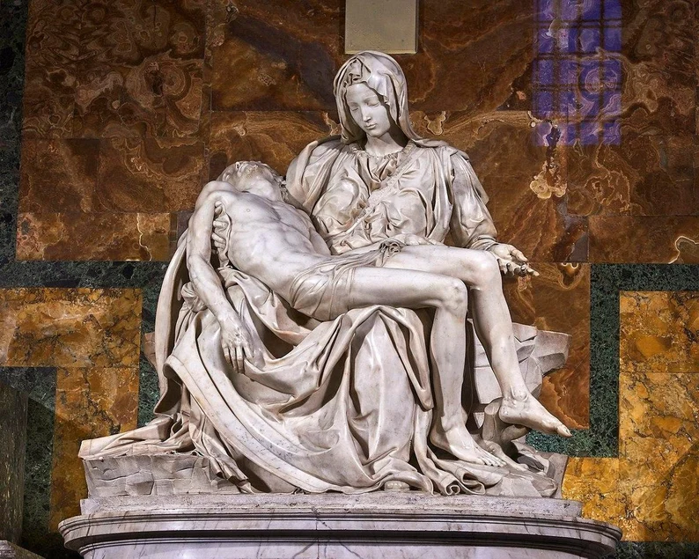
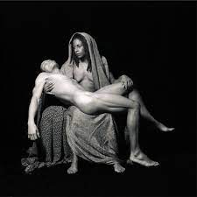
Michelangelo’s La Pieta and Cox’s Yo Mama’s Pieta
La Pieta, 1498-99
Yo Mama’s Pieta, 2001

Slide 20
Application of Principle/Practices to EWRT 1A (Freshman composition)
Traditional Education Practice | Equity Principle | Culturally Responsive Classroom Practices
One dominant culture represented in textbooks and course materials. • High cost of course textbooks and materials. | Represent multiple cultures in textbooks and course materials. • Use low-cost and zerocost textbooks/materials | Center BIPOC authors/experiences in textbooks and course materials. Ex: Textbooks: Heart of Fire: An Immigrant Daughter’s Story by Mazie Hirono Low-cost and zerocost Textbooks/materials by BIPOC author: 3 PDF (free) chapters from Alicia Garza’s book The Purpose of Power, used by permission of the publisher. These chapters were also part of a campuswide “One Book” initiative that multiple disciplines’courses/faculty participated in, culminating in a campus Zoom booktalk/Q&A with Alicia Garza, facilitated by students.

Slide 21
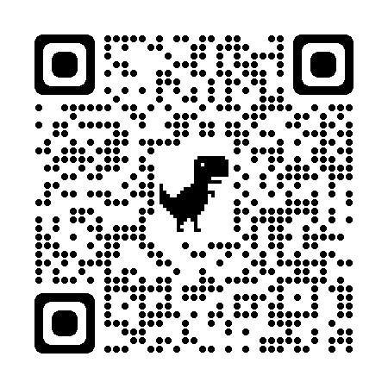
Equity-minded Liquid Syllabus
Emailed to students before the class starts.
Recommended Components:
Welcoming, hopeful language
Welcome note with brief, imperfect video and accurate captions
About This Course
Week 1 Success Kit
Learning Pact
Teaching Philosophy that positions diversity as a value
Inclusive images (with alt-text)
Michelle’s Liquid Syllabus
Michelle Pacansky-Brock, Mt. San Jacinto College
Michelle Pacansky-Brock, CC-BY
Notes:
Think about creating a liquid syllabus using Google Sites. A liquid syllabus is a public webpage is mobile responsive (changes to fit the size of your students’ screens) and has a brief, welcome video from you embedded at the top. Sends it to students the week before the class as a welcome package.
When students on a phone tap on the link, they are instantly taken to a beautiful webpage that is topped with the instructor’s warm human presence. Students are welcomed by a brief, imperfect video (with accurate captions). The video provides those verbal and nonverbal cues that are so essential to social inclusion. The site conforms to web accessibility guidelines; is written with welcoming, hopeful language (sending cues of growth mindset) … let’s take a look at an example.

Slide 22
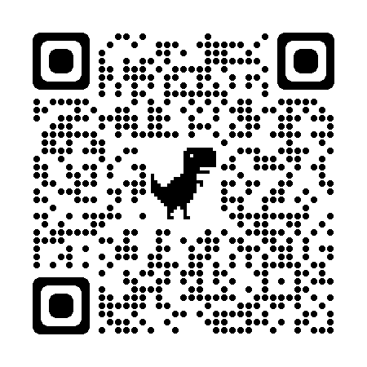
Let’s Share!
Please contribute to our Padlet so we can learn together …
Click here to go to the Padlet OR scan this code on your phone/tablet:
Notes:
Additional characteristics of a warm demander include:

Slide 23
Integrating Culturally Responsive Teaching into the Curriculum Review Process

Slide 24
Elements of a Course Outline of Record
(COR) (Title 5 55002)
The course is described in a course outline of record that shall be maintained in the official college files and made available to each instructor. The course outline of record shall specify the unit value, the expected number of contact hours, outside-of-class hours, and total student learning hours for the course as a whole; the prerequisites, corequisites, or advisories on recommended preparation (if any) for the course; the catalog description, objectives, and content in terms of a specific body of knowledge. The course outline of record shall also specify types or provide examples of required reading and writing assignments, other outside-of-class assignments, instructional methodology, and methods of evaluation.

Slide 25
Curriculum Committee
and Culturally Responsive Teaching
Committee membership:
How is membership determined?
How are students involved?
Curriculum Committee training & periodic check-ins
Opportunities to re-center discussions
When in the process do reviews of content, objectives, assignments, texts, and evaluation methods occur?
Resources and rubrics

Slide 26
Notes:
From DEI in Curriculum: Model Principles & Practices, p. 4

Slide 27
Culturally Responsive Teaching:
Beyond the Curriculum Committee
Department faculty initiate curriculum development and review
Departmental discussions of culturally responsive teaching
Discussions can encourage professional development
Include part-time faculty (new and experienced)
Course outline provided to new faculty
Provides ideas for how to embed active learning and culturally responsive teaching into the conduct of the course.
Sets culturally responsive teaching as a norm in education.

Slide 28
Professional Development

Slide 29
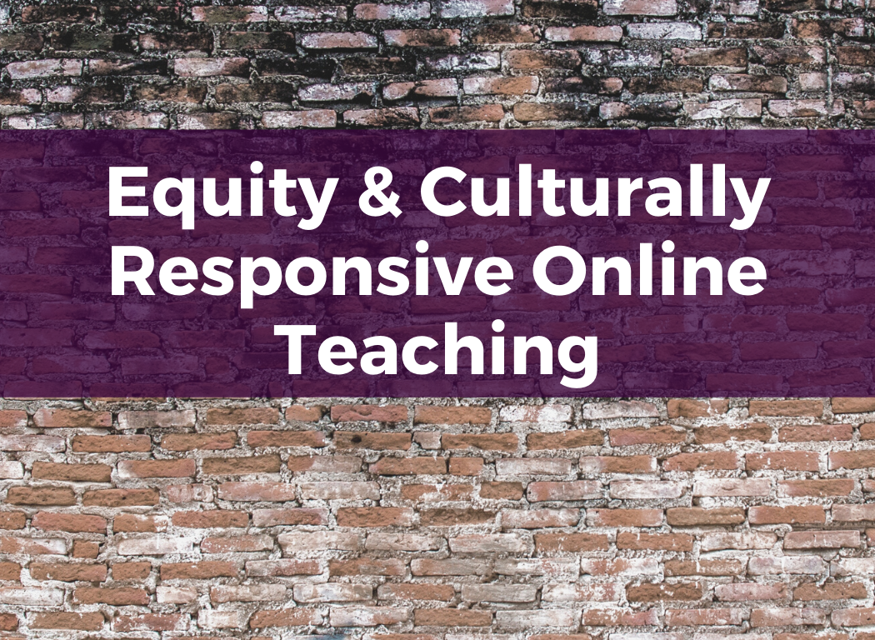
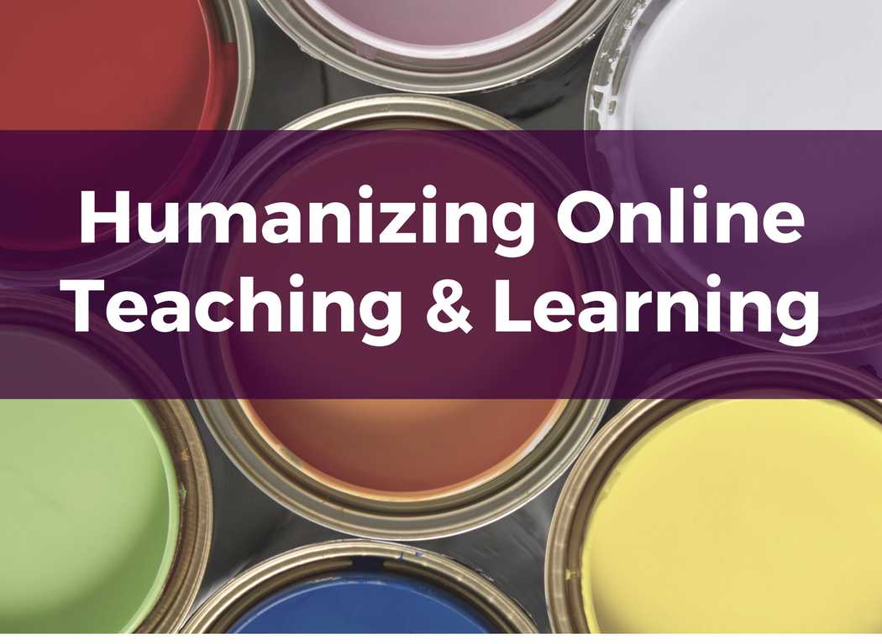
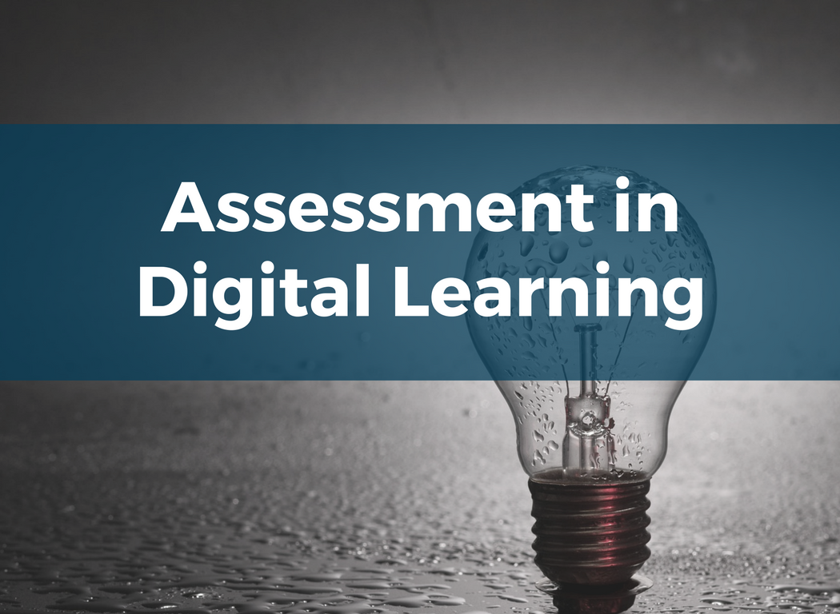
Professional Development from CVC/@ONE
CVC/@ONE is a CC Chancellor’s Office-funded initiative. Courses are designed and facilitated by CC faculty. Continuing ed units (CEUs) are available for an additional fee.
PD in support of equitable, inclusive online courses.
New!
Learn more: https://onlinenetworkofeducators.org/course-cards/
Notes:
In a 1975 study, Judith Kleinfeld found two characteristics that distinguished effective teachers from ineffective teachers of indigenous students (this work was done in Alaska). [CLICK] These are:
The ability to create a climate of emotional warmth that dissipates students' fears and fulfills their expectations of highly personalized relationships.
The ability to express concern for students, not by passive sympathy, but by demanding a high quality of academic work.

Slide 30
Let’s Discuss/ Q&A
Q&A
Please share: What additional information/ideas do you have to contribute to this breakout topic/discussion?

Slide 31
Thank you for participating!
For more information: info@asccc.org

