Slide 1
Effective Practices for Working with Regional CTE Advisory Committees
Friday April 30, 2021 3pm-4pm
Jim Bowen, Faculty
Dr Lynn Shaw, CTE Curriculum Director
Olivia Herriford, Regional Director, ICT and Digital Media
Alan Braggins, Statewide Director Advanced Manufacturing
Susanne Mata, Regional Director, ICT and Digital Media

Slide 2
Career and Technical Education
Regional Advisory Committees
The Career and Technical Education Advisory Committees include representatives from business, industry, labor, community agencies, faculty, students and other members.
The primary purpose of advisory committees is to provide direction and guidance for the specific career and technical area within the college to strengthen and enhance the success of college programs.

Slide 3
Goals and Objectives Of a Career Education Regional Advisory Committee
Job opportunities
Assist in surveying workforce needs and new and emerging occupations
Advise on the changing nature of the competencies in industry and career fields
Assist in gathering information for job placement of graduates
Inform the program of opportunities to place students in full-or part-time jobs

Slide 4
Goals and Objectives Of a Regional Career Education Advisory Committee
Facilities and program equipment
Consult on existing equipment, facilities, and resources and compare with career norms
Consult on lab equipment and compare with the current and future technology and industry/profession standards
Consult on lab safety program

Slide 5
Goals and Objectives Of a Regional Career Education Advisory Committee
Course content
Consult on the development of educational objectives
Review the program’s sequence and scheduling of courses and delivery options
Review and suggest content for courses of study and standards of proficiency in areas which are essential to becoming successfully employed in a career path

Slide 6
Goals and Objectives Of a Regional Career Education Advisory Committee
Instructional and learning experiences
Identify or suggest resource personnel to enrich the instructional content
Assist in locating and obtaining equipment and supplies on loan, as gifts, or at special prices
Suggest qualified persons for needed instructor/personnel vacancies
Participate as a resource person to enhance the instructional process

Slide 7
Goals and Objectives Of a Regional Career Education Advisory Committee
Promoting education
Participate in programs designed to promote career and technical education
Testify in support of career and technical education at meetings which may be called by local and state officials, boards, and legislative groups
Encourage other businesses to stimulate development of work experience programs
Build interest and understanding between the college and community and professional organizations

Slide 8
Creating a Regional Career Education Advisory Committee
Research Local Employers in your Specialty
Determine Point of Contact and keep a list of Phone # and/or Email
Attempt contacting and follow-up as needed. Request Volunteers
Check with fellow Instructors-full time and Adjunct for Leads
Follow-up obtaining qualified Volunteers
Check with present/past students, if feasible, working in the field
Request contacts and follow-up - obtaining volunteers.
Success rate? Questionable and Time Consuming!

Slide 9
South Central Coast Regional Consortium Resources Available:
Collaborative meetings with all Consortium Members
Colleges
Industry
High Schools
Resources for
CyberPatriot and National Cyber League
CALPOLY San Luis Obispo and the California Cyber Hub
Competition Judges are Industry looking for future employees and to have input on training

Slide 10
Success = Follow-up + Planning
Encourage Students to register with Linked-In for follow-up
Use Linked-In for future leads, and new Advisory members.
Most Computer Jobs require a background check – Introduce Infraguard.org and encourage it.
Industry Certifications, Microsoft, CompTIA and others are being required to get jobs.

Slide 11
Regional Career Education Advisory Committees
Bay Area Community College Consortium
Communities of Practice

Slide 12
Regional Career Education Advisory Committees
Inland Empire/Desert Region Strong Workforce Pilot Project
Initial Funding in 2016 (Round One) and Renewed in 2019 (Round 4)
Managed by the Regional Directors, Employer Engagement
Administered by a funded Project Director
One Advisory per sector, per year
May meet Perkins Requirements

Slide 13
Regional Career Education Advisory Committees
Community of Practice
LinkedIn Groups for Continuing Relationships
Not a one-and-done event
Skills Panel Format
Industry Speaks – Educators Listen
Advance Review of Curriculum
Submit curriculum to Industry Advisors in advance for Review

Slide 14
Cumulative Attendance

Slide 15
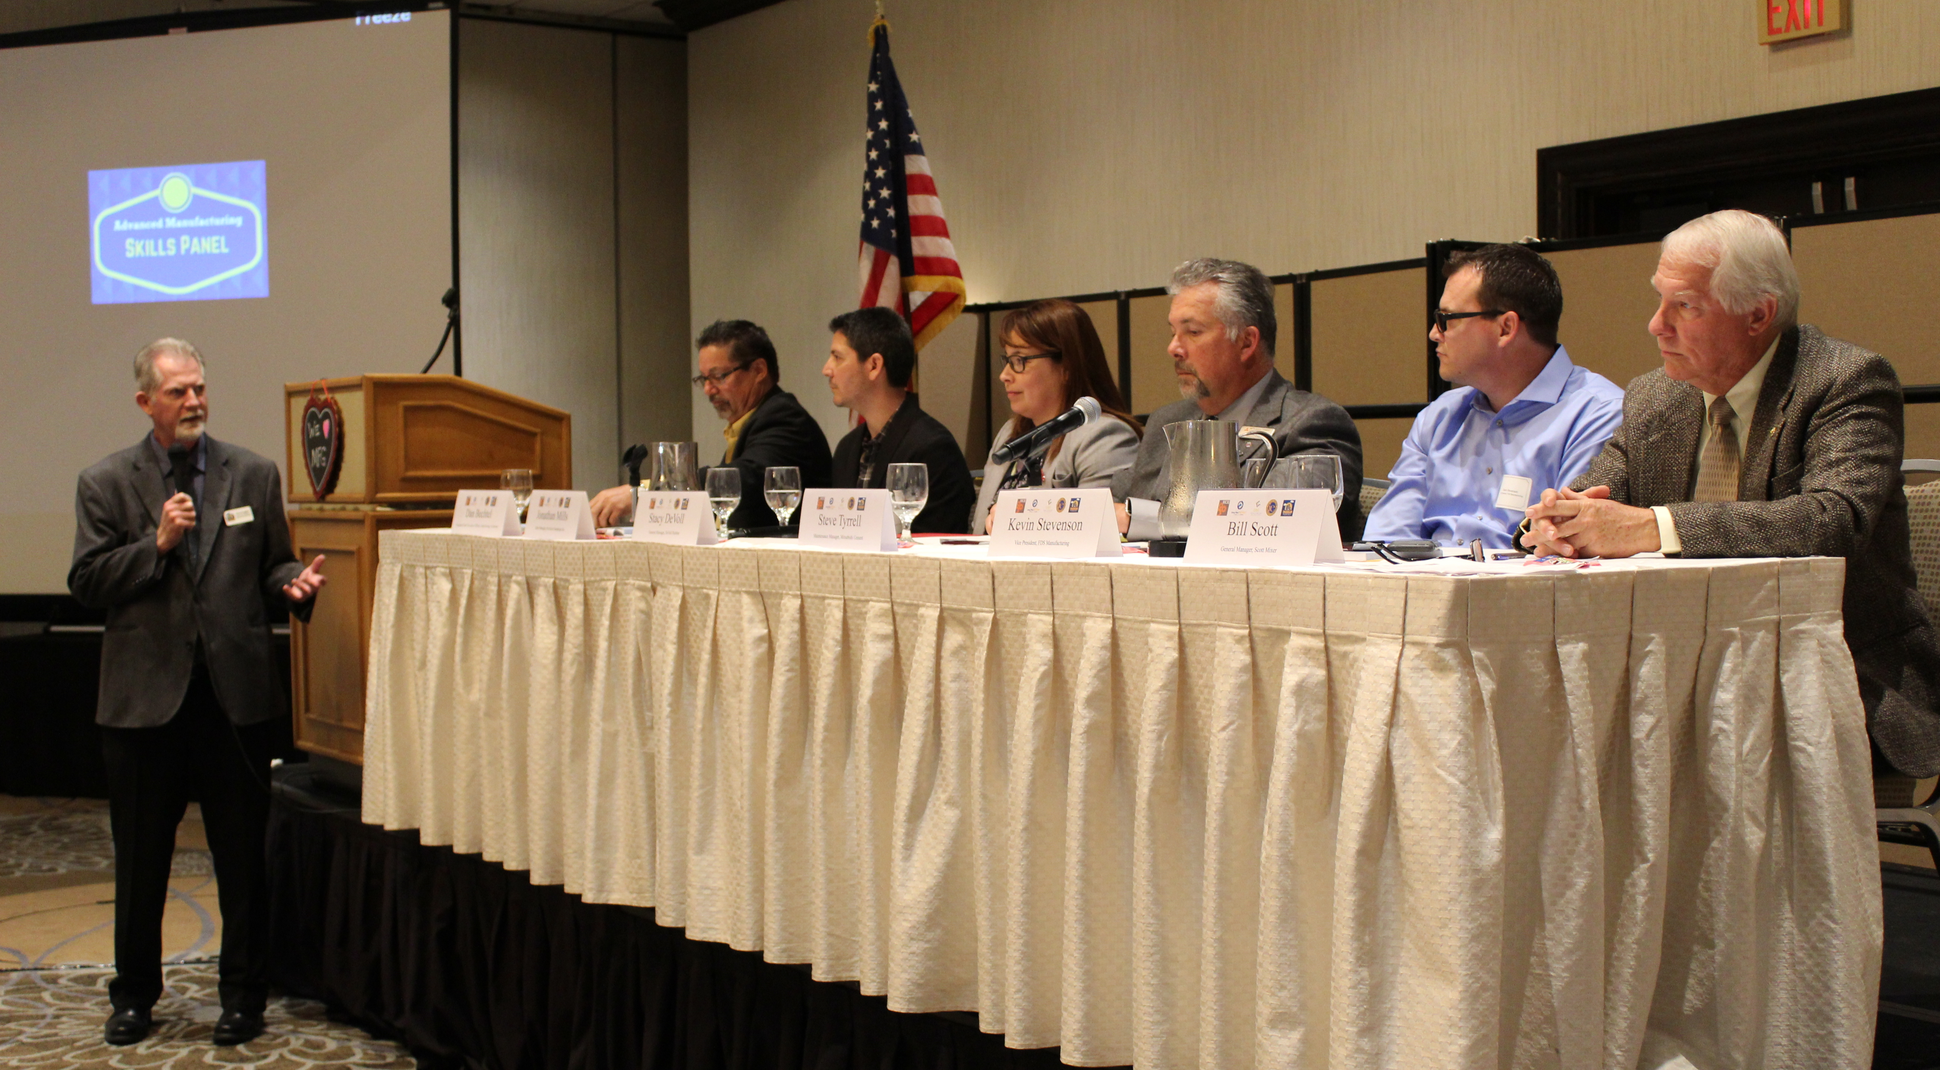
Regional Career Education Advisory Committees Original Meeting Format
Skills Panel
Curated Q & A by emcee, RDEE or industry guest
Allow limited time for audience questions
Industry Speaks
Educators Listen

Slide 16
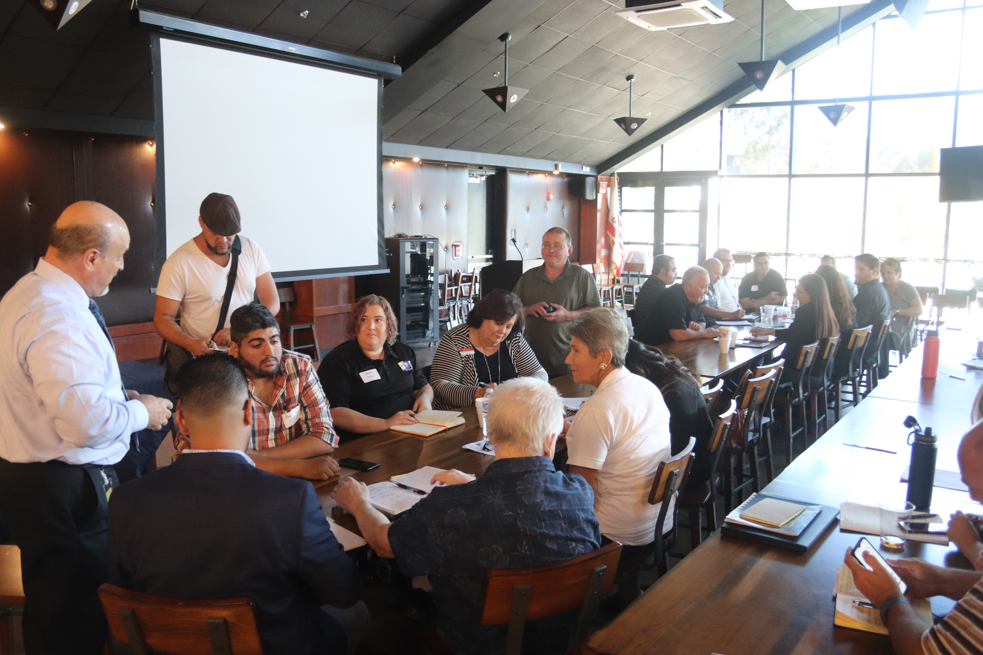
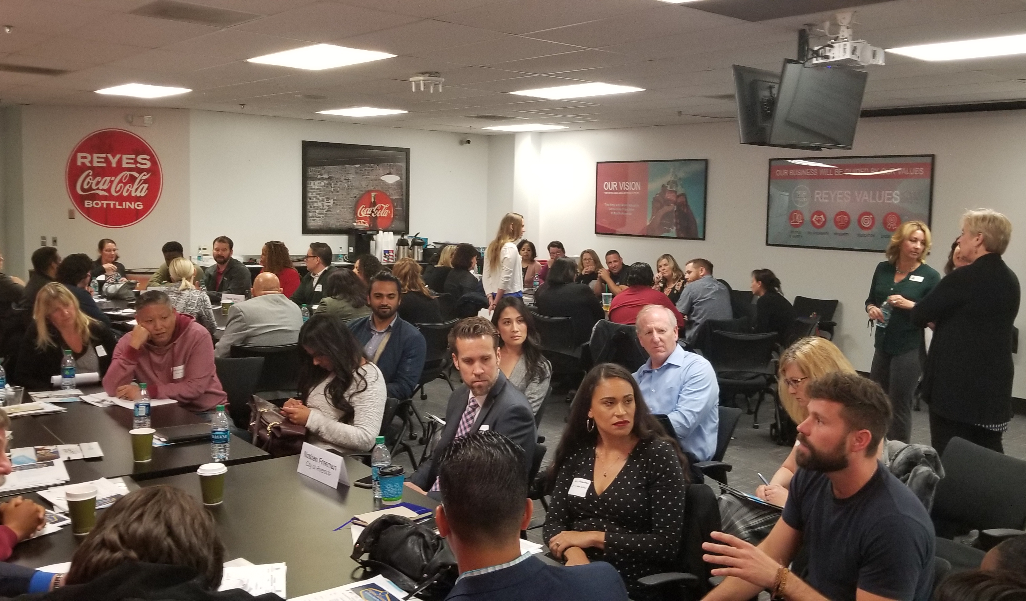
Regional Career Education Advisory Committees Breakout Groups
By Sub Sector Musical Chairs

Slide 17
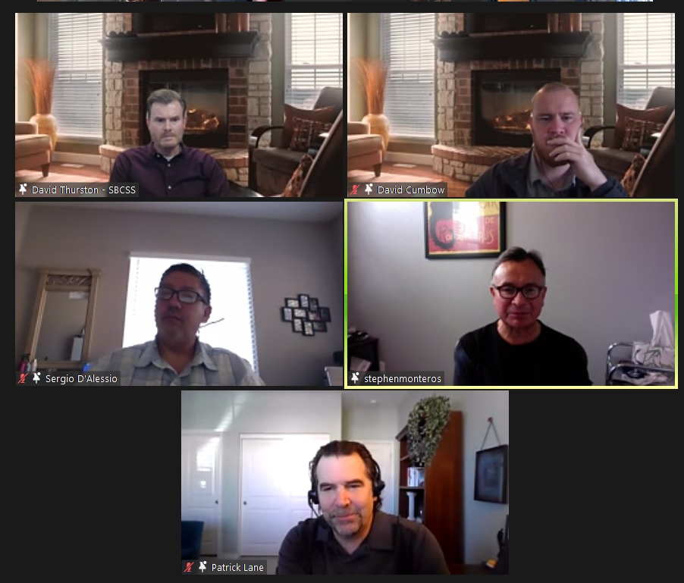
Regional Career Education Advisory Committees Current Evolution
Virtual Advisory Format Fireside Chat Format

Slide 18
Regional Career Education Advisory Committees
Contact Information:
Susanne Mata
Regional Director, ICT & Digital Media Sector
SMata@sbccd.edu
Alan Braggins
Statewide Director, Advanced Manufacturing
Alan.Braggins@CACT.org
CACT.ORG
DesertColleges.org

Slide 19
Discussion and Questions
Any comments, examples, or advice from the group?

Slide 20
Resources
A listing of the California Community College regional and statewide directors in various industry sectors.
https://www.cccco.edu/About-Us/Chancellors-Office/Divisions/Workforce-and-Economic-Development/Technical-Assistance-Providers
This is a toolkit on steps to adding qualified industry experts to your hiring pool by recognizing industry experience as equivalent.
https://asccc.org/sites/default/files/ADAversion_CTEMinQualsToolkit.pdf
166 page 2019 version of the Program and Course Approval Handbook (know as PACH
https://asccc.org/sites/default/files/CCCCO_Report_Program_Course_Approval-web-102819.pdf

Slide 21
Resources
A listing of the California Community College regional and statewide directors in various industry sectors.
https://cact.org/wordpress1/industry-sectors/
ASCCC CTE Labs Webinar Report.
https://drive.google.com/file/d/1TEekzcMsI_a8vIJs0AsG0KUZU-Ji3JQm/view?usp=sharing

Slide 22
Dr. Lynn Shaw shawlynn@gmail.com
Jim Bowen jbowen@avc.edu
Alan Bragggins Alan.Braggins@cact.org
Olivia Herriford olivia@baccc.net
Susanne Mata smata@sbccd.edu

