Slide 1
California Community Colleges Bachelor’s Degree Pilot Programs
Stephanie Curry, ASCCC North Representative
Dolores Davison, ASCCC Vice President
Craig Rutan, ASCCC Data and Technology Specialist

Slide 2
Breakout Description
Following legislation in 2014, fifteen community colleges have been given the ability to grant baccalaureate degrees. Ensuring that these opportunities are meeting the needs of students hasn’t always been easy, but those involved in these programs believe that these opportunities should expand and be permanent. Join us for a discussion about the steps it took to establish California community college baccalaureate degrees, challenges for moving the baccalaureate programs forward, and how colleges without baccalaureate degrees can support the existing programs by encouraging their students to consider transferring to a California community college with a Baccalaureate program instead of another university system.

Slide 3
History of the Bachelor’s Degree Program
In September 2014, Governor Jerry Brown signed Senate Bill 850 (Block) in to law. This legislation allowed up to 15 community colleges to be selected as baccalaureate offering institutions.
The Chancellor’s Office received 34 applications to participate in the Baccalaureate Degree Pilot Program.
By May 2015 the Board of Governors approved the 15 Baccalaureate Degree Pilot Program colleges.

Slide 4
History Continued
$6 million was received for implementation support and professional development for the BDP programs. Each BDP district received $350,000 and NOCCCD received a grant for $750,000 for professional development activities
BDP Handbook committee created guidelines to establish the parameters for offering bachelor’s degrees
Title 5 regulations authorized the BDP Handbook

Slide 5
Programs that Started in Fall 2016
Antelope Valley – Airframe Manufacturing Technology
Bakersfield – Industrial Automation
Feather River – Equine and Ranch Management
Foothill – Dental Hygiene
Rio Hondo – Automotive Technology
San Diego Mesa – Health Information Management
Santa Monica – Interaction Design
Shasta – Health Information Management
Skyline – Respiratory Care
West Los Angeles – Dental Hygiene

Slide 6
Programs that Started in Fall 2017
Cypress – Mortuary Science
MiraCosta – Biomanufacturing
Modesto – Respiratory Care
Santa Ana– Occupational Studies
Solano – Biomanufacturing

Slide 7
Spring 2018 Graduates
Bakersfield College, Cypress College, Feather River College, Foothill College, San Diego Mesa College, Santa Monica College Shasta College, Skyline College, West Los Angeles College
Total of 113 Graduates from 9 different colleges

Slide 8
Spring 2019 Graduates
All 15 BDP Colleges will have graduates in Spring/Summer 2019
Some self-reported numbers:
Antelope Valley = 10 (first cohort)
Cypress = 8
Foothill = 46
Rio Hondo = 16 (first cohort)
San Diego Mesa = 16
Solano = 14 (first cohort)
**Official numbers are being reported this term

Slide 9
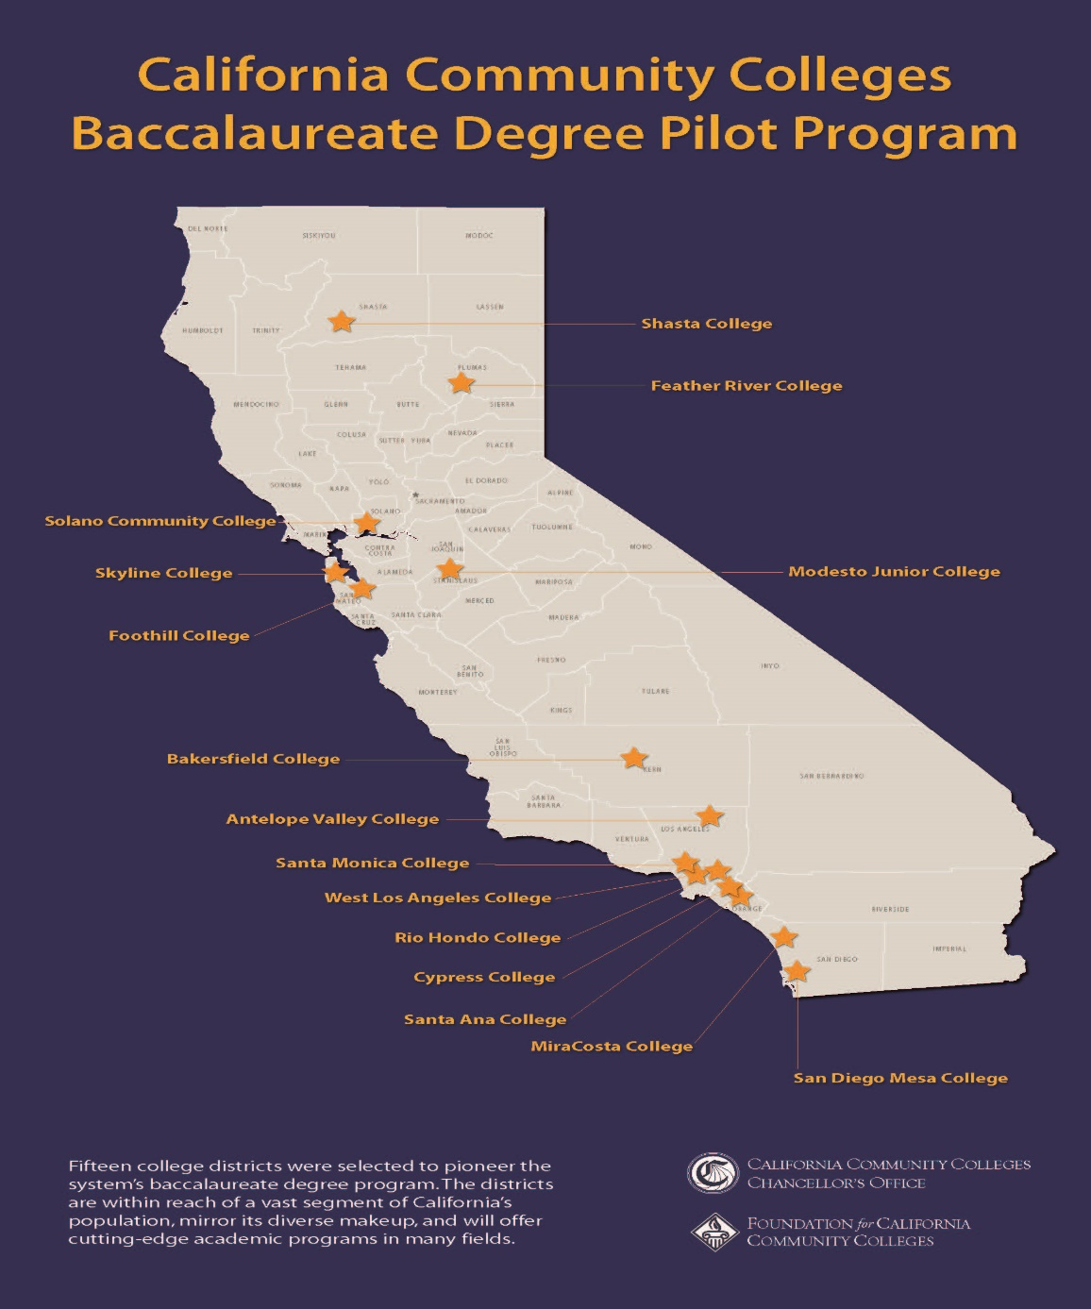

Slide 10
Restrictions in SB 850
Cannot have more than one program per district.
Cannot be duplicative of programs offered at CSU or UC.
At the time of the bill’s passage, ACCJC could not offer accreditation for more than one baccalaureate program per college (that has changed)

Slide 11
Establishing a BDP Program
There is currently no legislation that will allow for the establishment of additional programs. However, if the opportunity comes colleges can do the following:
Look at job growth in the area to see what program would benefit from a bachelor’s degree.
Ensure the program is not offered at CSU or UC****
Work with local industry for buy-in and to create a program that would allow students to go from graduation to work.
Ensure that program shows that a bachelor’s degree is needed in the field.
Ensure that the college can sustain the program without additional funding from the state.

Slide 12
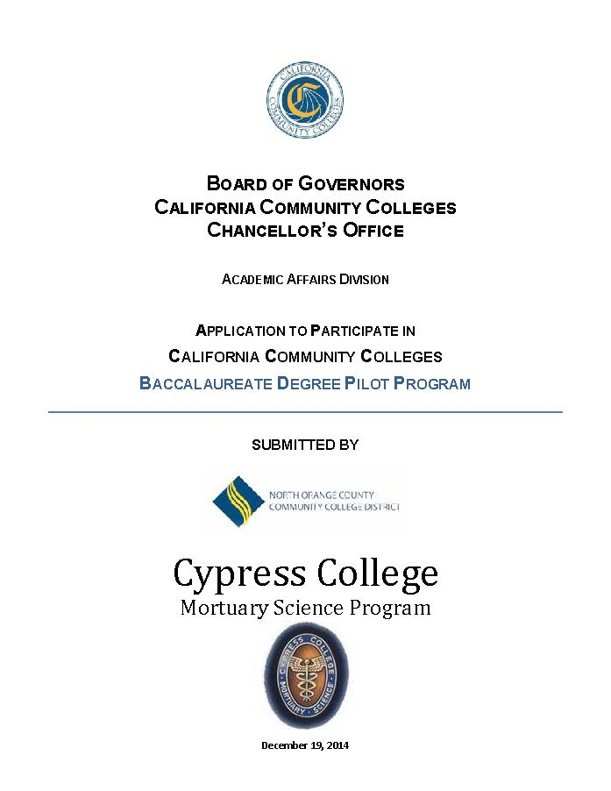
One Model of an Initial Design Process
Initially drafted using CSU/UC template and the CSU-GE/IGETC pattern
Considered the national discipline accreditation standards
Mirrored other BS degrees currently offered in the discipline

Slide 13
Program Development
Outreach to local community, other regional programs that offer associate degrees, discipline and industry partners
Pathways created from both native associate degrees as well as others around the state
Marketing in discipline specific publications, local media, other regional colleges

Slide 14
Steps for Implementation
Curriculum approval and offerings
Enrollment and orientation
Credit for prior learning

Slide 15
Challenges

Slide 16
Challenges
Ongoing marketing – community support
Enrollment - Transition from A.S. Program
Lower Division General Education
Board Accreditation as well as ACCJC
College community awareness
Pilot Status

Slide 17
Support/Next Steps

Slide 18
Supporting BDP Colleges
Aligning lower division courses with lower division at BDP Colleges so that students can have a seamless transfer.
Work with the CTE-C-ID Model Curriculum Workgroup to establish model curriculum for the BDP College programs.
Contact your local senator or assembly member and let them know you are supportive of legislation that would take the colleges out of pilot status.

Slide 19
Moving Forward with BDP - ACCJC
ASCCC and the Chancellor’s Office have agreed that baccalaureate degree students should complete a minimum of 41 units of general education (36 lower division and 6 upper division).
ACCJC requires that students complete a minimum of 36 units of general education (27 lower division and 9 upper division).
ACCJC requires more lower division GE than Title 5 §55063

Slide 20
Moving Forward with BDP - GE
Colleges are required to impose GE requirements that satisfy the Chancellor’s Office and ACCJC.
This means that students will be required to complete 45+ units of general education to complete a baccalaureate degree.
If the BDP is to become permanent and expand, the CCCs may need to develop their own general education pattern.

Slide 21
Additional Steps to Move Forward
Baccalaureate degrees should be given the same point value in the SCFF as ADTs.
There needs to be a systemwide way to track students that enter the program as freshmen, as juniors, and to distinguish those students from students that take an upper division course because they are interested.
All CO level technology must fully integrate the baccalaureate programs and not treat them as separate or temporary.

Slide 22
Additional Steps (2)
The Legislative Analyst’s Office is currently collecting data to submit a report to the Legislature about the programs. This report is due in February 2020.
Colleges with a baccalaureate program should inform students in AS programs that lead into a BDP that this option is available for them.
In order for the Legislature to make the programs permanent and consider expanding the programs beyond the first 15, we must work together as a system to make them as successful as possible.

Slide 23
Additional Steps (3)
Potential pending legislation
LAO Report due in February regarding current programs
Current resolutions (F19):
Requesting an end to the pilot status of the program as well as a reversal of the previous ASCCC position in opposition to the creation of Baccalaureate programs
Expansion of the program with a focus on Allied Health

Slide 24
Questions? Info@asccc.org

