Slide 1
OER in biology
Research findings

Slide 2
Presenters
Kristyn Vander Waal Mills
Saint Paul College - Saint Paul, Minnesota
Jeff Schinske
Foothill College – Los Altos Hills, California

Slide 3
tinyurl.com/ASCCC-OpenEd

Slide 4
Implementation of Open Textbooks in Community and Technical College Biology Courses: The Good, the Bad, and the Data
Summary of published paper:
Vander Waal Mills, K E; Gucinski, M; Vander Waal, K. (2019). CBE-Life Sciences Education,18 (3). https://doi.org/10.1187/cbe.19-01-0022
Have you ever wondered how useful textbooks are in a course? Are Open Textbooks better or worse than traditional textbooks? Are students still successful with these “alternative” books? We collected data from 33 classes (4 different colleges) and around 900 students on the effectiveness of an Open Textbook in General Biology. In addition, we surveyed biology students and biology faculty on their use and perceptions of these Open Textbooks. We will share the results with you and give data-driven ideas about how to implement the texts, the challenges, and possible solutions.
This work is licensed under the Creative Commons Attribution 4.0 International License. To view a copy of this license, visit http://creativecommons.org/licenses/by/4.0/ or send a letter to Creative Commons, PO Box 1866, Mountain View, CA 94042, USA.

Slide 5
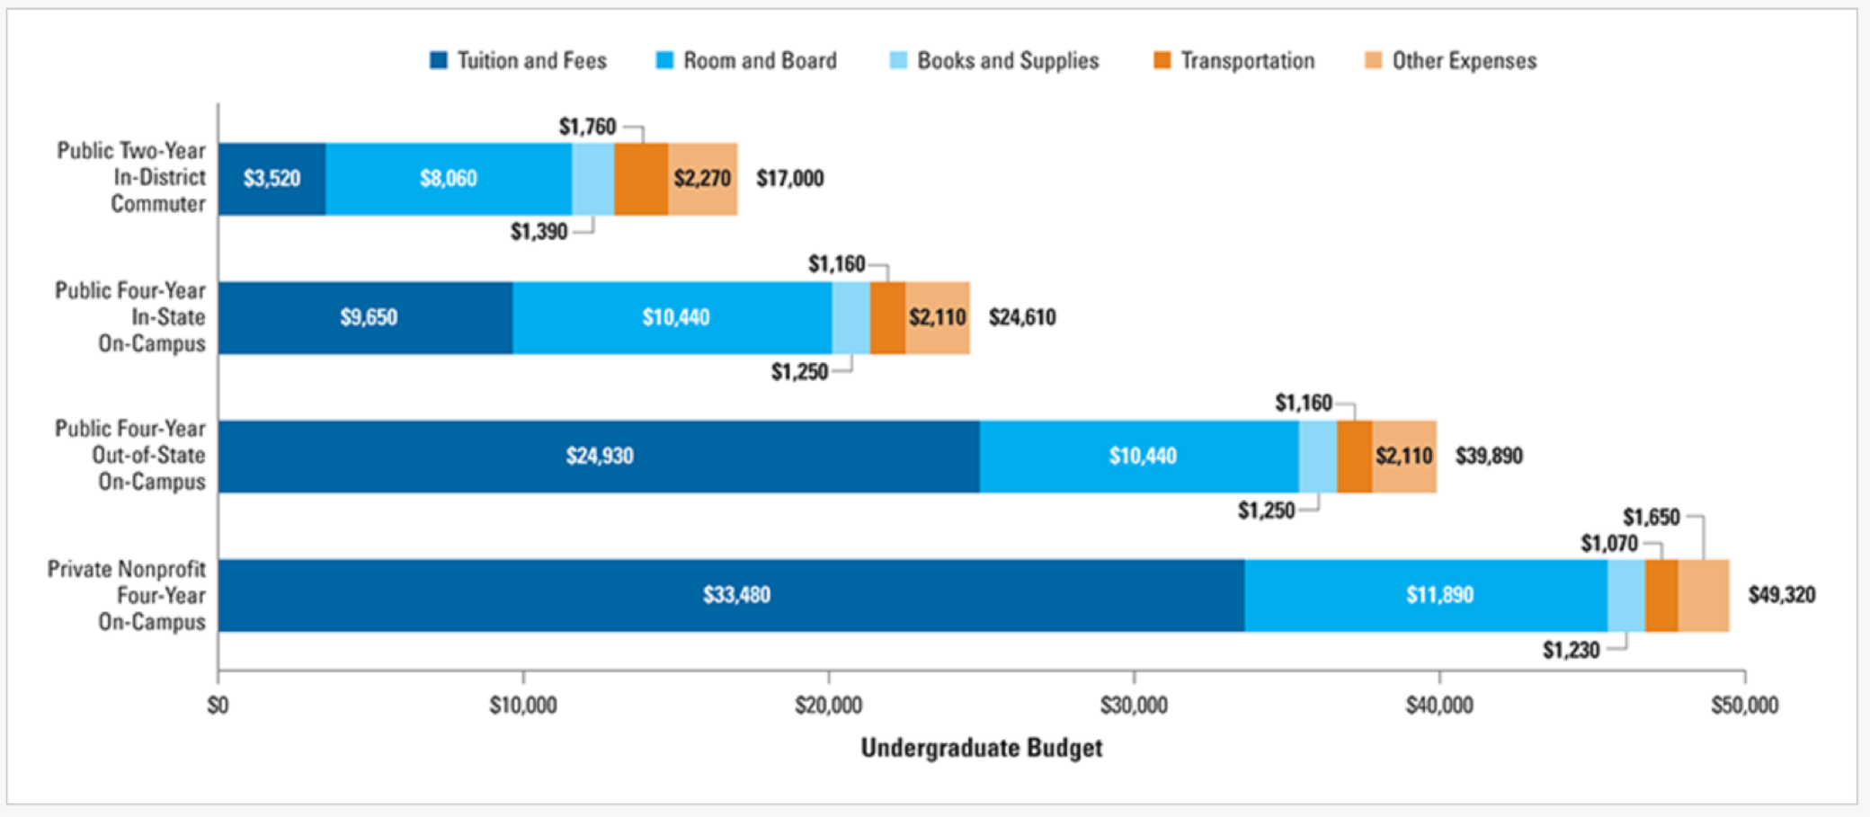
The Textbook Cost Challenge
College Board, 2017
A student pays ~$1400 per academic year in books and supplies at two-year colleges.
Cost is particularly onerous at two-year colleges where students typically have lower incomes and textbooks are a larger percentage of the overall cost of education
Discuss: How much do your textbooks cost? Do you run into issues of students not accessing the material until several weeks into class?
Notes:
2015-2016 data
2 min

Slide 6
Open Educational Resources (OER): A possible solution
To cut book expenses, can use Open Educational Resources (OER)
“Open” means they can be accessed by anyone
Educational
For non-commercial purposes (UNESCO, 2002)
Open textbooks (a subset of OER) directly replace expensive commercial textbooks
free online
use Creative Commons licenses so that teachers and others can revise them to better meet the needs of local students (Johnstone, 2005; Bissell, 2009; D’Antoni, 2009)
Example:

Slide 7
Questions About Open Textbooks
Where can I find one for my course?
Do faculty like them?
Do students learn well from them?
Are they high quality (if anyone can create)?
How about support materials?
How can these textbooks be free? Who funds them?
How about online homework programs?
Discuss: Do you use any OER materials? Why/why not? How do you choose the materials for your courses?
Notes:
How can OER be viable from an economic standpoint? Basically, a donor funds the open text production. For example, a University (SUNY, Purdue), foundation (Bill and Melinda Gates), or government (British Columbia) produces the material and releases it to the public.

Slide 8
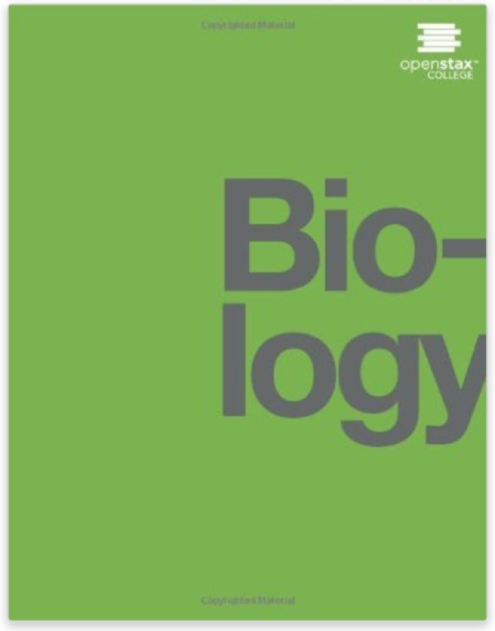
Finding Open Textbooks for Your Course
U of MN database of OER textbooks (http://open.umn.edu/opentextbooks/Ourbooks.aspx)
o All are open and used at more than just the author’s institution
o All available in a downloadable format
o Many are reviewed by faculty
Widely-used OER for biology is OpenStax Biology (Rice University) (https://openstax.org/details/books/biology)
o Print copies available for ~$50 (less, if you do B&W copies)
o Some instructional resources available
o Book can be used with online learning tools (Sapling Learning, Wiley Plus)
Notes:
Downloadable format - like a pdf
Instructional resources - PPTs (mostly just the figures), review/test questions

Slide 9
Textbook Choice
How textbooks were chosen in our survey
But is the quality really different? Do students really learn better with one vs another?
Notes:
*Faculty could choose more than one reason for choosing textbook
Note cost differences; students learn well vs. cost effectiveness (priorities are different)
*More on methods and results coming next!

Slide 10
Digging into textbook effectiveness and perceptions
1) Recruit faculty willing to try the textbook and collect data (while telling more faculty about OpenStax Biology).
2) Collect data on student performance in courses using a published textbook and courses using the OpenStax Biology textbook (~1000 students total; 33 courses; 4 colleges). And statistical modeling!
3) Survey our biology students on perceptions and use of the textbook. And stats!
4) Survey biology faculty on perceptions and use of textbooks (OER or otherwise). And stats!
6) Share results widely! As few studies to date focus on the adoption of OER biology materials OR on two-year schools OR on attitudes of non-OER users
Collaborators: Anoka Technical College (my previous college), Saint Paul College (Sandy Vue, surveys; Joanna Cregan; biology professor; myself), MN State (OER Grant and administrative support), Century College (Michelle LaBeau), St. Cloud Community and Technical College (Mark Gucinski), University of Minnesota (Kimberly VanderWaal, statistical analysis)

Slide 11
Does the textbook matter?
Discuss: What do you think? How do students use textbooks in your class? What makes the biggest difference(s) to student success (textbook quality, textbook use, in-class learning, other resources)?
Notes:
Before I show you any data…

Slide 12
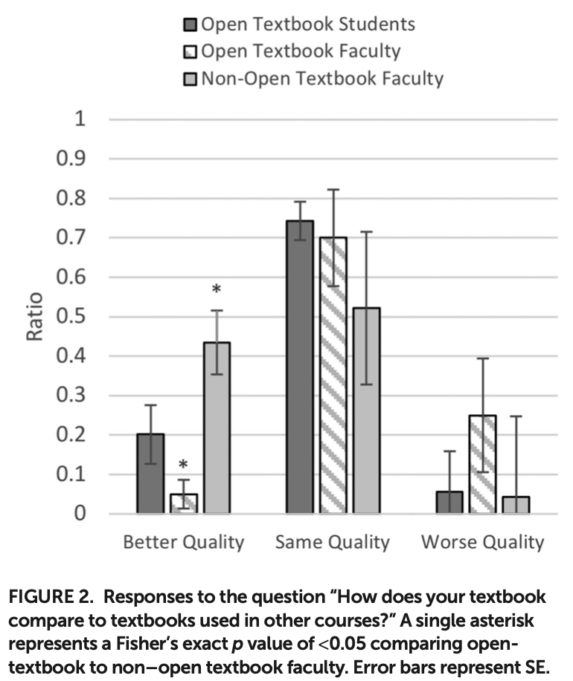
Does the textbook matter?
Data on quality of textbooks
Non-OER faculty find their textbook better
At least three studies find similar results where at least 50% of students and instructors find the OER textbook equal in quality to other textbooks (Bliss et al., 2013a and b; Hilton 2016)
Notes:
- Bliss et al. (2013b) surveyed 58 instructors and 490 students at eight colleges and universities on OER experiences. Fifty percent reported equal quality between traditional and open textbooks, and forty percent reported better quality of the open resource.
- (Bliss, 2013a), most instructors continued to find the open textbooks as equal or better quality than traditional textbooks. Fifty-five percent found they were the same quality, and 35 percent felt they were an improvement over their previous texts.
- Hilton 2016 found that across nine studies involving 4,510 students and faculty that “half of students found OER to be comparable to traditional resources, a sizeable minority believed they were superior, and a smaller minority found them to be inferior.”

Slide 13
Does the textbook matter?
Data on quality of textbooks
Student comments on their (OER) book | Faculty comments on their (OER) book | Faculty comments on their (non-OER)book
SAME “It is the same because I don't exactly use any of my textbooks.” | SAME “I really think it is pretty equal to a text like Campbell Biology, but it is SO much less expensive for students.” | BETTER “Campbell's Biology in a standard and essentially perfect textbook for the first year of biology. Comprehensive and well-organized.”
WORSE “I felt it was harder to understand the material in this text then other books I had to use.” | WORSE “I wish that some of the diagrams and pictures were better in the text.” | WORSE “There are not a lot of ancillary materials to use with this text.”
BETTER “It was less expensive. The online book is easily accessible from my laptop, tablet and phone.“ | BETTER “Free and great examples and resources!” “like the links embedded within the chapters for videos and animations.” | BETTER “This book has good illustrations and also the depth necessary for the general biology class. Students also like the online resources.“
Notes:
selected comments after the better/same/worse question. There are many more, mainly along these same lines. Discuss the results so far… does it change your mind/make you think more about your use/non-use of OER?

Slide 14
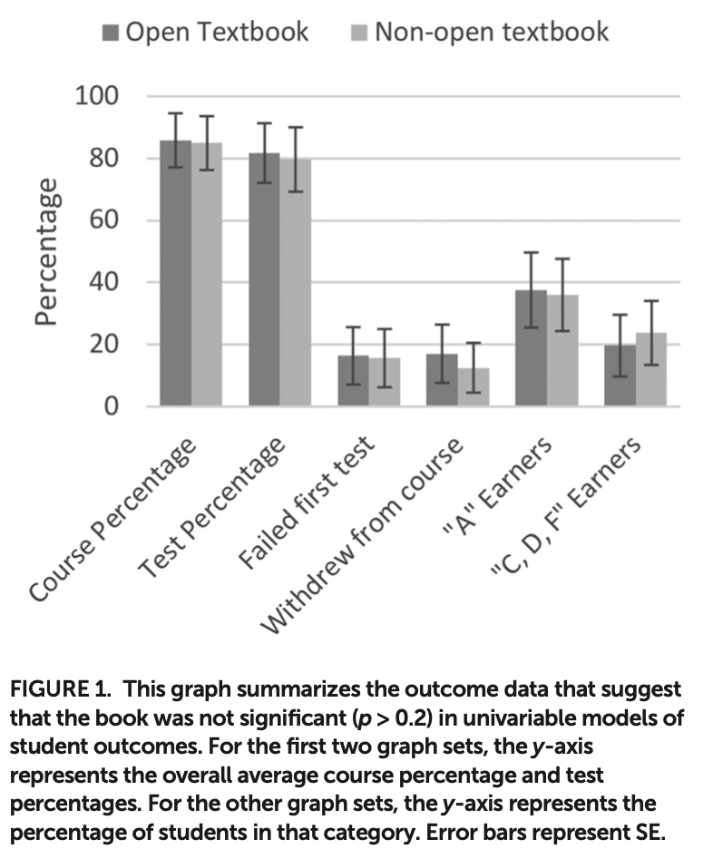
Does the textbook matter?
Data on student outcomes vs. textbooks
We analyzed 8 student outcomes (4 shown here) using generalized linear models (GLMs)
Random effects due to course/school/instructor differences were built into the models
Book was not significant (p > 0.2) for any outcome in univariable models
These results are similar to other published findings (Hilton et al., 2013; Hilton, 2016; Robinson et al., 2014)
Notes:
7 outcomes per student: course percentage, mean test percentage, pass/fail grade on first exam (yes/no), class withdrawal (yes/no), received an A (yes/no), and received a C, D, or F (yes/no). Also first exam percentage though this data was not available at the student level. Dependant variables with binomial outcomes (yes/no) were analyzed using mixed-effect generalized linear models (GLMs) with logit link functions (i.e., logistic regression). Continuous variables, including course percentage (student-level), mean test percentage (student-level), and first exam percentage (course-level), were analyzed with GLMs with logit link function and a beta distribution for the response to account for the fact that the dependent variable was bound between 0 and 1. For course percentage and first exam percentage, which both had had values that exceeded 1.0 due to extra credit, values were re-scaled to ensure that all values fell within 0 and 1 by subtracting 0.1 from all values. In all regressions, random effects were included to account for clustering of students within courses, with course ID nested within instructor included as a nested random effect. Logistic and beta GLMs were performed using the lme4 and glmmTMB packages (cite), respectively, in R Statistical Software (v3.2.4).

Slide 15
Does the textbook matter?
Discuss the results so far: Does it change your mind/make you think more about your use/non-use of OER? Are the student comments or faculty comments/opinions more important in textbook decisions?
Notes:
(Differences in use of textbook and factors that DO impact student outcomes coming soon!)
- After OER adoption by a math department at a community college, scores on department exams were essentially unchanged compared with previous semesters when traditional textbooks had been utilized (Hilton et al., 2013)
- In nine OER efficacy studies (involving 46,149 students), 93% of students achieved the same or better outcomes when OER were implemented (Hilton, 2016)
- After open science textbooks adoption in three high school science subjects (1274 students), standardized test scores were slightly higher (but statistically significant) in the group utilizing OER (Robinson et al., 2014)

Slide 16
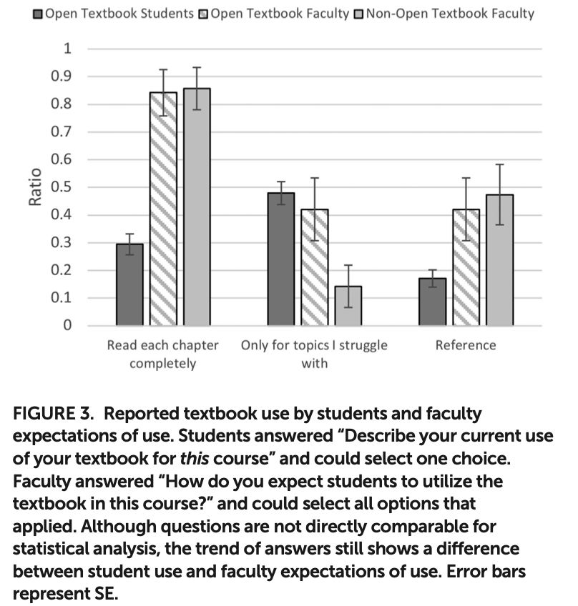
Maybe textbook only matters when…
If students read the book?
These are self-reports student use vs. faculty expectation of use
So, can't do statistics between student and faculty answers
Note ~28% of students actually reading vs. ~85% of faculty expecting that students read
OER faculty are more likely to find the book used only for topics students struggle with
The trend suggests different ideas on the use of the textbook
Notes:
(Perhaps it is course specific? As in, different classes might have different ideas on textbook necessity (these faculty teach a mix of classes)

Slide 17
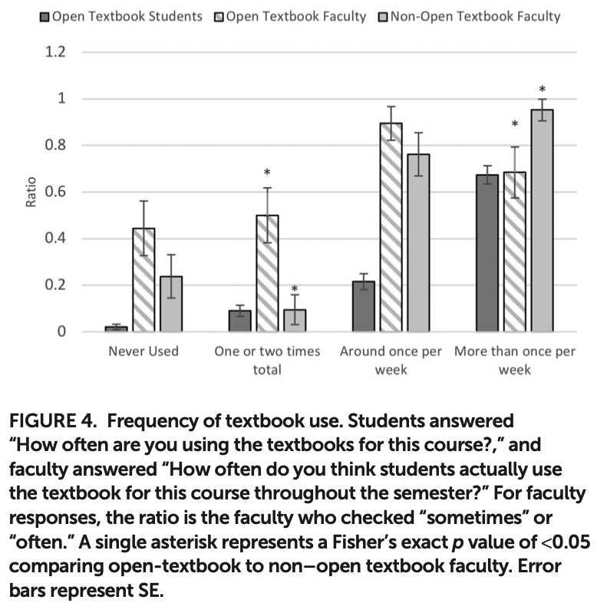
Maybe textbook only matters when…
Students use textbook differently?
these are reports of how students actually use vs. faculty expectation of use
OER students use textbook fairly often (perhaps more than what OER faculty thought?)
again, due to question format differences, cannot do statistics between student and faculty answers
OER faculty think students use the textbook less often than non-OER faculty but students ARE using the book in some way!
Notes:
students chose one answer; faculty ratio is how many chose sometimes/often for that category

Slide 18
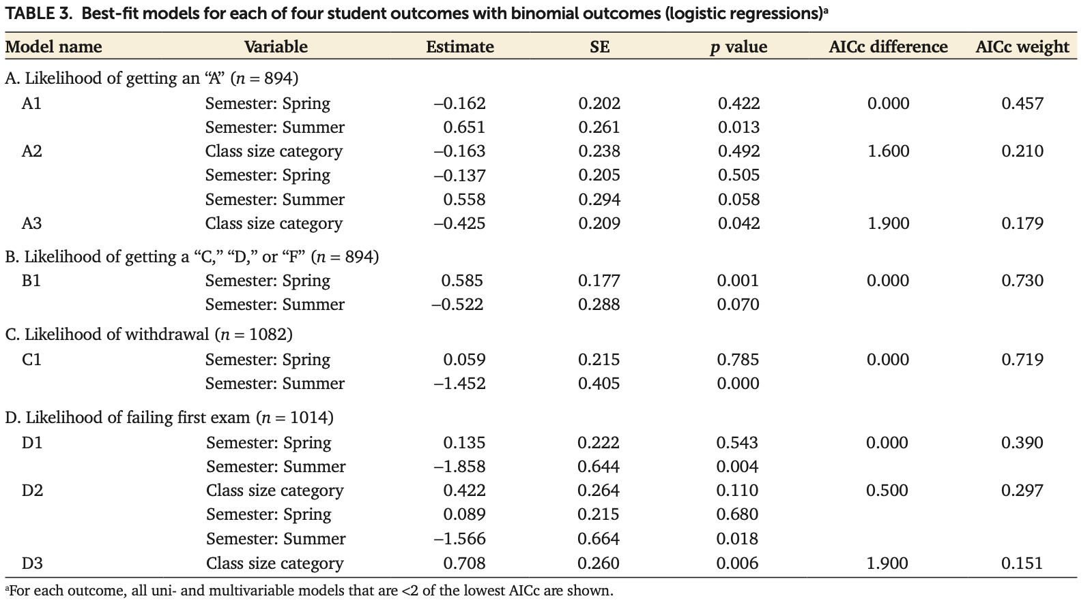
So what does affect student outcomes?
Sample Statistical GLM Results
We also looked for interactions between 7 student outcomes and semester (fall, summer, spring), course format (seated, online, hybrid), and class size (<29 students, >29 students). Model data
Notes:
Mention earlier slide
Multivariable statistics can be shown (at another time), if interested. Class size category breaks for small and large classes were based on the median class size in the dataset (29 students). Variables were first screened in univariable analyses with either logistic or beta GLMs. For multivariable regression, all variables were included in a full model, which was then backward selected until a minimal univariable model was reached. An interaction between book type and class format was considered plausible and was also explored. Model comparisons of multi- and univariable models were performed to select the best-fit model using the Akaike information criterion corrected for small sample size (AICc). Models with AICc values within 2.0 of the model with the lowest AICc were considered equally good fits for the data
Also summer earn higher test % by 30% and spring earn lower text % bt 12%

Slide 19
So what does affect student outcomes?
Summary of all significant findings in student outcome data
We also looked for interactions between 7 student outcomes and semester (fall, summer, spring), course format (seated, online, hybrid), and class size (<29 students, >29 students). All stats in this summary have p < 0.05.
Large classes (as compared to small): 35% less likely to earn A (n = 894); 2.0 times more likely to fail first exam (n = 1014)
Summer students (as compared to fall): 1.9 times more likely to earn A (n = 894); 75% less likely to withdraw (n = 1082); 80% less likely to fail first exam (n = 1014); earn higher course percentages by 20% (n = 802)
Spring students (as compared to fall): 1.8 times more likely to earn C/D/F (n = 894); earn lower course percentages by 15% (n = 802);
Notes:
Mention earlier slide
Multivariable statistics can be shown (at another time), if interested. Class size category breaks for small and large classes were based on the median class size in the dataset (29 students). Variables were first screened in univariable analyses with either logistic or beta GLMs. For multivariable regression, all variables were included in a full model, which was then backward selected until a minimal univariable model was reached. An interaction between book type and class format was considered plausible and was also explored. Model comparisons of multi- and univariable models were performed to select the best-fit model using the Akaike information criterion corrected for small sample size (AICc). Models with AICc values within 2.0 of the model with the lowest AICc were considered equally good fits for the data
Also summer earn higher test % by 30% and spring earn lower text % bt 12%

Slide 20
Summary
Open textbooks are a less expensive option for many classes
Book (OER vs. published) did not make a significant difference to measured student outcomes (but summer semester has a positive impact and larger class sizes and spring semester have a negative impact)
Student textbook use does not always align with faculty expectations (~28% of students actually reading vs. 75-95% of faculty expecting that students read)
OER faculty vs. non-OER faculty have different thoughts about textbooks
 | OER Faculty | Non-OER Faculty
Reason for choosing textbook | Cost-effectiveness | Students learn well (but maybe they don’t?!)
Textbook Quality | Similar quality to other textbooks | Better quality to other textbooks
Book Necessity | More likely to say for reference and review only | Less likely to say for reference and review only
How often students use it | Less likely to say more than once a week | More likely to say more than once a week

Slide 21
Further Questions
Are online programs effective for student outcomes? Or, is D2L sufficient?
Do we assume that our textbooks benefit students without data to back that up? (And therefore, continue to use our current books.)
Would non-OER students answer questions differently than the OER students?
Do OER/non-OER faculty answer questions differently because they are different types of teachers or because they use different types of books?
This is only for general biology. Would we see similar results in other courses?
Find my paper if you want to see lots of references, more statistics and modeling details, or if you want to see more details!
https://doi.org/10.1187/cbe.19-01-0022
This work is licensed under the Creative Commons Attribution 4.0 International License. To view a copy of this license, visit http://creativecommons.org/licenses/by/4.0/ or send a letter to Creative Commons, PO Box 1866, Mountain View, CA 94042, USA.

Slide 22
Anatomy & Physiology Open Textbook Student Survey
These data were collected at Foothill College by Matthew R. Fisher (Oregon Coast College) in collaboration with Jeff Schinske (Foothill College). Foothill College has a 3-quarter integrated A&P series. These data are from a student survey in the last quarter of the series. Over the 3 quarters, students switched between instructors using different texts – sometimes using Openstax A&P and other times using a traditional, for-pay book. As such these students had opportunities for direct comparison between an OER book and a traditional text for the same course.

Slide 23
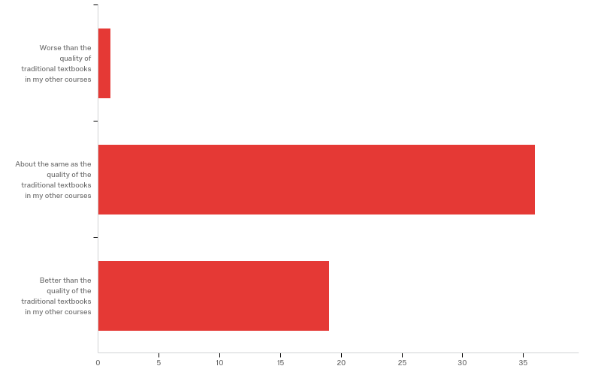
Q5 - How would you rate the quality of the free online textbook used in your current biology course?

Slide 24
Q5 - How would you rate the quality of the free online textbook used in your current biology course?
# | Answer | % | Count
1 | Worse than the quality of traditional textbooks in my other courses | 1.79% | 1
2 | About the same as the quality of the traditional textbooks in my other courses | 64.29% | 36
3 | Better than the quality of the traditional textbooks in my other courses | 33.93% | 19
 | Total | 100% | 56

Slide 25
Q7 - If you answered "better than..." in the question above, please briefly describe what made the quality of the textbook better than traditional textbooks in other courses.
If you answered "better than..." in the question above, please briefly describe what made the quality of the textbook better than traditional textbooks in other courses.
Easily accessible. No need to carry heavy books or pay the price.
The accessibility!
Easy accessibility and searching for keywords.
Electronics and clearly see the demonstrations and picture on the textbook are better than papers. So, I don’t have to carry heavy in my backpacks when I walk to class on the campus.
It was convenient. I could use it anywhere without lugging around a giant textbook. Also, the diagrams we're clear and the chapters were easy to switch between. I also enjoyed the summary and definitions after each chapter. My favorite feature was the search feature which made finding a term I still had questions about much easier.
Easy access, good to read wherever you are, you don’t have to bring a bid book everywhere
Good descriptions and pictures, you can copy and paste into your notes, you can easily scroll or click back and forth between sections
I can copy and paste the information directly to my note without typing the information

Slide 26
Q7 - If you answered "better than..." in the question above, please briefly describe what made the quality of the textbook better than traditional textbooks in other courses.
If you answered "better than..." in the question above, please briefly describe what made the quality of the textbook better than traditional textbooks in other courses.
It’s very clear and has as much info as any textbook I’ve used. Additionally it’s not as wordy as a college textbook so it’s even easier to follow
the wording is simple and easy to understand, besides there are the review question at the end of each chapter really helpful
I don’t have to purchase the book which is very helpful, I also don’t have to carry it out , and I like how the professor gives us a link for the sections we only have to read .
Easy to understand
The quality of the textbook is just as high as the other textbooks I’ve used, but the price is where it stands out.
It was short and got to the point
Being able to search inside the textbook and having it accessible on any online devices.
being able to have it at hand without carrying an actual textbook

Slide 27
Q7 - If you answered "better than..." in the question above, please briefly describe what made the quality of the textbook better than traditional textbooks in other courses.
If you answered "better than..." in the question above, please briefly describe what made the quality of the textbook better than traditional textbooks in other courses.
More convenient
Being able to download it and write notes on the side. Less paper waste. Teacher being able to link the sections we need to read or use as reference
very good

Slide 28
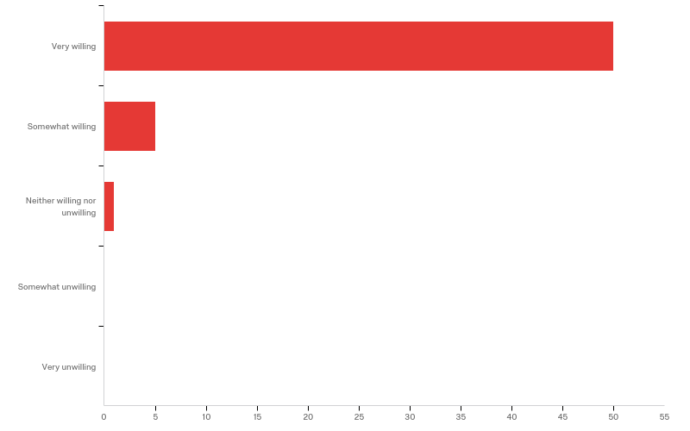
Q8 - How willing are you to register for a future course with free online textbooks like the one used in your current biology course?

Slide 29
Q8 - How willing are you to register for a future course with free online textbooks like the one used in your current biology course?
# | Answer | % | Count
1 | Very willing | 89.29% | 50
2 | Somewhat willing | 8.93% | 5
3 | Neither willing nor unwilling | 1.79% | 1
4 | Somewhat unwilling | 0.00% | 0
5 | Very unwilling | 0.00% | 0
 | Total | 100% | 56

Slide 30
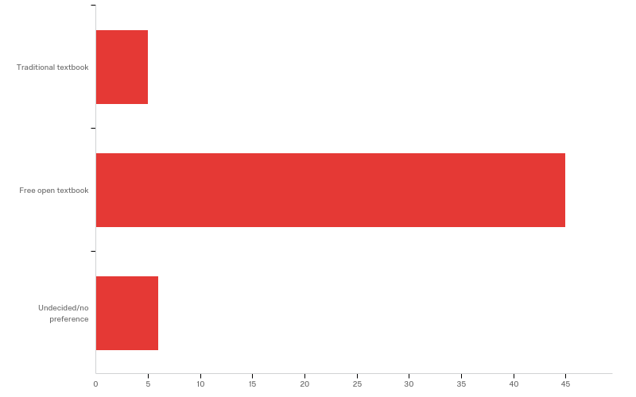
Q9 - Considering the following choices, which one would be your ideal preference for a required textbook in a biology course?

Slide 31
Q9 - Considering the following choices, which one would be your ideal preference for a required textbook in a biology course?
# | Answer | % | Count
1 | Traditional textbook | 8.93% | 5
2 | Free open textbook | 80.36% | 45
3 | Undecided/no preference | 10.71% | 6
 | Total | 100% | 56

Slide 32
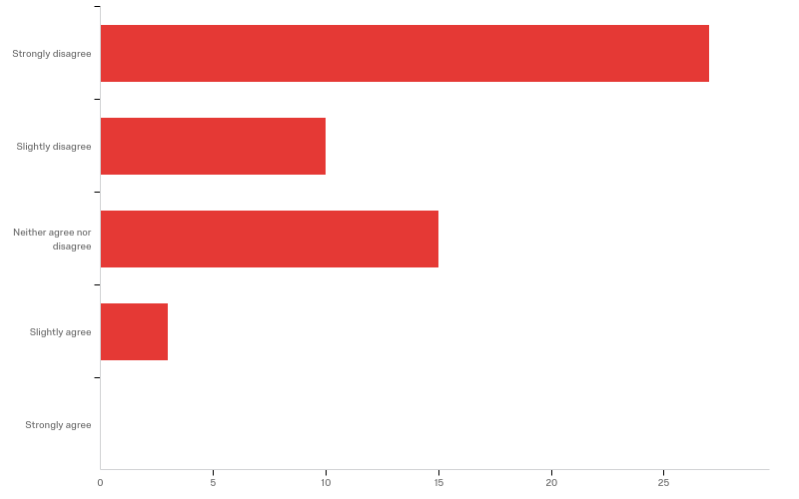
Q13 - To what extent do you agree with the statement: "I would have preferred to purchase a traditional textbook for this course"?

Slide 33
Q13 - To what extent do you agree with the statement: "I would have preferred to purchase a traditional textbook for this course"?
# | Answer | % | Count
1 | Strongly disagree | 49.09% | 27
2 | Slightly disagree | 18.18% | 10
3 | Neither agree nor disagree | 27.27% | 15
4 | Slightly agree | 5.45% | 3
5 | Strongly agree | 0.00% | 0
 | Total | 100% | 55

