Slide 1
The Brown Act and Local Academic Senates
Thursday, June 18, 2020 at 11:00 a.m.-12:30 p.m.
Jake Knapp, Associate Vice Chancellor of Human Resources, Los Rios CC District
Michelle Velasquez Bean, At-Large Representative, ASCCC

Slide 2
Session Description
As legislatively-created bodies, local academic senates are required to comply with open meeting requirements of the Ralph M. Brown Act. What does this mean for local academic senate leaders? Is it just about posting agendas by deadlines, or is there more to consider? Not to complicate things, but how does Governor Newsom’s Executive Order N-29-20, which relaxes some of the public meeting requirements of the Brown Act in response to COVID-19 stay-at-home orders effect local academic senates? This session will help local academic senate leaders understand the basics of the Brown Act and provide effective practices for ensuring a commitment to openness that meets both the letter and the spirit of the law.

Slide 3
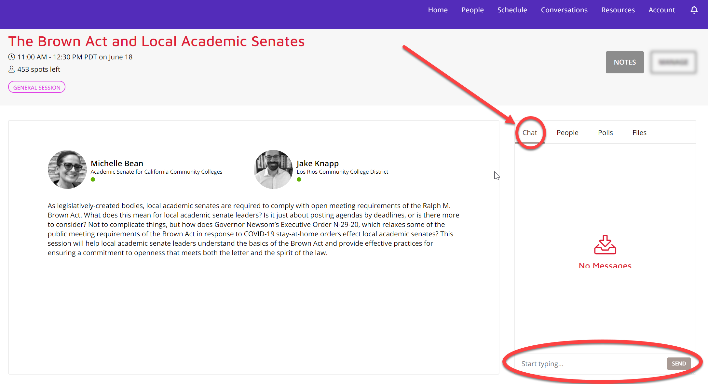
Type Your Questions in the CHAT Box

Slide 4
POLICY
“The people of this State do not yield their sovereignty to the agencies which serve them. The people, in delegating authority, do not give their public servants the right to decide what is good for the people to know and what is not good for them to know. The people insist on remaining informed so that they may retain control over the instruments they have created.”
- GC Section 54950

Slide 5
LEGISLATIVE BODIES
“All meetings of the legislative body of a local agency shall be open and public, and all persons shall be permitted to attend any meeting of the legislative body of a local agency, except as otherwise provided in this chapter.” -GC Section 54953(a)

Slide 6
Is This a Legislative Body?
The Brown Act applies to all “Legislative Bodies”
“Legislative Bodies” include:
“Governing Bodies”
“Appointed Bodies”
Certain private entities

Slide 7
“Governing Bodies”
The governing body of a local agency or any other local body created by state or federal statute is subject to the Brown Act.
Examples: Community College District Board of Trustees, City Council, School Board
Education Code 70902: “Every community college district shall be under the control of a board of trustees…”
Bottom Line: If created by statute, the local body is covered by the Brown Act

Slide 8
“Appointed Bodies”
General Rule: A commission, committee, board, or other body of a local agency, whether permanent or temporary, decision-making or advisory, created by charter, ordinance, resolution, or formal action of a legislative body.
Bottom Line: Committees created by formal action of a legislative body are subject to the Brown Act.
EXAMPLE: The Chancellor of the Salton Sea CCD appoints a committee to make recommendations on a new mascot for Salton Sea College. Are the meetings of the mascot committee subject to the Brown Act?

Slide 9
Salton Sea CCD
No!
An advisory body created by formal action of a legislative body is subject to the Brown Act. In this example, the mascot committee was created by the Chancellor.
What if a member of the board of trustees informally establishes an advisory committee to advise her on mascot-related issues as they arise?

Slide 10
Salton Sea CCD
No!
An advisory body created by formal action of a legislative body is subject to the Brown Act. A mascot committee created informally by an individual member of the board, and not by formal action of the body, is not subject to the Brown Act.

Slide 11
Appointed Bodies – Standing Committees
Standing Committees of a legislative body are ALWAYS subject to the Brown Act.
Standing committees, irrespective of composition, which have either: (1) a continuing subject matter jurisdiction, or (2) a meeting schedule fixed by resolution or formal action of the legislative body.
Examples: long-term committees on professional development or curriculum.

Slide 12
Appointed Bodies – Temporary Advisory Committee Exception
Ad Hoc: “Made or happening only for a particular purpose or need.”
A temporary advisory committee composed solely of less than a quorum of the legislative body that serves a limited or single purpose, that is not perpetual, and that will be dissolved once its specific task is completed is not subject to the Brown Act.

Slide 13
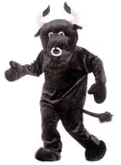
Salton Sea CCD
NO!
The Salton Sea CCD Board of Trustees establishes a two member advisory committee to make a recommendation on a new mascot for Salton Sea College.
The mascot committee’s two members are both members of the Salton Sea CCD Board of Trustees.
Are the meetings of this mascot committee subject to the Brown Act?

Slide 14
Private Entities
Certain private entities are subject to the Brown Act
The governing body of any private organization that is either: (1) created by the legislative body in order to exercise authority that may lawfully be delegated to a private entity; or (2) receives agency funding and whose governing board includes a member of the legislative body appointed as a full voting member of the private entity’s governing board.

Slide 15
What About Local Academic Senates?
A “legislative body” includes “a commission, committee, board, or other body of a local agency, whether permanent or temporary, decision-making or advisory, created by charter, ordinance, resolution, or formal action of the legislative body.”
Is a local academic senate an advisory body of the community college district board of trustees?

Slide 16
What About Local Academic Senates?
Title 5, section 53200(b) defines academic senate:
“an organization…whose primary function is, as the representative of the faculty, to make recommendations to the administration of a college and to the governing board of a district with respect to academic and professional matters.”
By definition an academic senate is an advisory body to the district board of trustees

Slide 17
What About Local Academic Senates?
A “legislative body” includes “a commission, committee, board, or other body of a local agency, whether permanent or temporary, decision-making or advisory, created by charter, ordinance, resolution, or formal action of the legislative body.”
Is a local academic senate an advisory body created by formal action of the board of trustees?

Slide 18
What About Local Academic Senates?
Title 5, section 53202 establishes the procedures for the formation of an academic senate
The steps include a vote of the faculty, plus certain actions by the district board after the faculty vote (recognition of the senate, authorization for faculty to establish structures and procedures, etc.)
“The legally mandated joint action to be taken by the faculty of a community college and a district board in establishing an academic senate constitutes the requisite “formal action” contemplated by [the Brown Act].” - Attorney General Opinion No. 83-304 (1983)

Slide 19
MEETINGS
“All meetings of the legislative body of a local agency shall be open and public, and all persons shall be permitted to attend any meeting of the legislative body of a local agency, except as otherwise provided in this chapter.” -GC Section 54953(a)

Slide 20
What is a “Meeting?”
“Any congregation of a majority of the members of a legislative body at the same time and location to hear, discuss, deliberate, or take action upon any item that is within the subject matter jurisdiction of the legislative body.” - GC Section 54952.2(a)
The Brown Act is not limited to “meetings” where a final decision is made!
“HEAR”
“DISCUSS”
“DELIBERATE”

Slide 21
Serial Meetings
SERIAL MEETINGS ARE STRICTLY
PROHIBITED!!!

Slide 22
Serial Meetings
“A majority of the members of a legislative body shall not…use a series of communications of any kind, directly or through intermediaries, to discuss, deliberate, or take action on any item of business that is within the subject matter jurisdiction of the legislative body.” - GC Section 54952.2(b)(1)
Common Types of Serial Meetings:
Daisy Chain
Hub and Spoke
Email

Slide 23
Meetings – Exceptions to the Rule
Individual Contacts
But beware of the serial meeting!
Social or Ceremonial Occasions
So long as business of the state body is not discussed
Conferences
So long as they are open to the public and involve subject matter of general interest to the public
Meetings of Another Legislative Body
The meeting must be open to the public and properly noticed

Slide 24
Teleconference Meetings
Agendas must identify each teleconference location and be posted at each location
Each location must be open and accessible to the public and allow for public participation
Example: Hospital bed
Example: No participation by cell phone in car
Agenda must provide an opportunity for public comment from each teleconference location
At least a quorum of the legislative body must participate from locations within the local agency’s jurisdiction
All votes must be audible and taken by roll call

Slide 25
NOTICE AND AGENDAS
“All meetings of the legislative body of a local agency shall be open and public, and all persons shall be permitted to attend any meeting of the legislative body of a local agency, except as otherwise provided in this chapter.” -GC Section 54953(a)

Slide 26
The Basics – Regular Meetings
The agenda must be posted at least 72 hours in advance of the meeting in a location “freely accessible to members of the public.”
The legislative body must mail a copy of the agenda to any person who has filed a written request for such materials. The copies may be mailed at the time the agenda is posted.
The notice, agenda and supporting documents are public records and must be made available to public
Writings, when distributed to a majority of the body by any person in connection with a matter subject to consideration at a public meeting, are public records that must be made available to the public “upon request without delay.” -GC Section 54957.5

Slide 27
Agendas
Agenda must contain a brief description of the items of business to be transacted or discussed in either open or closed session
In general, agenda descriptions need not exceed 20 words per item
Agenda descriptions should provide sufficient information to allow members of the public to decide whether or not to attend the meeting or participate in the agenda item
Closed session items must include reference to specific statutory authority for the closed session

Slide 28
Agenda Descriptions - Example
Is this agenda item descriptive enough?
Item No. 1.3: Consideration of contract
Item No. 1.3: Consideration of contract with JK Consulting
Item No. 1.3: Consideration of contract with JK Consulting in the amount of $50,000
Item No. 1.3: Consideration of contract with JK Consulting in the amount of $50,000 for design services related to the new Academic Senate logo

Slide 29
Adding an Item to an Agenda (Urgency Items)
The Brown Act generally prohibits any action or discussion of items not on the posted agenda.
Urgency Items: When 2/3 of all members present (or all members if less than 2/3 are present) determine that there is a need for immediate action and the need to take action “came to the attention of the local agency subsequent to the agenda being posted.”
Note that this exception may not be used if the legislative body or the staff knew about the need to take immediate action before the agenda was posted.

Slide 30
Special Meetings – 24 Hours
A special meeting may be called by the presiding officer or by a majority of the members of a legislative body.
Written notice of the special meeting must be posted and sent at least 24 hours in advance to each member of the legislative body and to each local newspaper and radio or TV station that has requested notice in writing.
The body may only consider business identified in the notice (no urgency item additions).

Slide 31
Emergency Meetings – 1 Hour
An emergency meeting may be called with one hour advance notice to media outlets.
An emergency is limited to “a work stoppage, crippling activity, or other activity that severely impairs public health, safety, or both, as determined by a majority of the members of the legislative body.” -GC Section 54956.5
The one hour notice requirement is waived for “dire emergencies.”

Slide 32
PUBLIC PARTICIPATION
“All meetings of a state body shall be open and public and all persons shall be permitted to attend any meeting of a state body except as otherwise provided in this article.”
- GC Section 54953(a)

Slide 33
The Public’s Place at the Table
The legislative body must provide an opportunity for members of the public to directly address the body on each agenda item before or during the legislative body’s discussion or consideration of the item.
Every agenda for a regular meeting must also allow members of the public to speak on any other item of interest within the subject matter jurisdiction of the legislative body (even if not on the agenda).

Slide 34
The Public’s Place at the Table
The legislative body may not prohibit criticism of policies, procedures, programs or services of the legislative body/agency
Reasonable regulations on public comment may be adopted (example: time limits for individual speakers)
The legislative body may remove individuals from a meeting who willfully interrupt proceedings.
-GC Section 54957.9

Slide 35
The Public’s Right to Attend
All meetings must comply with the ADA
Any person may record the proceedings via audio recorder, video recorder or still motion camera
No conditions may be set for attendance at or participation in a public meeting
Sign-in not required
Self-identification not required as a prerequisite to speak
No fees may be charged for providing notice

Slide 36
Governor Newsom’s COVID-19 Executive Orders: Meeting Process
Physical presence of members of the legislative body or of the public are not required as a condition of participation in or quorum for a public meeting
Notice is not required of each teleconference location from which a member will be participating in a public meeting
Teleconference location does not have to be accessible to the public
The possibility of members of the public addressing the body at each teleconference conference location is not required
Agendas do not have to be posted at all teleconference locations

Slide 37
Governor Newsom’s COVID-19 Executive Orders: Emergency Updates
Executive Order N-35-20 allows all members of a legislative body to receive updates from federal, state and local officials relevant to the declared COVID-19 emergency, including impacts of COVID-19, the government response, and “other aspects relevant to the declared emergency”
Members may ask questions of those federal, state and local officials who provide the updates in order to stay apprised of emergency operations and the impact the emergency has on their constituents
Members may not take action on, or discuss amongst themselves, any item of business that is within the subject matter jurisdiction of the legislative body without complying with otherwise-applicable requirements of the Brown Act

Slide 38
CLOSED SESSIONS
“All meetings of a legislative body shall be open and public and all persons shall be permitted to attend any meeting of a state body except as otherwise provided in this article.”
- GC Section 54953(a)
Without specific statutory authority for a closed session, a matter must be discussed in public.

Slide 39
Authorized Closed Session Topics
The Brown Act authorizes closed sessions for specific topics, including:
Existing or anticipated litigation
Real property negotiations
Public employee appointments, evaluation and discipline
Labor negotiations
Threats to security
Note: There is no statutory exemption for topics that are embarrassing, difficult, sensitive uncomfortable or controversial

Slide 40
Education Code Section 72122
Authorizes a community college district board to meet in closed session to:
Consider the suspension or discipline of a student, if a public hearing would reveal personal, disciplinary or academic information about the student in violation of state or federal student privacy laws (the student or parent/guardian may request a public hearing)
Consider the conferring of honorary degrees
Consider gifts from a donor who wants to remain anonymous

Slide 41
Closed Session Process
Closed session items must be briefly described on the posted agenda and the description must state the specific statutory authorization
The Brown Act supplies a series of sample agenda descriptions for various types of authorized closed sessions (“safe harbor descriptions”)
The legislative body must make a public announcement prior to the closed session (may reference the closed session agenda)
Following a closed session, the legislative body must provide an oral or written report on certain actions taken in closed session

Slide 42
Closed Sessions
When considering a closed session, always consult with your local counsel!
Your attorney will ensure:
The topic is appropriate for a closed session
The closed session agenda is properly drafted
The proper individuals attend the closed session
Appropriate reporting out of closed session

Slide 43
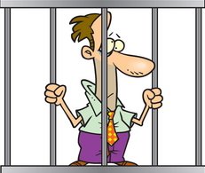
VIOLATIONS AND REMEDIES
Injunctions, overturned decisions, misdemeanor charges and the court of public opinion…

Slide 44
Why should I care?
Lawsuits
Depending on the circumstances, the decision of the body may be invalidated
Before filing a court action seeking invalidation, a person must send a “cure and correct” demand to the legislative body
Demand must describe the challenged action, the nature of the claimed Brown Act violation, and the “cure” sought.
Legislative body then has 30 days to “cure and correct” the action
Injunctions against future violations
A prevailing plaintiff may recover attorneys fees and costs of litigation
Criminal misdemeanor penalties
If a member attends a meeting of the legislative body where action is taken in violation of the Brown Act, and where the member intends to deprive the public of information to which the member knows or has reason to know the public is entitled.

Slide 45
Don’t Forget
We are public servants who represent our community college districts
We are conducting the public’s business and expending public funds
The open meeting laws were adopted with full knowledge that some efficiencies would be lost
The court of public opinion – this is about the public’s perception of how its business is conducted

Slide 46
Talk to local counsel!
When in doubt, ask for help!
The ASCCC and the Office of the General Counsel at the State Chancellor’s Office provide our colleges with general legal resources and information.
The information in this presentation is for general background, and does not constitute legal advice.
Always check in with your local counsel if you have specific legal questions.

Slide 47
Questions

Slide 48
Thank you!
Ask your legal counsel when in doubt
Email info@asccc.org with any questions
Ask for a Technical Visit anytime--fill out form at https://asccc.org/services/local-senate-visits

