Slide 1
April 24, 2020 1:00 – 2:00PM John Stanskas, ASCCC President Cynthia Olivo, CSSO President Don Miller, CIO Vice President
Building Your Team in the Virtual Environment
Notes:
John
Introductions

Slide 2
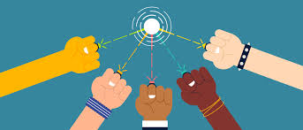
Outline
Building a Team with the academic senate and administration is crucial
Finding Common Ground
Key Elements to Building a Team
Questions/Dialogue

Slide 3
Why Building the Team is Important
If the administration and academic senate are not moving in the same direction, the college cannot move forward
In a crisis, our students and communities need to see us united in service

Slide 4
Finding Common Ground
Assume that everyone at the college has a common altruistic drive to serve students and communities
Every new term, every new person in a new position is an opportunity to reset

Slide 5
Key Elements to Building a Team Virtually
Check-in, both formal and informal
Audio/Visual queues
Listening to priorities
Respecting different perspectives
Understanding the humanity in each of us and recognizing the crisis affects us all

Slide 6
Questions and Dialogue
Notes:
All

Slide 7
Remember
There is so much happening right now it cannot be the job of one person or even an executive team. Collective engagement by the entire institution must be the goal for a college to succeed. Your partnerships can carry the college forward
Do not take all of this on by yourself
Delegate and let go of the outcome
Practice self-care
Remember to care for others

Slide 8
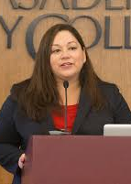
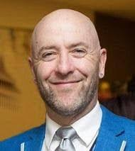
Thank You
Notes:
All

