Slide 1
Crises and the Commons
Robin DeRosa
Notes:
This slide deck is licensed CC BY by Robin DeRosa.
COVID-19 has thrown higher education into chaos, as campuses navigate reopening plans, remote pivots, and the balance between continuity and flexibility. In this presentation, Robin will explore a framework for thinking about how colleges could thrive during disruption, and how the changing needs of our learners can act as a guide for how we design our assignments, courses, and institutional structures. Centered on the values of adaptability, connection, and equity, Robin will provide a conceptual map and practical approaches for rethinking the future of learning, during and beyond this global pandemic.

Slide 2
March 11, 2020
Notes:
Source: https://www.cnbc.com/2020/03/11/who-declares-the-coronavirus-outbreak-a-global-pandemic.html

Slide 3
March 12, 2020
Notes:
Source: https://learningenglish.voanews.com/a/us-colleges-move-classes-online-because-of-coronavirus-threat/5324996.html

Slide 4
March 23, 2020
Amid novel coronavirus outbreak, for-profit education stocks are expected to gain manifold as online educators are viewing shutdowns as an opportunity to increase its reach among students. In fact, many offline players are also striving to reach students who aspire to complete their courses as planned, with the help of various online education platforms.
On Mar 11, the World Health Organization declared the novel coronavirus a "global pandemic" during a press conference in Geneva. The virus is spreading so vigorously that it has infected more than 340k people in 192 countries and territories, and caused nearly 15k deaths as of Mar 23.
Notes:
Source: https://finance.yahoo.com/news/coronavirus-outbreak-offer-opportunities-online-153203022.html

Slide 5
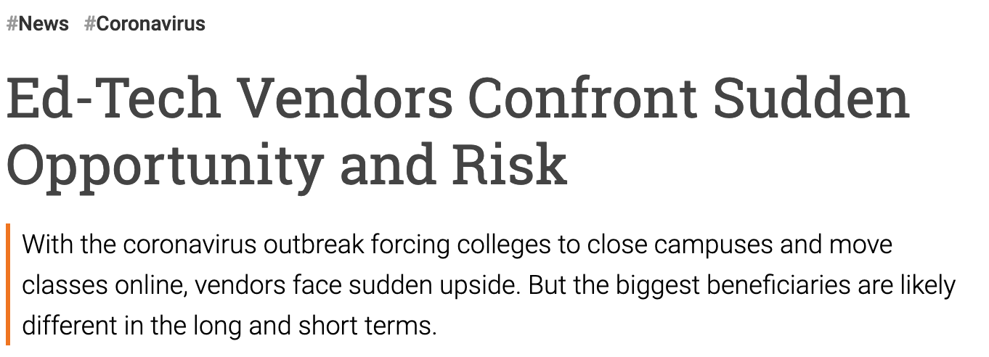
Notes:
Sources:
https://www.insidehighered.com/news/2020/03/16/coronavirus-closures-force-colleges-move-students-online-ed-tech-experts-see
https://www.proctoru.com/coronavirus-support

Slide 6
Notes:
Source: https://markets.businessinsider.com/news/stocks/2019-global-edtech-investments-reach-a-staggering-18-66-billion-1028800669

Slide 7
Notes:
Source: https://www.cnbc.com/2020/02/26/zoom-has-added-more-users-so-far-this-year-than-in-2019-bernstein.html

Slide 8
March 23, 2020
My father and I are both out of work as of right now because our jobs closed down and we are having trouble feeding my 4 year old brother. With his daycare being closed my dad has asked me to come home and babysit him while he hunts for jobs. We do not have access to wifi at our home, making it hard for me to focus on my studies to the best of my ability. This money could help my father and I gain Wifi access and put food on the table.

Slide 9
March 23, 2020
My brother is currently going through cancer and my parents are struggling to get my rent payment in at the moment due to the coronavirus affecting their jobs. I signed my lease anticipating being here for the full year and now I have to pay my rent for a house I am no longer residing in. Thank you for looking into my situation and providing any possible help.

Slide 10
March 23, 2020
I am a self-supporting student. I have no home other than PSU because my family is abusive. Sometimes I even have to support my mother financially out of my own pocket so she can survive. I need help now to cover cost of food and hygiene products. Because of the COVID19 crisis I lost my second job and the other one I have is on campus and it does not pay enough for me to make it. I feel like my life is under extreme uncertainty with res life moving students out and my finances being so low that I have no other home alternative if I am moved out. I do not want to be kicked out of the school because I would be in serious mental and physical danger.

Slide 11
What if we responded to the needs of our students rather than to the expectations of an industry?

Slide 12
The ACE Framework is an educator-created guide for course- and institutional-level design to help faculty and administrators rethink curriculum delivery during times of intense crisis. Openly licensed and learner-centered, the framework highlights the values of adaptability, connection, and equity in order to keep resources and plans squarely centered on learner need.

Slide 14
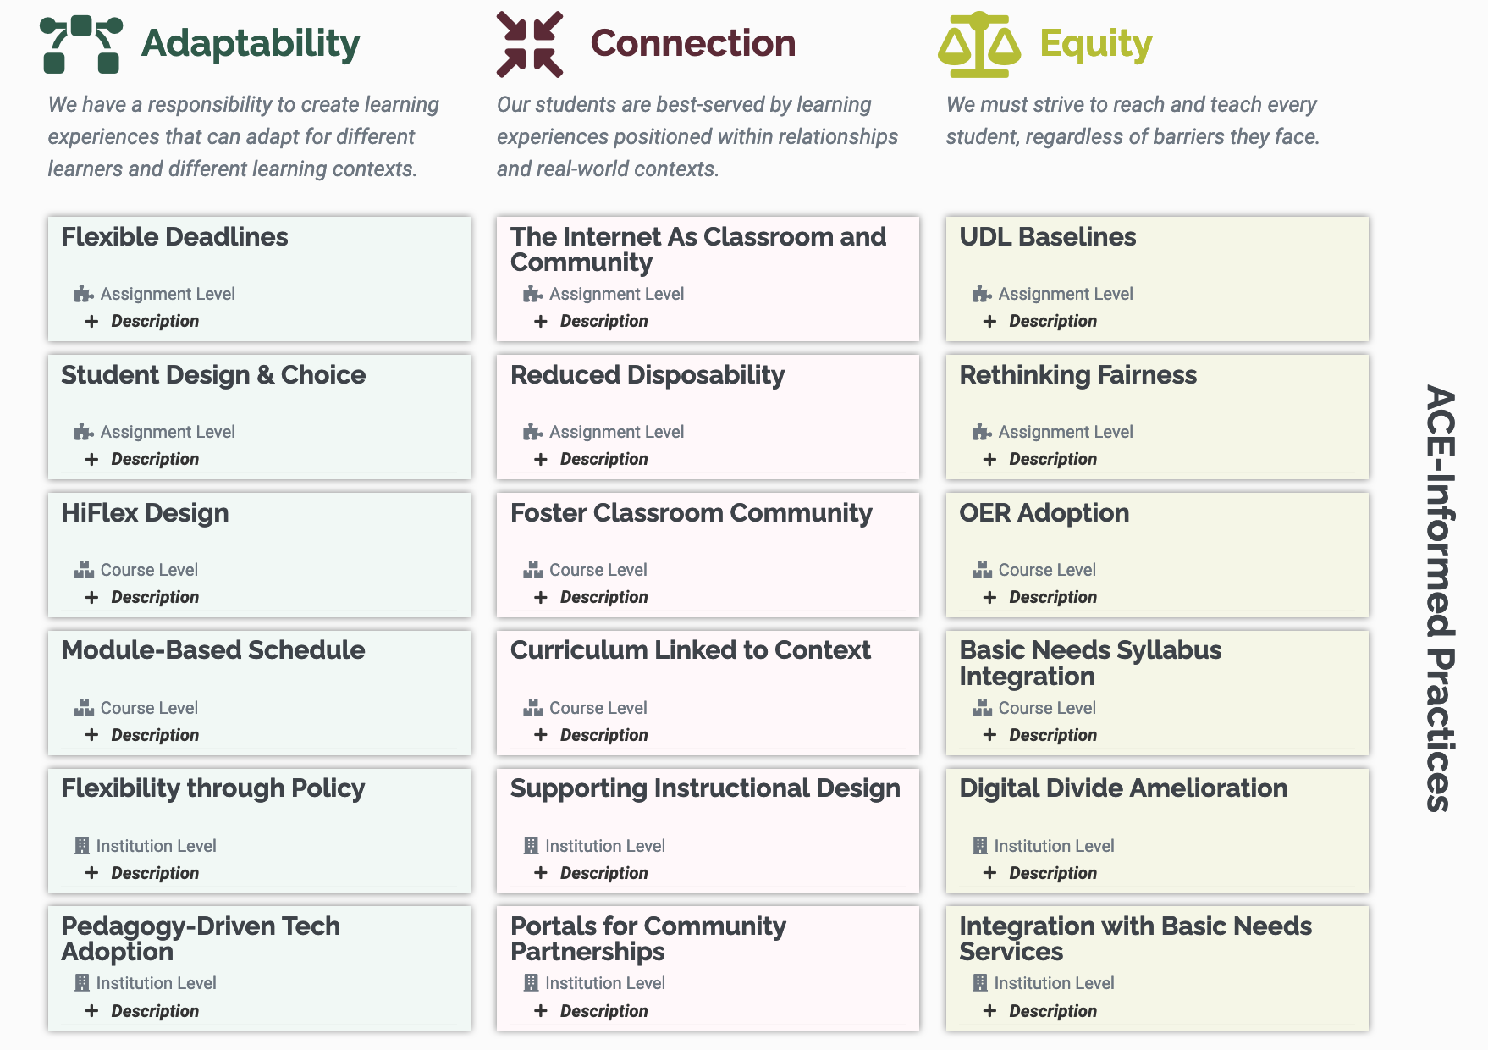
Levels
Assignment
Course
Institution
Notes:
https://colab.plymouthcreate.net/ace/

Slide 15
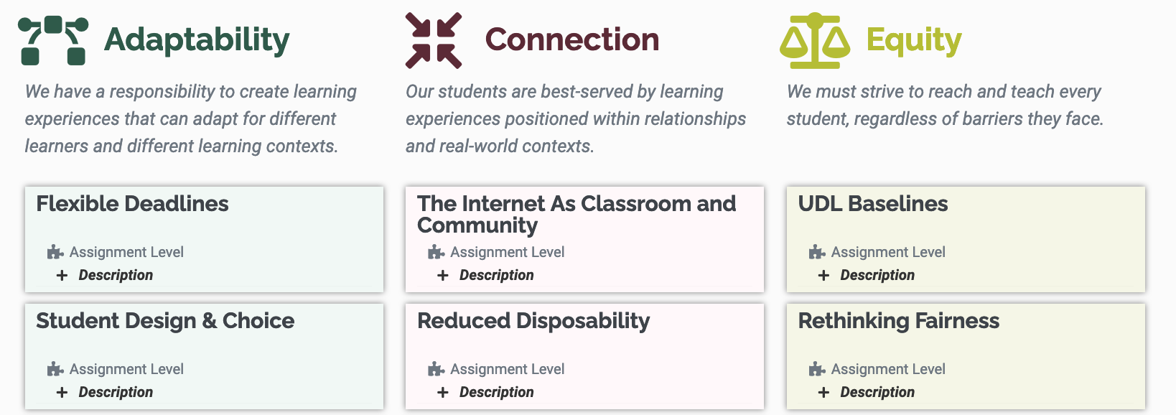
How can an assignment increase the fit between a course and a student’s life?
How can an assignment connect students to each other and to their communities of practice? How can an assignment be shaped to include more learners, more fully?
Notes:
https://colab.plymouthcreate.net/ace/

Slide 16
How can course delivery accommodate students’ realities?
How can course design connect students to their academic communities? How can course design take responsibility for barriers to learning?
Notes:
https://colab.plymouthcreate.net/ace/

Slide 17
How can institutions better fit students instead of asking students to better fit institutions?
What role do institutions play in shaping connected learning? What structures do institutions need to create to support equitable learning?
Notes:
https://colab.plymouthcreate.net/ace/

Slide 18
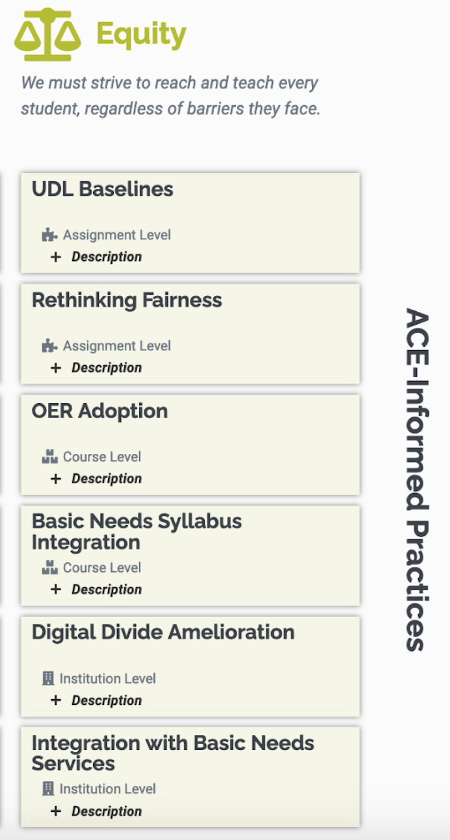
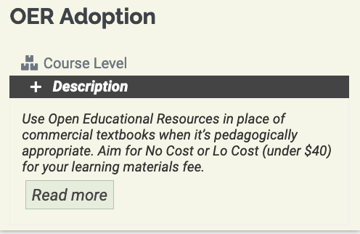
https://colab.plymouthcreate.net/ace-practice/oer-adoption/
Notes:
https://colab.plymouthcreate.net/ace-practice/oer-adoption/

Slide 19
pandemic
from Greek pandēmos, “of all the people”

Slide 20
Notes:
Photo by Allie on Unsplash

Slide 21
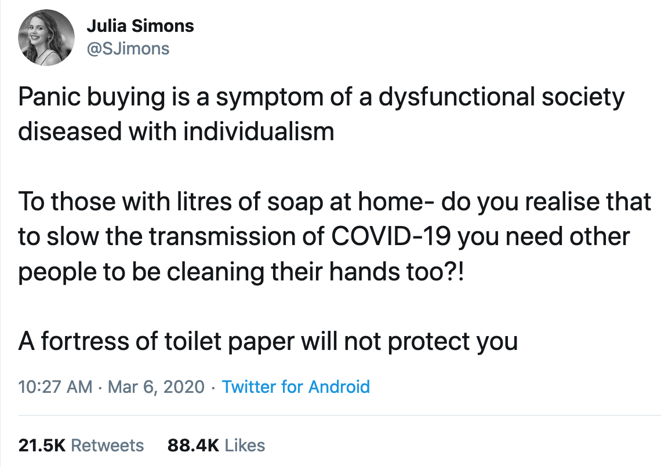
Notes:
Tweet: https://twitter.com/DrJulia_Simons/status/1235950178789724168?s=20

Slide 22
Notes:
David Bollier quote: The commons is frequently confused with an open-access regime—a free-for-all in which a resource is essentially open to everyone without restriction; common resources are taken for sale on markets. In contrast, a real commons has a "social infrastructure" of cultural institutions, rules, and traditions, and the resources are restricted to personal (non-market) uses by members of the community. Without that infrastructure, the only operative social value is private profit for the most aggressive appropriators.

Slide 23
Public Health, Public College, Public Good

Slide 24
“(We've) transferred the cost of education from our entire population, where we used to consider it a public good, now to the individual family, essentially making a choice to make it an individual consumer commodity.”
Colorado State University Chancellor Tony Frank
Notes:
From https://www.cpr.org/show-segment/with-state-funding-dwindling-will-higher-education-in-colorado-make-the-grade/

Slide 25
The College Earnings Premium
114%
real but reductive
Notes:
From a report by Philip Trostel, “It’s Not Just the Money: The Benefits of College Education to Individuals and Society”: https://www.luminafoundation.org/files/resources/its-not-just-the-money.pdf

Slide 26
If you go to college, you personally
Many of those benefits will be passed to your children whether or not THEY go to college!
Will be less likely to be unemployed;
Will be healthier;
Will be less likely to become disabled;
Will be less likely to go to prison;
Will be more satisfied with your life;
Will have a better marriage;
Will have a 25% lower mortality rate;
Will live seven years longer!
Notes:
From a report by Philip Trostel, “It’s Not Just the Money: The Benefits of College Education to Individuals and Society”: https://www.luminafoundation.org/files/resources/its-not-just-the-money.pdf

Slide 27
If more people in a region go to college
All people make more money;
Greater tax revenues;
Reduced need for public assistance;
More people volunteer and give to charity;
More people vote;
More people interact and trust people in the neighborhoods;
Lowered crime rates.
ROI in college students for taxpayers: 10.3%
ROI to state and local gov’ts: 3.1%
Notes:
From a report by Philip Trostel, “It’s Not Just the Money: The Benefits of College Education to Individuals and Society”: https://www.luminafoundation.org/files/resources/its-not-just-the-money.pdf

Slide 28
What if we responded to the needs of our students rather than to the expectations of an industry?

Slide 29
What if we designed our
assignments, courses, and institutions to serve and strengthen the public good?

Slide 30
A Vision for Community College
In times of crisis, it not only adapts, it excels because it’s deeply integrated with public need

Slide 31
Decisions, Budgets, Plans, and
Responses are Values Statements
Align to mission
Align levels of your learning environment
Notes:
Photo by Julia Craice on Unsplash

