Slide 1
CBE as a Vehicle for Equity
Lance Heard, ASCCC At-Large Representative
Cheryl Aschenbach, ASCCC Secretary

Slide 2
As the eight community colleges participating in the CBE Collaborative work out details for implementing direct assessment competency based education (DA CBE) in consultation with the Chancellor’s Office, we have an opportunity to consider how colleges have already successfully employed CBE within our current curriculum structure. By understanding the foundational characteristics of CBE, we can identify how they can readily be incorporated into a strategy to provide equity for students who have not been provided the education to achieve degree completion, certificate attainment, or the desired levels of success. This session will allow attendees to explore what programs are doing with CBE and how they might transfer those ideas to facilitate student success within their own programs and disciplines.
Breakout
Description

Slide 3
Discussion
What do you know about CBE?
In what ways have you or your colleagues engaged in dialog about CBE?
What concerns do you have about CBE?
Please share via chat in the Pathable window

Slide 4
Overview
CBE…
Equity
Curricular Considerations
Examples
Resources
Questions

Slide 5
Four Persistent Equity Gaps Competency-Based Education Could Help Reduce
Achievement Gap
Attainment Gap
Opportunity Gap
Skills Gap
Notes:
The achievement gap is the difference in learners’ academic standing—often connected to race, class, and/or gender
Closely related to the achievement gap is the attainment gap. This is the difference between those who earn a postsecondary credential and those who leave without completing
The opportunity gap is the difference in the quality and quantity of opportunities and supports available to learners, often because of who they are or where they live
The skills gap is the difference between what individuals can do and the skills they need for a role or responsibility, oftentimes in the workplace.

Slide 6
Addressing Equity is an Urgent Matter
Education Trust-West 2020 Report: Recognizing All Learning to Help California Achieve Educational and Racial Equity
Estimated 40% of CA jobs will require a bachelor’s degree by 2030 (PPIC)
Advocacy groups: goal of 60% of Californians with a postsecondary credential by 2030
16% of CA working-age adults have some college but no degree
Current racial equity gaps:
80% Latinx adults & 64% Black adults in CA do not have a postsecondary degree
Attainment rates persistently lag for Black, Hispanic, Latinx, and Native American
Addressing these inequities—and expanding learning opportunities after high school for everyone—is essential to reducing the injustice that influences much of American life. (A Stronger Nation. Lumina 2021)
Notes:
Also mention challenges for working adults, demands of families
CA attainment rose 10% points 2009-2019 (current = 52%), partly with inclusion of certifications and certifications.

Slide 7
CBE & Equity
Community colleges educate more underserved and underrepresented learners than any other postsecondary learning environment.
Of particular importance is community colleges’ history of partnering with employers to align learning and jobs.
Unfortunately, community colleges grapple with chronically low persistence and graduation rates.
CBE could be an effective strategy for recruiting more learners, retaining those already enrolled, and increasing the numbers who persist and graduate ready for the workforce.

Slide 8
CBE & Equity
In CBE programs, learners advance based on what they know and can do, rather than time spent in class.
With a more flexible structure, CBE programs offer learners high levels of customization.
This is most important for those who juggle school along with work and family.
Flexible learning pathways are often the only real option for working adults, especially those who take care of children or other family members.

Slide 9
Definitions
Direct Assessment Competency-Based Education (DA CBE) in CA Community Colleges: an intentional outcomes-based and equity-minded approach to earning a college degree in which the expectations of learning are held constant, but time is variable through a flexible, self-paced, high-touch and innovative learning practice (title 5 §55270.1)
Competencies: the integration of knowledge, skills, and attitudes in complex ways that require multiple elements of learning. Competencies represent the acquisition of knowledge, skills, abilities and intellectual behaviors that reflect the balancing of theory and application present in a demonstration of mastery (title 5 §55270.1)

Slide 10
Shared CBE Program Design Elements
• Learning is the constant, while time and place are the flexible and supporting elements.
• Instructors drive instructional design and delivery, engage with external stakeholders (such as employers), support program fidelity, and make sure programs align to real-world needs.
• Teaching, learning, and assessment focus on competencies that are essential for particular fields of work or study.
• The program is learner-centered, offering flexible scheduling, customization, coaching, and navigational supports.
• Learners move ahead when they are ready, which often leads to accelerated program completion.

Slide 11
Example:
Competency-based curriculum project with Career Ladders Project started in 2010
Core competencies identified, then programs backwards mapped
Extraneous units eliminated. Curriculum revised to address all competencies within program.
Tier of competencies
Specialty Competencies (most specific)
Occupation-Specific Technical Competencies
Industry-Wide Competencies
Academic & Career Readiness Competencies
Foundational competencies
LA Trade Technical College

Slide 12
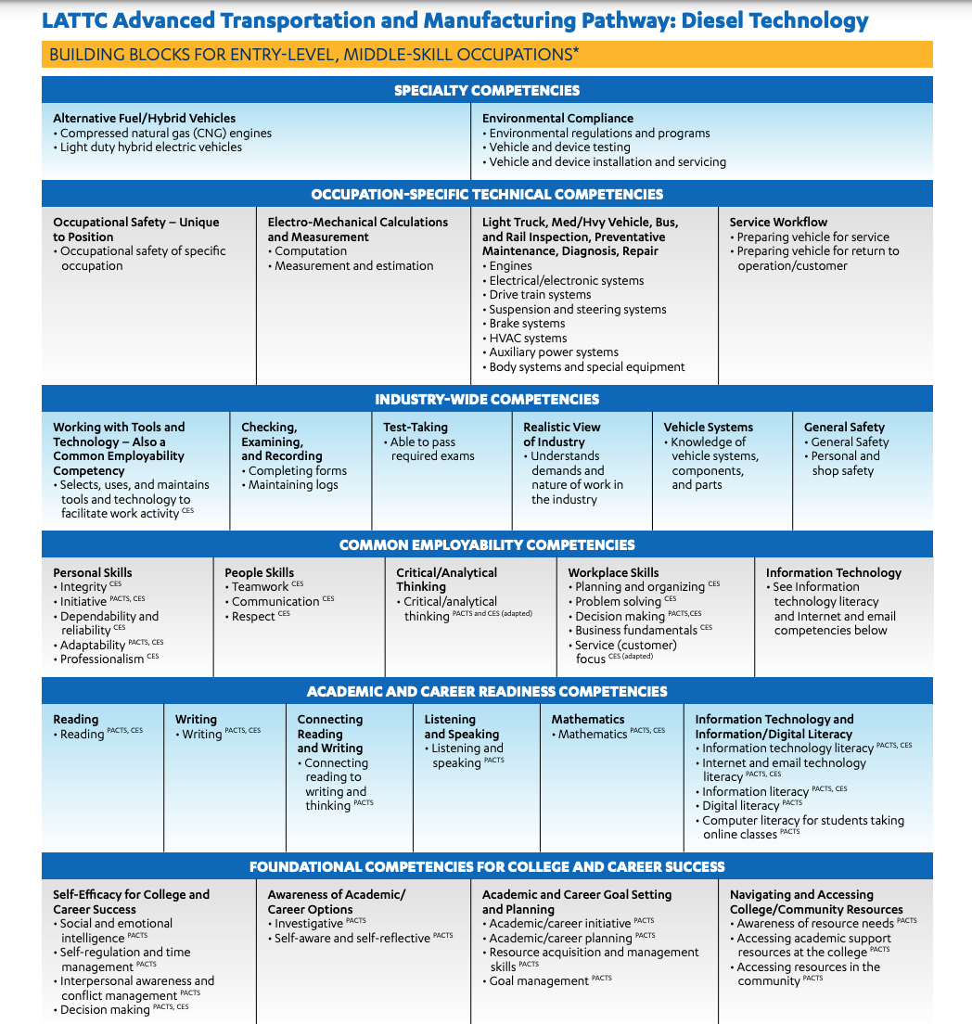
LATTC Example
Advanced Transportation and Manufacturing Pathway: Diesel Technology

Slide 13
Curricular Design
Curricular development now:
“What are we going to teach?”
CBE Curricular development:
“What should our students learn?”
“What knowledge and skills do students need to thrive?”

Slide 14
Defining Competencies
Defining and Assessing Learning: Exploring Competency-Based Initiatives (Jones & Voorhees, National Postsecondary Education Cooperative, 2002)

Slide 15
Resources: Outcomes Development
Essential Learning Outcomes (Association of American Colleges & Universities)
Degree Qualifications Profile (Lumina, 2014)
Employability Skills Framework (US Dept. of Education)
Common Employability Skills Framework (National Network of Business and Industry Associations)

Slide 16
C-BEN Resources
Quality Framework for CBE Programs
Quality Framework User’s Guide
Strategic Storytelling Toolkit
More CBE research and information at cbenetwork.org
The Competency Based Education Network
Notes:
quality framework and rubrics that can help institutions design and assess CBE programs

Slide 17
Discussion
Where could CBE work at your college?
Who needs to be involved in discussions about CBE?
How can you activate discussions about CBE?
What additional information or resources would be helpful?
Contribute via chat OR
Raise your hand to speak

Slide 18
CBE Resources
Understanding Competency-Based Education, Credit for Prior Learning, and Other Flexible Learning Approaches in California (CA EDGE Coalition, 2021) SUMMARY | REPORT | WEBINAR | SLIDES
Recognizing All Learning to California Achieve Educational and Racial Equity (Education Trust-West, 2020) REPORT
Competency-Based Education at LATTC (Career Ladders Project, 2020) BRIEF
Competency-Based Education: A Flexible Approach to Learning: Designing with Equity and Careers in Mind (Career Ladders Project, 2020) SLIDES
How Closing My Competency-Based School Led to Learning What Works (Krauss, 2018) ARTICLE
How Competency-Based Education May Help Reduce Our Nation’s Toughest Inequities (Krauss, Lumina, 2017) ARTICLE
CBE: 7 Things to Know (Educause Learning Initiative, 2014) ARTICLE
CBE at Salt Lake Community College WEBSITE
Defining and Assessing Learning: Exploring Competency-Based Initiatives (Jones & Voorhees, National Postsecondary Education Cooperative, 2002)

Slide 19
Questions? Comments? Thank you!
info@asccc.org
lheard@mtsac.edu
caschenbach@lassencollege.edu

