Slide 1
They Showed Us the Money, Now Give Them the (Non)Credit – Effectively Implementing CDCP
Cheryl Aschenbach, Lassen College
Rebecca Eikey, College of the Canyons
John Freitas, Los Angeles City College
Omar Torres, College of the Canyons
ASCCC Fall 2015 Plenary Session
Irvine Marriott

Slide 2
Outcomes for Today
Gain an overview of CDCP noncredit
Learn from the experiences of a college that is building its CDCP noncredit program

Slide 3
Noncredit Serves the Most Underserved Members of Our Communities
Nearly 25% of CA’s 38 million people live in poverty: 8.9 million people
CA: highest level of poverty in US according to 2014 US Census report that takes into account broad measures of income and cost of living
Highest rates: Los Angeles (27%), Napa (26%), San Francisco Bay Area and coastal communities (22%)

Slide 4
Noncredit Serves the Most Underserved Members of Our Communities
Often the neediest, most underserved members of our communities can be served by noncredit – look at the goals in your college’s SSSP and Equity Plans
Wide range of goals, generally attempting to gain skills needed for:
Personal/family
Employment
Educational transition, pre-collegiate skills

Slide 5
ABCs of Noncredit
Regular noncredit
Stand alone courses, 10 categories
CDCP – Career Development College Preparation (Defined in Ed Code §84760.5)
(Enhanced Funding, SB361 – 2007)
Equalized Funding (SB860 – 2014) – Equalized to Credit Rate
Noncredit Certificates of Competency and Completion
Sequences of courses
Open-entry/Open-exit vs. Managed Enrollment
FTES Generation – “positive attendance” versus census date
AB86
Important: Noncredit is not community services!

Slide 6
Credit vs. Noncredit
Credit
Noncredit
Degrees, certificates of achievement
Generates apportionment
Student fees apply
Degree applicable and non-degree applicable (developmental/basic skills)
Unit bearing
Not repeatable
Certificates of completion, certificates of competency
Generates apportionment: two levels
CDCP apportionment now same level as credit
No student fees
No units
Repeatable
Limited to 10 different categories (CDCP = 4 categories)

Slide 7
Noncredit Courses
10 categories of noncredit courses are eligible for state funding (§58160, CB22) (p. 96 and 190 of PCAH, Program Course Approval Handbook, 5th Edition)
English as a Second Language
Immigrant Education (including citizenship)
Elementary and Secondary Basic Skills (incl. supervised tutoring)
Health and Safety
Courses for Adults with Substantial Disabilities
Parenting
Home Economics
Courses for Older Adults
Short-Term Vocational (incl. apprenticeship)
Workforce Preparation
(The blue font indicates AB86 funded categories)

Slide 8
Course Outline of Record Required
Title 5 §55002(c)(2) - The course outline of record shall specify the following:
Number of contact hours normally required for a student to complete the course
Catalog description,
Objectives,
Contents in terms of a specific body of knowledge
Instructional methodology
Examples of assignments and/or activities
Methods of evaluation for determining whether the stated objectives have been met
No distinction in quality between regular and CDCP noncredit
All noncredit courses must be approved by the local academic senate (curriculum committee), by the local governing board and the Chancellor’s Office.

Slide 9
Career Development and College Preparation (CDCP) Noncredit
CDCP requirements established in Ed Code §84760.5
CDCP “prepares students for employment or to be successful in college-level credit coursework.”
CDCP courses must be sequenced and lead to certificates
CDCP Enhanced Funding Categories:
ESL
Math and English Basic Skills
Short-term Vocational (Short-term vocational program must be determined by the Chancellor, in consultation with the Employment Development Department, to have high employment potential)
Workforce Preparation (speaking, listening, reading, writing, mathematics, decision-making, and problem solving skills that are necessary to participate in job-specific technical training)

Slide 10
CDCP Certificates - Defined
Certificate of Completion
Sequence of CDCP courses in Short-term Vocational or Workforce Preparation
Defined in Title 5 §55151(h)
Certificate of Competency
Sequence of CDCP courses in ESL or Elementary and Secondary Basic Skills
Defined in Title 5 §55151(i)
Standards for approval (Title 5 §55151(j))
Determined by local curriculum committee
Use same standards of quality as established in Title 5 §55070 for credit certificates

Slide 11
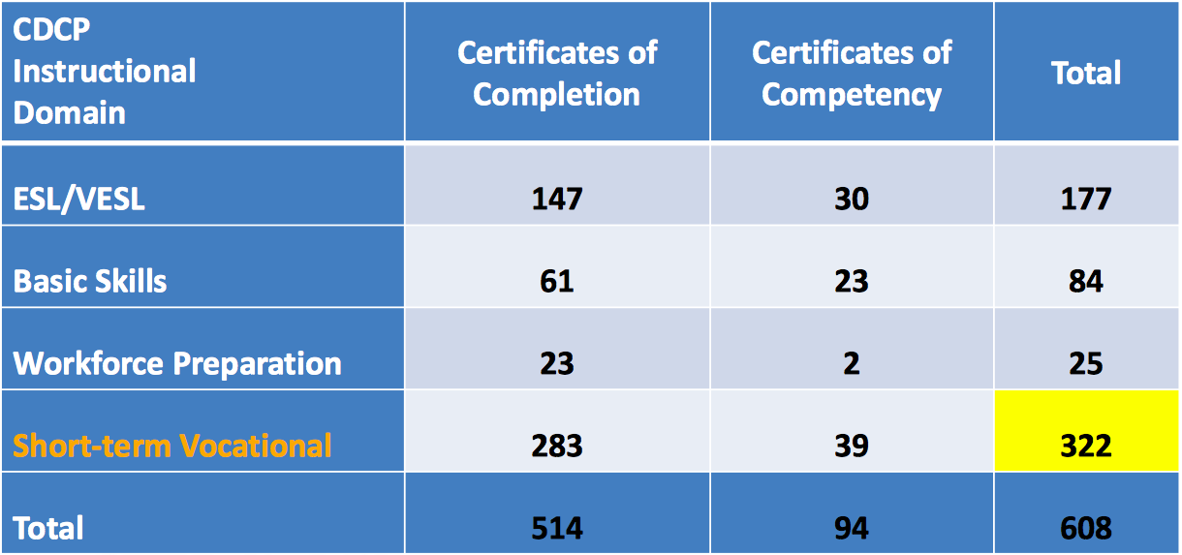
Certificate Approvals by CDCP Category, 2014-2015 Source: CCC Chancellor’s Office presentation to ACCE October 19, 2015 in Sacramento, CA

Slide 12
Selected Senate Positions on Noncredit
Resolution 9.07 F07 – Encourage dialog between credit and noncredit faculty
Resolution 9.02 F11 – Equalize CDCP apportionment with credit apportionment (less student fees)
Resolution 14.02 S14 – Urge local implementation of noncredit progress indicators
Resolution 7.01 F14 – Revise the FON calculation to include full-time noncredit faculty
Resolution 17.05 S15 – Urge that local senates establish noncredit liaison positions

Slide 13
Why Have CDCP Noncredit Programs? Some Benefits/Opportunities for Students Include…
Multiple pathways for transfer and non-transfer students
Students have many options if they are not eligible for financial aid.
More flexible scheduling
More options for students who are struggling with passing credit courses
Students can develop the requisite skills to be successful in credit courses
Successful completion of noncredit courses can be part of multiple measures assessments
Students don’t use up basic skills units.

Slide 14
Engaging Faculty in CDCP Noncredit Conversations
Faculty should lead in the creation of a shared vision for noncredit curriculum development.
Identify funding sources to support faculty in taking leading roles in curriculum changes and full participation at the local level
Ensure faculty oversight of all new curriculum collaborations
Ensure curriculum and program changes drive funding conversations

Slide 15
Local Conversations on CDCP – Challenges
FON – full-time noncredit faculty not included
Reliance part-time faculty
Stigma attached to noncredit, whether fair or not
of noncredit course/program value
of faculty – lower minimum qualifications
of teaching “low” levels
Higher workloads and lower pay
Overlap with credit (ESL, Basic Skills, CTE)

Slide 16
Building and Expanding CDCP
What
College of the Canyons
Is Doing

Slide 17
Motivation for Change at College of the Canyons
Daunting reality: Approximately 6% of COC arithmetic students complete college-level math
Commitment to Evidence-based Student Success Models
Redesign of Pre-Algebra to include necessary arithmetic topics
Creation of statistics pathway – Intermediate Algebra for Statistics
Repurposing sections of arithmetic to higher-level Math
Financial Aid and Registration purpose benefits
Design of Basic Arithmetic Skills Certificate of Competency (Noncredit)

Slide 18
Statewide Initiatives in Place to Support Change
CDCP funding changes
3SP and Student Equity
AB 86/AEBG
College’s commitment to Career Pathways
Senior Center (inter-generational) work emphasizing vocational education and reform

Slide 19
Team Effort
Dialogue and leadership from the Math Faculty
College wide FLEX sessions educating faculty about non-credit pathways
Support from the Chancellor, CIO, AVPAA, Deans (including noncredit), Institutional Research, Student Services, Student Equity Coordinator, and Basic Skills Coordinator
Follow through and expedited approval by the College’s Academic Senate and Curriculum Committee (Curriculum Committee already aware of benefits to students)
Approval by the State Chancellor’s Office
ACCJC and Substantive Change Proposal update

Slide 20
Next Steps at College of the Canyons
Offerings of noncredit Basic Arithmetic Skills courses
Open Educational Resources
Construction of a more accurate and fair placement system that recognizes the difference math pathways (STEM/Business and Statistics)
Program viability

Slide 21
Now It’s Your Turn!

Slide 22
Resources
Academic Senate for California Community Colleges. (2006). The Role of Noncredit in the California Community Colleges. Sacramento, CA.
Academic Senate for California Community Colleges, Noncredit Ad Hoc Committee. (2009). Noncredit Instruction: Opportunity and Challenge. Sacramento, CA.
Academic Senate for California Community Colleges. Noncredit Committee webpage. www. asccc.org/directory/noncredit-committee.
Academic Senate for California Community Colleges, Noncredit Task Force. (2014). AB 86: A Brief History and Current State of Affairs from the Noncredit Task Force. Rostrum (March 2014). Sacramento, CA.
Legislative Analyst’s Office. (2012). Restructuring California’s Adult Education System. Sacramento, CA.
Shaw, Leigh Anne and Candace Lynch-Thompson. (2014). Trojan Horse or Tremendous Godsend? Retooling Adult Education in a New Era. Rostrum (October 2014). Sacramento, CA.

Slide 23
Questions?
Thank you!

