Slide 1
CURRICULAR ACCREDITATION REQUIREMENTS
Friday July 14, 2023
9:00am – 10:15am
Notes:
Robert

Slide 2
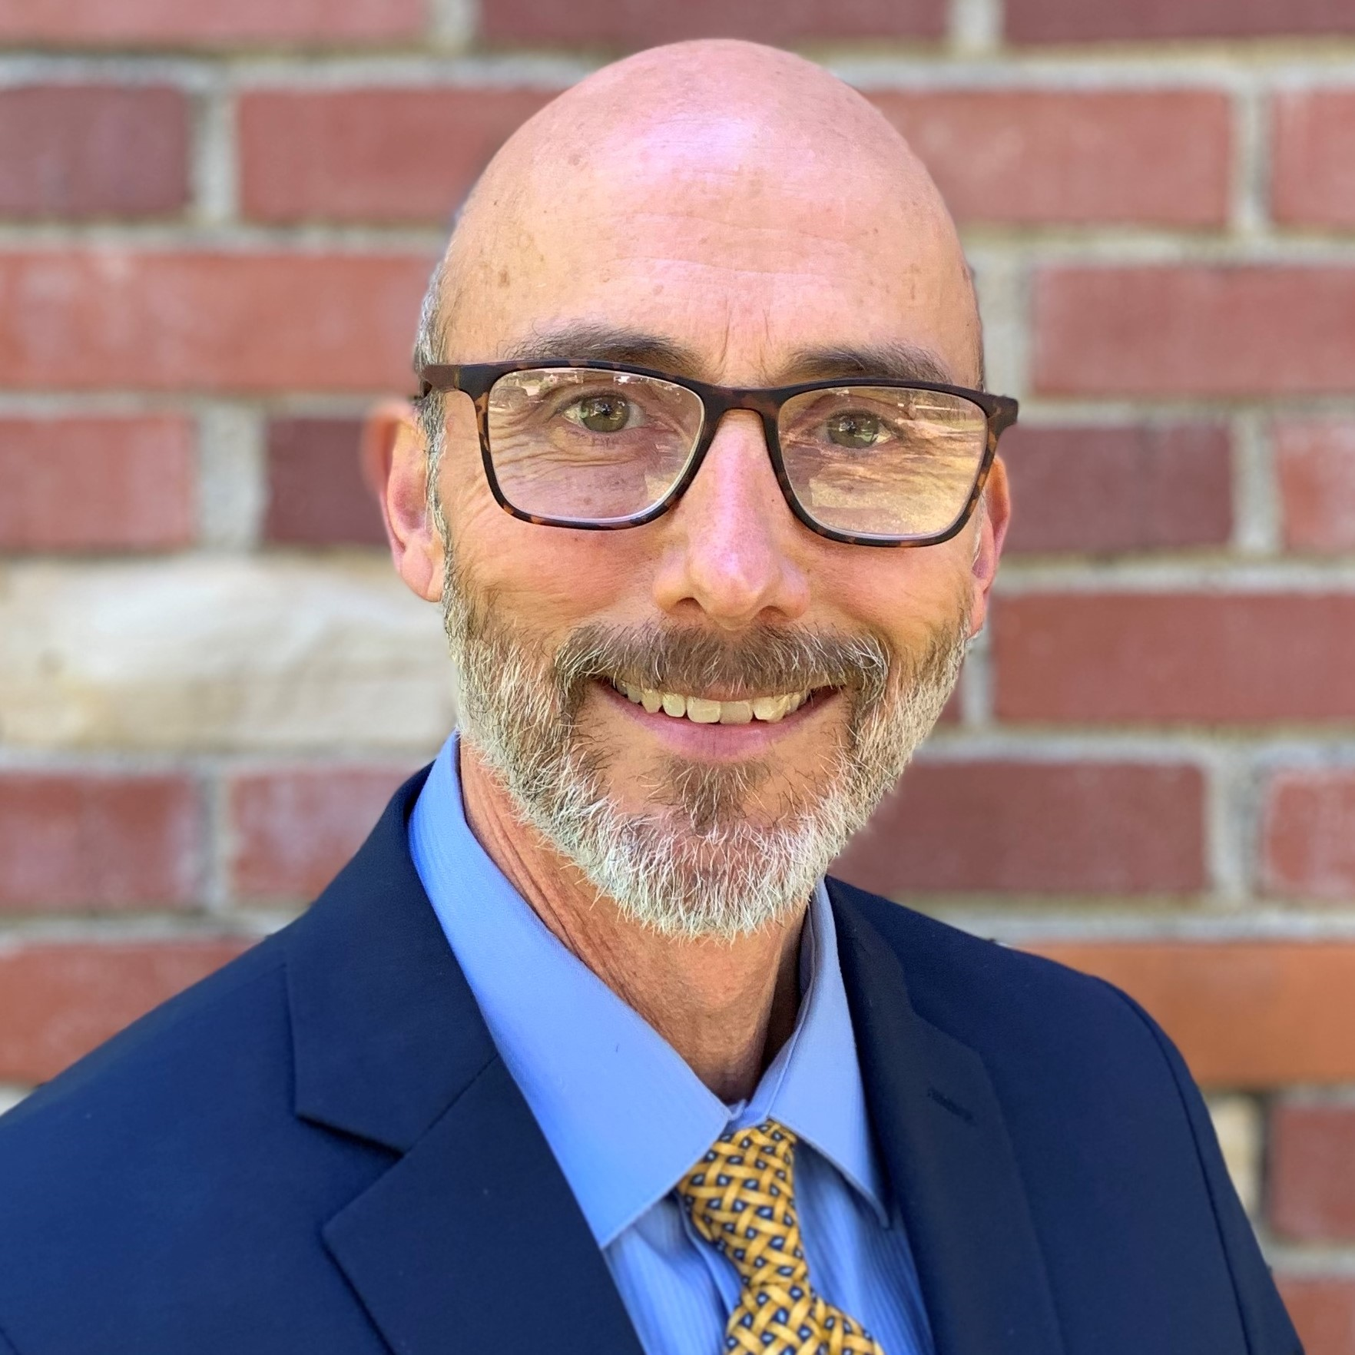
Presenters
Randy Beach, Southwestern College, ACCJC Commissioner
Kevin Bontenbal, ACCJC Vice President
Robert L Stewart Jr, ASCCC Treasurer
Manuel Vèlez, ASCCC Vice-President
Notes:
Each of us will introduce ourselves and share a little about our own local experiences on this topic. Also, we can do some quick audience analysis to see who is in the room and their experiences.

Slide 3
Breakout Description
Curriculum is a key component of the accreditation standards, and the relationship between curriculum and accreditation is critical for understanding the accreditation process. In this breakout, explore the interplay of curriculum requirements in relation to the requirement of accreditation and the importance of curriculum specialists, curriculum chairs, articulation officers, and others in the accreditation process.
Notes:
Robert

Slide 4
Session Outcomes
At the end of this session participants will have an increased understanding of:
Accreditation catalog requirements
ACCJC publication requirements
Accreditation standards related to curriculum (2014 and 2024)
Programmatic accreditation
ASCCC Resources to support accreditation
Notes:
Robert

Slide 5
Catalogs and Your College’s Mission
Your College’s catalog is a tangible example of the college’s work and efforts to meet its mission.
Notes:
Manuel
Mission-driven
Catalog documents and publicizes the college’s mission
Programs, degrees/certificates, services reflect the college’s mission
Expansion of college’s mission (i.e.: bachelor's) and accreditation implications

Slide 6
Who are the consumers of ​the catalog?
Students – prospective, current, former​
Counselors/advisors​
Degree auditors​
Financial aid personnel​
Faculty, staff, and administrators​
Advisory committee members​
Local employers​
Accrediting/licensing bodies​
Transfer institutions​
Others?
Notes:
Manuel

Slide 7
Accreditation Catalog Requirements
1. General Information ​
Official Name, Address(es), Phone Number(s), Website Address of the Institution ​
Educational Mission ​
Representation of accredited status with ACCJC, and with programmatic accreditors if any ​
Course, Program, and Degree offerings ​
Student Learning Outcomes for Programs and Degrees ​
Academic Calendar and Program Length​
Academic Freedom Statement ​
Available Student Financial Aid​
Available Learning Resources ​
Names and Degrees of Administrators and Faculty ​
Names of Governing Board Members
2. Requirements ​
Admissions ​
Student Tuition, Fees, and Other Financial Obligations ​
Degrees, Certificates, Graduation and Transfer​
General Education Requirements/Philosophy ​
3. Major Policies and Procedures Affecting Students ​
Academic Regulations, including Academic Honesty ​
Nondiscrimination ​
Acceptance and Transfer of Credits ​
Transcripts ​
Grievance and Complaint Procedures ​
Sexual Harassment ​
Refund of Fees ​
Code of Conduct​
4. Locations or Publications Where Other Policies may be Found
Notes:
Manuel

Slide 8
ACCJC Publication Requirements
I.C.1 The institution assures the clarity, accuracy, and integrity of information provided to students and prospective students, personnel, and all persons or organizations related to its mission statement, learning outcomes, educational programs, and student support services.​
I.C.2 The institution provides a print or online catalog…with precise, accurate, and current information on all facts, requirements, policies, and procedures listed in the “Catalog Requirements.”​​ (ER 20)
I.C.4 The institution describes its certificates and degrees in terms of their purpose, content, course requirements, and expected learning outcomes.​
I.C.5 The institution regularly reviews…publications to assure integrity in all representations of its mission, programs, and services.​
II.A.12 The institution requires of all of its degree programs a component of general education based on a carefully considered philosophy for both associate and baccalaureate degrees that is clearly stated in its catalog.
Notes:
Kevin

Slide 9
2014 Accreditation Standards on Curriculum
II.A.3 The institution identifies and regularly assesses learning outcomes for courses, programs, certificates and degrees using established institutional procedures. The institution has officially approved and current course outlines that include student learning outcomes. In every class section students receive a course syllabus that includes learning outcomes from the institution’s officially approved course outline.
Things to Consider:
The institution has established a procedure for identifying student learning outcomes for courses, programs, certificates, and degrees.
Role of curriculum committee in SLO process
Role of curriculum committee and union regarding SLO - Is there conflict here?
Intent of Standard is Integrity focused. Making sure the public/ students understand the intended learning outcomes of the course (see II.A.9 for SLOs as measurement of learning).
Notes:
Randy
“program” -
SLO’s and Equity

Slide 10
2014 Accreditation Standards on Curriculum
II.A.5 The institution’s degrees and programs follow practices common to American higher education, including appropriate length, breadth, depth, rigor, course sequencing, time to completion, and synthesis of learning. The institution ensures that minimum degree requirements are 60 semester credits or equivalent at the associate level, and 120 credits or equivalent at the baccalaureate level.
Things to Consider:
Communicating degree standards applied when creating, revising, or discontinuing programs and where they come from? Where do you define “practices common to American higher education?” A handbook? A policy?
Clarity around distinction between associate degree standards and baccalaureate-level standards, if applicable. Where is this codified? What does it look like in practice?
Notes:
Randy

Slide 11
2014 Accreditation Standards on Curriculum
II.A.9 The institution awards course credit, degrees and certificates based on student attainment of learning outcomes. Units of credit awarded are consistent with institutional policies that reflect generally accepted norms or equivalencies in higher education. If the institution offers courses based on clock hours, it follows Federal standards for clock-to-credit-hour conversions.
Things to Consider:
The role of the curriculum committee in ensuring this occurs (does the cc approve SLOs?)
Clarity between course objectives and student learning outcomes
Clear relationships between assessments, objectives, content, and outcomes on your COR
The institution can demonstrate that at the course level passing grades on assignments or exams link directly to students’ demonstration of achieving learning outcomes.
Documentation of policy for clock-to-credit hour conversions
Notes:
Randy

Slide 12
2014 Accreditation Standards on Curriculum
​II.A.12 The institution requires of all of its degree programs a component of general education based on a carefully considered philosophy for both associate and baccalaureate degrees that is clearly stated in its catalog. .... (ER 12)
Things to Consider:
The process used to approve courses to fulfill your local general education pattern, specifically the role of faculty in making a determination
How is it communicated? Is it in the catalog? Do students understand the significance?
For California colleges, general education defined in regulation (changes underway) but general education standards are not determined according to title 5
Notes:
Randy

Slide 13
2024 Accreditation Standards on Curriculum
2.1 Academic programs at all locations and in all modes of delivery are offered in fields of study consistent with the institution’s mission and reflect appropriate breadth, depth, and expected learning outcomes.
2.3 All degree programs include a general education framework to ensure the development of broad knowledge, skills, and competencies related to communication, quantitative reasoning, critical thinking, information literacy, civic responsibility, and the ability to engage with diverse perspectives.
2.6 The institution uses delivery modes and teaching methodologies that meet student and curricular needs and promote equitable student learning and achievement.
2.9 The institution conducts systematic review and assessment to ensure the quality of its academic, learning support, and student services programs and implement improvements and innovations in support of equitable student achievement.
Notes:
Kevin

Slide 14
Programmatic Accreditation
Focused on a single professional program within your institution (e.g. ACEN - Accreditation Commission for Education in Nursing and ASE-Automotive Services Excellence)
Has standards unique to the program, though some overlap may occur
Status required in your catalog (“Representation of accredited status with ACCJC, and with programmatic accreditors if any” )
​Demands of a programmatic accreditor may lead to impacts on your curriculum approval process
Some colleges adopt an expedited approval process when a matter endangers a program accreditation
Notes:
Randy

Slide 15
ASCCC & Accreditation Support
Title 5 § 53200 (b): Academic Senate means an organization whose primary function is to make recommendations with respect to academic and professional matters. In Sections 53200 (c), "Academic and professional matters" mean the following policy development and implementation matters (10+1).
#7) Faculty roles and involvement in accreditation processes, including self-study and annual reports
How can ASCCC support local faculty accreditation efforts:
ASCCC Accreditation Resource Teams
Effective Practices in Accreditation - A Faculty Guide
Contact info@asccc.org to request support for accreditation
Title 5 Section 53200
Notes:
Robert

Slide 16
Questions and Discussion
Notes:
Robert

Slide 17
Resources
ASCCC: Effective Practices in Accreditation a Guide for Faculty (2015 Paper)
California Community Colleges Program and Course Approval Handbook (8th Edition)
ACCJC 2014 Standards
ACCJC 2024 Standards (with Review Criteria and Suggestions for Evidence)
ACCJC Eligibility Requirements
ACCJC Institutional Policies Page
National Advisory Committee on Institutional Quality and Integrity (NACIQI)
Council of Higher Education (CHEA)
Council of Regional Accrediting Commissions (C-RAC)
ASCCC Accreditation Resource Teams
Title 5 Section 53200
Notes:
Robert

