Slide 1
General Education: AB928 Cal-GETC, CCC GE, and CCC Baccalaureate GE (Regulatory Changes)
Friday, July 14, 2023 12:45 p.m. to 2:15 p.m.
General Session 3

Slide 2
PRESENTERS
Ginni May, Sacramento City College, ASCCC Past President
LaTonya Parker Ed. D., Moreno Valley College, ASCCC Secretary
Erik Shearer, Butte College, Vice President of Instruction

Slide 3
DESCRIPTION
The requirement by AB 928 (Berman, 2021) for a singular lower division general education pathway for transfer to both UC and CSU has amplified faculty, student, and the public’s voices relative to streamlining transfer pathways and general education. The new Ethnic Studies requirements for transfer (CSU General Education Area F/UC Area 7) and legislative mandates for a single standard California General Education (GE) Transfer Curriculum (CalGETC), have made GE a hot topic on our campuses. Come learn updated information regarding faculty roles in General Education (GE), regulatory changes and how Academic Senates and Curriculum Committees should be involved in the process given that curriculum and degree requirements are key components of the 10+1.

Slide 4
AGENDA
Purpose of General Education
Current GE patterns used for transfer
Why align GE patterns/pathways?
Cal-GETC
Proposed alignment of CCC Associate Degree GE
Proposed alignment of CCC Baccalaureate Degree GE
Opportunities and challenges for colleges and students
Title 5 Updates

Slide 5
Purpose of General Education
Title 5 §55061
Philosophy and Criteria for Associate Degree and General Education
General Education is designed to introduce students to the variety of means through which people comprehend the modern world. It reflects the conviction of colleges that those who receive their degrees must possess in common certain basic principles, concepts and methodologies both unique to and shared by the various disciplines. College educated persons must be able to use this knowledge when evaluating and appreciating the physical environment, the culture, and the society in which they live. Most importantly, General Education should lead to better self-understanding.

Slide 6
Historical Development of GE
Origins in the educational reforms that started late 1800s / early 1900s. Introduction of elective curriculum and rise of concentration / elective systems.
Liberal Education vs. Specialization
General Education as the liberal education core to ensure balance for academic and career specialization for students.
1940 – 1970s: codification of general education as a common intellectual experience for all students.
GE courses are conceived of as courses outside of discipline requirements. Tension between discipline specialization vs. GE.
1970s to today: back and forth, particularly in the community colleges as career specialization gained traction
Has never been a static thing, but current changes are most significant in decades

Slide 7
Current General Education Patterns
GE Patterns—Not Aligned
CSU GE Breadth (39 semester units)
IGETC (34 semester units)
IGETC for STEM (34 semester units with some units taken after transfer)
General Education for Associate Degree with Additional Requirements (competency, graduation) (18+ semester units )
Baccalaureate Degree Lower Division General Education (uses CSU GE Breadth or IGETC) (34-39 units)

Slide 8
Why Align GE Patterns/Pathways?
Required by AB 928 for transfer to CSU and UC
Simplify transfer preparation
Reduce chances that students take ”wrong” courses i.e. course counted for GE in one pattern/pathway but not another
Make transfer process easier to navigate
Create a student-centered transfer process
Ensure more students arrive at CSU/UC ready to succeed

Slide 9
Cal-GETC

Slide 10
California General Education Transfer Curriculum (Cal-GETC): AB 928 (Berman, 2021)
Singular lower division general education pathway agreement by December 31, 2023 and implementation by 2025-2026.
Only lower division GE pathway to determine transfer eligibility to both the CSU and UC systems
GE pathway to include no more units than those required under the current IGETC pattern as of July 31, 2021—34 semester units
The Intersegmental Committee of the Academic Senates (ICAS) shall establish the GE pathway by May 31, 2023
IF NOT… administrative bodies of the CCC, CSU, and UC systems shall establish the GE pathway by December 31, 2023.

Slide 11
Cal-GETC: The Process
Spring 2022 – Special Committee on AB 928 formed
9 ICAS voting members
Additional advisory members: students, administrators, articulation officers, Executive Directors
Current GE pathways compared for common course areas
Minimum required units limited to 34 semester units
Courses must meet both CSU and UC requirements
Recommendation sent to ICAS for Cal-GETC
ICAS recommended for field vetting of proposed Cal-GETC: June 2022-October 2022
Vetting among faculty through academic senates in each of the three segments: CCC, CSU, UC

Slide 12
Cal-GETC: The Process 2
All three segment academic senates endorsed Cal-GETC:
CCC: resolution to provide opportunities to CCC students to take LLSD courses
CSU: resolution to require significant input from segment academic senates for Cal-GETC modifications
UC: approved Cal-GETC in Senate Regulation 479
ICAS established framework on February 1, 2023
ICAS created Cal-GETC Standards and approved first Cal-GETC Standards version 1.0 on May 22, 2023
More work to take place on Cal-GETC Standards document for Areas 2-5 during fall 2023 to create Cal-GETC Standards version 1.1.

Slide 13
Cal-GETC 2
Area | Subject | Courses (minimum 3 semester/4 quarter units)
1 | English Communication English Composition Critical Thinking and Composition Oral Communication | 1 course 1 course 1 course
2 | Mathematical Concepts and Quantitative Reasoning | 1 course
3 | Arts and Humanities Arts Humanities | 1 course 1 course
4 | Social and Behavioral Sciences Two disciplines | 2 courses
5 | Physical and Biological Sciences Physical Science Biological Science Laboratory (for physical or biological science course) | 1 course 1 course (1 unit)
6 | Ethnic Studies | 1 course
Total Courses (units) |  | 11 courses (34 semester units)

Slide 14
Cal-GETC: Differences from other GE Patterns
Oral communication included; adjustments to CCC courses required
Arts and Humanities Area limited to two courses
Behavioral and Social Sciences Area limited to two courses
Lifelong Learning and Self-Development not included
Ethnic Studies included

Slide 15
CCC General Education

Slide 16
Proposed Alignment of CCC GE with Cal-GETC – 5C
5C is responsible for the development and revision of all title 5 regulations related to curriculum and instruction, the periodic revision of the Program and Course Approval Handbook, the Baccalaureate Degrees Handbook, and all other recommendations that require approval by the Board of Governors. In formulating its recommendations to the Board of Governors, the 5C shall consult with all appropriate constituencies, and shall rely on the advice and judgment of the Academic Senate.
2022-2023 Associate Degree Regulations Workgroup Formed
Reviewed and amended SECTIONS 55060, 55061, and 55062 OF DIVISION 6 OF TITLE 5 OF THE CALIFORNIA CODE OF REGULATIONS

Slide 17
Proposed Alignment of CCC GE with Cal-GETC – ASCCC
In collaboration with 5C, recommended simplification of associate degree requirements:
Align GE with Cal-GETC, although not identical
Include equivalent requirements as current associate degree requirements
Eliminate complications regarding competency requirements
Provided feedback to CCCCO and 5C
Resolution F22 07.01 for the ASCCC to work with the CCCCO to amend regulations on associate degree to align with “Cal-GETC”
Resolution S23 06.05 for the ASCCC to support revised associate degree requirements

Slide 18
Proposed Alignment of CCC GE with Cal-GETC (fall 2022)

Slide 19
Proposed Title 5 Associate Degree GE Pathway

Slide 20
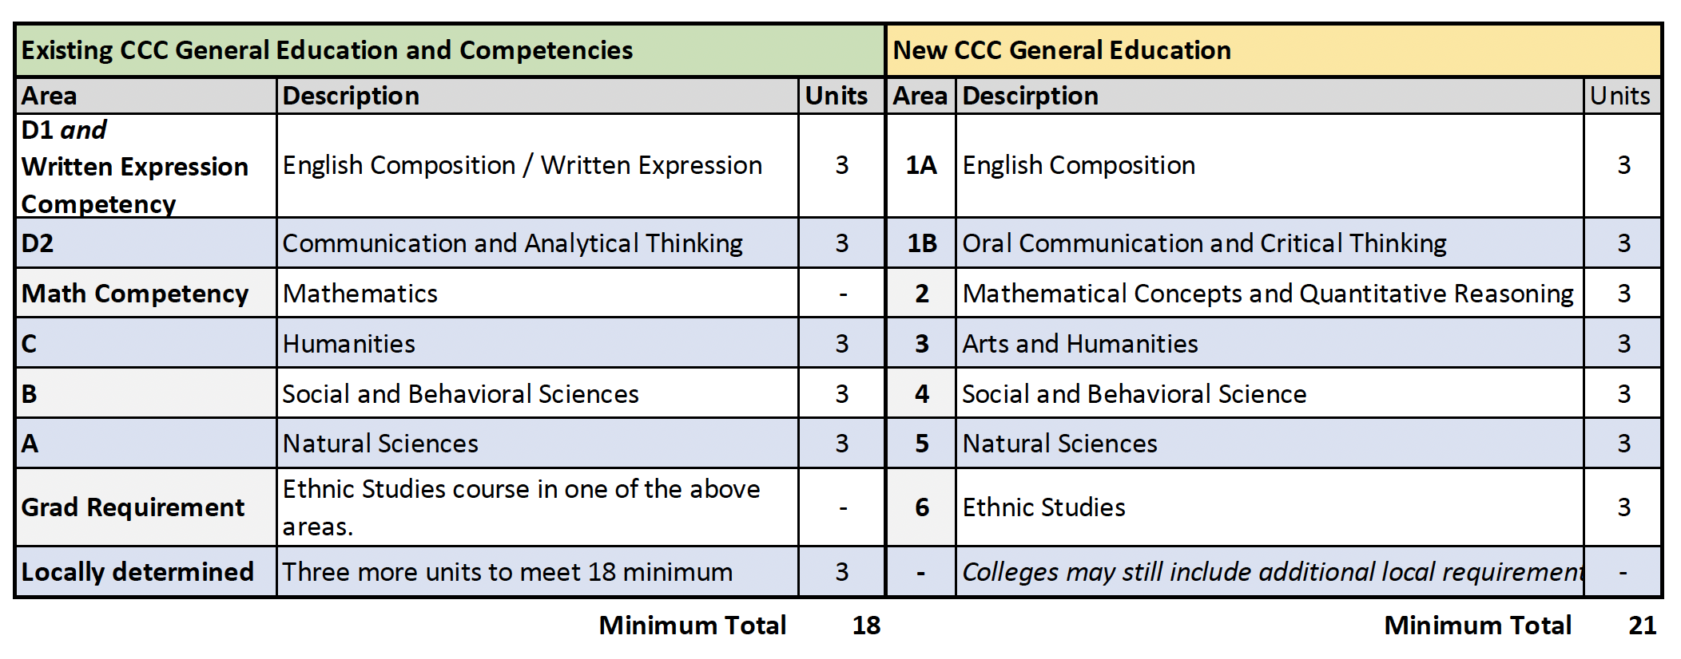
Cross-walk for CCC GE Changes

Slide 21
Summary of Changes to t5 Associate Degree Regs
Overall: Shorten regs to clarify distinctions among degree standards and criteria, constructing and approving a local degree, and how a student earns an AA/AS
§55060 – Philosophy and Criteria for Associate Degrees and Gen Ed.
§55061 – Associate Degree Requirements
How you build and approve through the curriculum process. Includes new Gen Ed categories. Clarifies the definition of “area of emphasis.”
§55062 – Requirements for Awarding an Associates Degree
Residency – changed from “College” to “District”
Includes use of noncredit to satisfy requirements (from old §55064)
Allows colleges to compute a minimum 2.0 GPA by excluding courses not used to satisfy degree requirements.
Includes new language re: meeting GE requirements through previous baccalaureate degree completion.

Slide 22
New GE for CCC Baccalaureate

Slide 23
Proposed CCC Baccalaureate Lower Division Degree GE
ACCJC currently requires 36 units of GE for CCC baccalaureate degree students (27 lower division; 9 upper division)
Students are currently required to follow IGETC or CSU GE (which are being replaced by Cal-GETC)
The proposed GE pathway:
Helps address the challenge of high-unit technical degree programs
May be more appropriate for our baccalaureate degree students (in terms of structure of pattern and area criteria)
Would allow for increased flexibility for local approval of courses

Slide 24
(proposal consideration) Baccalaureate Degree Lower Division GE Pathway
Area | Subject | Courses (minimum 3 semester/4 quarter units)
1 | English Communication, Oral Communication, and Critical Thinking English Composition Oral Communication and Critical Thinking | 1 course 1 course
2 | Mathematical Concepts and Quantitative Reasoning | 1 course*
3 | Arts and Humanities | 1 course
4 | Social and Behavioral Sciences | 1 course
5 | Natural Sciences | 1 course
6 | Ethnic Studies | 1 course
7 | Lifelong Learning and Self-Development | optional
 | Two additional courses from any two areas above | 2 courses
Total Courses (units) | Courses must be transfer-level courses. *Exceptions: Students in career technical programs seeking a certificate or associate degree with specific requirements, as dictated by the program’s advisory or accrediting body, that cannot be satisfied with transfer-level coursework. See EDC §78213 | 9 courses (27 semester units)

Slide 25
Considerations

Slide 26
Opportunities and Challenges for Colleges and Students
Opportunities:
Clear GE pathway to both CSU and UC
Students meeting GPA requirements will be prepared for transfer to both CSU and UC
For local associate degrees, colleges may include additional areas
All associate degree requirements will be GE or majors; no competency or additional graduation requirements needed
Challenges:
All transfer students will need to take courses meeting UC course standard requirements, even if transferring to CSU
Reduced options for students – Fewer courses are UC transferable or approved for GE/majors requirements than at CSU

Slide 27
A sampling of…Courses meeting CSU GE Breadth but not IGETC
Trigonometry
Math for Teachers
Personal Finance
Career Exploration and Life Planning
College Success Strategies
Health Science
Nutrition
Introduction to Kinesiology
Foundation of Fitness and Wellness
Reading for Academic and Lifelong Literacy
Introduction to Career Exploration
Human Reproduction and Sexuality
MORE…

Slide 28
Q & A

