Slide 1
Integrating Diversity, Equity, and Inclusion into Curriculum: Leveraging Software for Inclusivity
ASCCC Curriculum Institute, July 12-15, 2023
Craig Canfield, EdD
(he/him)
Director of Diversity, Equity, and Inclusion

Slide 2
Agenda
Introduction to CourseLeaf
The importance of DEI
Practical ways to integrate DEI into curriculum using CourseLeaf
CourseLeaf’s new Inclusive Curriculum Tool

Slide 3
Learning Outcomes
Understand the importance of DEI and why it should be incorporated in the curriculum.
Learn actionable ways to incorporate DEI into the curriculum.
Learn how to leverage CourseLeaf software for DEI, including using the new Inclusive Curriculum Tool.

Slide 4
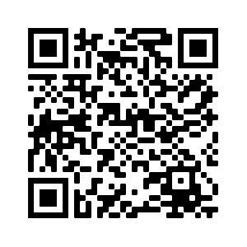
In the spirit of our Leepfrog Café.
Notes:
Add right after your opening slide
Before we get started….
At Leepfrog, we love our java and we love our clients! We have a coffee mug in our Leepfrog Café for each of the 475 campuses that use CourseLeaf.
In the spirit of this tradition, we will be giving away a $20 Starbucks gift card at the end of our presentation. We will also send a copy of our presentation to everyone who participates. Just add your business card to the bag that we are handing around. If you don’t have a business card, feel free to use the back of the card placed on your chair. We just need your name and email address!

Slide 5
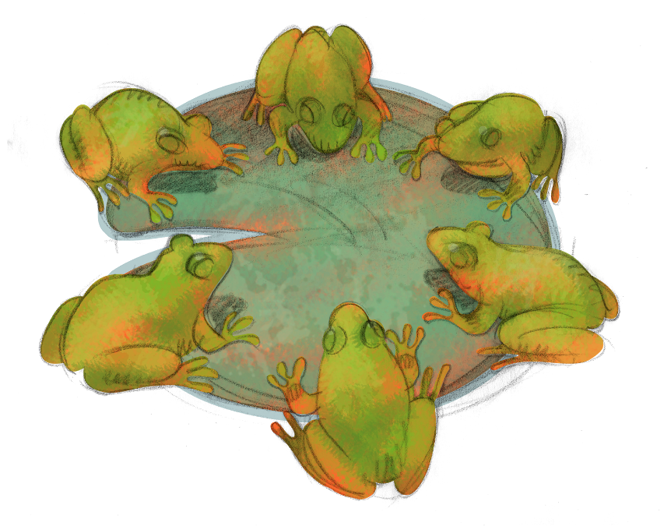
The right software not only makes life easier for staff and faculty, it drives positive student outcomes.
Meet Leepfrog and CourseLeaf

Slide 6
An experienced team of Curriculum Geeks.
500+ Clients in 8 Countries
150+ Curriculum Geeks at Your Service
In Person Consultation and Training
24/7 Live Support
Robust User Community
Three Employee Resource Groups: WELL, FRED, & Pride+
Notes:
WELL = Women Education, Leading, and Learning; FRED = Froggers for Racial and Ethnic Diversity; Pride+ = LGBTQ group

Slide 7
Five modules, one holistic solution
Notes:
Our CourseLeaf software includes five modules that support curriculum management, catalog publishing, section scheduling, student registration, and syllabi publication.
You can use one or multiple modules and grow your system as your campus needs and resources grow.
Today, we will be focusing on our section scheduler, CourseLeaf CLSS.

Slide 8
What makes CourseLeaf unique?
Student Focused
Efficient
Personalized
Features that drive student engagement and on time completion.
Functionality that can support, integrate, and sync with complex systems.
Intuitive software that adapts to your institutional language, logic, and processes.

Slide 9
Some of our Technology Integration Partners
Notes:
SYL Intro

Slide 10
The Importance and Impact of DEI

Slide 11
Importance of DEI
Essential and growing concern for higher education.
More than half of college students feel excluded based on an aspect of their identity, even though 64% of students believe their school is supportive of DEI.
When students feel excluded, they are aren’t as successful. However, when students feel a sense of belonging, their academic, health, and engagement outcomes improve significantly.
While students engage with their schools in a variety of different ways, they are all engaging with the curriculum, making it essential to incorporate DEI in this area.

Slide 12
“All instruction is culturally responsive. The question is: to which culture is it currently oriented?”
- Gloria Ladson-Billings

Slide 13
Impacts of DEI: Better Student Outcomes
Students feel a sense of belonging and thus greater motivation & persistence.
Students better understand and respect different perspectives and backgrounds.
Students are more prepared for a diverse world and workplace.
Students feel safer and more confident.
Students build a greater capacity for empathy.
Sources: The Importance of Diversity & Cultural Awareness in the Classroom, Drexel University; Incorporating Diversity, Center for Teaching and Innovation, Cornell University; & How to Center DEI, Eberly Center, Carnegie Mellon University

Slide 14
Practical Ways to Integrate DEI into Curriculum

Slide 15
Publish a catalog that represents your diversity and values.
What images are you using to represent your school?
Check for exclusive or biased language.
Ensure clear career pathways are available.
Be clear about your DEI goals and initiatives. Show that your school is doing something more than just a statement.

Slide 16
Catalog: Include Diverse Images

Slide 17
Diverse Images

Slide 18
Catalog: Share Career Pathways

Slide 19
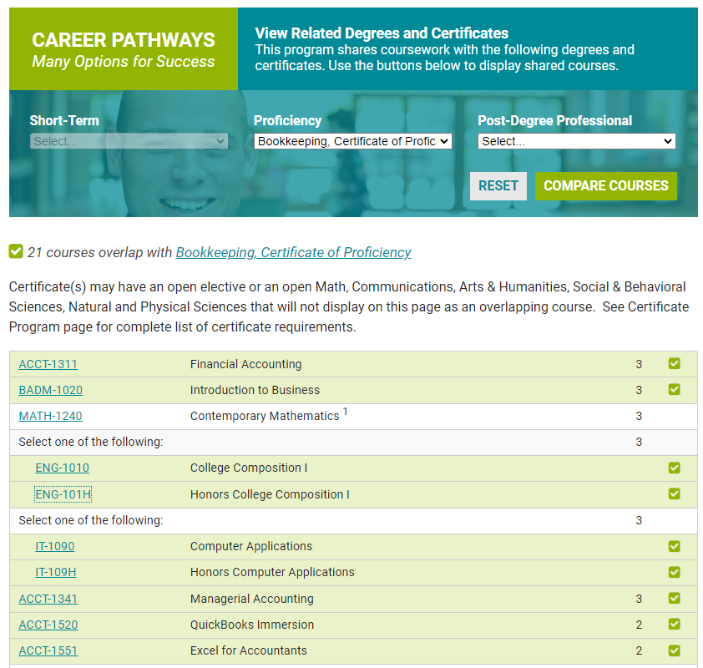
Career Pathways Example 1

Slide 20
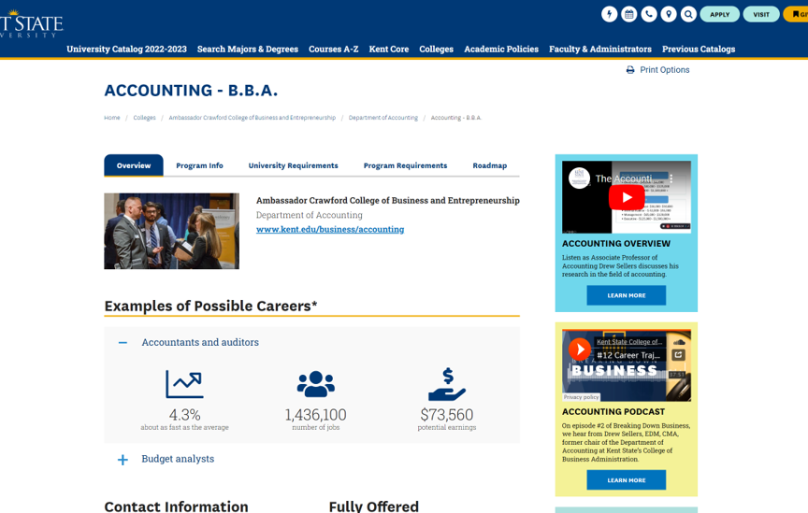
Career Pathways Example 2

Slide 21
Catalog: Highlight Courses with DEI Content

Slide 22
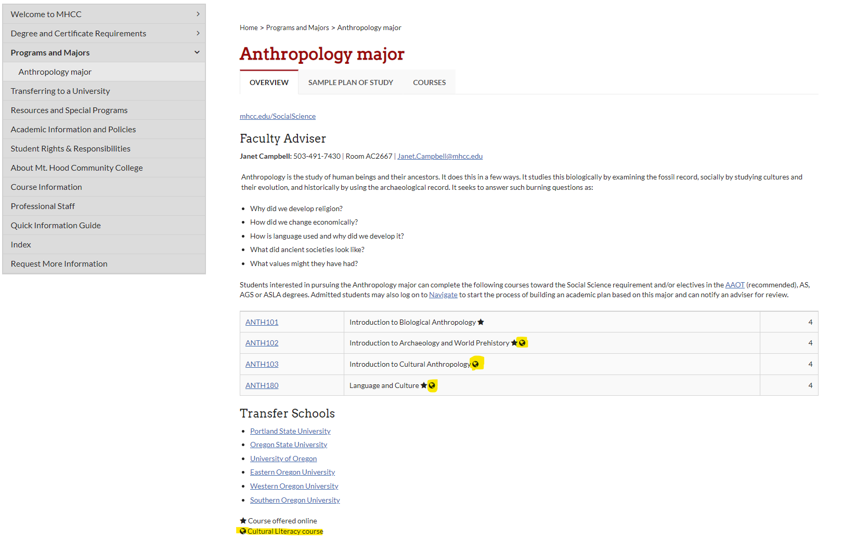
Highlighting courses that feature cultural literacy

Slide 23
Catalog: Highlight Majors and Programs with DEI Content

Slide 24
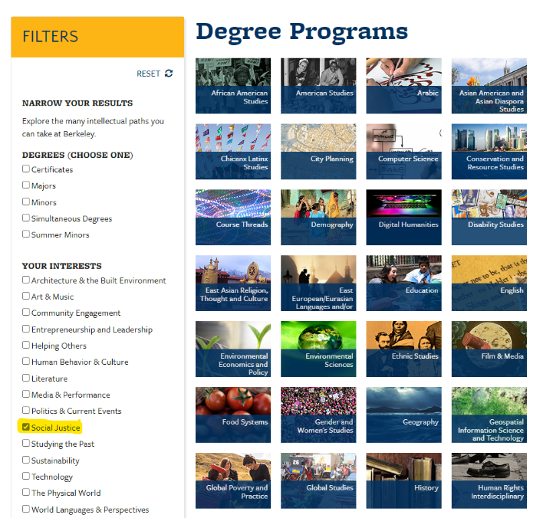
Degree Program Filtering

Slide 25
Catalog: Highlight DEI Resources

Slide 26
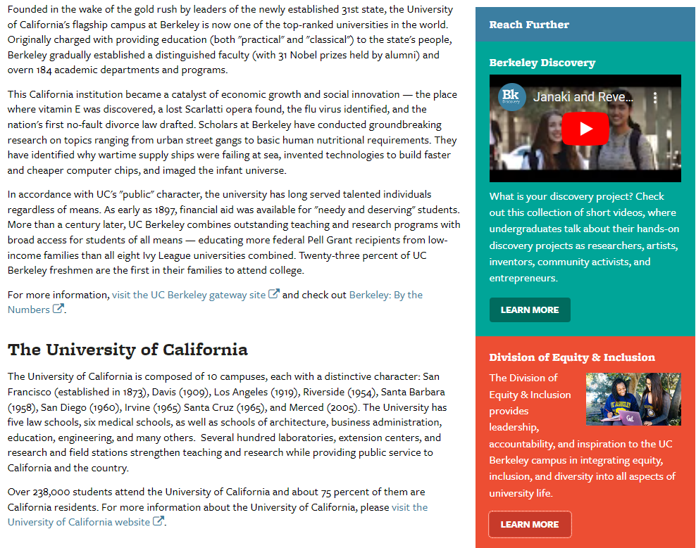
Highlighting DEI resources in the catalog

Slide 27
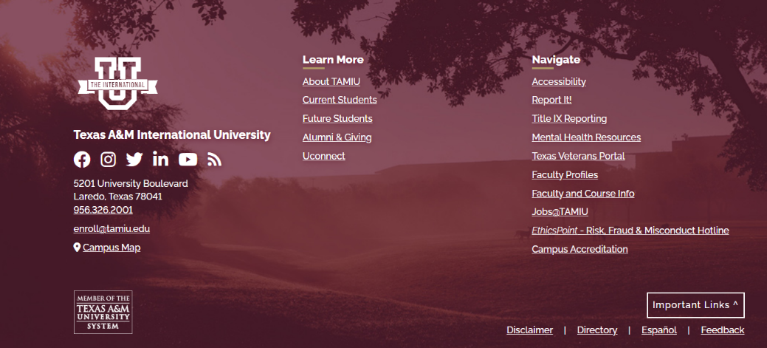
Using Footers

Slide 28
Catalog: Make it Accessible

Slide 29
Accessibility is DEI Work
Essential for some, beneficial for all.
Medical vs Social models
Software is built to accessibility standards, but content is equally important.
Are catalog editors and contributors knowledgeable in accessibility best practices?
Use the Accessibility report in CAT to check for accessibility issues in your catalog, and check out our accessibility tips on the Leepfrog User Community website.

Slide 30
Catalog and Curriculum: Leverage Your DEI Team

Slide 31
Include your DEI staff in the review process.
Can they review catalog content and/or course descriptions for exclusive or biased language?
Can they provide training to catalog editors and contributors?
Can they help you incorporate institutional goals in the work you do?
Robust workflow engines can be leveraged to ensure your DEI person is included in your review processes.

Slide 32
Curriculum: Track and Report DEI Content

Slide 33
Reporting can help you demonstrate progress and outcomes.
Use attributes or other tags to indicate courses that have DEI content.
Build it in to your course proposal/review process
Ensure that the information is available to students
Is the information easily reportable? Annual reports, accreditation, state requirements may require reporting.
Through CIM, you can add custom fields that sync with your SIS, and our new reporting engine makes reporting simple.

Slide 34
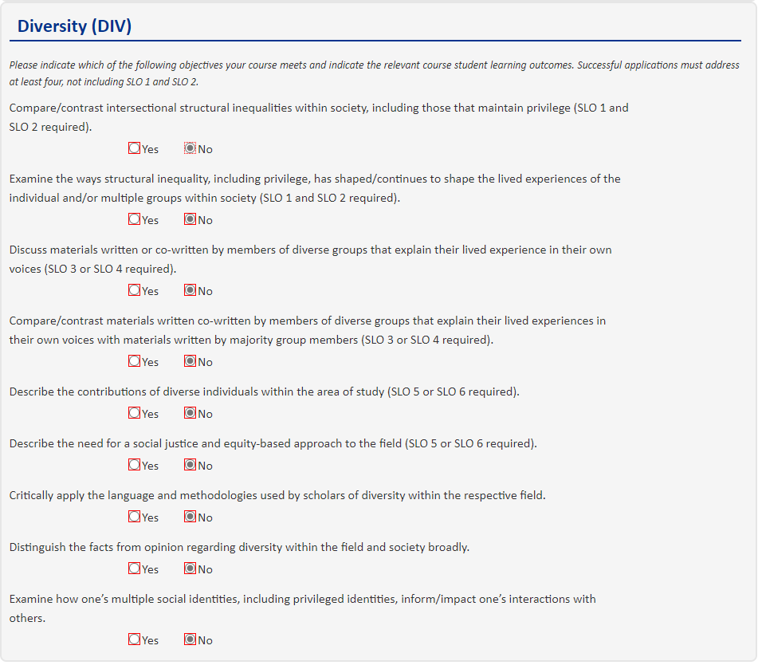
Adding questions about DEI content on the course proposal form

Slide 35
Curriculum, Scheduling and Syllabi

Slide 36
Driving DEI in curriculum management, scheduling, and syllabi
Consider and review general education, introductory, and multi-section courses.
Organize syllabi diversity workshops for faculty.
Add questions about DEI to course proposal forms.
How have you incorporated diversity into your reading list?
How do you plan to create an inclusive classroom environment?
How are your learning objectives supporting inclusion?
Do your course offering times match the diversity of your student population?
Use customizable rules in CLSS help ensure course offerings are meeting student needs.

Slide 37
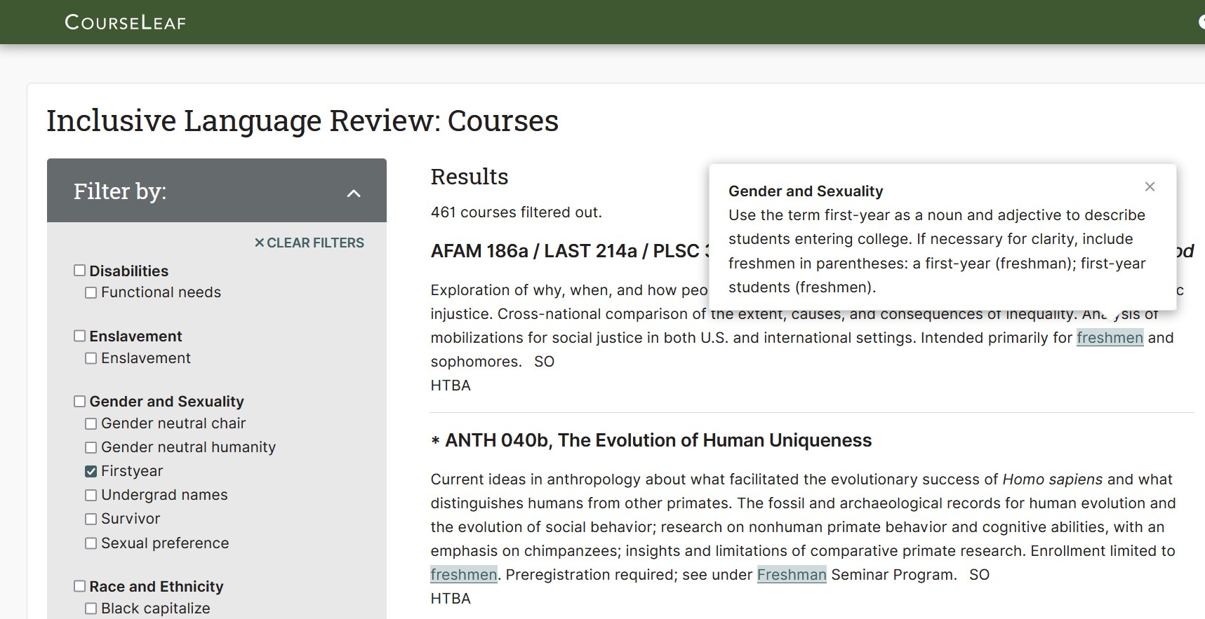
CL 10: CourseLeaf’s New Inclusive Curriculum Tool

Slide 38
Inclusive Curriculum Tool
Language matters.
CourseLeaf’s Inclusive Curriculum Tool allows schools to custom create inclusive language style guides and promote the use of inclusive language across the curriculum.

Slide 39
A Tool to Promote Belonging
Features & Benefits
Quickly identify course titles and descriptions using exclusive language using custom rules based on institutional standards.
Ensure inclusive language is being used consistently across all course titles and descriptions.
Publish an inclusive language style guide anywhere in the catalog.
Promote the use of inclusive language campus-wide and foster student belonging.

Slide 40
Exclusionary Language → Inclusive Language
“Exceptionally well-prepared students may enroll in Cell Structure and Function and/or Genetics in their first year.”
“A school official has a legitimate educational interest if the official needs to review an education record in order to fulfill his or her professional responsibilities for the university.”

Slide 41
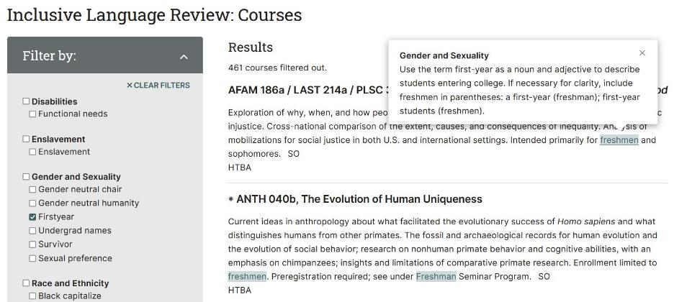
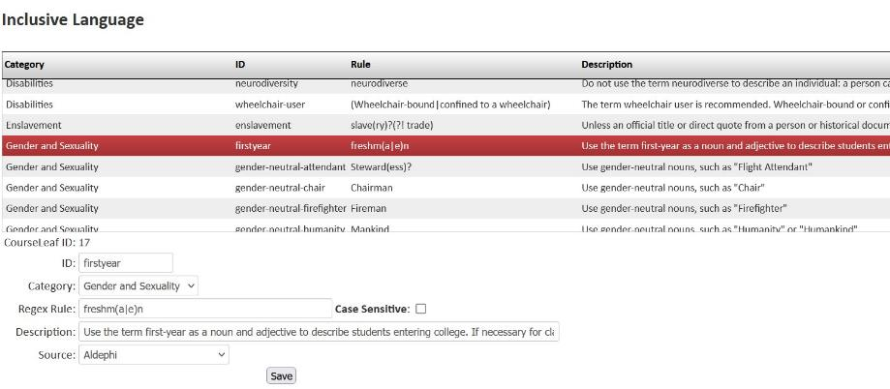
Inclusive Curriculum Tool Continued

Slide 42
Style Guide Considerations
Consider all aspects of diversity, including gender, sexuality, race and ethnicity, pronouns, and disabilities.
Make sure all contributors have a copy of your style guide.
Consider reading level. It’s an accessibility and inclusivity matter!
Normalize thinking about inclusive language.

Slide 43
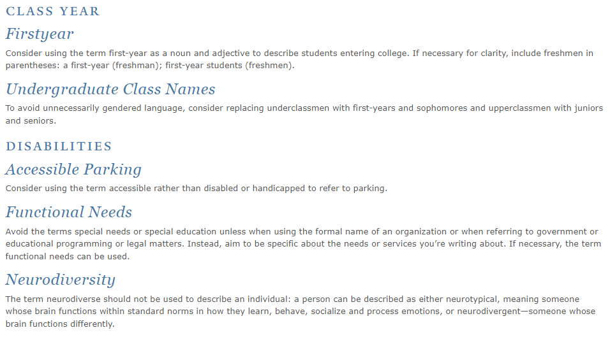
Publish an Inclusive Language Style Guide

Slide 44
How can I get it?
A CourseLeaf 10 Feature
Included with your upgrade to CL 10 at no charge.
Ready to use when you are, after you upgrade.
Prepopulated with a set of rules to help you get started.

Slide 45
Questions and Discussion
Notes:
Add right before your last slide (Q&A Slide) -
If you would like some additional information about CourseLeaf software, you can use this QR code to quickly send us your information. You can also let me know in person and we will make sure to connect with you after the conference.

Slide 46
Thank you for your time and attention.
Contact: ccanfield@courseleaf.com
Craig Canfield, EdD
(he/him)
Director of Diversity, Equity, and Inclusion

