Slide 1
Pre-Session: New/Newer Curriculum Professionals/ Specialists
Wednesday, July 7, 2023
2:00 – 3:50 p.m.
Notes:
Lesley

Slide 2
Presenters & Breakout Description
Curriculum specialists play an essential role in the college curriculum process, and the work can be daunting for those new to this role. This workshop is intended for new or newer curriculum specialists and provides the basics of the roles and responsibilities of curriculum specialists, designing your personal tracking system, promising and effective practices for submitting curriculum, and building relationships with faculty and the curriculum chair.
Lesley Agostino, Curriculum Management Specialist (Senior), Diablo Valley College (5C)
Shireen Awad, Curriculum Specialist, Chaffey College
Guillermo Castilla, Faculty, Evergreen Valley College
Kelly Fowler, Vice President of Instruction, Mt. San Antonio College (5C)
Erin Larson, Dean, California Community Colleges Chancellors Office
Notes:
Lesley

Slide 3
Overview
Roles and Responsibilities
Designing a Personal Tracking System
Effective Practices for Submitting Curriculum
Building Relationships as a Curriculum Specialist
Keeping Up with Curriculum Developments
Resources
Q&A Session
Notes:
Lesley

Slide 4
Who and What?
Who is in the room?
Curriculum Specialists
Classified Professionals other than Specialists
Curriculum Chairs
Curriculum Committee Members
Faculty
Administration
Articulation
Other?
Fill out cards with questions, concerns, general comments about Curriculum Specialist tasks and duties.
Notes:
Ask who is the newest/most recent hire (I have a “prize” pack). Hand out cards for questions.
Trying to get a feel who is in the room, probably just specalists ☺ Everyone

Slide 5
Where Do I Start?
Curriculum Language
Acronyms (PCAH, 8th edition pp. 29-33)
Curriculum has its own language
Ed. Code and Title 5 references included
Chancellor’s Office Curriculum Inventory (COCI)
California Community Colleges Curriculum Submission and Technical Manual
Program and Course Approval Handbook (PCAH), 8th Edition
Guide/handbook for curriculum development created and updated by the Chancellor’s Office and 5C.
Key elements of Title 5 and Ed. Code.
Valuable resource for faculty, classified professionals, and administration.
MIS Data Element Dictionary
Taxonomy of Programs Manual
Learning these helpful resources takes time! This position is a continuum of learning. Experiences with these resources and working with faculty influence learning in this role. Download/print these as guides but do not try to memorize or become an expert overnight.
Notes:
Mention how even in introductory sessions, we speak in language, referencing Title 5 “55063” Associates Degree, 55003 Prereqs, etc. , ASSIST, C-ID,
Shireen

Slide 6
Roles & Responsibilities
Under the supervision of the Vice President of Instruction, Curriculum Specialists generally:
Coordinate the curriculum approval process from the course and program proposal level through local and state approval, including ACCJC (if appropriate).
Participate in Curriculum Committee meetings including creating agendas and taking minutes.
Serve as technical support for faculty and tech review.
Prepare/maintain documentation of curriculum actions
Assist in production of the college catalog and schedule of classes
Track new and revised curriculum
General duties of a Curriculum Specialist
Notes:
Logistics for meetings, minutes/agendas, curriculum management system/software, catalog production/publishing, public web sites, support/training for faculty/staff/admin,
Shireen

Slide 7
Roles & Responsibilities General duties of a Curriculum Specialist
Under the supervision of the Vice President of Instruction, Curriculum Specialists generally:
Oversee/manage the local curriculum management system of record and submit curriculum to the state inventory (COCI)
Validate that codes are aligned/consistent across various curriculum systems - local curriculum management system, scheduling system, COCI, etc.
Coordinate with the Financial Aid office to update the Eligibility and Certification Approval Report (ECAR) and Program Participation Agreement (PPA).
Assist the district in reconciling any course-level referential (misalignment between what is reported and what is in the Management information Systems (MIS) master course file) or syntactical (rules based) MIS errors for the college during end-of-term reporting.
Notes:
Logistics for meetings, minutes/agendas, curriculum management system/software, catalog production/publishing, public web sites, support/training for faculty/staff/admin, Shireen

Slide 8
Roles & Responsibilities Additional duties of a Curriculum Specialist
Under the supervision of the Vice President of Instruction, Curriculum Specialists sometimes:
Assure compliance of the curriculum with Student Services in the areas of Articulation, Matriculation, and Admissions and Records
Perform a variety of technical duties relative to assigned area
Notes:
Shireen, Kelly

Slide 9
Roles & Responsibilities Duties of Others
Curriculum Specialist serve as support for faculty and administration in the following areas:
Creating the Course Outline of Record (COR) and Program Narratives
How to use your CMS to help with this
Determining Course Design, including:
Methods of instruction (lecture/lab/studio)
Number of course hours and units
Academic discipline
Assigning the TOP Code (CB03), CIP Code, SAM code (CB09), Basic Skills Status (CB08), Special Class Status (CB13), Levels Below Transfer (CB21), and other coding
Determining the Minimum Qualifications for a course
These elements should be established through collegial consultation with faculty (Academic Senate) and Administration.
Notes:
Shireen, Lesley

Slide 10
Roles & Responsibilities What is NOT part of the Specialist's Role?
Writing/revising curriculum
California Code of Regulations “10+1”
Approving curriculum
Voting members of the Curriculum Committee
Based on local bylaws
Some colleges have a Specialist as a voting member
Submitting curriculum to ASSIST or C-ID
Articulation Officer
Notes:
Shireen

Slide 11
Designing a Personal Tracking System: Courses
Approval dates - Curriculum Committee, Board, and State
Catalog and scheduling deadlines
Currency - Courses are reviewed every 5 years
CB code changes - Codes entered in COCI
C-ID descriptors
Effective term - Fall, Spring, Summer
GE codes - local, CSU-Breadth, IGETC (CalGETC)
Potential impact of course changes on programs
Substantial changes (resulting in the issuance of a new control number)
Changes to prerequisites
Useful for yearly prereq report required by Chancellor’s Office
Changes to distance education
Sometimes needed by DE committee for reporting
What information is important to track regarding courses?
Notes:
Shireen, Lesley

Slide 12
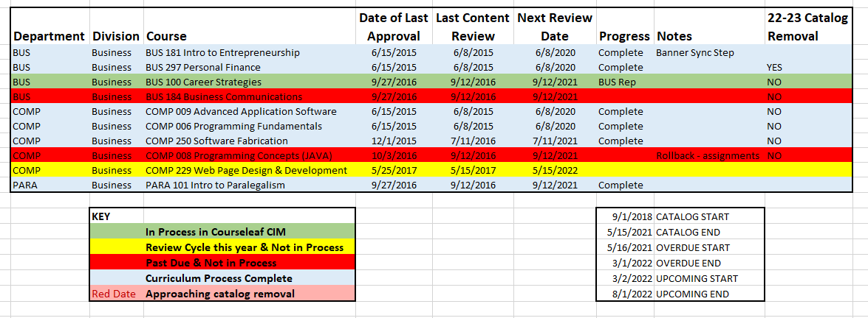
Personal Tracking System: Courses
Spreadsheet tracking allow for easy sorting and reporting
Extractions from curriculum management software
Color coding
College of the Sequoias
Notes:
Shireen, Lesley

Slide 13
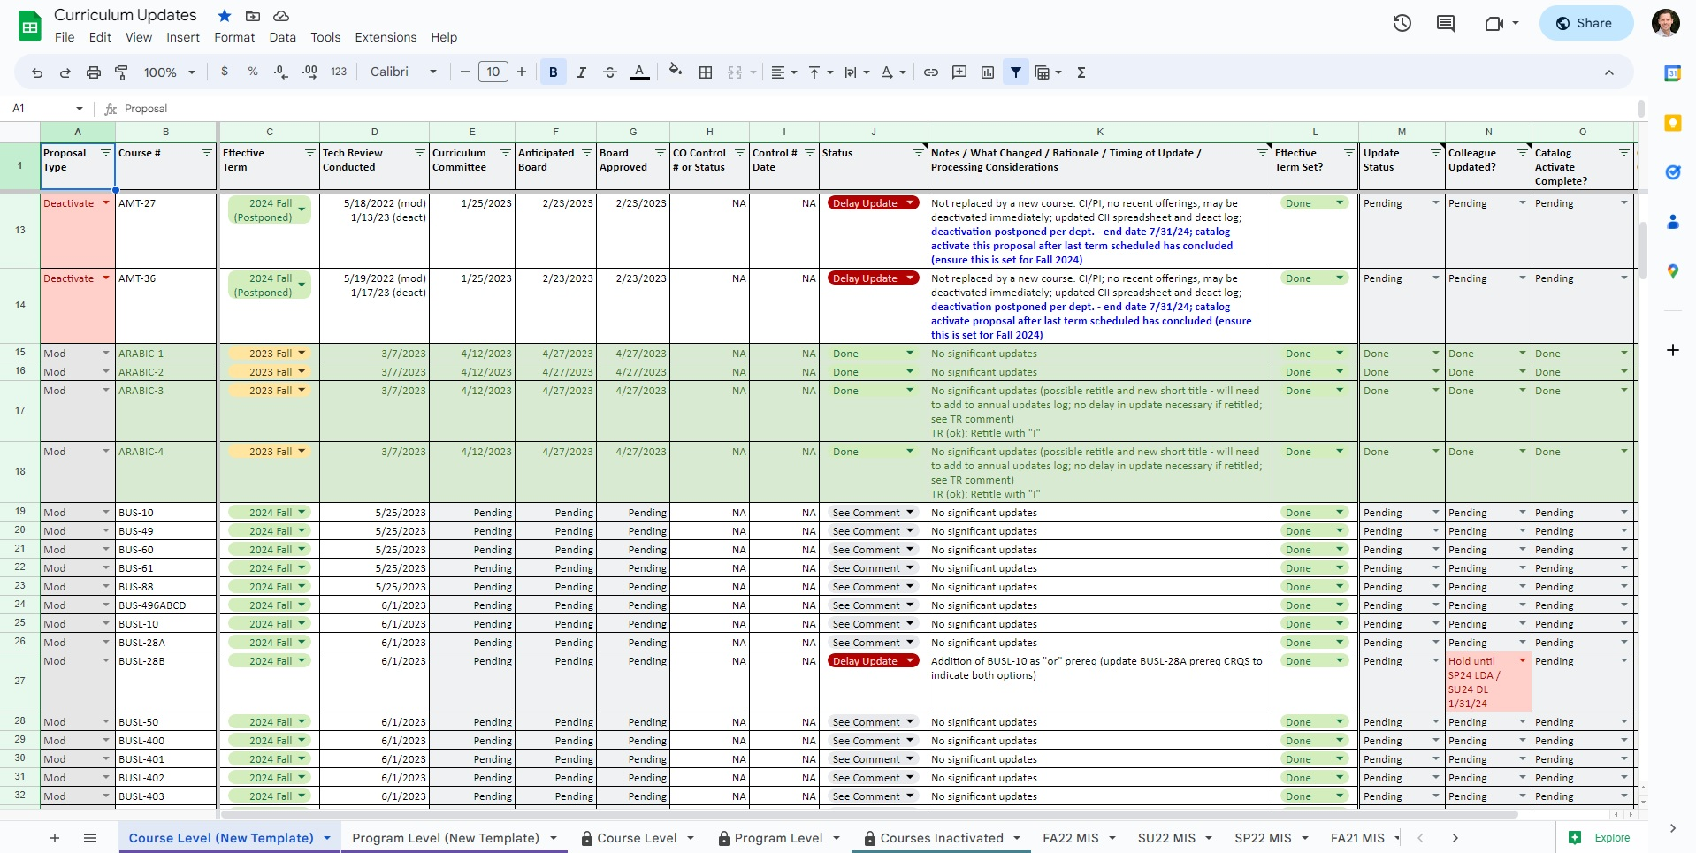
Designing a Personal Tracking System: Courses (College of the Sequoias)
Notes:
Shireen, Lesley

Slide 14
Designing a Personal Tracking System: Courses (DVC)
Diablo Valley College
Notes:
Shireen, Lesley

Slide 15
Designing a Personal Tracking System: Programs
What information is important for programs?
Currency (2 years for CE)
Substantial changes to courses (title/units)
Course list requirements
Narrative updates
TOP/CIP alignment
Status of supporting documentation
CE – Advisory board, LMI, Regional Consortia, transfer documentation
Apprenticeship – LMI, California Division of Apprenticeship Standards approval letter
ADTs - TMC, required transfer documentation (AAM, BCT, GECC), C-ID submission status for courses pending approval
Local degrees – transfer documentation
What information is important to track regarding programs?
Notes:
Working within COCI to ensure that items are updated. Shireen, Lesley, Erin

Slide 16
Personal Tracking System: Programs
Using the same or similar tracking sheet that is used for courses.
What information is helpful?
Approval dates
Catalog and scheduling deadlines
Effective term
New, revised, or deleted designations
State and/or Federal requirements
Notes:
Shireen Lesley

Slide 17
Check-In and 5-minute Break
Any tracking sheet suggestions?
Questions about anything we have covered so far.
5 –Minute Break

Slide 18
Effective Practices for Submitting Curriculum
Encourage faculty to use resources when creating and/or revising curriculum.
Continuous check in with requirements during the creation/revision process:
California Education Code
Title 5
Program and Course Approval Handbook
MIS Data Element Dictionary
Applications and curriculum management software that is tailored for easy submission into COCI.
Notes:
Going backwards to get information is frustrating. Creating submission forms that follow the PCAH and COCI requirements.
Erin, Shireen

Slide 19
Chancellor's Office Curriculum Team
Notes:
Erin

Slide 20
Effective Practices for Submitting Curriculum: Courses
Curriculum management software should have all the required elements for COCI.
Using the Data Element Dictionary to prevent data errors (delays) in course submissions.
Review Integrity Checks
Ensuring course data is correct in COCI and matches your local enterprise resource planning (ERP) software (i.e. Colleague).
MIS error reports
“Course Form” in COCI
Auto approval – be mindful of your submissions
Notes:
Going backwards to get information is frustrating. Creating submission forms that follow the PCAH and COCI requirements. Course form in COCI is helpful for schedulers since not all aspects of the data needed for ERP is on the COR. Erin, Shireen

Slide 21
Effective Practices for Submitting Curriculum: Programs
Use the Program and Course Approval Handbook
Proposal fields are consistent, accurate, and match the narrative:
Title, goal, award type, descriptions, TOP/CIP, units, and all sections of the narrative are complete.
For legacy programs confirm that old/outdated attachments (including CORs) and regenerated/duplicate attachments have been removed.
Notes:
Going backwards to get information is frustrating. Creating submission forms that follow the PCAH and COCI requirements. Erin, Shireen

Slide 22
Effective Practices for Submitting Curriculum: Programs
Certificates and Associate Degrees
Narrative
Follow the PCAH!
LMI, Advisory Board, Regional Consortia for Career Education (CE)
Apprenticeship Standards
Transfer documentation
Up-to-date course outline of record
Associate Degrees for Transfer
Narrative including the template ADT language (Checklist)
Transfer Model Curriculum (TMC)
C-ID approval/pending approval on courses.
Up-to-date course outline of record
All supporting TMC documents
AAM
GECC
BCT
Double Counting!
Work with your Artic Officer
Notes:
Erin, Shireen

Slide 23
Effective Practices for Submitting Curriculum: Programs (Noncredit & Bachelor’s Degrees)
Noncredit
Use the PCAH
Narrative
LMI for Short-Term Vocational Programs
Use hours, not units
Bachelor’s Degrees
Cycle 3 Applications Due September 5, 2023
Application
Notes:
Erin, Shireen

Slide 24
Building Relationships as a Curriculum Specialist
Serving as a Liaison to the Chancellor’s Office
Reviewers may contact you directly and submitters have access to contact reviewers
Revisions?
Ask for clarity if needed.
Care and empathy for reviewers
Staffing issues
Open to suggestions and dialog
Chancellor’s Office staff want to help!
Care and empathy for yourself
Submissions can be tiring and there is a lot to track
Revisions are normal
Chancellor’s Office
Curriculum Chairs
Faculty
Notes:
Shireen, Erin, Kelly

Slide 25
Building Relationships as a Curriculum Specialist: Curriculum Chairs
Teaming up with your Chair
It’s a true partnership
Developing yearly goals
In-office goals
Faculty related goals
Campus goals
Promote team approach that sets aside perceived hierarchies
Formulate a clear understanding of respective responsibilities within the team structure
Develop and maintain regular and open communication with the chair(s)
Collaborate to develop annual curriculum timelines, calendars, goals, and objectives: always being mindful of 10+1
Be open to ideas for process improvement and innovation wherever they come from
Attend training opportunities together and plan professional development together
Support IDEAA conversations and inclusion of culturally responsive practices in curriculum
Notes:
Value of the curriculum specialist voice, Shireen

Slide 26
Developing Goals with Curriculum Chairs
New Chairs
Chairs may rotate every few years and training will be required
Work with new chairs on their expectations and time allowance (release time)
Recommended practices for new chairs
One-on-one meeting to explain your role and responsibilities
Work schedule, other duties outside of Curriculum Committee, professional goals
Review bylaws, forms, calendars, submissions processes
Open communication
Goal setting
Notes:
Value of the curriculum specialist voice
Kelly, Shireen,

Slide 27
Building Relationships as a Curriculum Specialist: Faculty
Building Relationships with Faculty
Technical assistance for development, revision, and maintenance of curriculum
Be point person for communication with faculty
Provide annual training
Give grace to all the nuances of curriculum development
Specialist do this everyday, faculty do not
Help guide the curriculum development process with assistance and positive solutions
Clarify roles with the Chair, Academic Senate, and the Committee
Relationship with Articulation Officer and/or Articulation Assistant is key!
Notes:
Value of the curriculum specialist voice, Guillermo, Shireen

Slide 28
Keeping Up With Curriculum Developments
Academic Senate for California Community Colleges Papers
Academic Senate for California Community Colleges Rostrum
California Community Colleges Board of Governors
California Community Colleges Curriculum & Instruction Unit
California Community Colleges Curriculum Committee (5C)
Chancellor’s Office Curriculum Assistance Listserv
Curriculum Specialists Listserv (send email request to join to cacurriculumstaff+owner@groups.io)
Curriculum Institute and Regional Meetings
Notes:
All

Slide 29
Staple/Essential Resources
Program and Course Approval Handbook - 8th Edition
Curriculum Submission and Approval Technical Manual
2023 Taxonomy of Programs
Course Data Elements
TOP-CIP Crosswalk (2020)
Policies for Prerequisites, Corequisites, and Advisories on Recommended Preparation
The Course Outline of Record: A Curriculum Reference Guide Revisited (Spring 2017)
Notes:
All

Slide 30
Additional Resources
CCCCO MIS Data Mart
Credit Course Repetition Guidelines
Common Concerns and Questions for Community Services Offerings
Guidelines for Required Instructional Materials in the California Community Colleges
Supplemental Learning Assistance and Tutoring Regulations and Guidelines
Notes:
All

Slide 31
Recommended Breakout Sessions
Thursday, July 13
10:30 – 11:45 a.m.
Noncredit Basics
Updated Work Experience Regulations
DEI in Curriculum: Model Principles and Practices
12:45 – 2:00
Brown Act Basics
Accounting Methods for Credit and Noncredit
Updates to the PCAH
Friday, July 14
9:00 – 10:15 a.m.
Curriculum Accreditation Requirements
Advanced Noncredit
10:30 – 11:45 a.m.
Assigning Courses to Disciplines/Cross-Listing
Collaboration Between Curriculum and Articulation to Support Student Transfer
Saturday, July 15
9:00 – 10:15 a.m.
CO COCI Q&A Listening Session
General Sessions
Thursday, 2:15 – 4:00 p.m.
CCCCO Curriculum Updates /Training
Friday, 2:30 – 4:00 p.m.
Student Panel--GE and Student Perspectives
Saturday, 10:30 – 11:45 a.m.
AB1111 Common Course Numbering AND/OR Equitable Placement
Notes:
All

Slide 32
Thank You!
Additional Q&A
You are valued and appreciated!
Lesley Agostino
lagostino@dvc.edu
Shireen Awad
sharon.awad@chaffey.edu
Guillermo Castilla
Guillermo.castilla@evc.edu
Kelly Fowler
kelly.fowler@mtsac.edu
Erin Larson
Elarson@CCCCO.edu

