Slide 1
From Complexity to Clarity:
Enhancing Educational Excellence through eLumen's Learning Outcomes Assessment and Curriculum Development Solutions
Rachel Dwiggins-Beeler, Senior Director of Services & Communication
Kristen Nelson, Customer Success Manager
Special Guest - Jessica Carroll, Curriculum Analyst, Cabrillo Community College
Curriculum Institute, July 2023

Slide 2
Agenda
The Client Experience
New Service Offerings
TCC - Roadmap
Ballot 2 release
Ballot 3 feature proposal
Announcing Our Winner
July 14, 2023

Slide 3
Our Audience

Slide 4
Who We Are

Slide 5
Our philosophy
Curriculum development, learning outcome assessment, and program review are processes vital part to the holistic ecosystem on campus and should intrinsically support continuous improvement.

Slide 6
Key In App Integrations
Catalog
CATALOG
Curriculum & Assessment
Curriculum & Catalog
Assessment & Strategic Initiatives (SI)
CURRICULUM
SI
PROGRAM REVIEW
SI/Program Review
ASSESSMENT
Notes:
Curriculum & Assessment - Data flows from Curriculum to Assessment - Data: Terms, Mapping/Linked LOs, SLO statements, Reports
Curriculum & Catalog - Data flows from Curriculum to Catalog - Data: Curriculum Library of CORs and PORs are published to your Catalog nad Public Site (URL/public)
Assessment & SI (Program Review) - Data flows from Assessment to SI/ Program Review - Data: Performance data pulls into SI templates (disaggregated/aggregated)

Slide 7
An Integrated System

Slide 8
The Client Experience

Slide 9
What We Do
Personalized Success Planning
Goals
Team alignment
Site optimization
Community Engagement
Newsletter
Knowledge base
In-app tips
User guidance
Services
Custom Data Exports
Custom Data Dashboards
Specialized Training

Slide 10
Engagement

Slide 11
Exercise: Engaging in Product Development Innovation
Prompt: You are a group of developers at ABC Company and you are needing to create a product that solves how to make a quick bag of popcorn that does not smell up the office.
Break into groups of 3-5.
Work with your group to solve this. How would you go about creating a product that would solve this? (3 minutes) What would your strategy be to solve this issue?
Then, we will discuss and compare paths to solutions.

Slide 12
eLumen: evolving with you as your technology partner!

Slide 13
New Services in
Partnership with our Clients

Slide 14
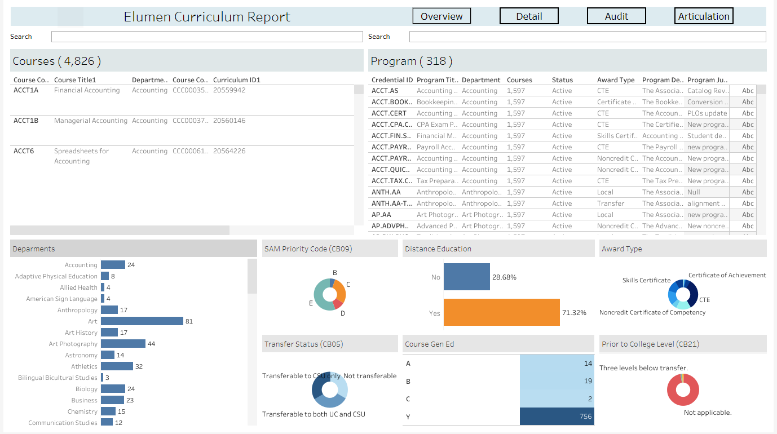
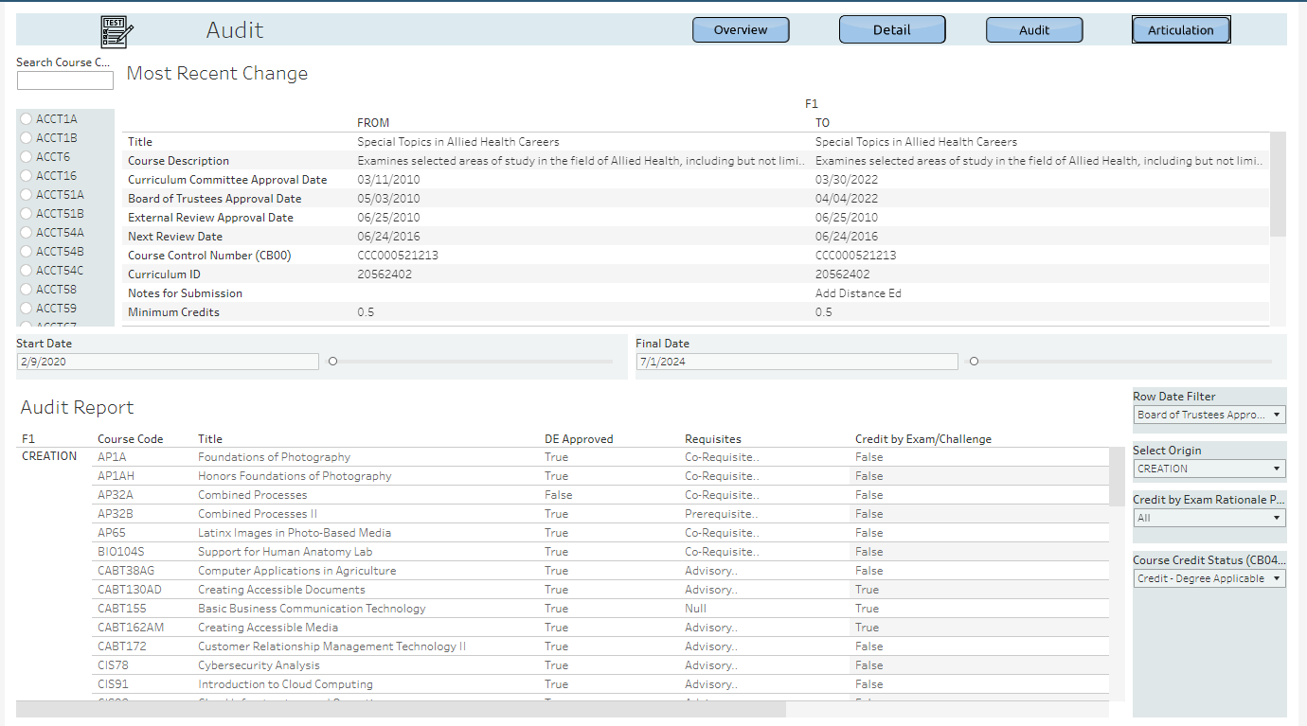
Tableau Curriculum
Dashboard

Slide 15
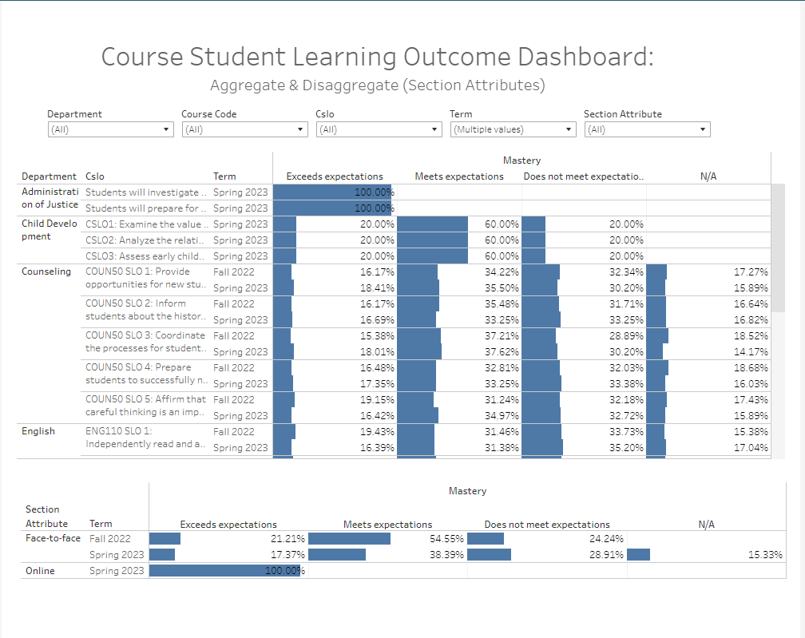
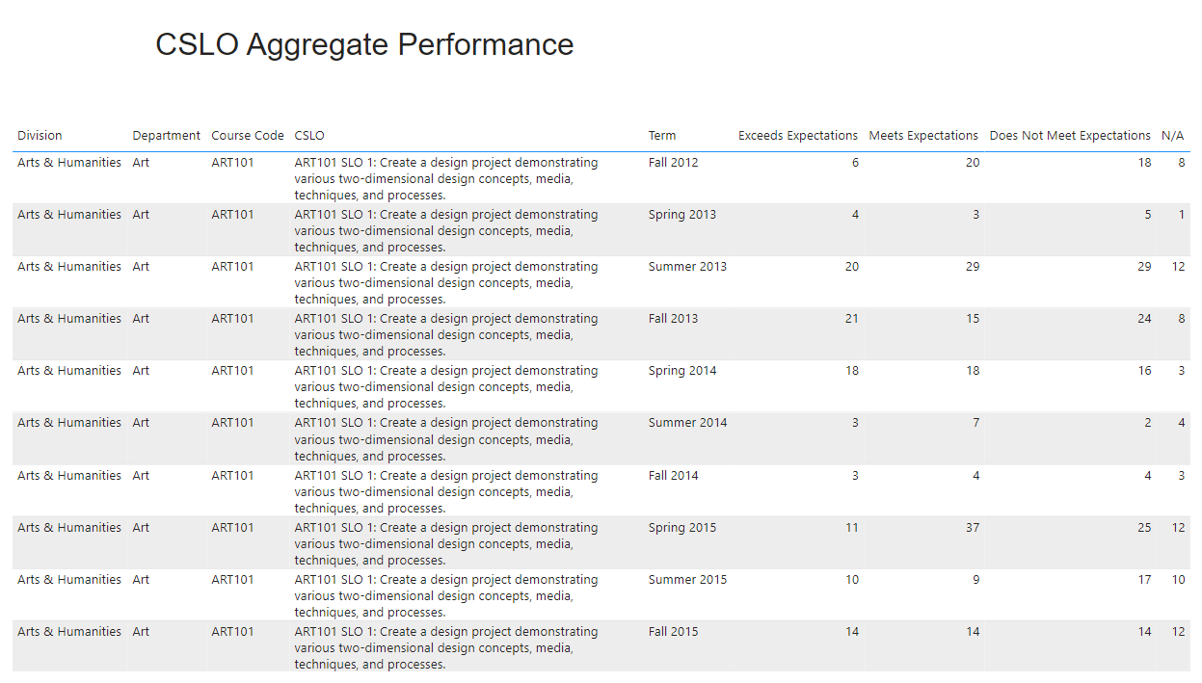
SLO Performance Dashboard in Tableau and Power BI
Tableau
Power BI

Slide 16
Our Clients are Our Partners in Development
The new Curriculum Dashboard in collaboration with partner institutions like Cabrillo Community College.
Jessica Carroll, Curriculum Analyst
Refining dashboards to consider the targeted users
Building transparency and equity in curriculum
Providing data that prompts action
Notes:
Jessica

Slide 17
The Connect Consortium
The Connect Consortium
Partners in Development
Purpose
Process
Next steps…

Slide 18
The Connect Consortium
Our community-driven approach to software development
The Connect Consortium (TCC), is comprised of eLumen users who collaborate with each other and our product team to identify future strategic product improvements.
Enable our partners campuses to:
(a) have a better line-of-sight of forthcoming enhancements, and
(b) have the opportunity to directly impact the prioritization and “solution-ing” of enhancement requests
TCC Process: Planning (Meeting), Voting, Developing, Release

Slide 19
Exercise: Be a designer
Design thinking is a human-centered, iterative problem-solving approach using empathy, collaboration, and experimentation.
Participate in the design thinking process
Empathy Interview (Tired Student) : Listen to understand the problem (2 minutes)
Ideation (product): Lightning brainstorm as many ideas a possible, no good or bad ideas. (2 minutes)
Prototype: Choose an idea and sketch a prototype (use as few words as possible) (5 minutes)

Slide 20
How We Get There
Notes:
Jessica

Slide 21
Path of Development
Stage 1
Review prior features
Brainstorm new features
Stage 2
Review press release outlining feature use case, value, function
Stage 3
Review feature mock-ups, refined use case, value, function
Stage 4
Vote for features to include in ballot process

Slide 22
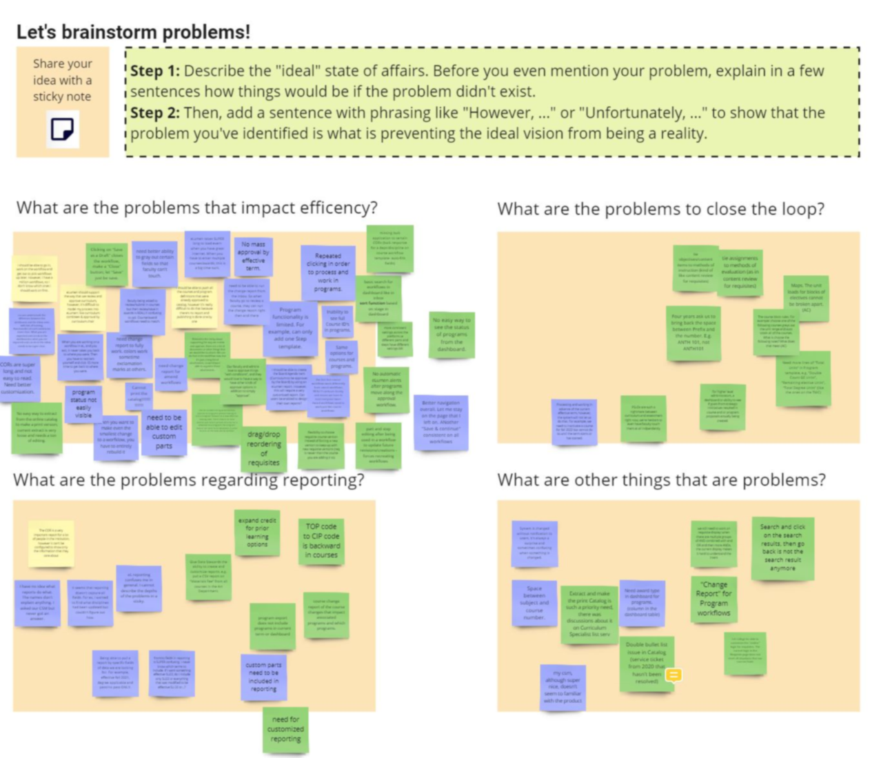
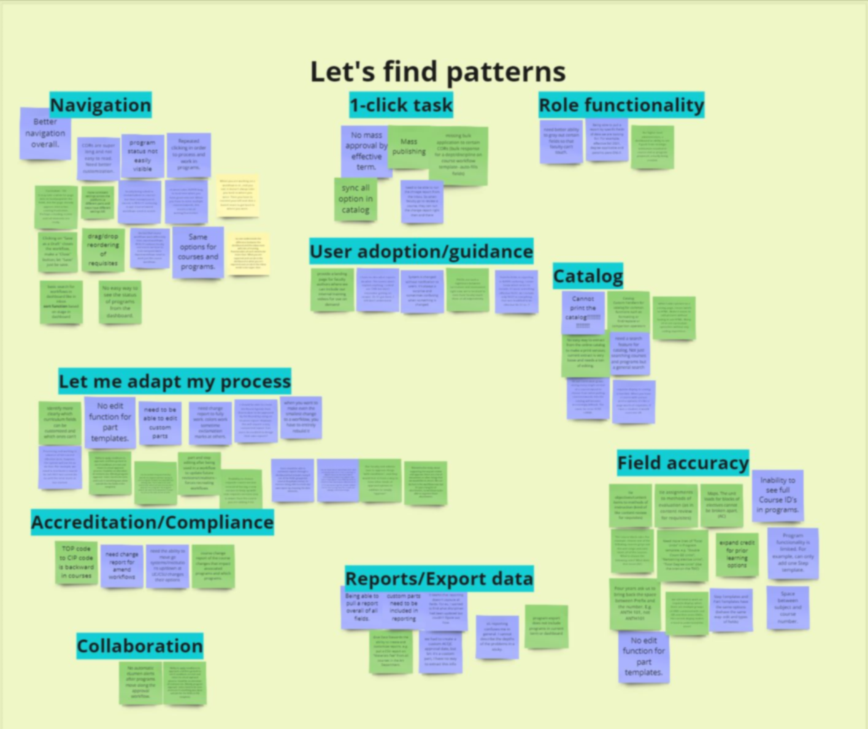
Empathize and Define
Notes:
Jessica

Slide 23
Path of Development
Stage 1
Review prior features
Brainstorm new features
Stage 2
Review press release outlining feature use case, value, function
Stage 3
Review feature mock-ups, refined use case, value, function
Stage 4
Vote for features to include in ballot process

Slide 24
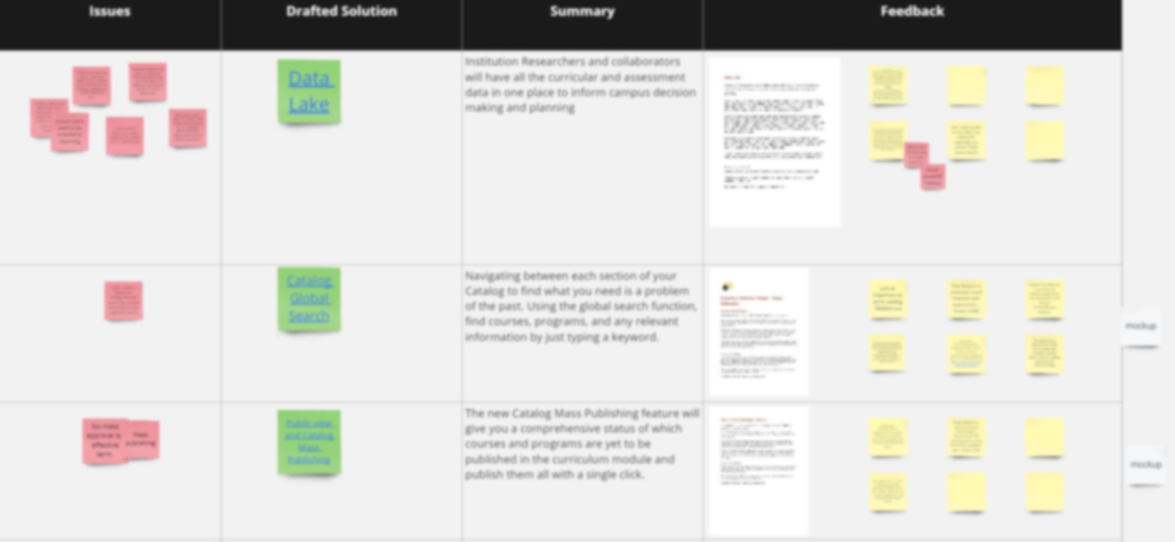
Ideate, Prototype, and Test
Notes:
Jessica

Slide 25
Path of Development
Stage 1
Review prior features
Brainstorm new features
Stage 2
Review press release outlining feature use case, value, function
Stage 3
Review feature mock-ups, refined use case, value, function
Stage 4
Vote for features to include in ballot process

Slide 26
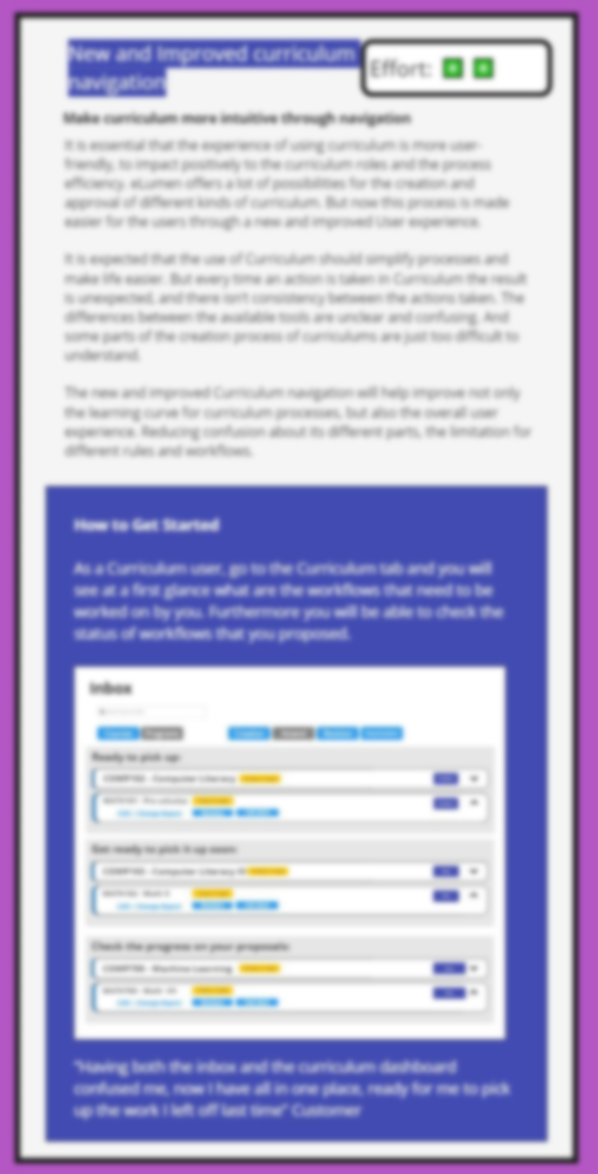
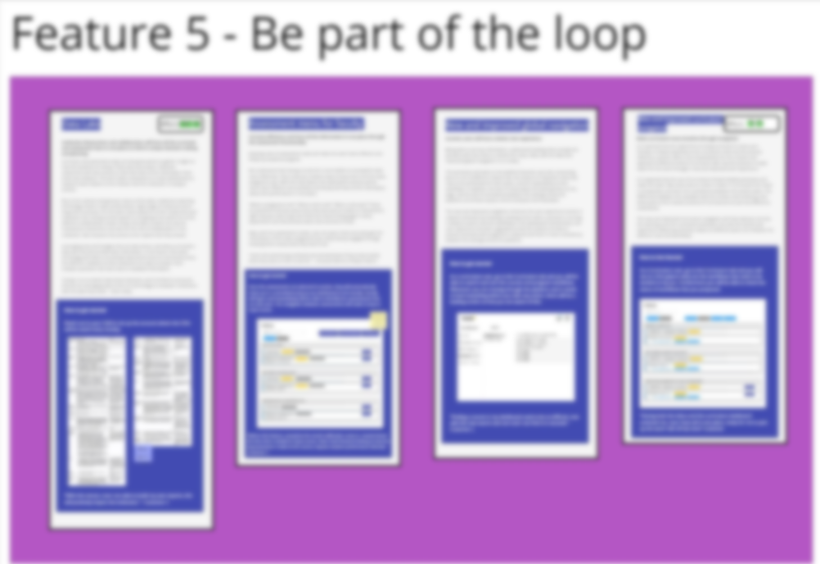
Vote and Implement!
Notes:
Jessica

Slide 27
TCC Experience: Collaboration in Action
Working alongside developers and seeing design thinking process in real time encourages a growth mindset and willingness to collaborate
Builds community with institutional partners and eLumen but also between institutional clients
Interesting to see inside the prioritization process and understand how resources (time and people) are connected to what can be produced in a given timeframe
Provides an opportunity to give your institution’s perspective on user needs and see how they align with others
It’s actually pretty fun!
Notes:
Jessica

Slide 28
Seeing Results
Notes:
Jessica hands it off

Slide 29
Ballot 2
Improved Curriculum Inbox
Improved Curriculum Dashboard Navigation
Print Entire Web-based Catalog
Improved Assessment Library
Improved Assessment Inbox
Improved Global Navigation
A Review Improved Navigability To Get Work Done

Slide 30
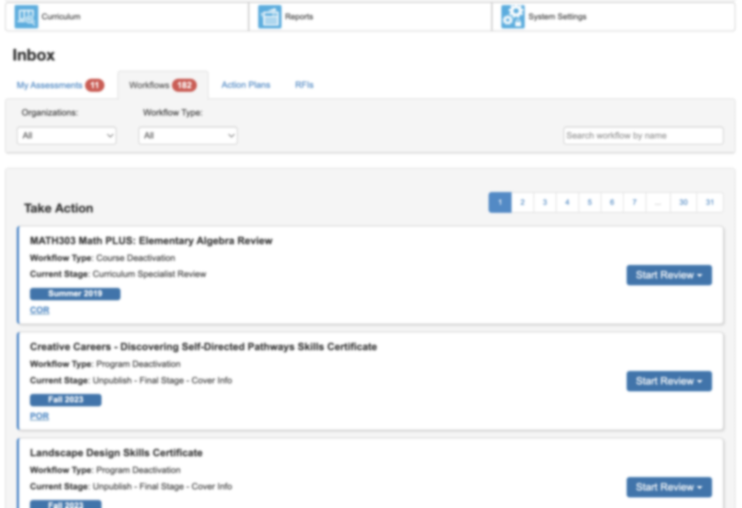
New & Improved Curriculum Inbox
Enhanced reviewer tools and visibility
Ordered for timely review
Term flagging
Critical reports linked
COR, POR, Change Report
Review proposals in progress
Expandable card for quick reference of status
Notes:
Multi-layer inbox view:
Ordered by user role

Slide 31
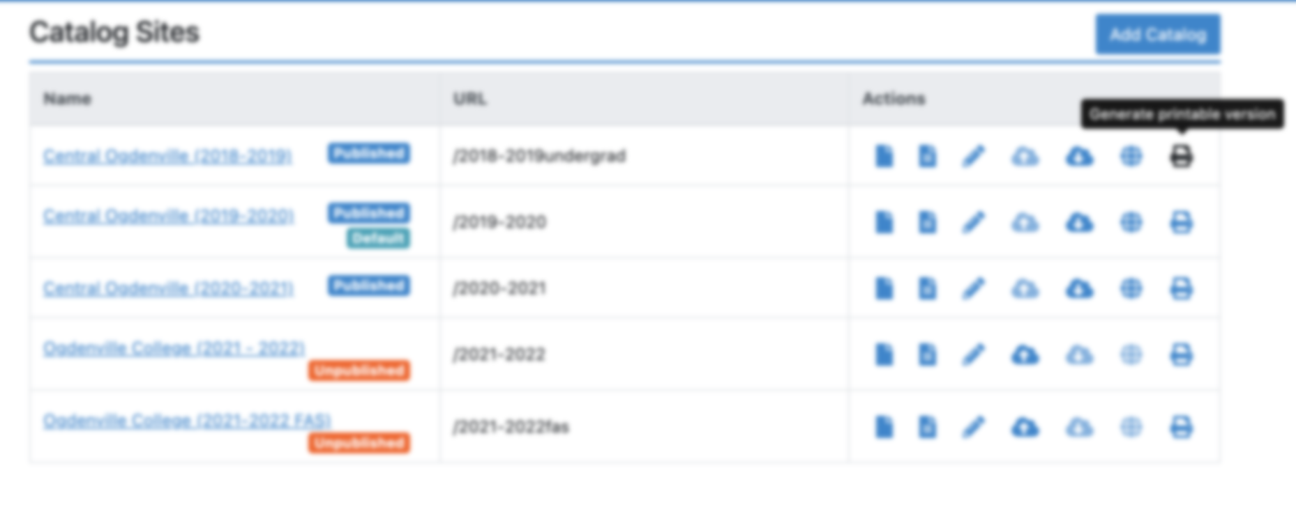
Catalog Printable Version
Ability to Print the Catalog via Catalog Site

Slide 32
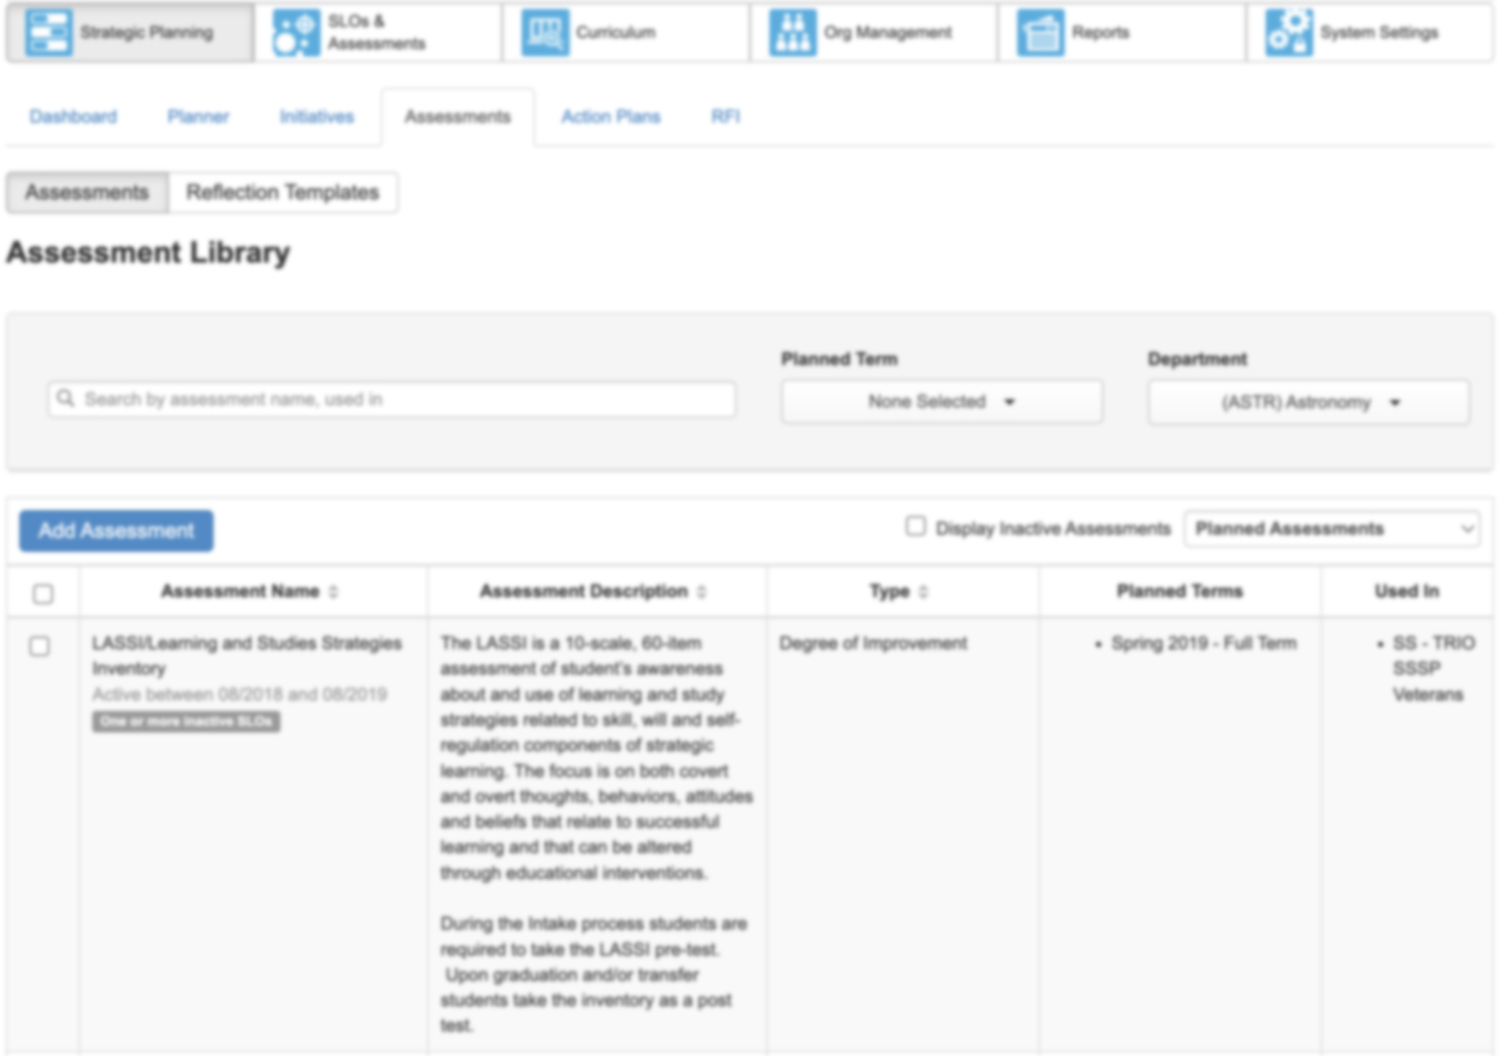
New Assessment Library
Enhanced Assessment Library
Search box vs filters
Quick reference to courses with the rubric planned
Clarity with SLO flagging

Slide 33
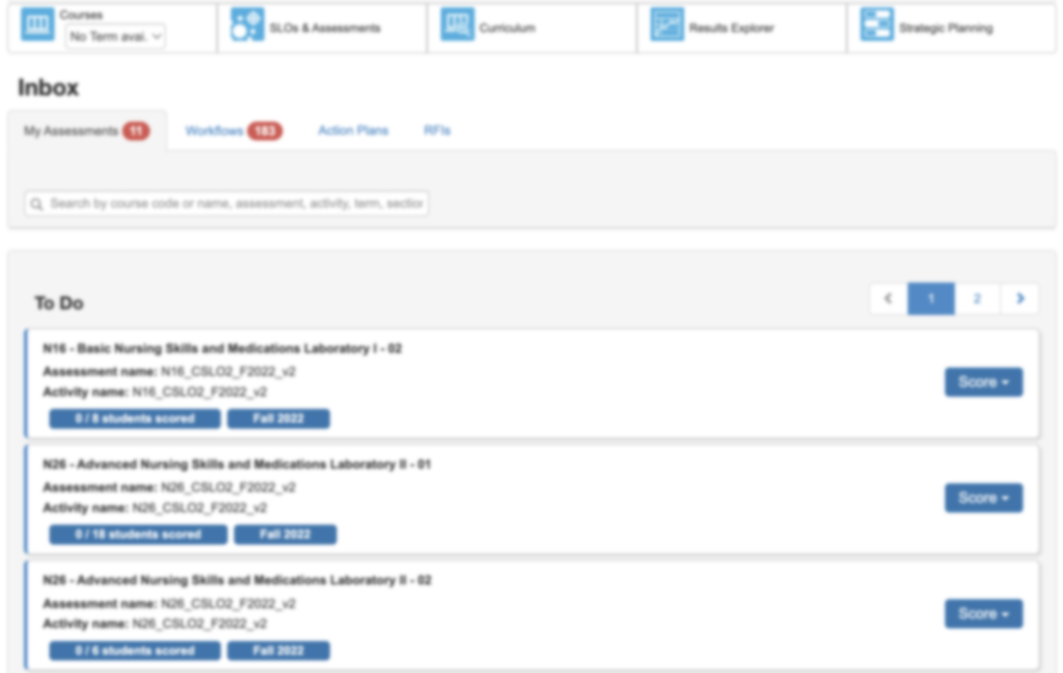
New Assessment Inbox
Log into the Faculty “To Do” List
Critical Information at your fingertips
Course/section
Term Assignment
Number of students on the roster
Number of students scored
Color changing button for quick reference!

Slide 34
Ballot 3
Feature sets released during eLumenation 2023 to all client partners.
New feature options

Slide 35
Ballot Three Feature Sets
Feature Set 1: Developing Curriculum | Feature Set 2: Delivering Data | Feature Set 3: Exploring Resources | Feature Set 4: Reviewing records & responses
Workflow Template and Workflow Stage Filters for Curriculum Dashboard | Data Lake | Catalog global Search | Reflections extract
Ability to advance course and program workflows in bulk | Descriptions for Reports page | Descriptions for Reports page | Workflow Template and Workflow Stage Filters for Curriculum Dashboard

Slide 36
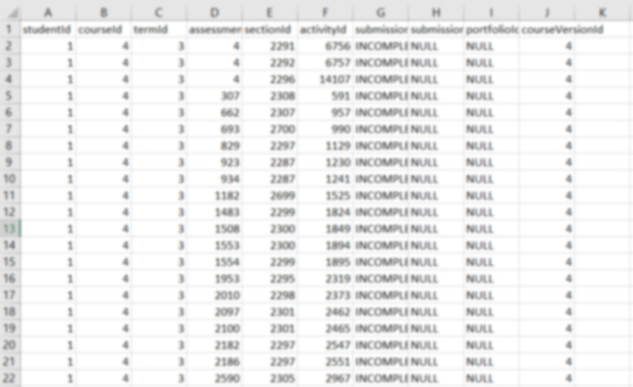
Data Lake
Institutions will have periodic access to CSV files containing comprehensive information from the curriculum and assessment modules. This access will empower institutions to develop dashboards that effectively measure key indicators aligned with the institution's mission.

Slide 37
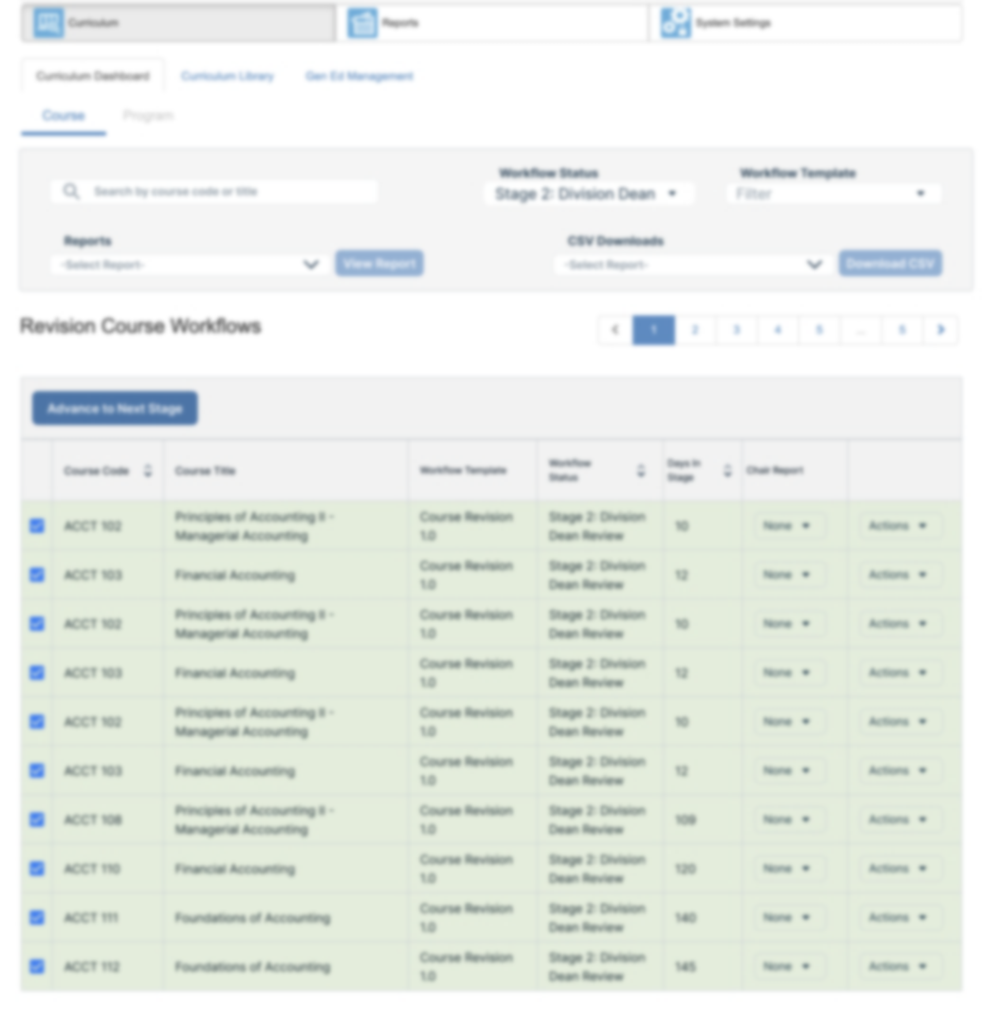
Bulk Advance Course and Program Workflows

Slide 38
Ballot 3’s Winner
The announcement will be sent to client partners via email today

Slide 39
Thank you! Please visit our booth. We’d love to chat!
Kristen Nelson, Custom Success Manager kristen@elumen.info

