Slide 1
Bridging the Conversation: Effective Practices for Dialogue and Decision-making
Thursday, July 9 @ 9:00 a.m.--10:15 a.m.
Michelle Velasquez Bean, ASCCC At-large Representative
Karen Chow, ASCCC Area B Representative

Slide 2
Session Description
This breakout session will focus on key elements of effective dialogue processes that lead to inclusive decision-making. Participants will engage in small group discussions for reflection on various scenarios that many of us face when working in teams and in curriculum committees. The outcomes will include various approaches to understanding, listening, empathy, and inclusion. Together, we will reflect on how to build peaceful and productive work environments and community norms that honor and provide space for our diverse voices.

Slide 3
Today, we will . . .
Discuss how to frame brave conversations
Provide tools for engaging in effective dialogue
Discuss scenarios in breakout groups
Reflect and chat on responses generated in the breakouts
Notes:
2 minute (Michelle)
MUTE YOURSELF
QUESTIONS IN THE CHAT
Closed Captioning available
Resources available in slides. Find in FILES in Pathable.
POLL at the end in Pathable.
We know everyone will have differing opinions and we respect that.
We invite you to come to this space today with an open rawness--a heart and mind of empathy and understanding.
Today will be about reflecting on processes for dialogue, not any one person.

Slide 4
Brave Conversations in Brave Spaces
Set up community norms and team goals outside of the dominant lens
Return to college vision and values
Lead with love and trust
Listen with open rawness and wonder
Notes:
5 minutes (Michelle)
Kendi: “What if instead of a feelings advocacy we had an outcome advocacy that put equitable outcomes before our guilt and anguish?” (p.210)
RECOMMENDATION for COMMUNITY NORMS:
What do you expect of us (leaders/curriculum chair)?
What do you expect of each other?
What do you think we expect of you?
OPEN RAWNESS: What if we frame every conversation and focus every dialogue on changing action and our behavior, not feelings.
Setting and returning to goals and values when listening to diverse voices means not just making yourself feel better, but rather loving others enough to put yourself second. That’s the power you have as a leader!

Slide 5
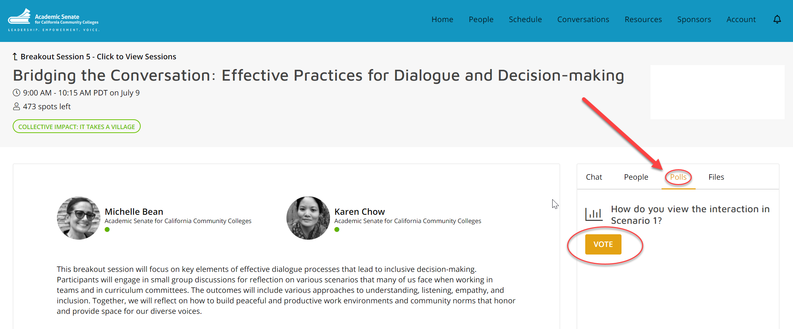
Using POLLS
Notes:
Michelle and Megan

Slide 6
Scenario 1
Directions: Please read scenario below and be ready to reflect on your feelings and perspective in a POLL.
You are in a committee meeting with colleagues from various departments. The committee is trying to determine services for vulnerable student populations and how they will be funded. You are advocating for resources to be funneled to students experiencing homelessness, and a colleague says, “All students are important. How can we determine who is more vulnerable or in need? But of course, you know what’s best for all of us. I wish you would be more civil and collegial.”
How do you view or feel after hearing this interaction?
How would you strategize, initiate, and lead a conversation between these colleagues?
Notes:
1 minute (Michelle)
POLL: How do you view the interaction in the scenario? (3 minutes)
Positive
Somewhat positive
Neutral
Somewhat negative
Negative

Slide 7
Guiding Questions:
Framing Conversations in Praxis
Whom does it benefit?
Are you inspiring liberation and collectivism?
Are you working to identify systems and practices of oppression?
Are you interrupting patterns of oppression and hierarchy?
Whom does it harm?
Are you seeing the patterns of oppression?
Are you taking steps to support the healing caused by oppression?
Notes:
Michelle (3 minutes)
Requires humans to work with humans collectively to eliminate all manifestations of oppression (Love, et al., 2007)

Slide 8
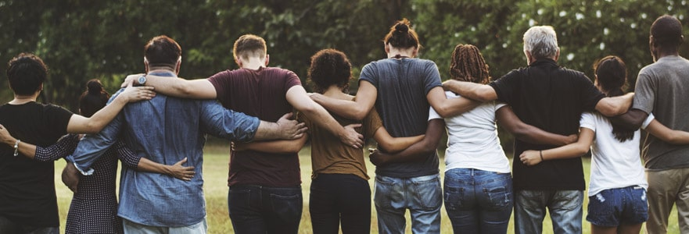
What works for effective dialogue?
Notes:
Michelle--2 minutes
Conversations--should be a dialogue.
Discussion=more like talking at a people.
So AVOID discussions, for more DIALOGUE and CONVERSATION.
How does that make people feel?
So what works?

Slide 9
R. A. V. E. N.
(Dr. Luke Wood and Dr. Frank Harris)
Redirect
Intervene, correct, pull aside
Ask probing questions for clarity
I think I heard you say . . . What do you mean by that?
I want to make sure I understand what you were saying. Were you saying that . . . ?
Values clarification
You know, in this department, we work hard to create space that is safe and welcoming for all. What you just said is not in alignment and/or inconsistent with our institutional values that prioritize equity and inclusion.
Emphasize your own thoughts and feelings
When I hear you comment, I think/feel . . .
Many people might take that to mean . . .
In my experience, . . .
Next steps
The next time you encounter this situation, you may want to consider doing . . .
Notes:
7 minutes (Karen)
Effective TOOLS to use:
RAVEN method
REDIRECT: Decide calling in vs. calling out: What’s effective? Do I know this person well?
ASK: If you feel it, ask for CLARIFICATION.
Listen for microaggressions and racialized microassaults: “THOSE” students. “She’s so touchy feely.” “I can’t even understand him with his accent.” “She’s so lazy.” “Here comes trouble”
Microinvalidations and microinsults: “Oh, you have a Ph.D.?” “You didn’t answer my question.” “Girls don’t do well in STEM usually” “You speak really good English” “I don’t see color” “I understand what you’re going through, I grew up poor”
VALUES CLARIFICATION:
Ask what they mean?
Remind them of the established COMMUNITY NORMS and COMMITTEE GOALS.
EMPHASIZE OWN FEELINGS:
GIVE what they can DO NEXT instead of flipping to a dominant culture lens
Handout and videos at the end of slides!
Remember that SELF-REFLECTION is the key--coded language is deep seeded in the “discourse of collegiality”

Slide 10
Scenario 2
Directions: Please read scenario below and be ready to reflect on strategies for dialogue in BREAKOUT GROUPS.
The Unicorn Studies department is the primary department offering courses in unicorn history and unicorn literature. They initiated, got curriculum approval, and are institutionally designated to offer the course curricula. The faculty in the history department and the English department are unhappy with Unicorn Studies department “owning” these courses and not offering them in the last few years. The history and English faculty would like to offer the courses, but Unicorn Studies faculty do not want to give them up.
How would you strategize, initiate, and lead a conversation between these departments?
Notes:
Karen (2 minutes)
Introduce yourselves briefly
Discuss various strategies--FOCUS on the PROCESS (not the outcome)
Breakout Rooms--7 minutes
Pick someone to be ready to share out

Slide 11
Framing Brave Conversations
Ask the WHY
Is it the right thing to do?
Whom does it benefit?
Does it align to our goal(s) or vision?
Is there a negative impact? On whom?
Focus on policy not people
Focus less on the personal issue and more on the problem solving
Aim to change behavior--we cannot change beliefs
Invest in community
Keep the focus on building a collective team
Allow for the organic community foundation--don’t get stuck in the idea of “perfection” before you start
Notes:
5 minutes (Michelle)
“Liberation is the creation of relationships, societies, communities, organizations and collective spaces characterized by equity, fairness, and the implementation of systems for the allocation of goods, services, benefits and rewards that support the full participation of each human and the promotion of their full humanness.” (Love, Dejong, Hughbanks 2013)
Return back to your FRAMING--ask the WHY? (goal, vision, passion, centering)
PEOPLE--often will want to go to the moral binary-- the focus on “good intent”
But avoid making space for an excuse for bad behavior
Ask if it is a reasonable request vs. making an accusation
Feelings may be that uncomfortable zone when addressing bias, racism, and sexism
But SELF-REFLECTION is the key--to being BRAVE.
The weakness is living off and decision-making based on our bias.
The narrative and lived experiences of whole human beings is just the beginning of the conversation. It is needed.
REMEMBER to INVEST in COMMUNITY!

Slide 12
Scenario 2:
Share Your Group Process
Notes:
Karen--5 minutes
ASK for ONE Group to Share

Slide 13
Scenario 3
Directions: Please read scenario below and be ready to reflect on strategies for dialogue in BREAKOUT GROUPS.
For some time, community members within the boundaries of your district have asked for classes in a particular Workforce Development program to be offered via distance education. The faculty from this program have come to your curriculum committee meeting to ask about how to get these online courses approved and offered next semester. Knowing that the curriculum process for review and approval may take longer than the community may realize, how would you strategize, initiate, and lead a conversation for this process?
Notes:
Karen--2 minutes
Introduce yourselves briefly
Discuss various strategies--FOCUS on the PROCESS (not the outcome)
Breakout Rooms--7 minutes
Pick someone to be ready to share out

Slide 14
Scenario 3:
Share Your Group Process
Notes:
Karen--5 minutes
ASK for ONE Group to Share

Slide 15
Brave Teamwork
Am I intellectualizing or actualizing a safe space for multiple perspectives?
Am I able to step back for other voices to be included?
Am I willing to grow, listen, engage, and acknowledge others for diverse perspectives?
Will I speak up when I see exclusionary behavior or hear unwarranted comments?
Am I engaging in liberation and healing and not self-loathing or denial?
Self-Reflection Questions
Notes:
3 minutes: Michelle
Brave Teamwork TO SUPPORT INCLUSION OF ALL VOICES: Requires self-reflection!
Be willing to hear what others are saying is not working--see something say something!
Speak up--DON’T give bullies hiding behind archaic ideas of “collegiality” a FREE PASS
Am I “going along to get along” or are I am going to speak up when something is off?
Be a witness to the exclusionary behavior--the aim is not to change that person but to show observers that there is another alternative.
We should not wield our positions of power to oppress or shut another colleague down.
Collegiality should not be a weapon--it should be a shield of protection to build community.
Healing means CELEBRATE DISCOMFORT, not denial:
We should all be exercising this muscle!
And remember that DEFENSIVENESS doesn’t help anyone. That doesn’t help anyone feel safe.
DIVERSE perspectives--remember intersectionality!

Slide 16
You have the POWER to CHANGE IT!
Notes:
1 minute (Michelle)
You have the power and privilege to change something,
To CHANGE a system that creates barriers to diverse voices
Be BRAVE and do something to change it
That’s CIVIL--that’s common HUMANITY! That’s empathy and equity.

Slide 17
Tools and References
ASCCC Effective Dialogue Tools
Tools for Building Professional Community
Open Rawness Handout
PBS Student Clips on Microassaults and Microinvalidations
YouTube Video on Microaggressions
UCLA Handout on Microaggressions
Notes:
References:
Alleman, N. F., Allen, C. C., & Haviland, D. (2017). Collegiality and the Collegium in an Era of Faculty Differentiation. ASHE Higher Education Report, 43(4), 1–131.
Goodman, Diane J. (2011). Promoting Diversity and Social Justice: Educating People from Privileged Groups. New York: Routledge.
Kendi, Ibram X. (2019). How to be an Antiracist. New York: One World.
Love, Barbara, Dejong, Keri, and Hughbanks, Christopher (2007). Critical Liberation Theory. Social Justice Education. Amherst: University of Massachusetts.
Protocols. School Reform Initiative. Accessed at https://www.schoolreforminitiative.org/protocols/.
Wood, Luke and Frank Harris, III. (2020). How to Respond to Microaggressions When They Occur. Diverse: Issues in Higher Education. CMA Publications. Accessed at https://diverseeducation.com/article/176397/.

Slide 18
THANK YOU
Technical visit or any questions
email info@asccc.org
Our contact info
mbean@riohondo.edu
chowkaren@deanza.edu

