Slide 1
Legislation and Advocacy – Working with the Legislature Thursday, May 12 | 3:10-4:30

Slide 2
Presenters
Wendy Brill-Wynkoop
FACCC President
president@faccc.org
Ginni May
ASCCC Vice President
mayv@scc.losrios.edu

Slide 3
Getting Started…
Ten-plus years of legislation impacting curriculum
Recent and Proposed Legislation impacting career, technical, and noncredit education
Being a faculty advocate

Slide 4
A Decade+ of Legislative Mandates and Policies
Focused on Student Success
2010
2012
2013
2017
2018
2019
2021
SB 1440
(Padilla)
Transfer Pathway Reform
Associate Degree for Transfer
ADTs
SB 1456 (Lowenthal)
Seymour-Campbell Student Success Act
Education Plans and success metrics
SB 440
(Padilla)
Student Transfer Achievement Reform Act
Require ADTs and Transfer Model Curriculum
AB 705
(Irwin)
Matriculation: assessment
Remedial
Education
Redesign
Vision for Success
Big Audacious System Goals
Guided Pathways
Budget Act
Student-Centered Funding Formula
SCFF
Fully Online College
Calbright
Budget Act
Cradle-to-Career Data System
AB 928 (Berman)
Student Transfer Reform
Intersegmental HE Committee, Common GE pathway, & Auto placement in ADTs
AB 1111 (Berman)
Common Course Numbering
Notes:
This list is most likely to grow…

Slide 5
Recent and Proposed Legislation
Signed by Governor Newsom on October 6, 2021:
AB 927 (Medina, 2021) - Baccalaureate Degrees
AB 928 (Berman, 2021) - Transfer and Singular GE
AB 1111 (Berman, 2021) - Common Course Numbering
Proposed - still in Assembly as of May 12, 2022
AB 1705 (Irwin, 2022) - Placement and Enrollment

Slide 6
AB 927 (Medina, 2021) - Baccalaureate Degree
ASCCC initially opposed the Baccalaureate Program…
ASCCC Resolution S10 06.01 Opposition to Proposed Modification of the Community College Mission
ASCCC changed position…
ASCCC Resolution F19 06.01 Reversal of Position Regarding Baccalaureate Degrees and Removal of Pilot Designation
ASCCC Resolution F19 06.02 Expansion of Baccalaureate Degree Programs in Allied Health
ASCCC Resolution S21 06.06 Support AB 927 (Medina, 2021)
ASCCC Resolution F21 09.02 Update Baccalaureate Degree Handbook
ASCCC Resolution S22 09.03 Develop Lower Division GE Pathway for CCC Baccalaureate Degree Programs

Slide 7
AB 927 (Medina, 2021) - Baccalaureate Degree
Amends SB 850 (Block, 2014)
Extends the Baccalaureate Degree Pilot Program indefinitely
Removes requirement of a maximum of 15 programs in the CCCs
Maximum of 15 programs approved each application period, two periods per year
Number of baccalaureate degree programs in a district cannot exceed 25% of the number of associate degree programs
Shall not be duplicative of baccalaureate degree programs at the CSU, UC
Chancellor’s Office Memo ESS 21-400-005 December 17, 2021
Cycle 1: Applications due January 15, 2022; Notifications May 31, 2022
Cycle 2: Applications due April 15, 2022; Notifications December 31, 2022

Slide 8
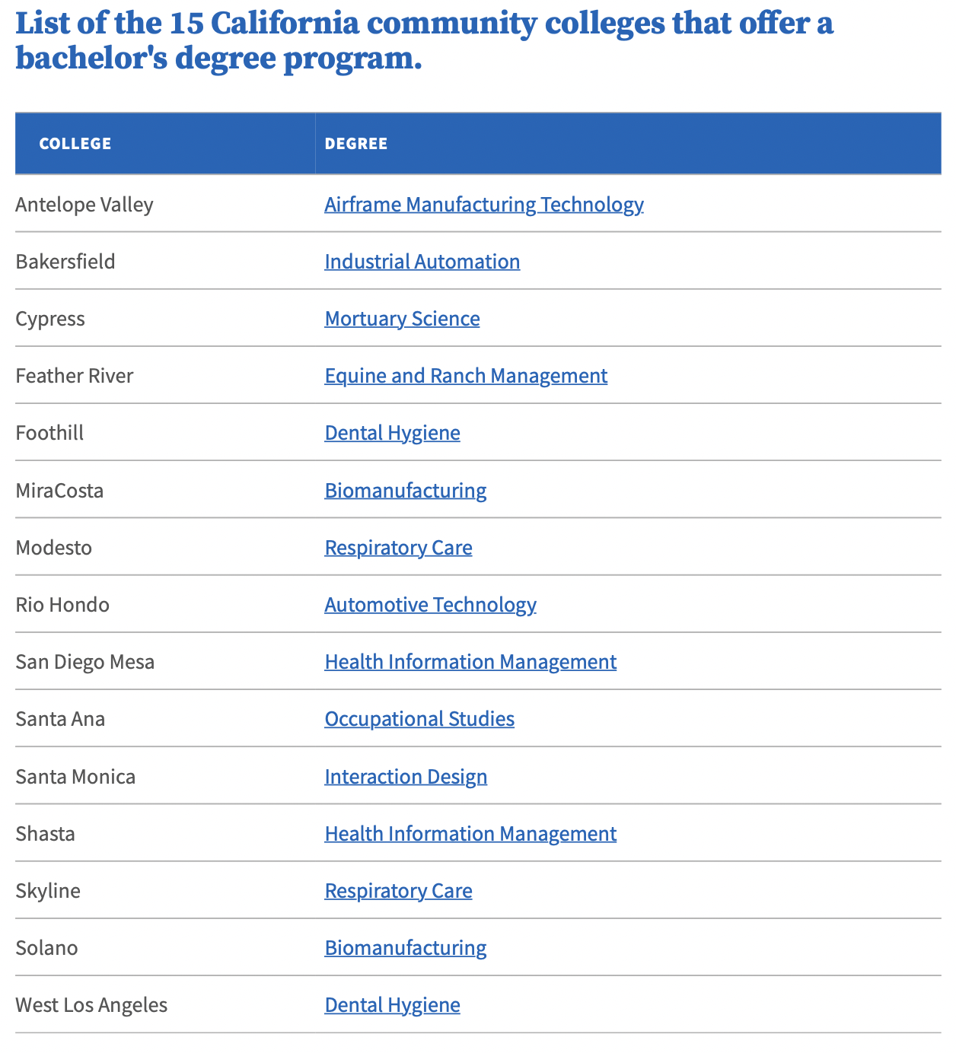
AB 927 (Medina, 2021) - Baccalaureate Degree
Chancellor’s Office webpage
Baccalaureate Degree Program Pilot Handbook

Slide 9
AB 928 (Berman, 2021)
Transfer Process and Reform
Intersegmental HE Oversight Committee charged with improving transfer
Singular GE Pathway - CSU GE Breadth and IGETC
Auto placement in ADTs
does not address the barriers to transfer
Unintended consequences:
Oversight committee of non-educators creating policy for education
Singular GE pathway
Limit of 34 units
Will change course taking patterns and enrollments in GEs at CCCs
Concerns about requirements in oral communication, lifelong learning
ADTs are the least common pathway to transfer
Most students transfer to CSUs without a degree at all
Many students use the TAG agreement

Slide 10
AB 928 (Berman, 2021)
Implementation Committee to be in place by March 1, 2022 – 16 members
One faculty member from each of the CCC, CSU, and UC systems
Examine unit limits on ADTs for STEM pathways
By May 31, 2023 Intersegmental Committee of Academic Senates to establish a singular GE pathway for transfer; if no agreement, then administrations shall establish the pathway by December 31, 2023
Beginning 2025-26, the GE pathway shall be only pathway to determine eligibility for transfer
The GE pathway may not require more units than the current IGETC (34 semester units)
On or before August 1, 2024 - Students with a goal of transfer for which there exists an ADT shall be placed on that pathway – students may opt out

Slide 11
AB 928 (Berman, 2021)
Progress
Intersegmental Committee of Academic Senates (ICAS) Special Committee on AB 928: 3 faculty from each segment, administration, students, AOs
Recommendation to ICAS in April
Information in email from ICAS in May
Information from CCCs at Curriculum Institute, Fall Curriculum Regionals
Vetting in fall 2022
More info to follow

Slide 12
AB 1111 (Berman, 2021)
Common Course Numbering
Require the establishment of a common course numbering system for all GE and transfer pathway courses throughout the CCCs by July 1, 2024;
Urge the common course numbering workgroup (see above) to consider starting with courses in the current C-ID system and expand from there.
Trailer Bill Language California Budget 2021-22
Allocate $10 million to the CCCCO to form a workgroup to support the development and implementation of a common course numbering system throughout the CCCs.
SOVA - is contracted to do this work, connecting with stakeholders to develop recommendations
Unintended consequences:
What is the problem we are trying to solve?
Time, money, resources spent on curriculum and redrafting articulation agreements

Slide 13
Ed Code vs. Title 5 - Equitable Placement
AB 705 (2017) | Title 5 § 55522 English and Mathematics Placement and Assessment | AB 1705 (2022)
Bill passed in 2017 and now law Revised through an act of the legislator | Title 5 regulation has the weight of law but is created & modified through the consultation process and approved through the Board of Governors. Theoretically regulations can be revised in a matter of months. | Bill currently working through the state legislature beginning in the Assembly in February. If it passes the Assembly by May it will move onto the Senate.
Maximize the probability that the student will enter and complete transfer-level coursework in English and mathematics within a one-year timeframe (ESL 3 years) | Details of AB 705 implementation. CCCCO guidelines which are not regulations, but intended to encourage colleges “implement AB 705 with fidelity” | Would codify (make law) many of the details in Title 5 and CCCCO guidance memos making revisions to the implementation requiring an act of the legislature.

Slide 14
AB 1705 (Irwin, 2022) - AB 705 “Clean-Up” Language
Would codify much of Title 55522 in statue
Amended 4/19/20 - CCCCO Analysis
Place and enroll all students (with few exceptions) into transfer-level English and mathematics when they begin a program of study and authorize colleges to offer or require* students to enroll in concurrent supports. [*must prove students benefit from support]
A student may opt-out of transfer-level math if they have an educational goal other than transfer, and the degree or certificate program has a specific math requirement that is not met with transfer-level coursework. [Most all pre-transfer mathematics can be met with transfer-level]
This bill would prohibit colleges from requiring students to enroll in pre-transfer level math coursework except under very limited circumstances.
Specifies the calculus pathway [this is additional language, not clarifying intent]

Slide 15
Legislative timeline for AB 1705 (Irwin, 2022)
Introduced in Assembly February 2022
Passed Assembly Higher Ed, April 26th, 2022
Passed onto Assembly Appropriations
Full vote in Assembly in end May
If it passes the Assembly, it moves onto the Senate through summer 2022
Full Senate vote would be in September, then onto the Governor in October

Slide 16
Questions about policy changes
How do these policy changes specifically affect our CTE and Noncredit programs?
What will your program look like in 3-5 years?
How can you ensure that CTE students are placed on the right pathway?
What role does/might noncredit education play?

Slide 17
What can we do about it?
Connect with statewide organizations and policy makers
Opportunity with new legislature in January 2023
Become an advocate
Communicate concerns
System practitioners need to proposed legislation that truly is the right solutions
Educate new employees
Notes:
Erica’s list

Slide 18
Develop a Relationship with Policy Makers
Call/Email your representative
Send a thank you note
Ask others to join you
Follow up!
Do your research and be prepared
Meet with Representative

Slide 19
Thank You!!
Contact info:
ASCCC: info@asccc.org
FACCC: info@faccc.org
Websites:
ASCCC: https://www.asccc.org
FACCC: https://www.faccc.org

