Slide 1
Curriculum– C-ID System
Lori Bennett, CCCCIO, Moorpark College Robert Cabral, ASCCC C-ID CTE Director, Oxnard College Sue Gochis, CCCCSSAA, Lake Tahoe College Craig Rutan, ASCCC C-ID Liaison, Santiago Canyon College Erik Shearer, ASCCC C-ID Curriculum Director, Napa Valley College
2016 Spring Session

Slide 2
Overview
Course Identification Numbering (C-ID) System
C-ID for CTE
Recommendations for CTE from the WFTF
Discussion of Recommendations
Report Out from Groups
Summary

Slide 3
C-ID
The Course Identification Numbering System (C-ID) is a supra-numbering system created to help simplify articulation with the California State University (CSU) system and make it easier for students to move from one community college to another.
Descriptors outline a set of minimum requirements for a course.
Once a college’s course has an approved C-ID designation, that college must automatically accept any other course with the same C-ID designation as equivalent!

Slide 4
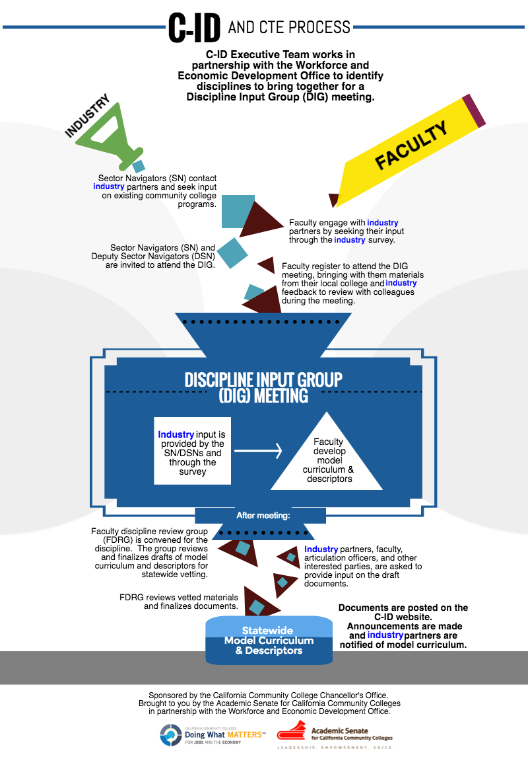

Slide 5
Descriptor Development and DIG Meetings
Descriptor development begins with the Sector Navigators (SN) contacting industry about existing community college CTE programs
Faculty contact industry partners to seek input using a survey
SNs and DSNs are invited to join faculty at a Discipline Input Group (DIG) meeting to begin drafting course descriptors and model curriculum
Draft descriptors and model curriculum and reviewed by a Faculty Discipline Review Group (FDRG) and finalized descriptors are distributed to faculty for comments.
Once the descriptors are finalized, colleges can submit their courses for C-ID designations and they can create certificates and degrees that align with the model curriculum.

Slide 6
C-ID for CTE
C-ID was originally created for courses that transfer to the CSU, but C-ID could also be used to create a descriptor that covers skills desired by employers.
C-ID began development in Addiction Studies, Automotive Technology, Commercial Music, Culinary Arts, Emergency Medical Services, and Biotechnology.
During Fall 2015, more disciplines were brought together to discuss possible descriptor development. Those disciplines were: Health Occupations/Allied Health Preparation - Radiologic Technology, Respiratory Therapy, Medical Assistant, Diagnostic Medical Sonography, Office Technology/Office Computer Applications/Business Information Worker, Small Business and Entrepreneurship, Hospitality – Culinary Arts, Welding Technology.
Additional DIG Meetings have been held in Spring 2016 for: Real Estate, Paralegal, Environmental Control Technology, Energy Systems Technology, Industrial Systems Technology and Maintenance, Water and Wastewater Technology, Machining and Machine Tools

Slide 7
WFTF Recommendation 10
Facilitate curricular portability across institutions
Scale up and resource the “C-ID” (course identifier) system for CTE courses, certificates and degrees to enable articulation across institutions.
Disseminate effective practices for streamlining and improving processes for recognizing prior learning and work experience and awarding credits or advanced placement toward CTE pathways.
Enable and encourage faculty and colleges, in consultation with industry, to develop industry- driven, competency-based and portable pathways that include stackable components and modularized curricula, work-based learning opportunities, and other support services.

Slide 8
WFTF Recommendation 11
Develop, identify and disseminate effective CTE practices
Develop a website repository of CTE model curricula that faculty and colleges can select and adapt to their own needs.
Develop an interactive system where regional industry stakeholders can provide feedback to both validate and enhance the quality of CTE programs.

Slide 9
WFTF Recommendation 12
Clarify practices and address issues of course repetition for CTE courses when course content evolves to meet changes in skill requirements.
Clarify interpretation of course repetition regulations to assist colleges in implementing policies and practices.
Identify and disseminate best practices for using noncredit to provide opportunities for CTE students to build skills and knowledge.

Slide 10
Conversation About Recommendations
Please break into groups of 5 – 10 to discuss the following questions (about 20 minutes) and how they relate to C-ID for CTE.
What do the Strong Workforce Task Force recommendations presented here mean to you? What is your understanding of them?
What ideas do you have for addressing these recommendations? Are there practices at your college/district that already address these recommendations and that can be shared?
Do the recommendations provide cause for concern or caution? If so, what are they and how should they be addressed?
Consider your responses to the previous sets of prompts. What actions do you suggest taking to fulfill the recommendations presented here?

Slide 11
“
Questions?

