Slide 1
CTE Strong Workforce Task Force Recommendation Implementation
Grant Goold
Julie Bruno
John Stanskas
Van Ton-Quinlivan
Lynell Wiggins

Slide 2
25 Recommendations for a Strong Workforce
Adopted by the Board of Governors
www.DoingWhatMATTERS.cccco.edu
#StrongWorkforce
@CalCommColleges @WorkforceVan

Slide 3
Student Success
CCCCO Implementation
Student Success
Task Force
CCCCO Implementation
2011
2012
2013
2014
2015
2016
2017
2018
2019

Slide 4
California needs 1 million more AA, certificates, or industry-valued credentials.
#StrongWorkforce
The Goal

Slide 5
Career Technical Education (CTE): The Path Out of Poverty
$60,771
($29.22/hour)
2-parent with one working adult, 2-children
Source: CA Budget Project
$66,000
AA – Career Technical Education
5-years later
Source: Salary Surfer, CA Community Colleges
$38,500
AA - General Education
5-years later
Source: Salary Surfer, CA Community Colleges

Slide 6
25 Strong Workforce Recommendations
#1-2 Student Success
#3 Career Pathways
#4-6 Workforce Data & Outcomes
#7-12 Curriculum
#13-16 CTE Faculty
#17-20 Regional Coordination
#21-25 Funding

Slide 7
Recommendations: Workforce Data & Outcomes
4a. Common workforce metrics
4b. Recognition of ‘skills builder’ in student success
4c. Report outcomes by student demographics characteristics
5. Student identifier
5a. Share employment, licensing, certification, and wage outcome information.
6. Improve the quality, accessibility, and utility of student outcome and labor market data

Slide 8
Legislation
Assembly Bill 1892 (Medina) –
CalGrant C financial aid
Recommendation #1F
Senate Bill 66 (Leyva) –
Data sharing
Recommendations #4a, 5a, 5b

Slide 9
Budget
$200M Trailer Bill Language
Expand the availability of quality CTE
Key components:
Regional planning
Allocation model
Allowable expenditures
Maintenance of effort

Slide 10
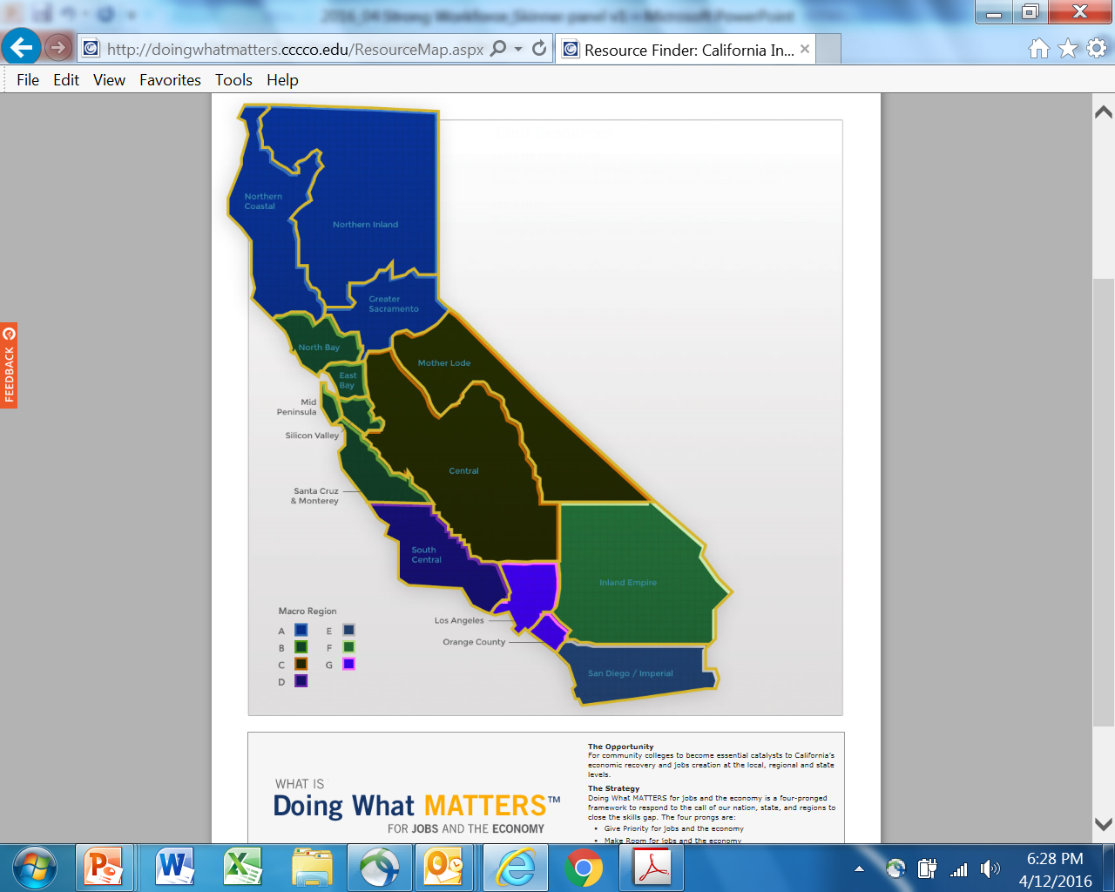
Regional Coordination
☑ regional economic clusters
☑ regional employers
☑ regional business associations
☑ regionally mobile workforce
☐ regional coordinated workforce development

Slide 12
Strong Workforce Task Force Recommendations Implementation
ASCCC Leadership

Slide 13
Recommendations and Faculty Purview
Student Success
Career Pathways
Workforce Data and Outcomes
Curriculum
CTE Faculty
Regional Coordination
Funding
ASCCC Role:
Develop, Co-Develop, or Advisory

Slide 14
Involvement of ASCCC Committees
ASCCC Committees
CTE Leadership (Advisory)
Standards and Practices (MQs and Equivalency)
Educational Policies (Statute and Regulations)
Legislation and Advocacy (Legislators and Law)
Transfer, Articulation, and Student Services (Student Services and Support)
Curriculum (Curriculum)
Noncredit (Curriculum and Teaching)
And others including C-ID; Equity, Diversity and Action; Faculty Development; Accreditation and Assessment; and system committees

Slide 15
Work in Progress…
CTE C-ID and Model Curriculum
Streamlining curriculum approval
Guidelines for equivalency
CTE Data Unlocked
System Advisory Committee on Curriculum
Professional Development
Focused Conversations Report

Slide 16
Participate!
Local
CTE Liaison position
Develop relationships and establish allies
Assist in implementing streamlined curriculum approval
Review and revise policies and process on equivalency
Serve on local Academic Senate and governance committees
Advocate for stronger CTE representation
Support CTE counseling and dedicated services for CTE students
Attend regional consortia meetings of CCCAOE
Become a translator

Slide 17
Participate!
State level
Attend C-ID and Model Curriculum meetings
Review Minimum Qualifications for appropriateness
Participate in developing effective practices on equivalencies
Involvement in CTE Data Unlocked
Volunteer for statewide servicehttp://www.asccc.org/content/application-statewide-service

Slide 18
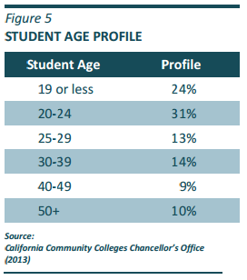
Student Success Act Speaks Through the CCC System Strategic Plan (2013 Update)
STRATEGIES
B1 Basic Skills as the Foundation for Student Success
B2 Assessment and Placement
B3 Articulation with K-12
B4 Intersegmental Transfer
B5 Teaching and Learning Effectiveness
B6 Degrees and Certificates
B7 Innovative Practices in Workforce Education
B8 Provide Students with Increased Direction and Expectations
Meeting Personal Educational Objectives is the key

Slide 19
SSSP to StrongForce Advisement & Ed Plans
Broaden and enhance career exploration and planning, work-based learning opportunities and other supports for students
Improve the quality, accessibility, and utility of student outcome and labor market data to support students, educators, colleges, regions, employers, local workforce investment boards, and the state in CTE program development and improvement efforts.
Create a sustained, public outreach campaign to industry, high school students, counselors, parents, faculty, staff, and the community at large to promote career development and attainment and the value of career technical education.

Slide 20
Career Pathway Relational System
Data Informed Decisions
Experiential Learning
K-12 to Career
Stackable Credentials
Industry Engagement
Labor Market Information
Work Based Learning
Alignment
Student Success + Completion
Project Based Learning

Slide 21
Questions or Comments?

Slide 22
Thank You!

