Slide 1
Equity: Still Working on It
Elton J. Robinson
Los Angeles Trade Technical College
Adrienne Foster, Ph.D.
West Los Angeles College
Adr

Slide 2
Equity: Still Working on It
CTE faculty strive for equity in our classrooms, but looking around the classroom faculty can wonder where or even if that equity exists. Finding students who are interested in non-traditional workforce fields can be a daunting task. This session will discuss how CTE faculty and program directors have increased their equity numbers for program review reporting, Perkins reporting purposes and most importantly for those students who are looking for career in these fields. CTE faculty will have time to share their best personal equity practices for their programs with other attendees.

Slide 3
Culturally Responsive Workforce
Education Code Section 87100(a)(3):
“A work force that is continually responsive to the needs of a diverse student population [which] may be achieved by ensuring that all persons receive an equal opportunity to compete for employment and promotion within the community college districts and by eliminating barriers to equal employment opportunity.”

Slide 4
Equity and Faculty Hiring
Recruiting and hiring faculty to meet the needs of and reflect the diversity of our student bodies is a complex issue and one that is being addressed in many arenas.
EEO and Diversity Advisory Committee of the CCCCO has at least two initiatives:
Focused presentations and discussions on diversifying faculty
AA to MA Faculty Diversity Pathway Initiative – encourages our community college students to consider community college teaching. Parallel and connected to recruit CTE students into the teaching careers. While a master’s degree may not be required, the same mentorship and employment possibilities could be offered to CTE students.

Slide 5
Equity: Faculty Skill Sets
Culturally Responsive Teaching:
“It is an approach that empowers students intellectually, socially, emotionally, and politically by using cultural referents to impart knowledge, skills, and attitudes.”
- Dr. Gloria Ladson-Billings

Slide 6
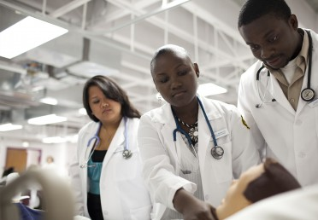
How do we become culturally responsive instructors?
Acknowledge the legitimacy of the cultural heritages of our student body, both as legacies that affect students’ dispositions, attitudes and approaches to learning and as worthy content to be taught in the course.

Slide 7
Reshaping the Curriculum
A reshaped curriculum is culturally responsive to the background of your students.
You should know the cultural heritage of the diversity of the students being served and include references in the course.
A culturally responsive (CT) curriculum does not rely on “one-time references” or mentioning of the usual underrepresented minority suspects but CT curriculum should be infused throughout the course.

Slide 8
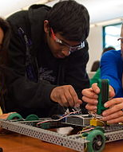
Access & equitable outcomes
Community colleges are open-access institutions that enable any student to participate in a wide range of academic, workforce training and personal development activities – regardless of their economic or skill level upon entry into the college.

Slide 9
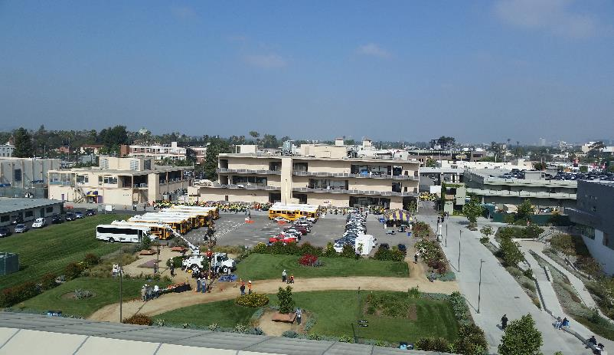
Campus Career Day for all the TRades

Slide 10
Equity: Recruitment of Students
Campus Career Days
Department demonstrations
Program and faculty webpages
Tours of the CTE programs
Department presentations
Utilize on-campus PR
Radio advertising
Informing high school students about the CTE Pathways

Slide 11
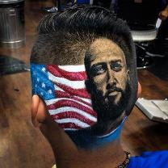
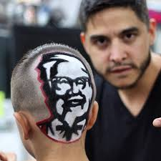
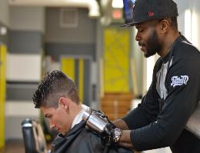
barbering program the 1st barbering program at the community college level in the state of California!

Slide 12
Reshaping Student Orientations
Orientation Video of program or programs
Curriculum maps made available at the orientations
CTE Student Organizations – extracurricular activities for secondary/community college CTE students to deepen their understanding and knowledge about industries
Counselors assigned to CTE disciplines

Slide 13
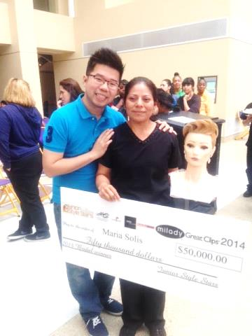
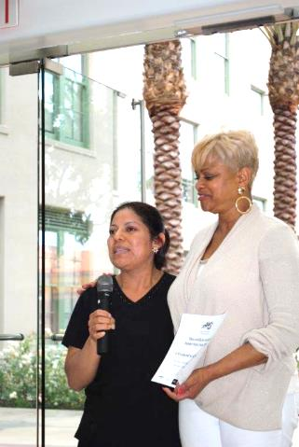
2014 Junior Style Stars Winner Maria Solis

Slide 14
Social Media & recruitment Options
Facebook
College website
Brochures and college ground media campaigns

Slide 15
Social Media

Slide 16
Sharing of Colleges’ Equity PractiCES

Slide 17
Questions????

Slide 18
Equity: Still Working on It
Elton J. Robinson robinsej@lattc.ecu
Adrienne Foster fosteraa@wlac.edu

