Slide 1
USING THE CTE FACULTY MINIMUM QUALIFICATIONS TOOLKIT
Career & Technical Education/ Noncredit
Regional Event
Dr. Lynn Shaw
Carrie Roberson, ASCCC

Slide 2
TODAY!
Introductions
History of the development of the Toolkit
Connecting General Education Areas to Experience
Scenarios
Discussion and Questions

Slide 3
25 Strong Workforce Recommendations Adopted by the Board of Governors in Fall 2015
Student Success
Career Pathways
Workforce Data & Outcomes
Curriculum
CTE Faculty
Regional Coordination
Funding
Notes:
Describe recommendation 13

Slide 4
“Increase the pool of qualified CTE instructors by addressing CTE faculty recruitment and hiring practices.
Clarify legislative and regulatory barriers to hiring CTE instructors who may not meet existing college hiring standards but possess significant industry experience.
Disseminate effective practices in the recruitment and hiring of diverse faculty and the application of minimum qualifications and equivalencies.
Develop pipelines to recruit community college faculty with industry expertise through collaborations with higher education, business, and industry professional organizations.
Establish a mentorship model that delineates pathways for industry professionals to intern at colleges to gain teaching skills, knowledge, and experience while pursuing an associate degree or an equivalent.”
Notes:
Lynn gives history of the Workgroup

Slide 5
CCCCO CTE Minimum Qualifications Work Group: Academic Senate, Chief Instructional Officers, College Presidents, Human Resources, California Community College Chancellor’s Office
Colleges and districts who are struggling with consistent application of equivalency.
Address difficulties surround equivalence to the associate’s degree, particularly to the general education component.

Slide 6
Challenges hiring CTE faculty?
Recognizing every community has a wealth of experts that never got an Associates Degree.
Finding the best possible faculty for our students is a crucial part in CTE program excellence.
Document credentials and get local industry experts into the hiring pool.
Notes:
find it nearly impossible to hire industry experts
Chancellor’s Request of a Survey: 43 Colleges
Comments in the survey
Recognize the abilities people have
Eminent or nationally recognized experts in their field, without an Associate Degree
Very small pool of applicants, often far less than 10, as opposed to general education areas that get xxx’s of applicants
Not understanding their CTE colleague’s issues and programs
Many comment on the irony of college preparing people for work, yet we didn’t accept industry credentials (the very place we are sending students to work) as equivalent to an Associate Degree
a mismatch of what colleges require and what the industry actually needs and wants. Colleges are preparing people for jobs in industries that sponsor the industry credentials, yet the college does not accept the industry experts as instructors with the industry credentials
“Boils down to this- Experience should be the most important factor in any CTE discipline.”
“The need to revise the equivalency evaluation process for industry experts that do not have an AA/AS degree is extreme.”

Slide 7
CTE Minimum Qualifications Toolkit
Equivalency
Faculty Internship
Apprenticeship Minimum Qualifications

Slide 8
CTE Faculty Minimum Qualifications
Toolkit Contents
Pre-planning checklist for Equivalency by Department
Equivalency Checklist for Human Resources Departments
Model Equivalency Committees Composition and Policies
Information and Checklist for Potential Equivalency Applicants
Credit for Prior Learning

Slide 9
Why General Education?
Purpose of GE is to produce a citizen who can interact effectively with the world around them based on critical thinking and reasoning, sound oral and written communication, an applied understanding of other peoples and cultures, and applied experiences with science and its impact on people.

Slide 10
What GE is required for an Associate of Arts or Associate of Sciences?
GE for an AA degree includes demonstrated competencies in math and English along with 18 units in 5 areas:
A. Natural Sciences
B. Social and Behavioral Sciences
C. Humanities
D.1. Language and Rationality: English Composition
D.2. Language and Rationality: Communication and Analytical Thinking

Slide 11
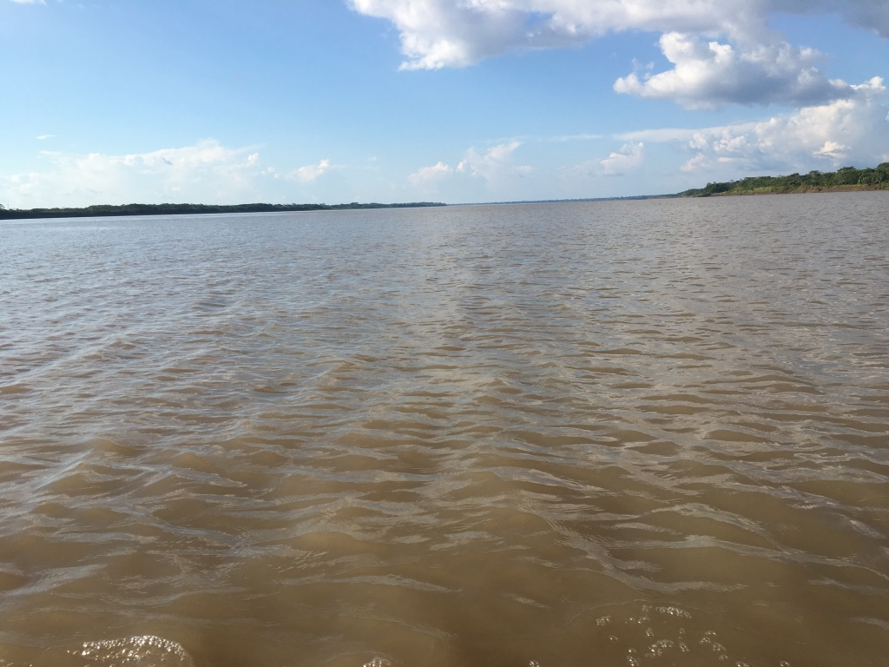
General Education Area A Natural Sciences
Example: Aviation (Certified Flight Instructor)
A certified recreational, private, or commercial must
understand and apply Newton’s Basic Laws of Motion
and Bernoulli’s Principle Ref: FAR 61.185(2)
Purpose for Including One Course in Natural Sciences for General Education
To develop the ability to examine the physical universe, its life forms, and its natural phenomena
To develop an appreciation of, understanding of, and ability to apply the scientific method
To develop the ability to understand the relationship between science and other human activities

Slide 12
General Education Area B Social and Behavioral Sciences
Example: Culinary Arts/Food Production
A chef or culinary artist works within varied ethnic
foods and understands and applies an understanding
of foods and culture as well as historical food trends
Purpose for Including One Course in Social and Behavioral Sciences for GE
To develop an awareness of the methods of inquiry used by the social and behavioral sciences.
To stimulate students’ critical thinking about ways people act or have acted in response to their societies
To promote students’ appreciation of how societies and social subgroups operate
To develop or promote a students’ understanding and appreciation of ethnic groups (Title 5 §55063 (b)(2) requires a course in Ethnic Studies. It is most likely met through the course/experience/ability counted in Area B or Area C)

Slide 13
General Education Area C Humanities
Example: Mortuary Science
Certified Funeral Service Practitioners complete
Celebrant training to develop an awareness of traditions
of different cultures and religions
Purpose for Including One Course in Humanities for GE
To develop an awareness of the way in which people throughout the ages and in different cultures have responded to themselves and the world around them in artistic and cultural creations.
To develop or demonstrate aesthetic understanding and an ability to make value judgements.
To promote a students’ understanding and appreciation of ethnic groups (Title 5 §55063 (b)(2) requires a course in Ethnic Studies. It is most likely met through the course/experience/ability counted in Area B or Area C)

Slide 14
General Education Area D.1. Language and Rationality: English Composition
Example: Any Discipline
Publishing a peer-reviewed article
Writing of a market, technical or sales report or manual, or writing of a similar document within the work environment
Purpose for Including English Competency and One Course in Language and Rationality: English Composition for General Education
To develop the principles and applications of language toward logical thought, clear and precise written expression and critical evaluation of written communication in whatever symbol system the student uses.
To develop expository and argumentative writing skills (English Composition)
Notes:
Cheryl talks about all the specific areas of the general education areas focusing on the cte examples

Slide 15
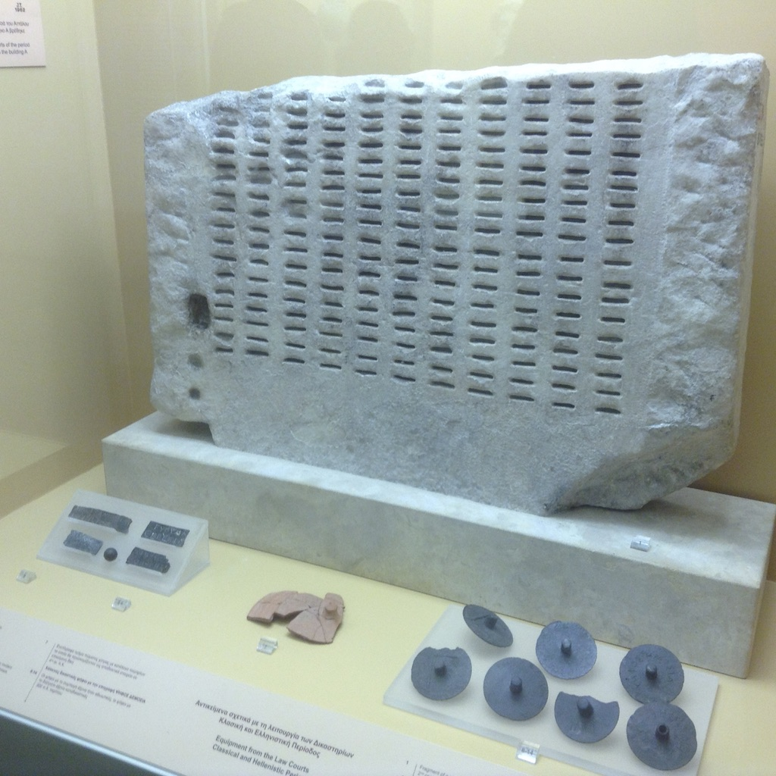
General Education Area D.2. Language & Rationality: Communication & Analytical Thinking
Example: Automotive Technology
A licensed automotive technician must use mathematical skills to manage and calculate ratios, measurements, comparisons, and specifications related to investigation of problems; may also use mathematical skills and reasoning to machine parts and tools to exact specification.
Purpose for Including One Course in
Language and Rationality for General Education
To demonstrate competence in mathematics at a level equivalent to intermediate algebra
To develop oral communication and analytical thinking skills
To develop skills interpreting and assessing data and statistics to draw conclusions
Notes:
Cheryl talks about all the specific areas of the general education areas focusing on the cte examples

Slide 16
Change to Apprenticeship Minimum Qualifications
In May 2018, the Board of Governors approved a Title 5 change revising the minimum qualifications for apprenticeship instructors (Section 53413 of article 2 of subchapter 4 of chapter 4 of division 6 of title 5 of the California Code of Regulations). The goal and the result of this change was to expand the pool of industry experts to teach in apprenticeship classrooms. In the past, the minimum qualifications required a community college apprenticeship instructor to have 18 units of general education courses.

Slide 17
Change to Apprenticeship Minimum Qualifications
The new regulations allow for credits earned within an apprenticeship program to count toward meeting the new minimum qualifications. In practice, this means anyone who completes a credit-based registered apprenticeship program (and nearly all community college apprenticeship programs are credit based) and has six years of work experience can qualify to teach.

Slide 18
Changing Title 5
In addition to apprenticeship credits” is eliminated from regulation, allowing credits earned in an apprenticeship program to count toward meeting the faculty minimum qualifications.
A section on an urgency condition is added
18 semester units is changed to 12 semester units.
“Community college faculty” member is changed to apprenticeship instructor

Slide 19
Effective Practices:
Train the local equivalency committee
Professional development/ learning
Disseminate resources
Consider who is at the table, who is missing
What else?

Slide 20
Scenario
Diesel Mechanics
Barron Drivetrain is actively managing one of the largest diesel repair facilities in the region. He has 15 years of experiences in diesel repair and is considered one of the region’s most highly respected diesel repair experts. He has extensive experience in training new mechanics and has established the first online, industry supported, professional development program in California for diesel professionals. Barron hires about 35% of the local program graduates and has been recognized by the High School Board of Trustees for his work with non-traditional students. Barron has a high school and certification from a private trade school.

Slide 21
What do you think?
Does your equivalency committee recommend Tanisha Diesel for equivalency in the discipline of Diesel Mechanics?
Why or why not?

Slide 22
Scenario
Health Information Technology (Medical record technology)
Danika Datawinski currently manages an office of 5 staff at a regional Health Information Technology (HIT) company and has 15 years experience implementing HIT recommendations from California’s Department of Health Services. Danika has completed several industry recognized credentials. She is responsible for the staff development of her employees and has developed a training handbook as a resource. Danika’s organization provides internships for the local community college’s HIT graduates. Danika speaks fluent Spanish, is a veteran, and has a certificate of achievement in HIT from her local community college.

Slide 23
What do you think?
Does your equivalency committee recommend Danika Datawinski for equivalency in the discipline of Health Information Technology?
Why or why not?

Slide 24
ASCCC Resources & Support
CTE Minimum Qualifications Toolkit:
https://asccc.org/sites/default/files/ADAversion_CTEMinQualsToolkit.pdf
Technical visits, including training your Equivalency Committee:
https://www.asccc.org/contact/request-services

Slide 25
Questions, comments, thoughts, ideas…?
INFO@ASCCC.ORG
Notes:
Lynn facilitates questions and comments

