Slide 1
DEI in Curriculum: Model Principles and Practices
Thursday, July 13, 2023

Slide 2
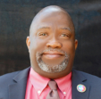
Presenters:
Nili Kirschner, Woodland Community College, ASCCC Curriculum Committee
LaTonya Parker Ed. D., ASCCC Secretary, ASCCC Curriculum Chair 2022-2023
Robert L. Stewart, Jr., ASCCC Treasurer, ASCCC Curriculum Chair 2023-2024

Slide 3
Breakout Description
The California Community College Curriculum Committee (5C) in 2020 created a set of recommended priorities focusing on championing equity-minded curriculum and practices for credit and noncredit instruction. The session will provide a safe space for participants to reflect and hear real-life examples to take back to college campuses championing curricular diversity and culturally responsive content with an antiracism focus. Join us to learn how to support these promising practices and begin conversations with curriculum committees on how to redesign practices within an equity-minded framework in support of our students.

Slide 4
Session Outcomes
Review what the ASCCC is doing around culturally relevant curriculum
DEI Leadership Practices
DEI Curriculum Reflection
Provide examples of how tools and frameworks can be applied at your college

Slide 5
Curriculum Change needs Collaboration (Trustees and CEOs Supporting Faculty)
Need partnership to support curriculum between faculty and administrators
To make change–collaborate in creating policies, practices, and implementation
It’s about championing! Supporting the work and shift of mindset
Need trust, relationships, and collaboration

Slide 6
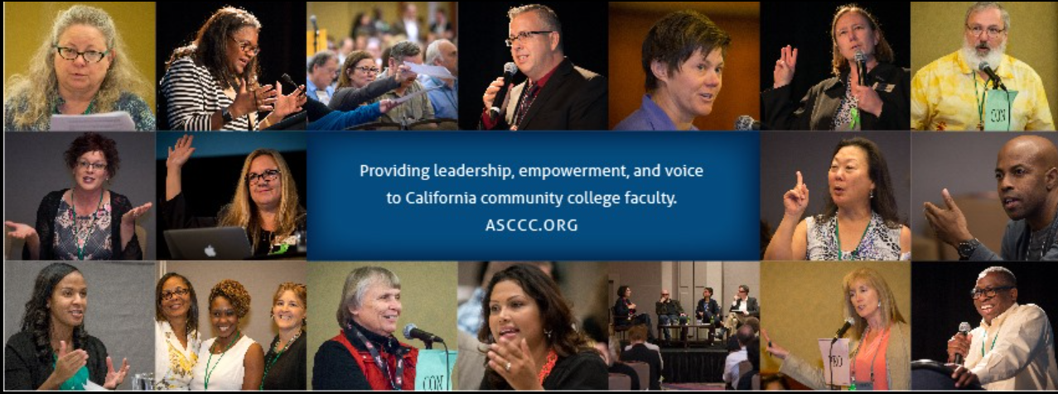
Encouraging and Supporting Faculty
Tool is for guidance – not a mandate
Will not solve all problems
Share with academic senates and curriculum committees
Dedicate time and resources to work through tool
Faculty and others using the tool may modify areas
Not a top-down approach
Could lessons learned with DEI in Curriculum inform DEI at the institution?

Slide 7
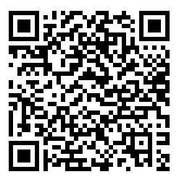
Our Model: DEI in Curriculum Model Principles and Practices Framework
The California Community College Curriculum Committee (5C) in 2020 created a set of recommended priorities that focuses on championing equity-minded curriculum and practices.
The committee created a workgroup in fall of 2021 to develop guidance for the field and recommendations on how to support the implementation of culturally relevant and responsive curriculum at local levels.
This workgroup, called DEI (diversity, equity, and inclusion)
in Curriculum, created a chart with promising practices for
both discipline/teaching faculty and curriculum committees
and local academic senates.

Slide 8
Adopted by ASCCC in Spring 2022
S22 3.02 Adopt the DEI in Curriculum Model Principles and Practices Framework
Resolved, That the Academic Senate for California Community Colleges adopts the DEI In Curriculum Model Principles and Practices and encourages local senates to use the model to review their curriculum practices; and
Resolved, That the Academic Senate for California Community Colleges works with system partners to support the implementation of the DEI in Curriculum Model Principles and Practices through collaborative professional learning.
Joint memo to field from Chancellor’s Office, ASCCC, CCCIO and SSCCC and professional development support for implementation

Slide 9
DEI Defined
Diversity: The myriad of ways in which people differ, including the psychological, physical, cognitive, and social differences that occur among all individuals, such as race, ethnicity, nationality, socioeconomic status, religion, economic class, education, age, gender, sexual orientation, marital status, mental and physical ability, and learning styles. Diversity is all inclusive and supportive of the proposition that everyone and every group should be valued. It is about understanding these differences and moving beyond simple tolerance to embracing and celebrating the rich dimensions of our differences.
Equity: The condition under which individuals are provided the resources they need to have access to the same opportunities, as the general population. Equity accounts for systematic inequalities, meaning the distribution of resources provides more for those who need it most. Conversely, equality indicates uniformity where everything is evenly distributed among people.
Inclusion: Authentically bringing traditionally excluded individuals and/or groups into processes, activities, and decision/policy making in a way that shares power.

Slide 10
Culturally Responsive Teaching Defined
Culturally responsive teaching refers to an educator’s ability to
recognize students’ cultural displays of learning and meaning making,
respond positively and constructively with teaching actions,
use cultural knowledge as a scaffold to connect what the student knows to new concepts and content in order to promote effective information processing, and
to create a safe space for learning (Hammond, 2015).
“When academic knowledge and skills are situated within the lived experiences and frames of reference for students, they are more personally meaningful, have higher interest appeal, and are learned more easily and thoroughly.”
--Geneva Gay, 2000

Slide 11
Equity-minded Defined
Equity-minded: a schema that provides an alternative framework for understanding the causes of equity gaps in outcomes and the action needed to close them. Rather than attribute inequities in outcomes to student deficits, being equity-minded involves interpreting inequitable outcomes as a signal that practices are not working as intended. Inequities are eliminated through changes in institutional practices, policies, culture, and routines.
Equity-mindedness encompasses being
race conscious
institutionally focused
evidence based
systematically aware
action oriented (CCCCO Diversity, Equity, and Inclusion Glossary of Terms)

Slide 12
Student-centered Defined
Student-centered: Refers to a wide variety of educational programs, learning experiences, instructional approaches, and academic support strategies that are intended to address the distinct learning needs, interests, aspirations, or cultural backgrounds of individual students and groups of students.

Slide 13
Introducing: DEI in Curriculum Model Principles and Practices
The intention of the DEI in Curriculum Principles and Practices chart is to:
focus on acknowledging the inequities of historically marginalized racial and ethnic groups (Black, Indigenous, Latinx/a/o, Asian Pacific Islander)
provide a tool and support structure to have conversations at your campus on looking at current practices and supporting analysis and change
The tool is not exhaustive; designed to be a starting point for local inquiry and can be expanded as needed

Slide 14
Areas identified in the tool
Textbooks
Student-facing documents
Role of discipline faculty
Course syllabus
Classroom assignments/ assessments
DEI in all disciplines
Ethnic Studies as a discipline
Siloed programs and services
Your college can add more!

Slide 15
Utilizing the Chart
Chart consists of 4 columns:
Traditional Educational Practice
Equity Principle
Culturally Responsive Classroom Practices
Culturally Responsive Practices for Curriculum Committees and Academic Senates
Promising practices that can be used by faculty, deans, curriculum chairs and committees, chief instructional officers, and local academic senates
Begin conversations on how to redesign practices from a traditional educational model to an equity-minded framework
Research citations and definitions included at the end of the document

Slide 16
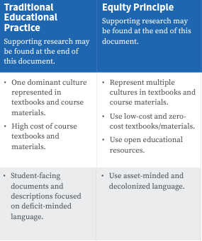
Columns 1-2: Shifting from Traditional to Equity-Focused
Column 1: Traditional Educational Practice
Acknowledges traditional practices that have shaped our system
Example: Student-facing documents and descriptions focus on deficit-minded language.
Supporting research citations and definitions included at end of chart
Column 2: Equity Principle
Presents alternative equity framework
Example: Use asset-minded and decolonized language.

Slide 17
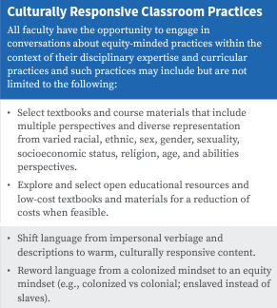
Engaging with Column 3: Classroom Practices
All faculty have the opportunity to engage in conversations about equity-minded practices within the context of their disciplinary expertise
Provides promising practices that faculty can begin implementing at the classroom level
Example: Shift language from impersonal verbiage and descriptions to warm, culturally responsive content

Slide 18
Examples of Classroom Practice
Shifting student-facing documents and descriptions focused on deficit-minded language to asset-minded and decolonized language
e.g., minority students vs minoritized; unprepared vs underprepared
Shifting language from impersonal verbiage and descriptions to warm, culturally responsive content
e.g., high minority population vs richly diverse community
Rewording language from a colonized mindset to an equity mindset
e.g., colonized vs colonial; enslaved instead of slaves
Collaborate with student services faculty and classified professionals to prioritize student needs in a more hands-on, holistic approach that addresses the whole student
e.g., basic needs, mental health, support services

Slide 19
Syllabus Language
NOW: EQUITY FOCUSED
My Commitment to You
You are entitled to an equitable learning environment that is free of unfair practices and a space that celebrates your voice, fosters your agency, and develops your capacity for self-advocacy. As your instructor, I am committed to equity and inclusion for you, our diverse students, acknowledging and rejecting institutional racism and discrimination. Your classroom should be a safe place to express, to reflect, to guide, and to be guided. I commit to protecting students of color, Dreamers, and students who are lesbian, gay, bisexual, transgender, queer, questioning, intersex, and asexual.
If life happens and you need assistance or support, please email me immediately; I am here to support!
(Example provided by Michelle Bean, Rio Hondo)
BEFORE: DEFICIT LANGUAGE
Every student is required to participate in class discussion. The teacher will call on all students as a form of assessment (to check for understanding); therefore, every student should come to every class prepared.
Each student is responsible for reading daily, in order to prepare for possible Pop Quizzes on the assigned material. If a student misses a Pop Quiz, he or she may not make it up.
Homework is assigned daily. IT IS THE STUDENT’S RESPONSIBILITY TO CHECK THE HOMEWORK SCHEDULE.

Slide 20
Culturally Responsive Instruction/Assessments
Now
Shift to more student-centered focus
in-class polls and feeling thermometers (anonymous)
online discussions with required replies, can be written or recorded (graded)
small group breakouts
Added – and rewarded – multiple opportunities for student self-reflection and course feedback
Anonymous surveys
“Reflect and Connect” section on exams
Before
Most sociology courses already include explicit multicultural and social justice content, objectives; many sociology OER materials already available
However, content is only half the battle:
Do methods of instruction and evaluation implicitly reinforce the historically racist, sexist, exclusionary higher ed practices?
Lecture-heavy instruction
Assignments and grading are “objective”
Students can share perspectives and opinions but doesn’t count towards grade

Slide 21
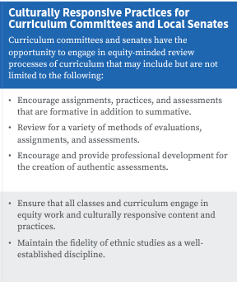
Engaging with Column 4: Curriculum Committees
Curriculum committees and academic senates have the opportunity to engage in equity-minded review processes of curriculum.
Suggests how local curriculum committees and academic senates can support equity work
Example: Encourage and provide professional development for the creation of authentic assessments.

Slide 22
Curriculum Committee Case Study: WCC
Woodland Community College curriculum committee has been piloting incorporating IDEAA into curriculum review since Fall 2021 – no formal policy yet; waiting for title 5 revisions
Started with professional development for committee and discipline faculty on incorporating IDEAA throughout the COR (See "Moving the Needle" link in Resources slide)
Committee began to look for tangible evidence of IDEAA in course descriptions, content, objectives, outcomes, assignments, and materials
Sent back course proposals to faculty originators with requests to include IDEAA in different elements of the COR, depending on course
AJ class already had explicit DEIA elements in content; asked faculty to consider adding objectives, outcomes, and student-centered description to highlight that focus
ECE courses had objective to "promote diversity in the classroom"– asked faculty to expand on this in content, assignments, and methods of evaluation
Health course revised to have more student-friendly description (jargon-free), added explicit content on intersectionality of race, ethnicity, gender, and age

Slide 23
Results of WCC Pilot (so far)
Art History courses revised to diversify representation and decolonize language:
Removing heavy focus on European art in Global Art History class; adding additional art forms from Africa, Oceania, Asia, Mesoamerica to balance representation
Adding more diversity to Contemporary Art: Black, Chicana/o/x, and Feminist art movements,
Decolonized language in course description:
BEFORE: Survey of Art history, painting, sculpture, and architecture; Art from the Paleolithic period through the Early Christian World, including pre-literate art and Pre-Columbian art.
AFTER: Survey of global art history, painting, sculpture, and architecture. This course will cover a geographically diverse range of art from around the world, starting with prehistoric art through the first millennium.
English department planning major revisions to degree:
Adding World Lit sequence
Deactivating "segregated" courses on Women's Lit and Ethnic Voices; revising all existing comp and lit courses to explicitly include diverse authors and perspectives

Slide 24
Concluding Thoughts
"Too often, we focus on only doing something to culturally and linguistically diverse students without changing ourselves...
Remember that even as educators, we... feel anxious, fearful, confused, and overwhelmed as we step outside our comfort zone. Embrace this stage and use it as a time for inquiry and reflection because this too shall pass.”
― Zaretta L. Hammond, Culturally Responsive Teaching and The Brain: Promoting Authentic Engagement and Rigor Among Culturally and Linguistically Diverse Students

Slide 25
ASCCC Resources
Entire webpage of Resources on Inclusion, Diversity, Equity, Anti-racism, and Accessibility (IDEAA)
DEI in Curriculum Framework
Numerous positions on DEI
Local Academic Senate/Curriculum Committee Visits
Will provide support and resources
Will listen
ASCCC represents the voice of local academic senates
Not an oversite body
Not a regulatory body

