Slide 1
Options for concurrent support
Craig Rutan, ASCCC Secretary
Michael Wyly, Solano College
2018 ASCCC Curriculum Institute

Slide 2
Current support options

Slide 3
Concurrent Support
The initial guidance from the Chancellor’s Office mentions offering and possibly requiring students to participate in some form of concurrent support
There are several different types of concurrent support that colleges could offer to students. These include
Redesigned Credit Course
Corequisite Credit Course (lecture or lab)
Corequisite Noncredit Course
Increased Access to Learning Centers
Embedded Tutoring
Supplemental Instruction

Slide 4
Required support

Slide 5
Limitations on Enrollment
Title 5 §58106 outlines when colleges are allowed to limit the ability of a student to enroll in a course
(a) Enrollment may be limited to students meeting prerequisites and corequisites established pursuant to section 55003
The prerequisites and corequisites outlined in Title 5 §55003 are described in §55002 of title 5
The current interpretation of the regulation is that it applies to credit courses, but the Chancellor’s Office is reviewing the language and determining if a noncredit course can be used to limit enrollment

Slide 6
New Credit Course
The college could create a new version of the transfer course that includes additional lecture or laboratory hours. For example, a 4 unit composition course could be changed to 5 units by adding 18 hours of lecture, 54 hours of lab, or some combination of lecture and lab.
Possible Advantages
All students enrolled have been identified as needing additional support
The same instructor for all course material
Students can reenroll if they are not able to pass the course
Possible Disadvantages
Student must pay additional fees
Student accumulates additional units
College will need to rearticulate the course, which could take 2 years
All students would receive the same additional instruction, but they may have different needs

Slide 7
Credit Corequisite
A credit corequisite course would require students to enroll in the transfer course. Students could be placed into the corequisite course and then be able to enroll in the transfer course.
The corequisite course could be lecture, lab, or a combination of the two
The corequisite course could have variable units (like many physical education courses) to allow different amounts of corequisite support to be scheduled with only one course outline.
Courses are required to have an approved course outline that meets the requirements outlined in Title 5 §55002 (this includes specifying possible topics that will be covered in the course content)

Slide 8
Credit Corequisite (2)
There are several items to take note of in Title 5 §55003
(d)(3) the corequisite course will assure, consistent with section 55002, that a student acquires the necessary skills, concepts, and/or information, such that a student who has not enrolled in the corequisite is highly unlikely to receive a satisfactory grade in the course or program for which the corequisite is being established;
(m) Whenever a corequisite course is established, sufficient sections shall be offered to reasonably accommodate all students who are required to take the corequisite. A corequisite shall be waived as to any student for whom space in the corequisite course is not available.

Slide 9
Credit Corequisite (2)
Possible Advantages
Students may be required to enroll in the corequisite
Courses can have different content that can be adjusted to the skills needed by the student
Does not require the transfer course to be rearticulated
Possible Disadvantages
Students must pay for additional course
Students accumulate additional units
Student cannot reenroll if they pass the support course and do not pass the transfer course
Students may have a different instructor for the support course and the primary lecture
Students could be in the transfer course with students that are much more prepared

Slide 10
Optional support

Slide 11
Corequisite Noncredit Course
A corequisite course in noncredit is allowable, but it is not currently interpreted that it can restrict enrollment (this could change)
The corequisite course could have variable hours to allow different amounts of corequisite support to be scheduled with only one course outline.
Courses are required to have an approved course outline that meets the requirements outlined in Title 5 §55002 (this includes specifying possible topics that will be covered in the course content)

Slide 12
Corequisite Noncredit Course (2)
Possible Advantages
Students enroll in the class for free
Students don’t accumulate excess units
Courses could be scheduled as open entry/open exit or regularly scheduled times
Student can reenroll in the support course until they pass the transfer course
Possible Disadvantages
Course would not count towards financial aid eligibility
Only open to legal California residents (could be changed soon)
Restricted to basic skills
Cannot require the student to enroll (based on current interpretation)
Student may have different instructor for lecture and support course
Student may be in lecture course with students that are for more prepared
Colleges would currently be paid at the noncredit rate (not enhanced funded)
Courses are not covered by streamlined approval at the CO

Slide 13
Tutoring Models
Drop-in
Most common model in most colleges
Free to student; does not require additional units
Embedded tutoring
Tutor is embedded in the classroom; meets with instructor, supports all students in the class
Some models have tutors meeting individually or in small groups outside of class
Free, no obligation to student
Creates a community of practice
Complications:
Currently restricted to basic skills, but there are two bills that would expand the use of tutoring

Slide 14
Supplemental Instruction Models
Many colleges have implemented supplemental Instruction (SI) in the past
SI typically involves SI leaders that attend course lectures and offer option SI sessions to cover topics from lecture.
SI sessions are usually not mandatory
Colleges normally have to fund SI, which sometimes limits availability

Slide 15
Lessons of solano college

Slide 16
Co-requisite Implementation: Areas of Local Concern
Local control: Curriculum & Academic Senate
Reliance on discipline faculty to develop curriculum
Identification of best practices
There is no “one” way to implement change
Implementation of multiple measures
Confidence in self-reported student data
Confidence in high school partners
Equity Gaps
Access
Success
Completion
Guided Pathways

Slide 17
Basic Skills Transformation at Solano: English
Pre-transformation/Traditional Curriculum in English
Three levels below college English
18% of students had immediate access to college English
28% of English 1 students were first-semester
Completion of College English within 2 years:
Students placed 1 level below: 43%
Students placed 2 levels below: 27%
Students placed 3 levels below: 7%
Disproportionate Impact on Students of Color:
White students 2 times as likely to have access to college English as African-Americans students (29% vs. 14%)

Slide 18
Revised Curriculum
One level below college is lowest placement possible
Co-requsite model
Over 80% of students have immediate access to college English (regular and co-requisite models combined)
50-55% of English 1/w/co-req students are first-semester
Completion of College English within 1 year:
College English (stand-alone): 71%
Co-Requisite Model: 68%
Students placed in old 1 level below: 31%
Disproportionate Impact on Students of Color:
White and African-American students have comparable access to college English (84% vs 68%).
In old sequence, African American students placed one level below transfer had a 32% chance of passing English 1 within a year
In Fall 2016, African American students enrolled in English 1/310D had a 67% pass rate.

Slide 19
New sequence: Success in English 1
Notes:
360 data based on 2015 cohort; E1 (N: 765) based on Fall ‘16 cohort, and 1/310D (N: 569) data based on FA’16/Sp’17/Fa’17 cohorts, first placed, first attempt

Slide 20
English 1 Success Broken Down by ethnicity: 1-below vs. co-req vs. stand-alone
Notes:
370 data Fall 2014, co-req data Fall 2016

Slide 21
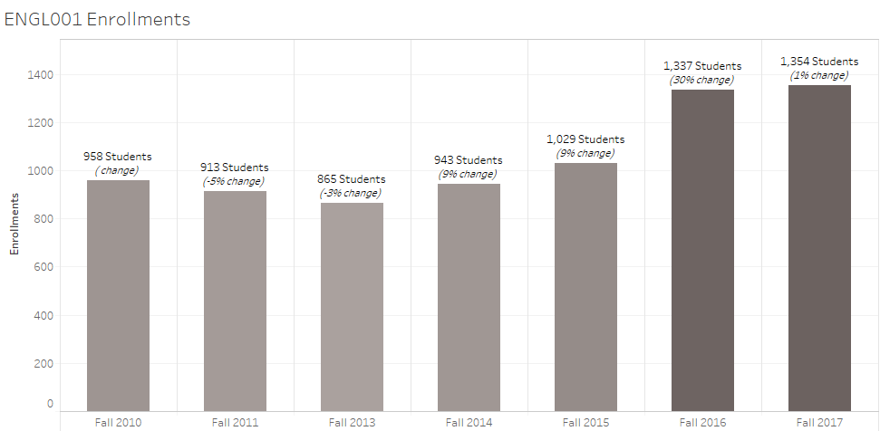
Impact on Enrollment
Notes:
Between Fall 2015 and Fall 2016 enrollments in ENGL 001 increased by almost 30% (308 students). Our FTES (3300 3200) did drop slightly during this point. In Fall ‘17, we have

Slide 22
Placement Reform Results in English
Previously students needed a 102 on Accuplacer to get into transfer-level English (English 1). 18% of incoming students had access.
Now:
English 1: 90 on Accuplacer OR a 2.7 HS GPA, OR a B in Junior/Senior year English.
English 1/310D: 70-89 Accuplacer OR 2.3 GPA or C in Junior/Senior English
Access to English 1 and 37% more to co-req on decreased cut score alone;
Based on Multiple Measures Placement, 94% of incoming students who report GPA now qualify for English 1 or 1/310D
Results: Pass rates in English 1 remain stable (76% vs 72%).

Slide 23
What made changes in English work?
Time
Changes were implemented over multiple semesters
Both sequences remained in catalog to learn what worked and what students wanted
Data tracking to inform decisions
Robust Dialogue
Among Discipline faculty: Department Ownership Over Changes
Curriculum Committee
Institutional Support
Teaching Apprentice Program
Tutor and Student Services Support
SSSP/Equity/Transformation Grant
Professional Development (on- and off-campus)
Procedural Compliance
Curriculum Committee
Academic Senate

Slide 24
But, It’s a Post-AB705 World
Even though we have a prescribed timeline for implementation, curriculum remains under faculty purview
Senate and Curriculum leadership should work with discipline faculty
Faculty Empowerment
Administrative Cooperation
Provision of Support (Research & Planning; Professional Development; Other Resources)
Data Analysis
Success and persistence rates
Equity gaps
Ease of navigation of sequence and placement
Completion data, mathematics sequence and impact on programs
Guided Pathways and Student Access
Clarify the Path
Enter the Path

Slide 25
Solano and Its Approach to Changes in Math
On-going doubt and resistance among discipline faculty
Feelings of disempowerment
Fear of administrative overreach
Lack of faith in the prescribed solution
Sequence is necessary to success
Concerns over lowering of standards

Slide 26
Senate/Curriculum Empowered Change
Search for Common Ground: Student Success
In Fall 2017, the Academic Senate, its Basic Skills Committee, and Discipline Faculty Recognized at Least Three Compelling Factors for Continued Change
Low Success Rates in Mathematics and Impact on Student Completion
AB 705 (Irwin)
Guided Pathways
Academic Senate worked with Curriculum and Mathematics
Resulting Math Taskforce (Mathematics Faculty, Curriculum Chair, Basic Skills Coordinator, Counseling Faculty, with Support from Dean of Research and Planning)
Data Analysis, including Equity
Understanding of AB 705
Development of Its Own Charges
Reports to the Academic Senate; Makes Recommendations to the Department of Mathematics
Clear Administrative Support for Faculty and Senate Purview, including Curriculum

Slide 27
Solano Math Taskforce Charges (for reference)
To analyze success and completion data in mathematics, including all identified equity gaps, with the goal of increasing student success in mathematics.
To recommend to the Department of Mathematics procedures and practices to address directly success and equity gaps, as well as to conform to the direction of AB 705 and Guided Pathways.
To work with the Department of Mathematics to accelerate the development of a co-requisite model for non-STEM and STEM students.
To make recommendations to the Academic Senate, as needed.
Measure of success: to increase the number of students who successfully complete a transfer-level course and to decrease or eliminate equity gaps.

Slide 28
Solano Math Taskforce Progress To-date
Implementation of Co-requisite in Mathematics (Stats) for Non-Stem majors. Pilot scheduled for Spring 2019 with plans for scaling in AY 2019-2020.
StatWay Presentation for March 14 FLEX
Active discussion of the below-330 classes, including how to increase success for students who remain in those courses.
Upcoming Tasks (Fall 2018):
Work with counseling;
Improve existing Multiple Measures to increase access and decrease student/counselor confusion
Identification of Resources required
Embedded Tutors
Teaching Apprentice Program
Professional Development
Other Equity Support

Slide 29
In Short--
Change should locally made and locally maintained
Discipline Faculty should lead (not administration)
Senate and Curriculum leadership is a must
Administrative Support is Needed (funding; resource allocation)

Slide 30
Questions?

