Slide 1
(CTE) Innovations in Curriculum: Contract Education
…institutions must go hand in hand with the progress of the human mind. As that becomes more developed, more enlightened; as new discoveries are made, new truths discovered and manners and opinions change, with the changes of circumstances, institutions must advance also to keep pace with the times.
Thomas Jefferson, 1787
Michelle Grimes-Hillman (facilitator) ASCCC Curriculum Committee Chair, Mt. SAC
Wheeler North
ASCCC Treasurer, San Diego Miramar College
Corine Doughty
Dean, Instruction, Economic & Workforce Development
Irvine Valley College

Slide 2
Why Contract Education?
A primary mission of the California Community Colleges is to advance California’s economic growth and global competitiveness through education, training, and services that contribute to continuous workforce improvement.
Education Code Section 66010.4.(a)(3)

Slide 3
What is Contract Ed?
A delivery system that responds to labor market demands by developing and implementing training programs and customized curriculum for industry sectors. Students, incumbent workers and businesses acquire job skills to maintain competitiveness.

Slide 4
Education Code
78020 - 78022 refer to:
(a) “Contract education” means those situations in which a community college district contract with a public or private entity for the purposes of providing instruction or services or obth by the community college.
(b) “credit” refers to any class offered for community college credit, regardless of whether the class generates state apportionments.
(c) “noncredit” refers to courses that meet the criteria for apportionment pursuant to Section 84757.
(d) “not-for-credit” refers to classes, including community services classes, that are offered without credit and that are not eligible for apportionments pursuant to Section 84757.
See handout for reference to ed codes listed above

Slide 5
Benefits to College
Increased discretionary revenue
Greater community visibility
Employer participation beyond contracting
Strategic partnerships
Increased access to students
Faculty professional development
Curriculum development – beta testing

Slide 6
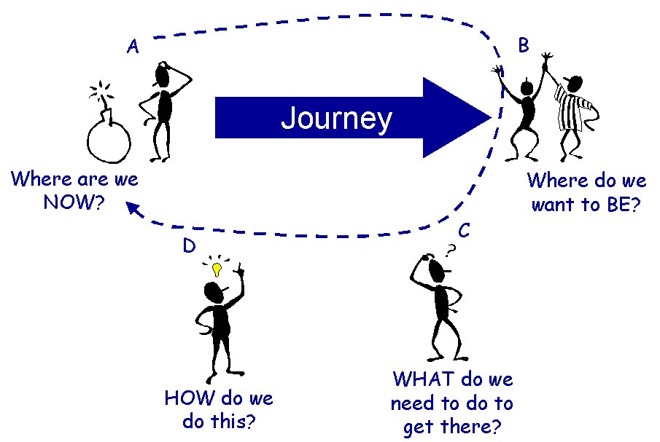
Benefits to Employer
GAP Analysis

Slide 7
What does industry really want?
How does the relationship between industry and a college start?
Who is critical to the relationship?
Does the potential employer have realistic expectations that the college can meet?
Timeliness
Costs
Do they want subject specific or soft skills education, or both?
Is college credit really needed?

Slide 8
Employer Consultation
Prior to meeting your employer, identify:
Identify the goals
Institutional strengths
Subject Matter Experts, faculty, facilitators, trainers
Research the client company prior to your meeting
Needs Assessment
Identify the challenge, or problem
What has been done to change the situation?
Are the employer expectations S.M.A.R.T?
What is the cost
What is the timeline
What are the industry standards for Skills, Knowledge, Abilities?
What is the most effective delivery method: credit, not-for-credit or non-credit?
Provide a solution

Slide 9
Questions for any program
Who will this program serve?
Number of students per class/pathway cohort
Duration of training/education needs
Status of entering students preparation
How stable is the Industry?
Newly emerging versus long standing/readapting
One employer versus many employers
What is each partner willing to invest into the potential partnership?
How will the partnership be evaluated?

Slide 10
Capacity amidst existing workload
What is the impact to the college?
Personnel workload reallocation
Facilities and equipment reallocation
What additional personnel need to be hired?
What processes already exist to accommodate this need?
What governance process exists for assessing the overall efficacy of a new partnership?

Slide 11
Examples of Training and Development
Vocational ESL
Office Applications
Customer Service
Technical Skills
Soft Skills
Leadership
Call Center
Technical Writing
Math
Advanced Manufacturing
Compliance, Health & Safety
Assessment
Performance Consulting

Slide 12
Challenges
Institutional support
Internal processes that support service delivery
Staff turnover
Lack of funding for marketing
No incentives for doing EWD
Changing roles for contract ed professionals
Responsiveness
Identified faculty, facilitators, trainers
Perception vs. reality

Slide 13
Repackaging existing and new development
What are the pros and cons of repackaging versus developing new?
Where can industry provide support?
Facilities, equipment, staff, content and instructional materials, etc.
Who provides the students?
Existing employees, employee candidates, existing college students, any recruit
What additional student support services will these students need?

Slide 14
Being Strategic
In instances where academic needs are broader than single training events, what pathways options are needed for students?
Assessing and credit for prior learning CBE
Adult Education (ROCP)
Noncredit, credit, contract ed
What other academic modalities can be implemented?
Online, cohort/linked courses, acceleration, etc.

Slide 15
Discussion/Questions

