Slide 1
Cops Court Corrections and Curriculum: Equity and Justice for All Fall 2020 Plenary November 5, 2020
Notes:
All
Description:
The goal of this session is to engage in an equity conversation on what is being taught, trained, and practiced in Administration of Justice and First Responders programs. Presenters will begin by giving an overview of the training and curriculum offered in these programs. The breakout will give participants an opportunity to provide input on applying an anti-racism and equity lens.

Slide 2
Meet Your Facilitators
Mayra Cruz, ASCCC Treasurer
Don Mason, Compton College
Lynn Shaw, CTE Curriculum Chair
Robbie Williams, LT Hawthorne Police Community Affairs Bureau Commander & Co-Founder Coffee with a Cop, INC
ASCCC 2020 Fall Plenary

Slide 3
Chatting
Type you first name and last name to offer a question/comment.
MUTE - Please place your microphone on mute if you are not speaking.
OR
Use the "Raise hand" found in the "Participants” feature here.
REACTIONS – Use Reaction to engage.

Slide 4
The Framework, The Conversation
“The police are the public and the public are the police; the police being only members of the public who are paid to give full time attention to duties which are incumbent on every citizen in the interests of community welfare and existence.”
Sir Robert Peel
ASCCC 2020 Fall Plenary

Slide 5
Our Purpose Today
To engage in an equity conversation on what is being taught, trained and practiced in Administration of Justice and First Responders programs.
ASCCC 2020 Fall Plenary

Slide 6
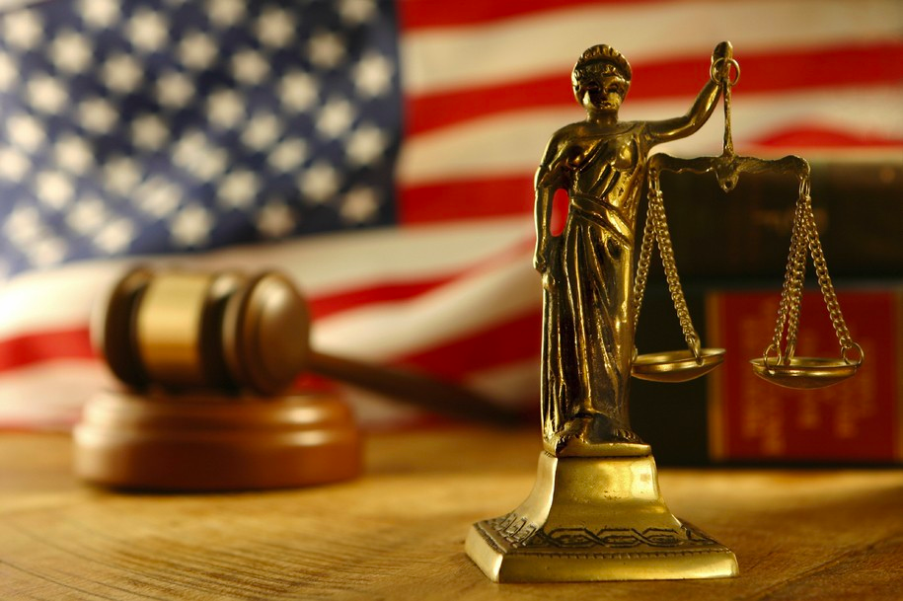
Overview of the Criminal Justice Training
What is being taught in the classroom?
What is being taught in the training academies?
What is being practiced on the streets?
How do we put these together to include equity & justice in our curriculum?
ASCCC 2020 Fall Plenary

Slide 7
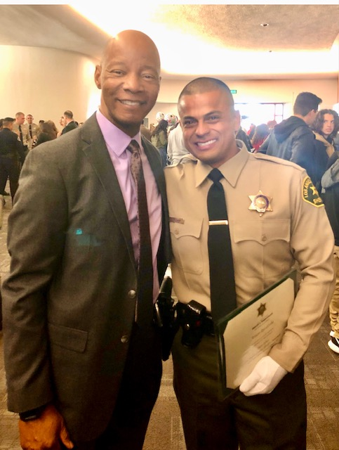
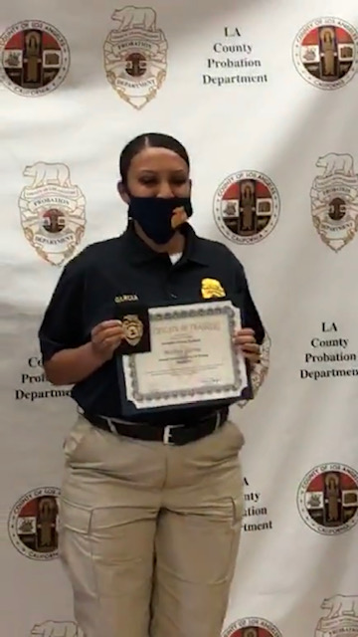
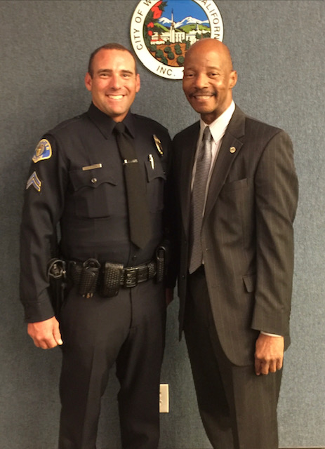
Administration of Justice Programs
What is being taught in the classroom?
A.A. and ADT Administration of Justice Program
ASCCC 2020 Fall Plenary

Slide 8
Student Demographics in Administration of Justice Programs
ASCCC 2020 Fall Plenary

Slide 9
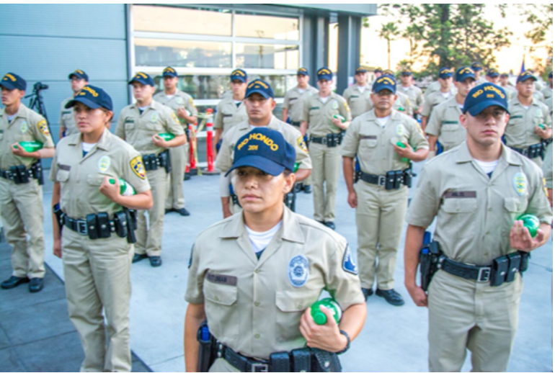
Police Training Academies
What is being taught in the training academies?
39 training academies in CA
16 Academies housed in Community College
Regular Basic Course Specifications
Highlight Cultural Diversity and Discrimination (Learning Domain 42)
ASCCC 2020 Fall Plenary

Slide 10
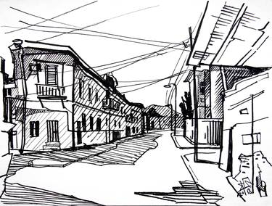
What is being practiced on the streets?
Field Training
Advanced Officer Training
Professional Standards
Citizen Review Board (CRB)
(Representatives: community leaders and
representatives, police department business,
schools and others
ASCCC 2020 Fall Plenary

Slide 11
The Voice of Lt. Robbie Williams

Slide 12
Conversation
What comments or ideas do you have to include equity and justice in our Administration of Justice curriculum?
What question/s do you have on how to include equity and justice in the Administration of Justice curriculum?
ASCCC 2020 Fall Plenary

Slide 13
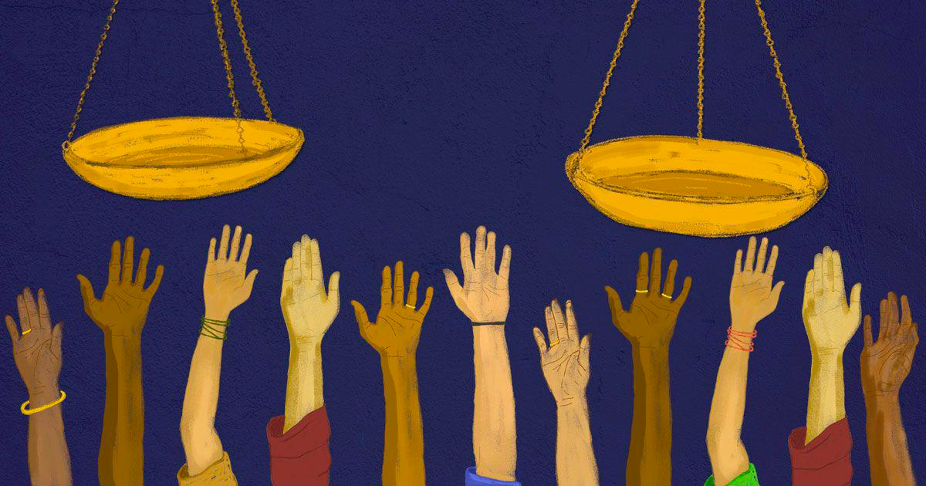
Moving Forward and Takeaways
How do we move forward in
Administration of Justice
Curriculum or
Training Academies?

Slide 14
Reflections
Reflections

Slide 15
Resources
POST California Commission on Peace Officers Standards and Training https://post.ca.gov/basic-training-academies
Regular Basic Course Specifications
https://post.ca.gov/regular-basic-course-training-specifications
CalPass
https://www.calpassplus.org/LaunchBoard/SWP.aspx
Heard, Lance. How I Have Taught Lessons on Issues of Race. ASCCC July 2020 Senate Rostrum, pages 28-30.
https://www.asccc.org/content/how-i-have-taught-lessons-issues-race

Slide 16
For More Information:
info@ascc.org
Mayra E. Cruz cruzmayra@deanza.edu
Don Mason DMason@riohondo.edu
Lynn Shaw shawlynn@gmail.com
Lt. Robbie Williams rwilliams@hawthorneca.gov
Notes:
Mayra

