Slide 1
Creating Opportunities for Collaboration
Briseida Ramirez, Mt. San Antonio College
Katie Oesau, Yuba College
Carrie Roberson, ASCCC North Representative

Slide 2
Collective Bargaining
Pay parity
Equal pay for equal work
In order to build awareness and improve conditions among the faculty, tenure-track and non-tenure track faculty should be recognized as part of the same community – as one faculty.

Slide 3
We are alike in some areas
Passion for teaching
Equity
Just as qualified to teach or work in our areas
Love of students and the community
Ideas for how to best serve the students in our colleges
Opportunities to serve on committees (at some colleges)

Slide 4
We differ in other areas
Employment insecurity
Connection to the college
Compensation
Perceived value to the college
Other- what else?:
Local college/district culture
Academic senate involvement
Department role in decision-making (10+1)
Mentoring/support

Slide 5
Creating connections
The more we know about resources the more we can share
How do we initiate these connections as Part Time Faculty?
Providing leadership opportunities
Part time faculty handbook
Santa Monica College created an adjunct survey in 2014 which resulted in an Adjunct Committee that “provides the Academic Senate with input on both campus issues relevant to adjunct faculty; fosters respect and inclusion, collegiality, and professionalism among all faculty, full and part-time; and interacts with adjunct faculty statewide on both faculty and adjunct-specific issues.”

Slide 6
Challenges for Collaboration
Pay for PT work
Internal competitiveness
Lack of respect
“Someone Calculated How Many Adjunct Professors Are On Public Assistance, And The Number Is Startling” (Huffington Post);
“When a College Contracts ‘Adjunctivitis,’ It’s the Students Who Lose” (PBS NEWSHOUR);
“Are Adjunct Professors the Fast-food Workers of the Academic World?” (The Guardian).
Freeway flyers, part-time instructors are forced to travel between campuses to make ends meet.

Slide 7
What is in a name?
Part time
Adjunct
Associate

Slide 8
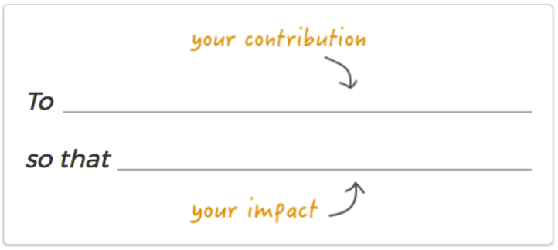
Initiating Collaboration as PT Faculty
Disseminating information to other PT faculty
Creating a “WHY” statement
Where are we today?
Where do we want to be?
How do we get there?
Adjunct academy

Slide 9
Common goals bring us together
Focus on what we goals we have in common
Seek to understand
10+1 academic and professional matters (not everything is union)
We can learn from models for inclusion that already exist.

Slide 10
What has worked for you?
Can you offer suggestions that have worked for you?
This Photo by Unknown Author is licensed under CC BY-SA-NC

